Slide 1
FDR

Slide 2
Modern Presidency
Pre-Modern 1789-1932
Modern 1933-present (or 1990s)
2nd American republic?
Theodore Lowi, The Personal Presidency

Slide 3
Why the Modern Presidency?
Crisis
The Depression
WW II
Solution: Power to the Presidency

Slide 4
The Depression

Slide 5
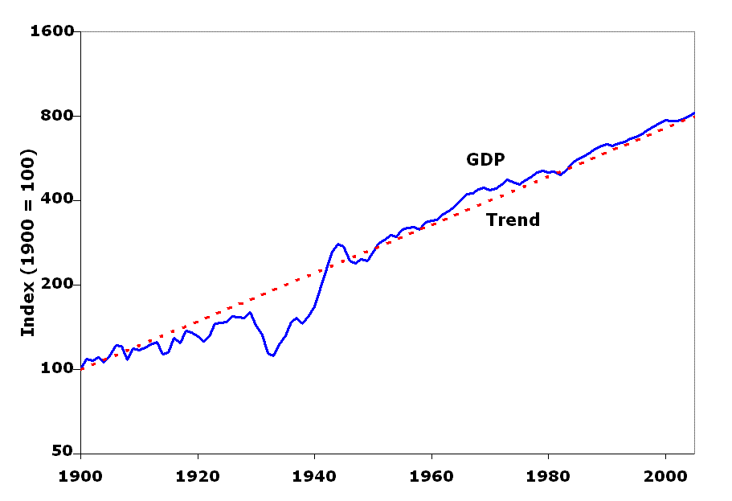
Real GDP (per working age person)
Timothy J. Kehoe Professor of Economics, University of Minnesota and Adviser, Federal Reserve Bank of Minneapolis, http://www.econ.umn.edu/~tkehoe/

Slide 6
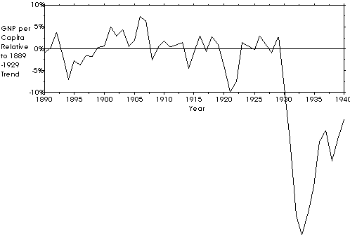
GNP Per Capita (relative to 1889-1929 trend)
J. Bradford DeLong, University of California at Berkeley and NBER http://econ161.berkeley.edu/TCEH/Slouch_Crash14.html

Slide 7
Stock Market
http://www.affordablehousinginstitute.org/blogs/us/Stock_market_crash_1929_small.jpg

Slide 8
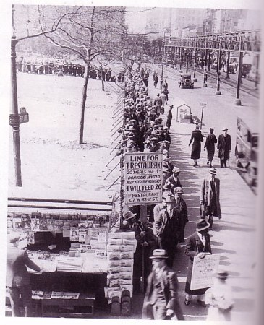
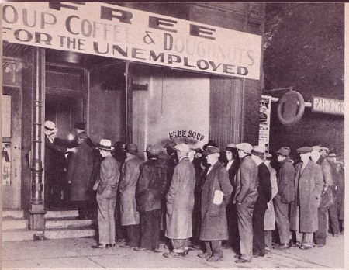
The Depression in the US

Slide 9
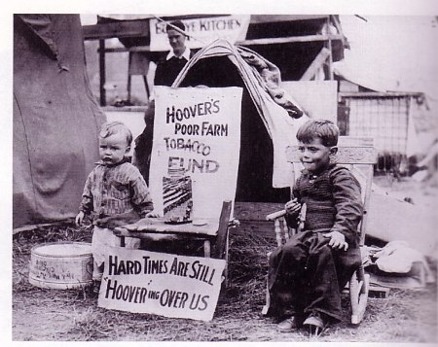
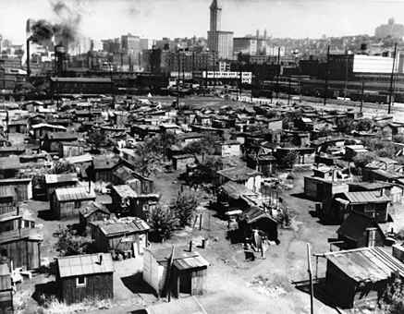
“Hoovervilles”

Slide 10
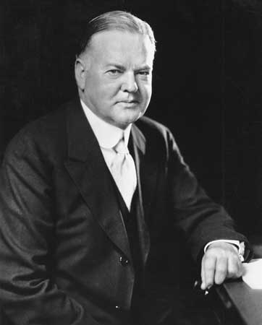
Herbert Hoover, 1929-1933

Slide 11
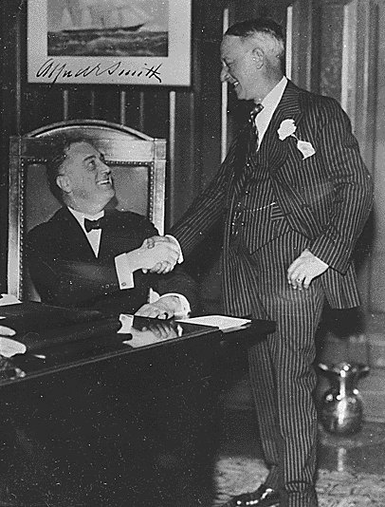
Governor Roosevelt of NY (with former Gov. Al Smith)

Slide 12
Economic Theory
Classical Liberalism
(Laissez-faire Capitalism)
vs.
Modern Liberalism
(Keynesian Economics)

Slide 13
Circulation
Newmann gets paid!!!!! Newmann gets paid!!!!!!!!!!!!
Employee Newmann
enrolls buys bagels,
at VCU Chinese food,
new Pat Metheny CD,
sneakers
Employee decides Employees of
he/she can pay businesses
for college near VCU
get paid

Slide 14
Business Cycle
Boom-Bust cycle
Self-regulating
W
E
A Classical Liberalism:
L And they lived happily
T ever after in terms of
H overall aggregate wealth in the long term
Time

Slide 15
But, what if….
Non-self-regulating

Slide 16
Government job?

Slide 17
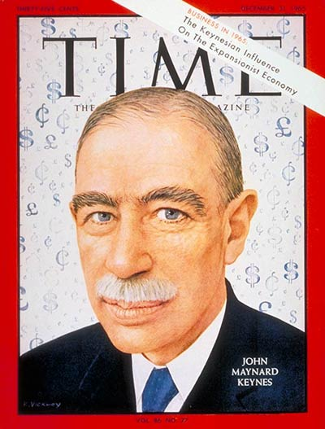
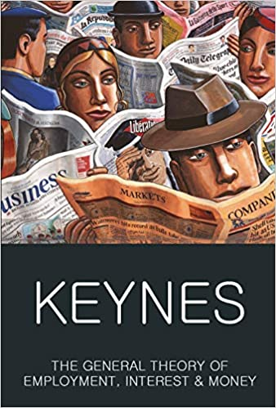
John Maynard Keynes: Modern Liberalism

Slide 18
FDR’s New Deal
FDR Inaugural Speech (text) (audio of oath of office and inaugural speech)
Fireside Chats

Slide 19
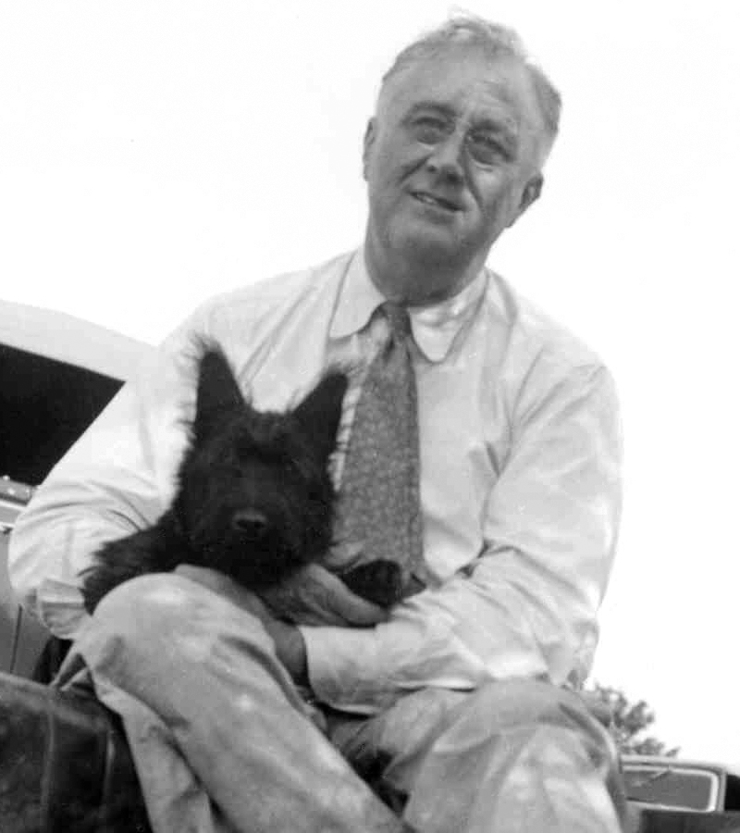
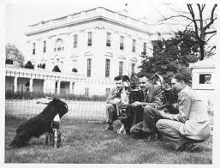
END
FDR Slide Show One

