Slide 1
Choosing a President
Electoral Votes
12th Amendment
Election Results
Electoral College Rules

Slide 2
Electoral College
Number of electoral votes: 538
Number of House of Reps seats
Based on population
Number of Senate seats
Two per State
State wide elections
Winner of state vote gets electoral votes
Winner needs 270

Slide 3
Actually Electing the President 2020
November 3, 2020: Election Day: The voters in each State chose electors.
By December 8, 2020: States resolve questions.
December 14, 2020: The electors in each State meet to select the President and Vice President of the United States.
December 23, 2020—Deadline for Receipt of Electoral Votes: from States to President of the Senate (VP) and Archivist.
January 6, 2021—Joint Session of Congress. Electoral Votes Counted in Congress. Pres of Senate (VP) presides.

Slide 4
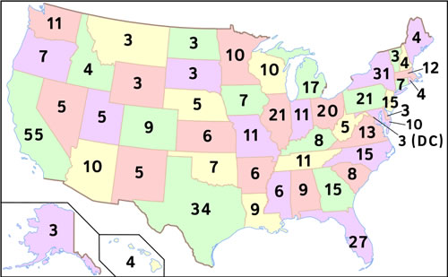
Electoral Votes 2008

Slide 5
Electoral College 2020

Slide 6
Red States (180 EV) (pre-2016 assumptions)

Slide 7
Blue States (215 EV) (pre-2016 assumptions)

Slide 8
Swing States (143 EV) (pre-2016 assumptions)

Slide 9
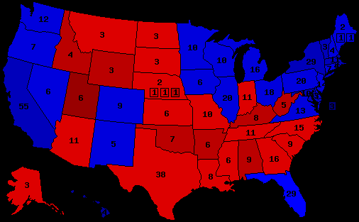
2012 Results (332-206) Obama Victory

Slide 10
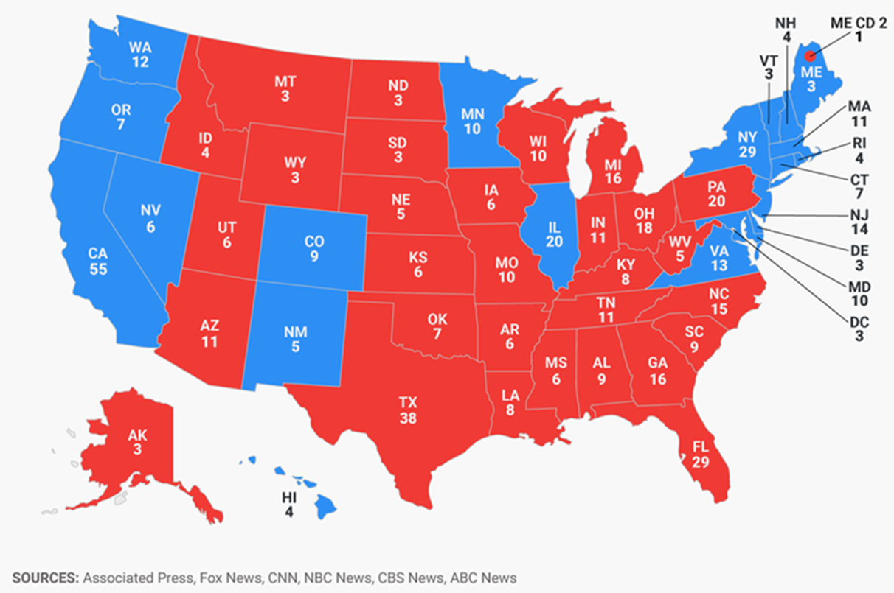
2016 Results (306-232)(304-227)* Trump Victory
*Faithless electors 2016 (7 Total) (December 19, 2016)
Faith Spotted Eagle (WA)
Sanders (HI)
Powell (3, WA)
Paul (TX)
Kasich (TX)

Slide 11
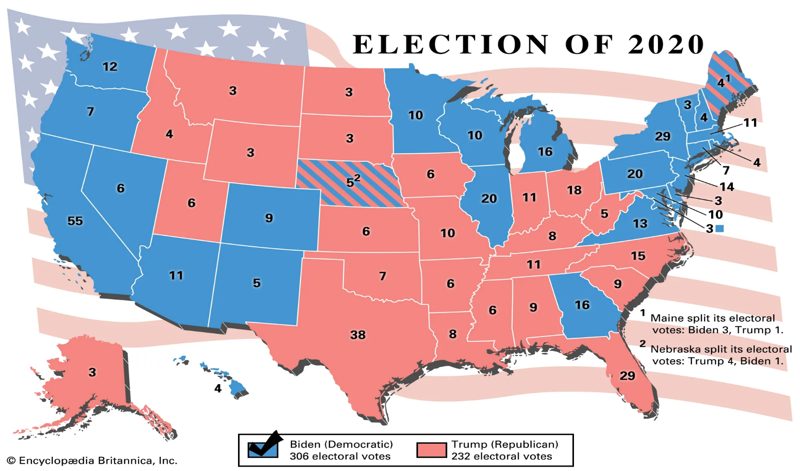
2020 Results
Biden 306 Trump 232

Slide 12
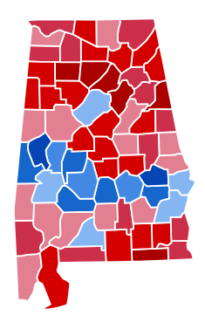
Urban plus College Towns vs. Rural Population Density Matters
Blue State by County: Illinois
Red State by County: Alabama

Slide 13
A Purple and Blue State by County
Virginia
Pennsylvania
Notes:
These maps add to the idea. Virginia is a purple state. Pennsylvania is a blue state. I know these two well by their geography. In Virginia, you can see the massive amount of red and the small blue areas. The blue represents Norfolk, Hampton Roads, Richmond, Charlottesville, the suburbs of DC, and that blue county way over in the west is Virginia Tech. For Pennsylvania, the massive amount of red in this blue state is interrupted by Philadelphia, Harrisburg, Scranton-Wilkes-Barre, Pittsburgh, and Erie.

Slide 14
2016 Results by County By Precinct

Slide 15
US Presidential Election Timeline
2020
2024
November 3: General Election Day (Popular Vote)
December 8: States issue Certificates of Ascertainment (“Safe Harbor” Deadline (Any problems; fixed by this day)
December 14: State Electors Vote
December 23: Certificates Delivered
January 6: Joint Session of US Congress counts votes
November 5: General Election Day (Popular Vote)
December 11: States issue Certificates of Ascertainment (“Safe Harbor” Deadline (Any problems; fixed by this day)
December 17: State Electors Vote
December 25: Certificates Delivered
January 6: Joint Session of US Congress counts votes

Slide 16
Complications
Popular vote vs. electoral vote
Ties (12th Amendment)
No one wins electoral majority: House
Objections to Electoral Vote

Slide 17
1. Electoral Vote and Popular Vote: Popular Vote Winner Lose the Electoral College
1876
1888
2000 2016
US Election Atlas
Candidate | Votes
Trump | 62,980,160
Clinton | 65,845,063
Johnson | 4,488,931
Stein | 1,457,050

Slide 18
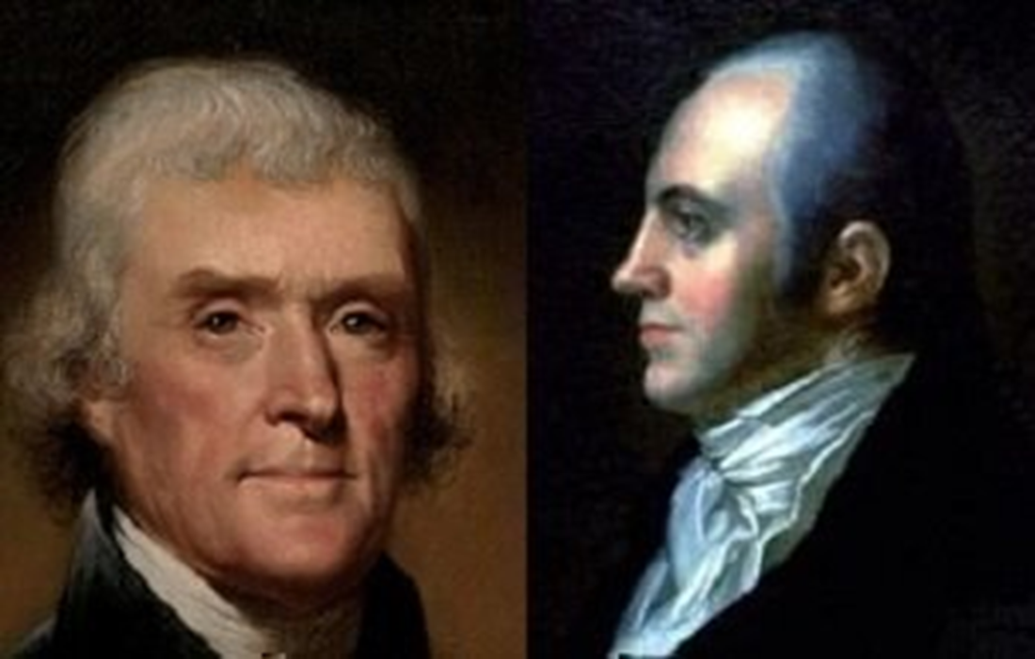
2. Ties: Vote in the House
1800: Jefferson and Burr

Slide 19
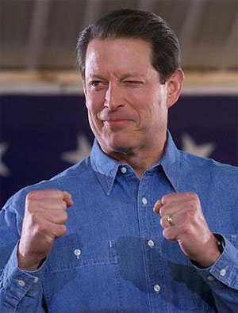
Before the 12th Amendment

Slide 20
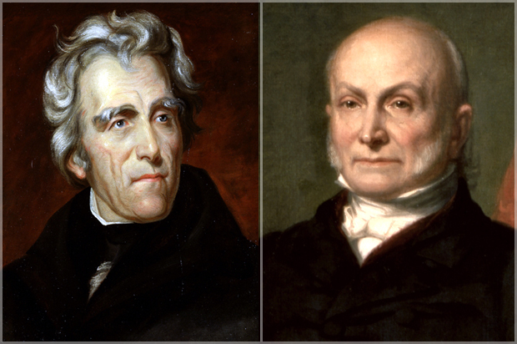
3. No one wins electoral majority
1824 Jackson JQ Adams

Slide 21
4. Objections to the Electoral Votes
Objections (1887)
In writing
Signed by one member of House and one of Senate
House and Senate meets separately to consider
Majority of both House and Senate required to reject an electoral vote
1969 and 2005 challenges and rejection of challenges by each chamber
Two slates of electors?
Or none?

Slide 22
Electoral Count Reform and Presidential Transition Improvement Act of 2022
Summary
Objection threshold raised to 1/5 of members of both House (87) and Senate (20)
Specifies that VP role is administrative only
Governor (or official designated in state constitution) forwards the electoral sate to US Congress
Electors chosen by state law as it exists prior to election day
Expedited judicial review

Slide 23
January 6, 2021 Certification Day
Arizona Votes Challenged
Paul Gosar (AZ) and Ted Cruz (TX)
Objection overruled 121-303 and 6-93
Pennsylvania Votes Challenged
(Scott Perry (PA) and Josh Hawley (MO)
Objection Overruled 138-282 and 7-92

Slide 24
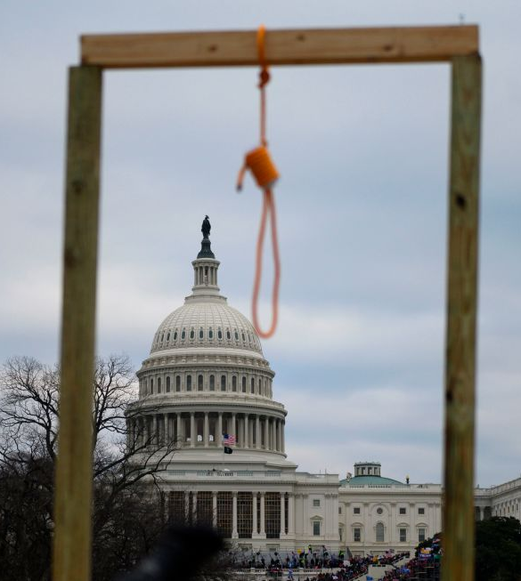
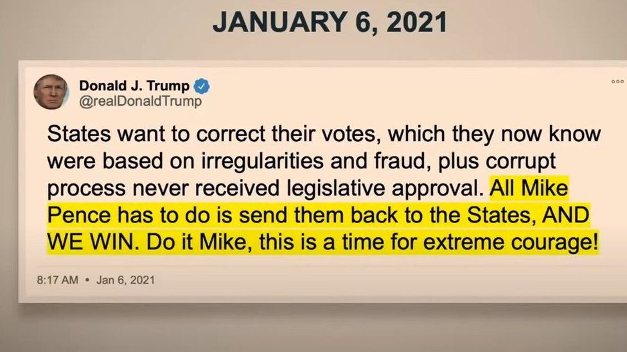
January 6, 2021: Certification Day

Slide 25
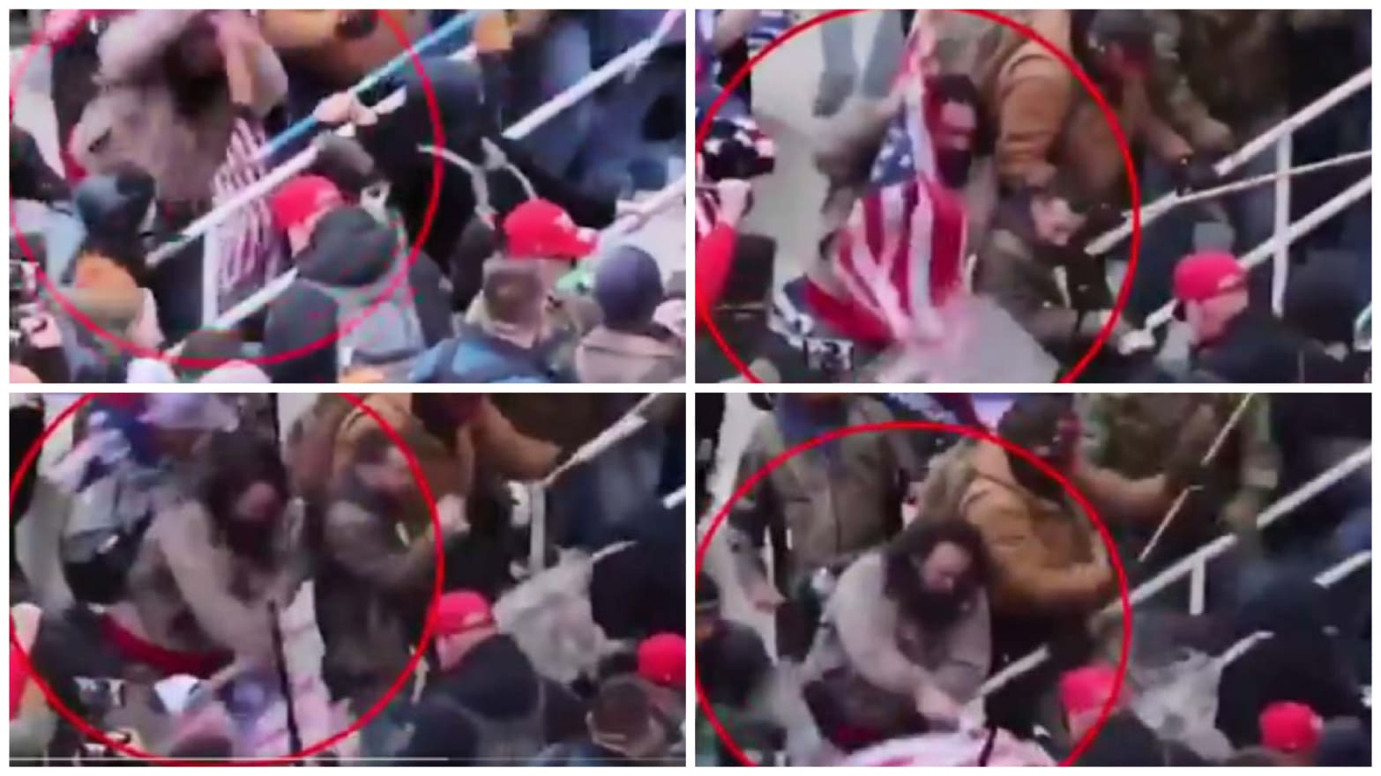
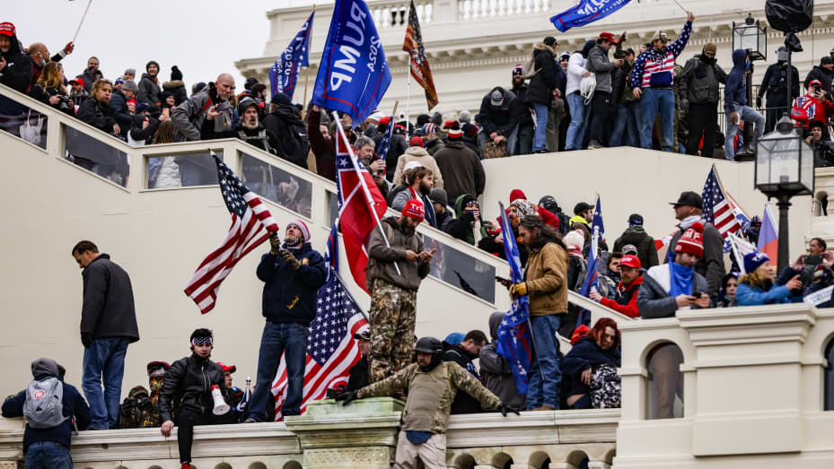
January 6, 2021

Slide 26
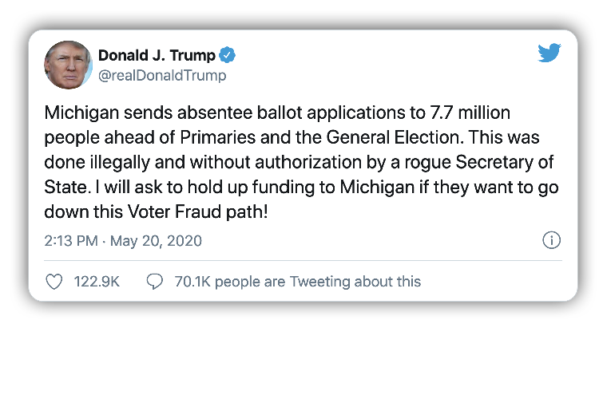
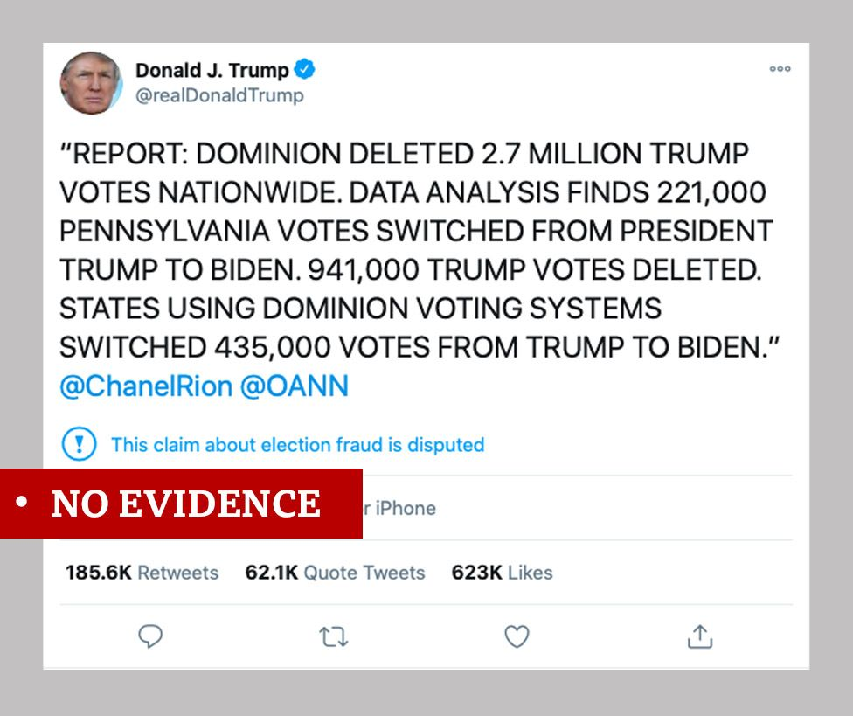
The Big Lie Information on Investigations, Court Cases…

Slide 27
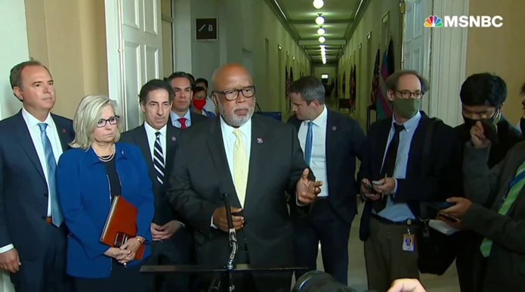
House Select Committee to Investigate the Attack on January 6
Report
12/22/22
Chair Bennie Thompson (D-MS)
Vice Chair Liz Cheney (R-WY)

Slide 28
A Coup Attempt? (reference)
Charges of fraud before the election, during the election, and after the election
Refusal to accept election results
Leading a protest rally at the Capitol to challenge the electoral results when the electoral vote is being counted
Encouraging protestors to confront Congress during electoral vote count
Meetings with President and senior officials to discuss a plan to reject election outcome/electoral votes Eastman Memo
Phone calls from the president to election officials in key states encouraging them to reject the election results or to “find more votes”
Presidential encouragement to VP to reject election outcome
Republican attempt to reject electoral votes of key states
Firing of officials who oversaw election
Firing of officials who would oversee protection of capitol building/region
Delay in sending reinforcements to capitol after rioting began
Presidential and Republican support for rioters on January 6 and after
Being told that there were armed people in the crowd, and still calling for people to march to the capitol to protest (an electoral fraud that did not happen)

Slide 29
Firings/Resignations After November 2020 Election (officials related to election, capital security issues) (reference)
11/9: Richard Pilger, Justice Dept. Election Crimes Division head
11/9: Secretary of Defense Mark Esper
11/10: Jen Stewart, DoD Chief of Staff
11/10: Alexis Ross, DoD Deputy Chief of Staff
11/10: Undersecretary f Defense for Intelligence and Security Joseph Kernan
11/10: Acting Undersecretary for Defense for Policy James Anderson
11/12: Asst. Secretary for Cybersecurity at CISA Bryan Ware
11/17 Chris Krebs, Director Cybersecurity and Infrastructure Security Agency
12/15: Resignation of Attorney General William Barr

Slide 30
What Comparative Politics Tells Us…
Party or leader Followers refuse to
claims only it/he accept opposition elected
can be trusted officials, reject facts;
(discredits independent news) only have faith and loyalty to leader
Party or leader
declares electoral Followers Followers lose
fraud where there believe the faith in electoral
is none election was system and the
stolen need for elections
Belief that since an End of free
election was stolen and fair
from them, they can elections;
justifiably steal the next one violence; collapse of democracy

Slide 32
Capitol Breach Cases (reference Links)
U.S. Attorney’s Office for the District of Columbia
List of Cases (US Atty)
Tracking Cases (NPR)
Oath Keepers sentences
18 years “seditious conspiracy”
Proud Boys sentences

Slide 33
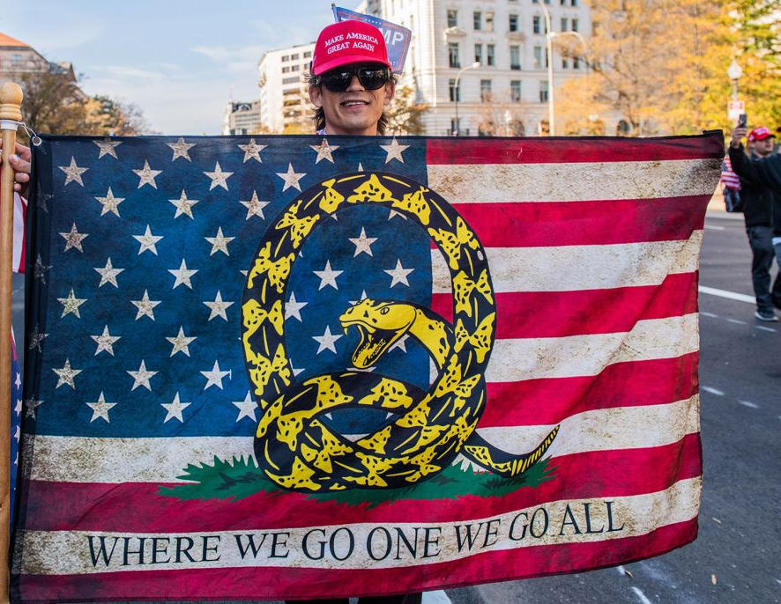
Key Groups
Oath Keepers
Proud Boys
QAnon

Slide 34
Special Counsel to Investigate Interference in the Transfer of Power 2020
Jack Smith
His Appointment Authorization
Indictment: US v. Donald Trump
August 1, 2023

Slide 35
Trump Indictments and Trial Dates
March 4, 2024: Federal Trial on 2020 Election Interference
United States of America v. Donald Trump
March 25, 2024: NY Trial on Falsifying Business Records
People of the State of New York v. Donald Trump
May 20, 2024: Federal Trial on Mishandling Classified Documents
United States of America v. Donald Trump and Waltine Nauta
Georgia Election Interference Case: No date set yet
The State of Georgia v. Donald John Trump, Rudolph William Louis Giuliani… (19 people) 41 Counts

Slide 36
Declassification (for reference)

Slide 37
The Debate
Persecution of your political opponents
or
Proof that no one is above the law
Republicans vs. Democrats
or
Trump and Supporters vs. Democracy

