Slide 1
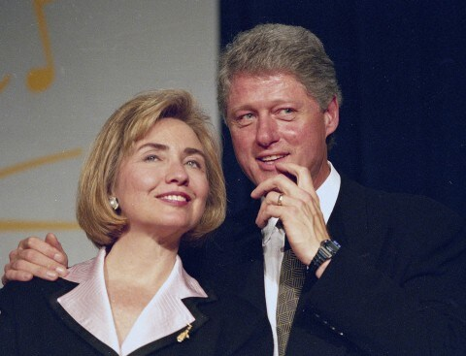
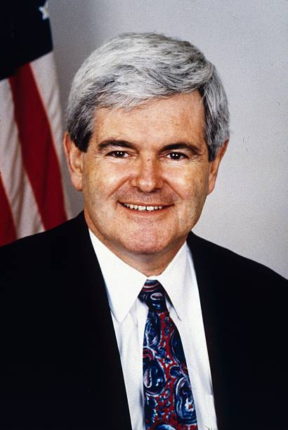
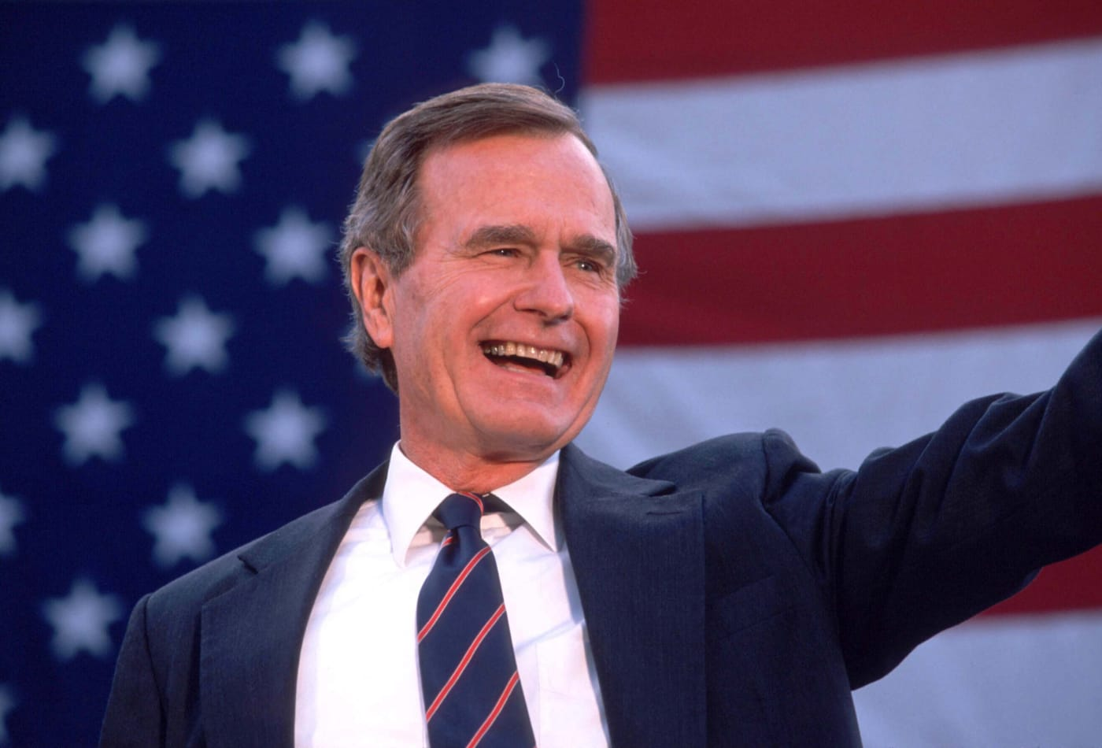
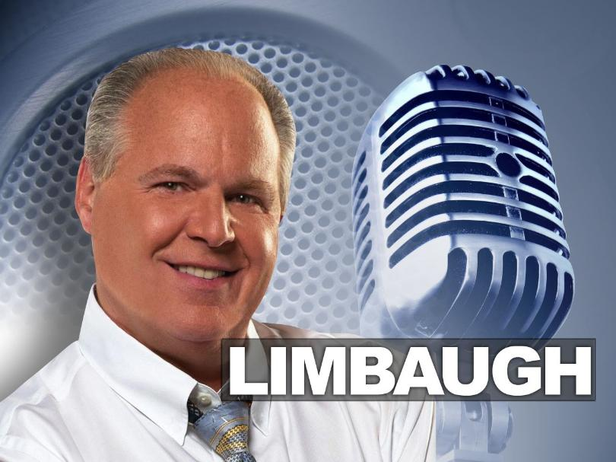
The Battle for Party Philosophy 1980s/1990s

Slide 2
The Republican Story
Context
Reagan Realignment
Reagan Success
Democratic defeat 1984: 525-13 EV
Change in belief:
Government is the problem

Slide 3
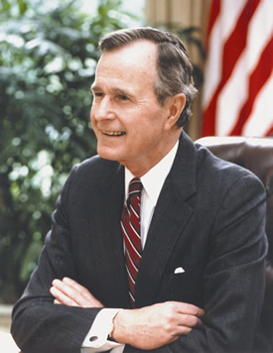
George H. W. Bush (41) Ultimate Insider (reference)
US House of Representatives (1967-71)
Senate Candidate 1970
US Ambassador to the UN
Head, US Liaison Mission to China
Republic Party Chairman
Director of Central Intelligence

Slide 4
The Battle Lines
conservative (Bush)
Small “c”
Smaller government
Some government role
Cut taxes
Economic focus
Might be pro-choice
Conservative (Reagan)
Movement Conservative
Gov’t is the problem
Huge tax cuts
Social conservative
Anti-Abortion
Gun rights
Evolution/Creationism
Anti-Gay rights
Prayer in school

Slide 5
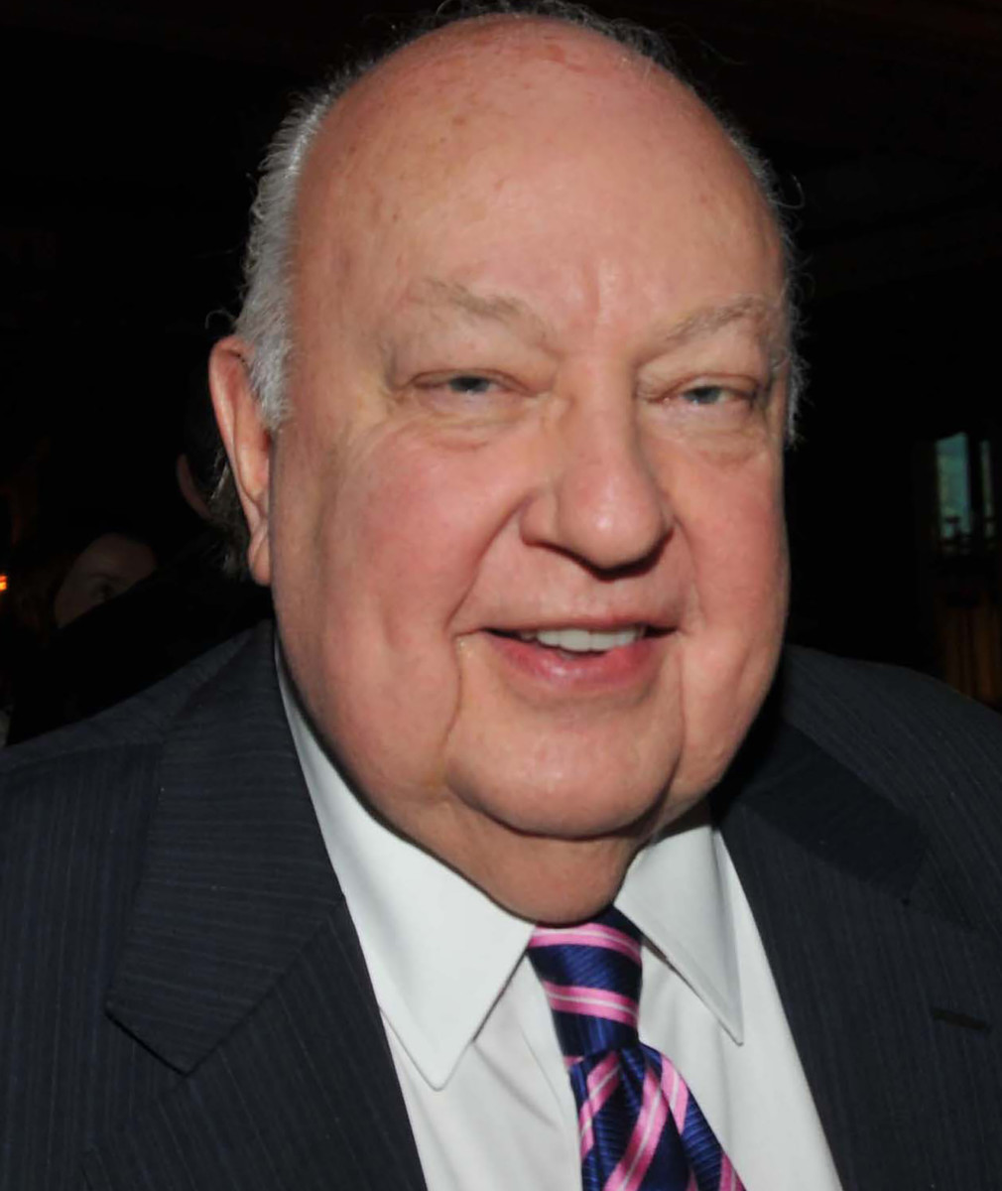
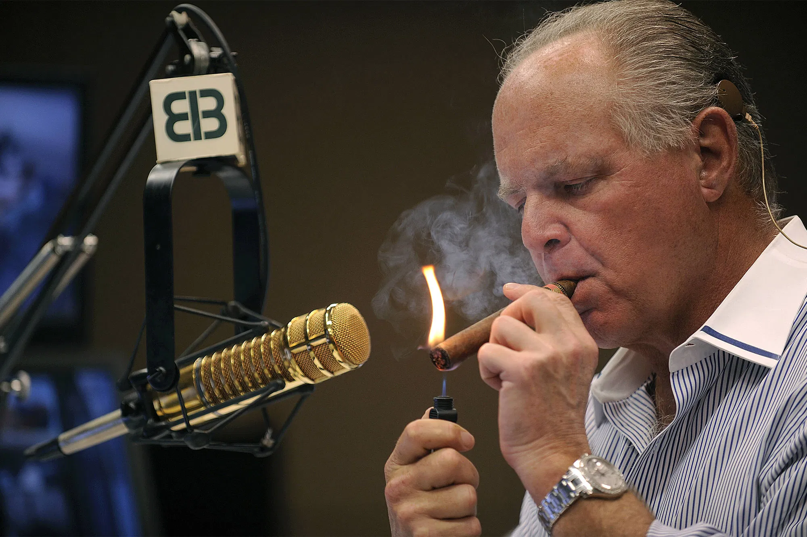
The Real Deciders
Rush Limbaugh Fox News
Syndicated since 8/1988 On air 10/96
Roger Ailes

Slide 6
Media Defines the Party
Limbaugh
Fox News
Republican
Voters
Republican
Politicians

Slide 7
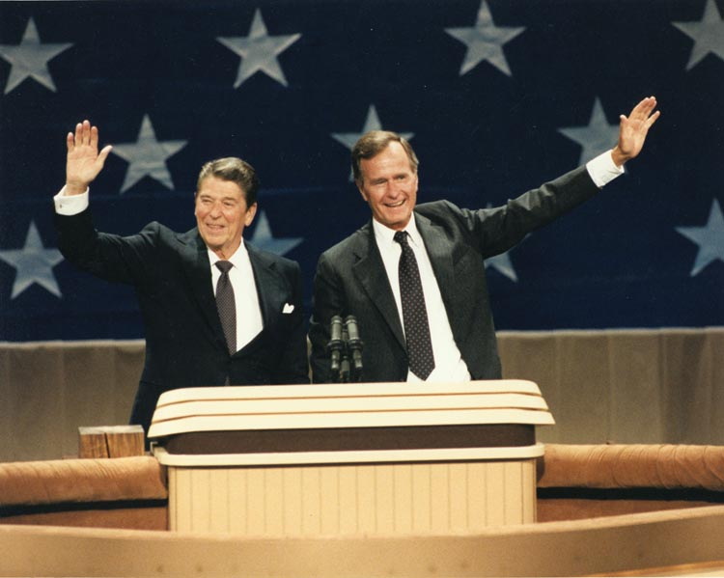
Party Loyalty: 1980

Slide 8
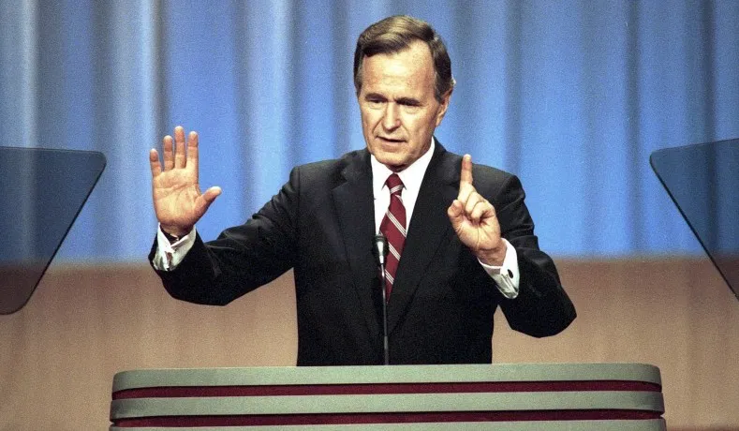
Bush and Belief
1988 “Read My Lips: No new Taxes”
1990: Tax Increase
1992: The Tax Increase was a Mistake

Slide 9
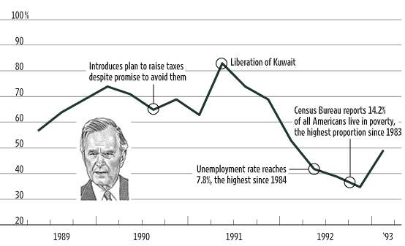
Bush 41 Approval

Slide 10
Movement Triumphs
Capital “C” Conservatives win
Ronald Reagan’s Party
or Limbaugh’s
or Fox’s

