Slide 1
Overview of Analytics Capabilities for Excel 2013 Data
Bob & Wilma Andrews Virginia Commonwealth University

Slide 2
Overview
Excel 2013
New data capabilities
Notes:
Intent of this session is to make participants aware of Excel 2013 data capabilities.

Slide 3
Data
obtain
manage
analyze
visualize
Notes:
Excel 2013 Professional Plus

Slide 4
Excel 2013 Data Capabilities
 | Obtain | Manage | Analyze | Visualize
Inquire |  | X
Recommended PivotTables |  |  | X
Recommended Charts |  |  |  | X
Power Query | X
Power Map |  |  |  | X
Power Pivot | X | X
Power View |  |  | X | X
Commercial Add-Ins |  |  | X | X
Apps for Office |  |  | X | X
 | Obtain | Manage | Analyze | Visualize
Inquire |  | X
Recommended PivotTables |  |  | X
Recommended Charts |  |  |  | X
 | Obtain | Manage | Analyze | Visualize
Inquire |  | X
Recommended PivotTables |  |  | X
Recommended Charts |  |  |  | X
Power Query | X
Power Map |  |  |  | X
 | Obtain | Manage | Analyze | Visualize
Inquire |  | X
Recommended PivotTables |  |  | X
Recommended Charts |  |  |  | X
Power Query | X
Power Map |  |  |  | X
Power Pivot | X | X
Power View |  |  | X | X

Slide 5
Basic level
New features

Slide 6
INQUIRE
Analyze workbook for problems or inconsistencies
See links between workbooks, worksheets or cells
Compare workbook versions (graphical dependency maps)
Worksheet relationship diagram
Notes:
Read more: http://www.microsofttraining.net/b/exceltraining/2013/04/excel-2013-audit-your-spreadsheet-with-the-inquire-add-in/#ixzz2tpQl0uoG

Slide 7
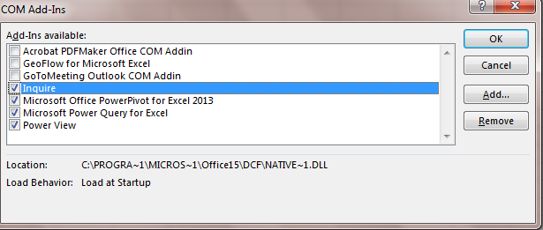
INQUIRE
Add-in
Turn on at Options/Add-ins/COM
Notes:
Quotes from http://office.microsoft.com/en-us/excel-help/what-you-can-do-with-spreadsheet-inquire-HA102835926.aspx
Compare two workbooks

Slide 8
INQUIRE
Workbook analysis
Show workbook links
Relationships – workbook, worksheet, cells
Clean excess cell formatting
Manage passwords
Compare files

Slide 9
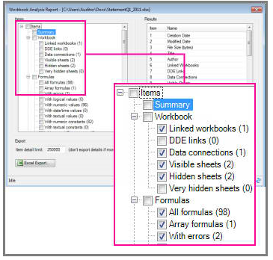
Workbook Analysis Report
Excel Help – Analyze a workbook

Slide 10
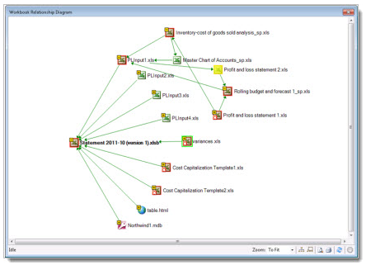
Relationships
Excel Help - What you can do with Spreadsheet Inquire

Slide 11
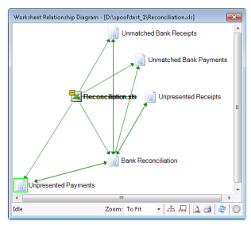
Relationships
http://www.microsofttraining.net/b/exceltraining/2013/04/excel-2013-audit-your-spreadsheet-with-the-inquire-add-in/

Slide 12
>300 Million Excel users worldwide
Those who create Pivot Tables
10% - Pivot Pros (Rob Collie)
Notes:
But now your students can become Pivot Pros because one of the new features of 2013 is to create pivot tables using the new Recommend PivotTables feature.

Slide 13
Recommended PivotTables
Notes:
Insert tab. So you have data in the spreadsheet, put cursor within the data and click on Recommend PivotTables.

Slide 14
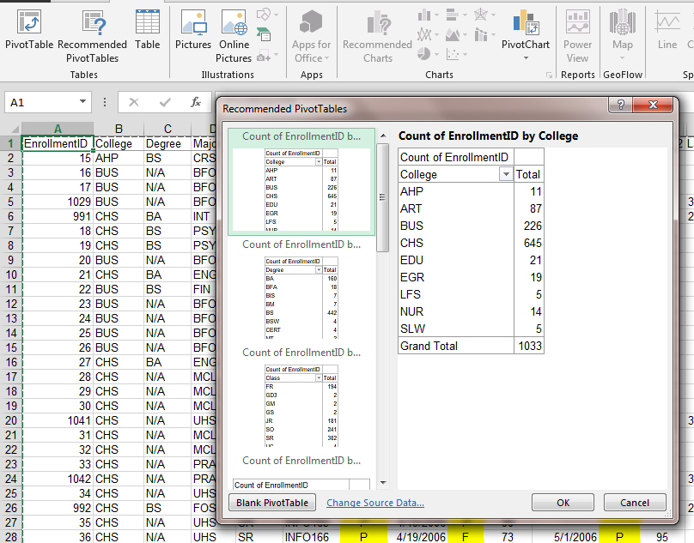
Recommended PivotTables
Notes:
Excel looks at the data and comes up with options. Scroll to see all of them. This may mean that students will be creating them with little or no idea of what they have done. So they still won’t be in the 10% until you teach them how to create/modify on their own.

Slide 15
Recommended Charts
Notes:
Again, cursor within the data, click on Recommended Charts and Excel will pick out options.

Slide 16
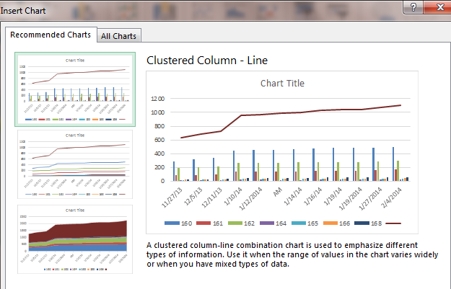
Recommended Charts

Slide 17
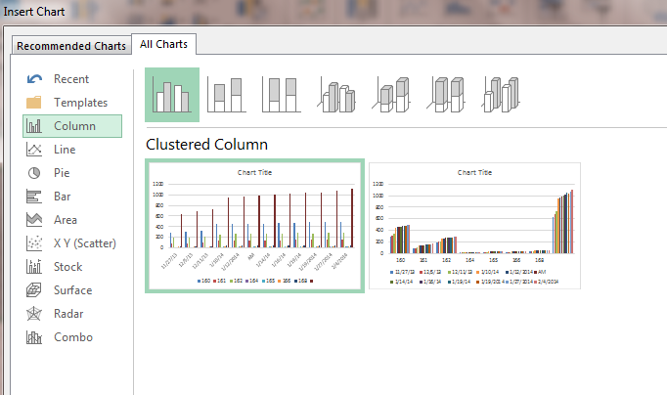
All Charts
Notes:
Click on All Charts and still use the selected data to show what it will look like.

Slide 18
One step up
Power User
Basic Excel

Slide 19
Power User
New features
Notes:
Defined Power User as anyone who truly uses PivotTables.

Slide 20
Microsoft’s four BI (Business Intelligence) products
Power Query
Power Map
Power Pivot
Power View

Slide 21
Power Query – simplify data discovery/access
Data discovery and query tool
Enhances self-service Business Intelligence experience
Public search feature (US only)
Notes:
http://office.microsoft.com/en-us/excel-help/how-power-query-and-power-pivot-work-together-HA104125038.aspx

Slide 22
Power Query
Notes:
Will have its own tab but has to be downloaded.

Slide 23
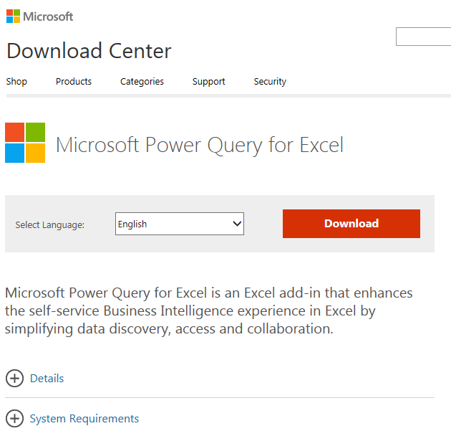
Power Query
Notes:
Microsoft Power Query is an Excel add-in that enhances the self-service Business Intelligence experience in Excel by simplifying data discovery and access. Power Query enables users to easily discover, combine, and refine data for better analysis in Excel. Power Query includes a public search feature that is currently intended for use in the United States only.

Slide 24
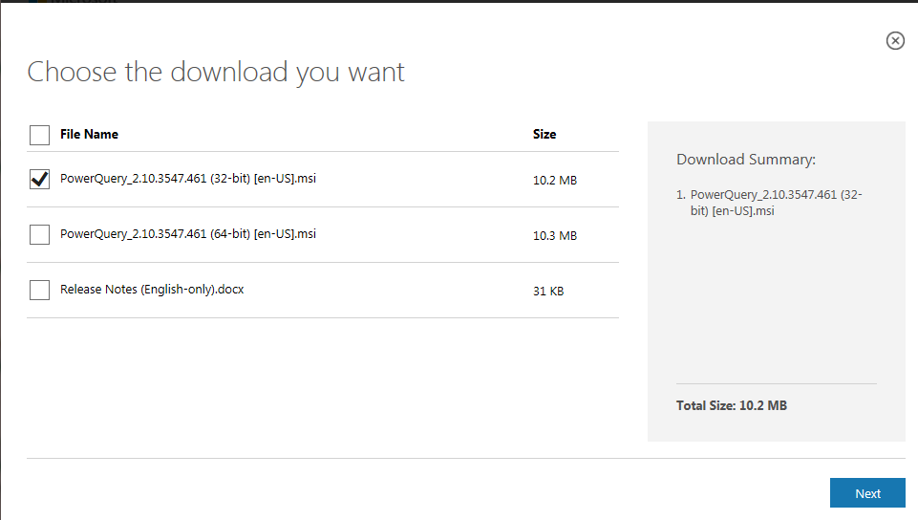
Power Query
Notes:
32 or 64 bit versions, then run. 64 bit is recommended.

Slide 25
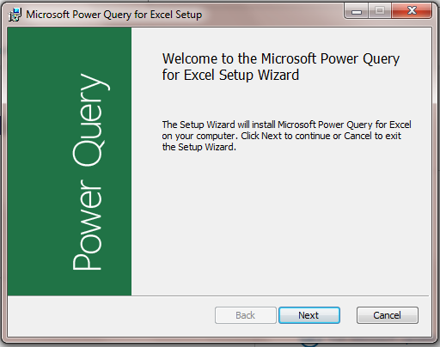
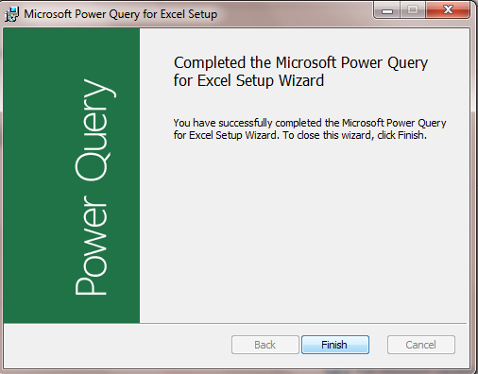
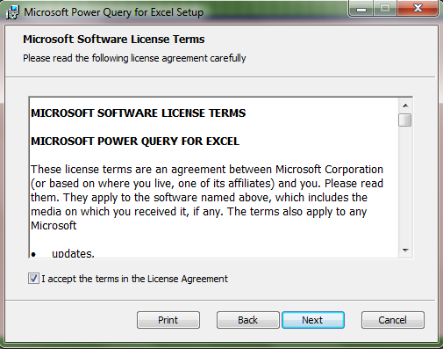
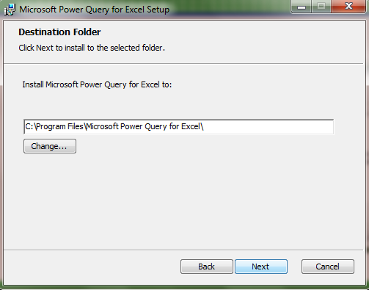
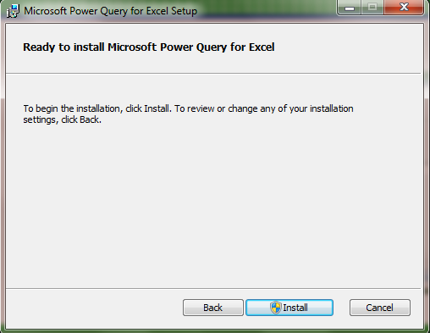
Power Query

Slide 26
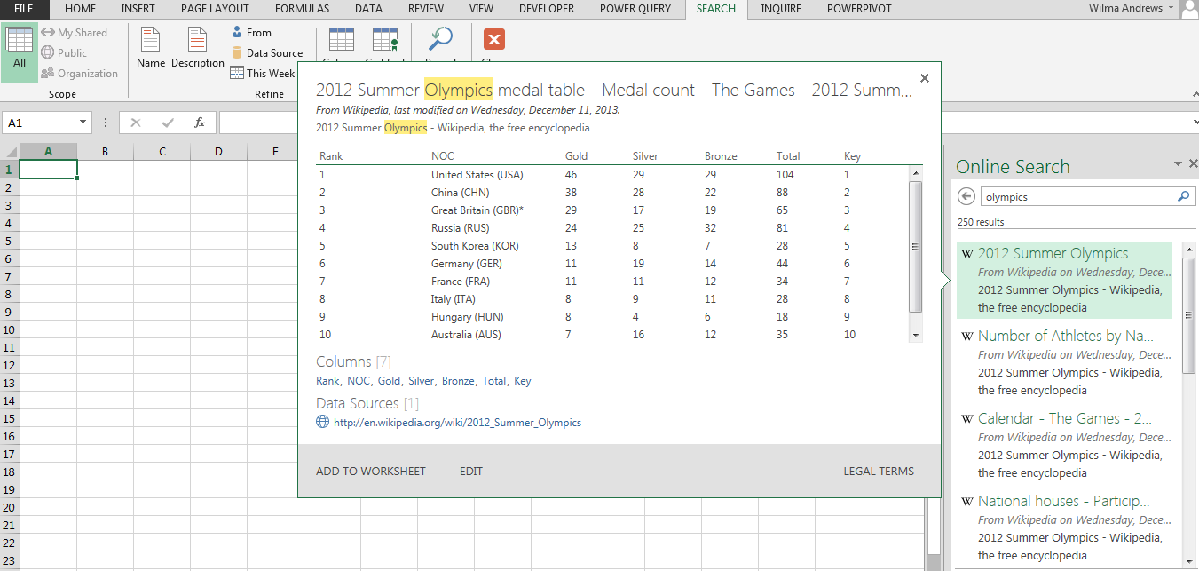
Notes:
Type in a search word – here Olympics. Option to add to worksheet. If do it again, can add another one to another worksheet

Slide 27
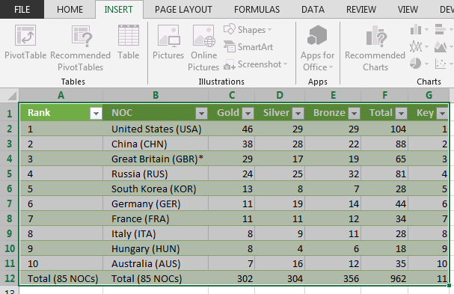
Table format

Slide 28
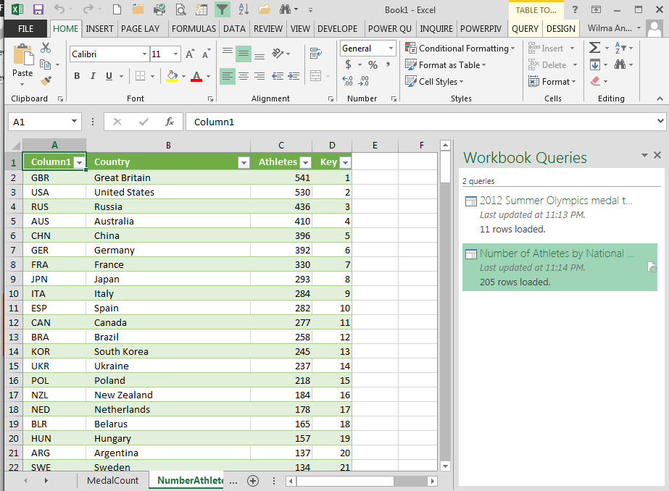
Notes:
Will put additional queries in on new worksheets.

Slide 29
Power Map (GeoFlow)
3-D data visualization of data sets

Slide 30
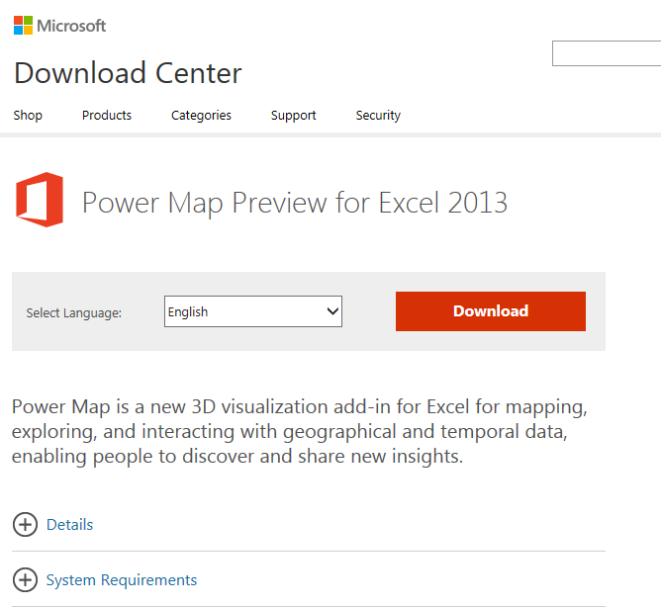
Power Map (GeoFlow)

Slide 31
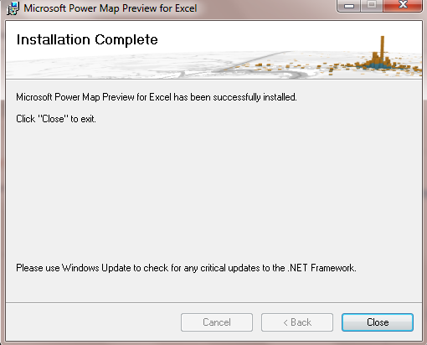

Slide 32
Power Map (GeoFlow)

Slide 33
GeoFlow

Slide 34
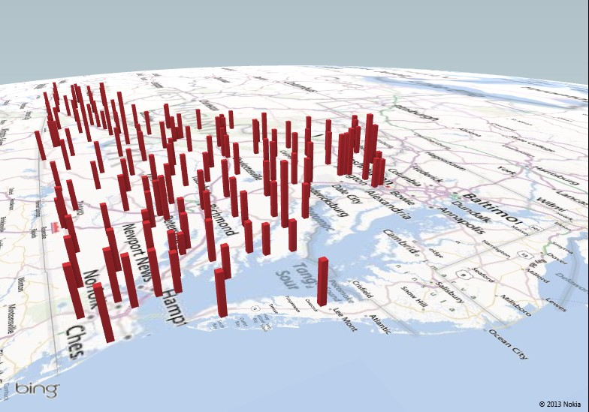
% Population 65 and Older by Locality
Notes:
Another GeoFlow example

Slide 35
% People in Poverty by State
Notes:
Another GeoFlow example

Slide 36
Another step up
Super Power User
Power User
Basic Excel

Slide 37
Super Power User
New features
Notes:
Defined Power User as anyone who uses PivotTables.

Slide 38
Power Pivot
“The best thing to happen to Excel in 20 years.”
Bill Jelen, Mr. Excel
“This is the rare technology that can (and will) fundamentally change the lives of millions of people.”
Rob Collie, PowerPivotPro

Slide 39
Power Pivot
By far, the biggest “competitor” to Power Pivot is… Excel itself.
In other words, lack of awareness that Power Pivot even EXISTS is still the biggest “competitor” to Power Pivot today.
http://www.powerpivotpro.com/2014/01/what-is-power-pivots-1-competitor/#more-8854

Slide 40
Power Pivot
Handles massive volumes of data
Builds on known pivot table skills
Possible multi-table pivots
“Save As” – option for interactive web application
Notes:
http://office.microsoft.com/en-us/excel-help/start-power-pivot-in-microsoft-excel-2013-add-in-HA102837097.aspx

Slide 41
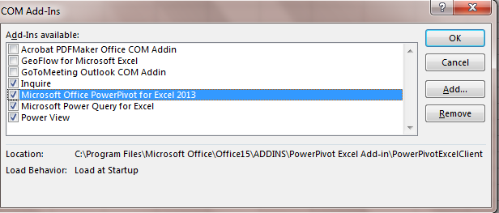
Power Pivot
Add-in
File/Options/Add-ins/COM Add-Ins

Slide 42
Power Pivot
Notes:
http://office.microsoft.com/en-us/excel-help/start-power-pivot-in-microsoft-excel-2013-add-in-HA102837097.aspx

Slide 43
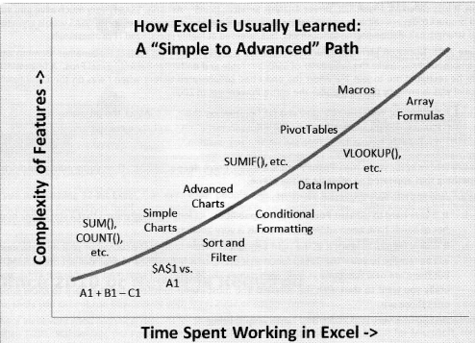
DAX FORMULAS FOR PowerPivot, Rob Collie, p.10

Slide 44
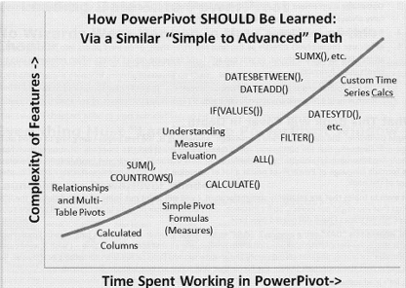
DAX FORMULAS FOR PowerPivot, Rob Collie, p.11

Slide 45
Power Query vs Power Pivot
Power Query - discover, connect to, and import data.
Power Pivot - model imported data
Both use Excel data in Excel to explore and visualize with Power Map, Power View, PivotTables and Pivot Charts.
Notes:
Power Query is the recommended experience for discovering, connecting to, and importing data.
Power Pivot is great for modeling the data you’ve imported. Use both to mold your data in Excel so you can explore and visualize it with Power Map, Power View, PivotTables, and PivotCharts, and then interact with the resulting workbook in SharePoint, on Power BI sites in Office 365, and in the Power BI Windows Store app.

Slide 46
Power View
Explore
Visualize
Present
Notes:
Sometimes the Power View icon is grayed out. If so, you may need to turn on the Power View add-in.
TIP It’s a good practice to work with Excel tables rather than just ranges of data. Before you insert a Power View sheet based on your data, create an Excel table.
USE TABLES ONLY

Slide 47
Power View
PowerPivot models intuitive data visualization
Join data together in a cohesive unit = data model
Data models created behind the scenes between tables and relationships
Notes:
Microsoft describes a Data Model as "a new approach for integrating data from multiple tables, effectively building a relational data source inside an Excel workbook."
videos - http://office.microsoft.com/en-us/excel-help/power-view-and-power-pivot-videos-HA104009784.aspx?CTT=5&origin=HA104048146

Slide 48
Power View
Charts
Filtering
Slicers
Sorting
Reports with multiple views
Notes:
http://office.microsoft.com/en-us/excel-help/power-view-explore-visualize-and-present-your-data-HA102835634.aspx#_Toc378340898

Slide 49
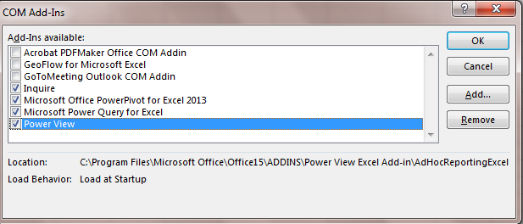
Power View
Add-in
File/Options/Add-ins/COM Add-Ins

Slide 50
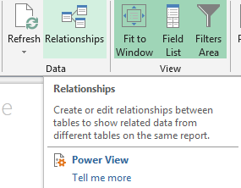
Power View
Notes:
Sometimes the Power View icon is grayed out. If so, you may need to turn on the Power View add-in.
TIP It’s a good practice to work with Excel tables rather than just ranges of data. Before you insert a Power View sheet based on your data, create an Excel table.
NOTE

Slide 51
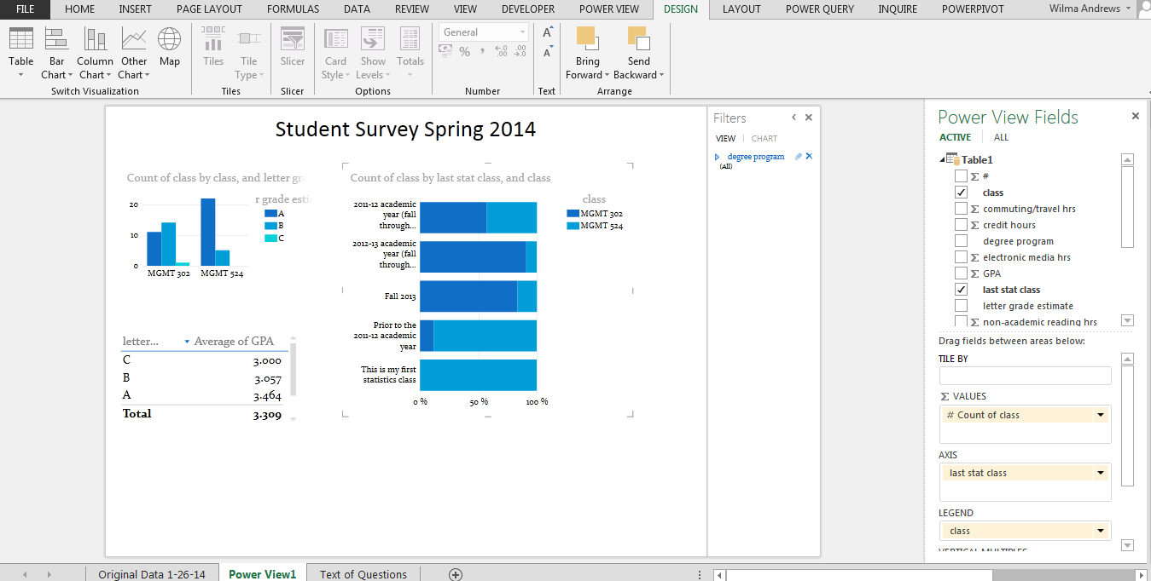

Slide 52
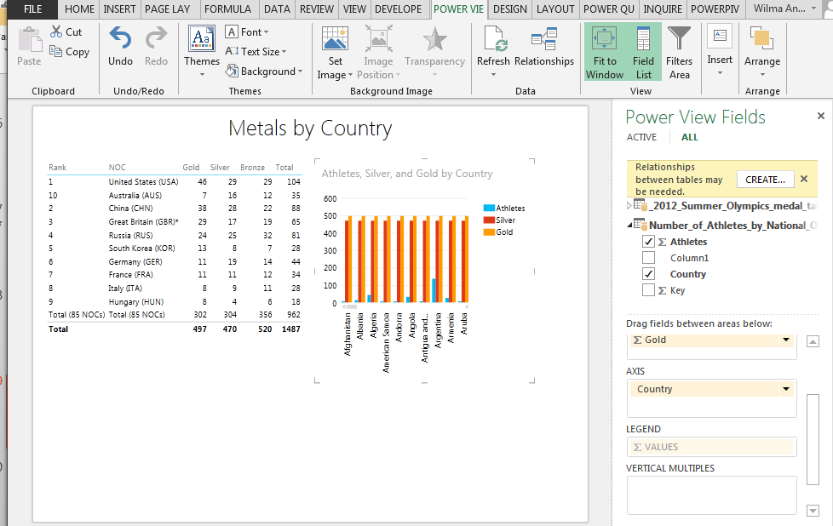

Slide 53
Commercial Excel Add-ins
JMP - http://www.jmp.com/support/help/Import_Data_Using_the_Excel_Add-In.shtml
StatTools6 - https://www.palisade.com/stattools/
XLMiner - http://www.solver.com/xlminer-data-mining
XLSTAT - http://www.xlstat.com/en/

Slide 54
Apps for Office

Slide 55
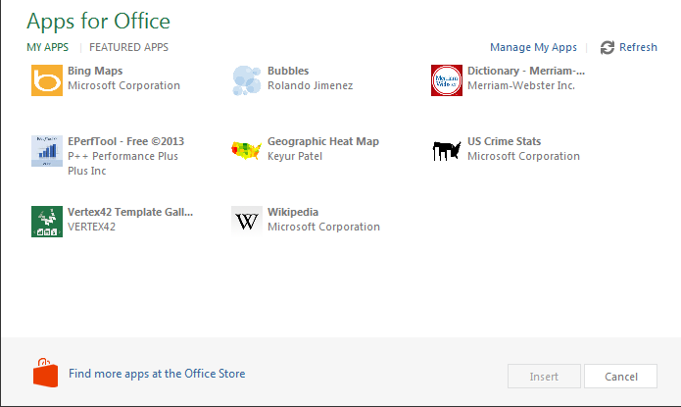
Apps for Office
Notes:
Click on See all and will have something like this come up. Then to see more, click on Office Store

Slide 56
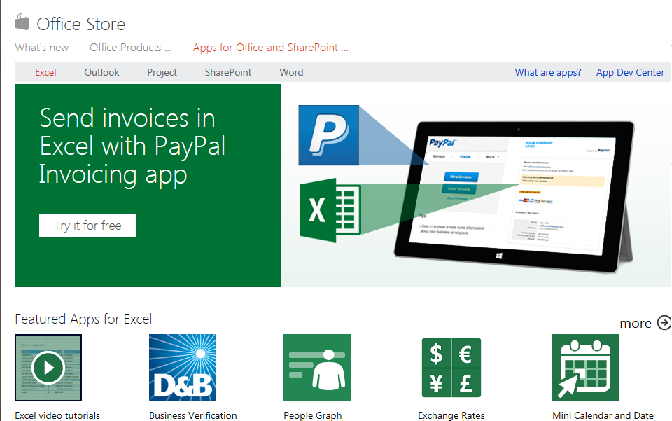
Apps for Office
Notes:
As of February 2014 – some free, some have to pay for.

Slide 57
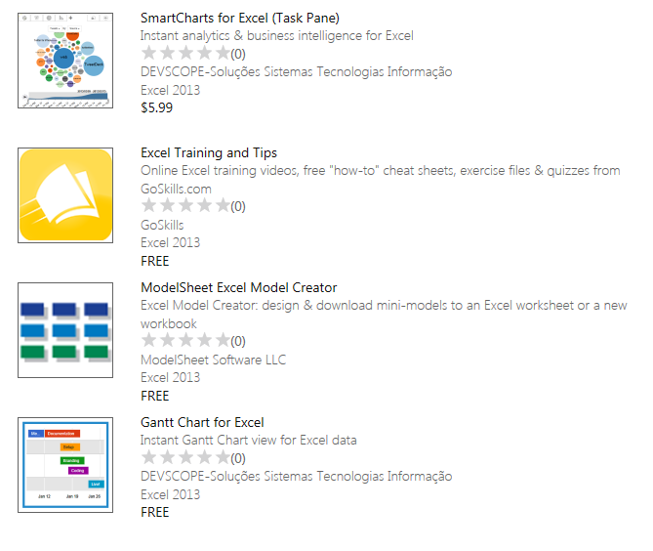
Apps for Office

Slide 58
Resources
Visualizing Data with Microsoft Power View,
Larson, Davis, English and Purington
Dax Formulas for PowerPivot, Collie
Microsoft Excel 2013, Building Data Models with PowerPivot, Ferrai and Russo
Notes:
website videos
http://office.microsoft.com/en-us/excel-help/power-view-and-power-pivot-videos-HA104009784.aspx?CTT=5&origin=HA102835634

Slide 59
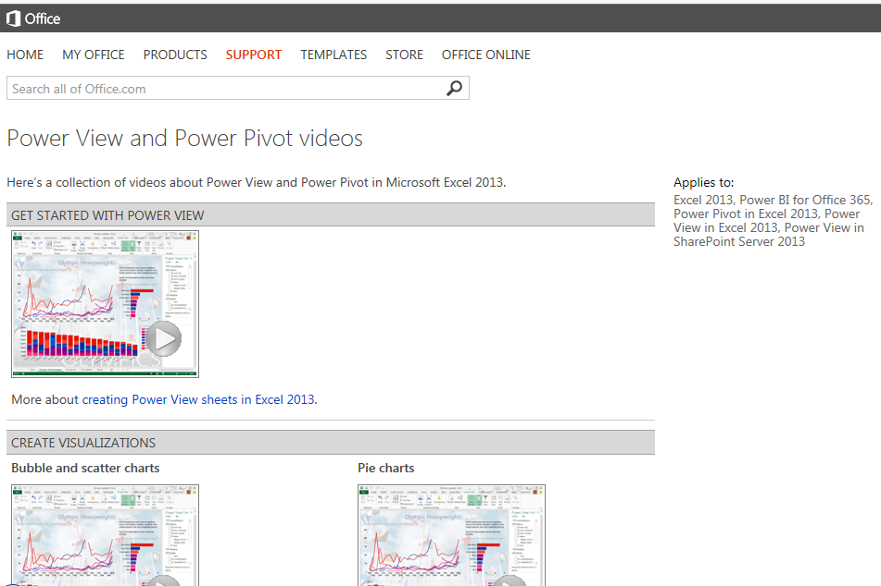
Microsoft Support site

Slide 60
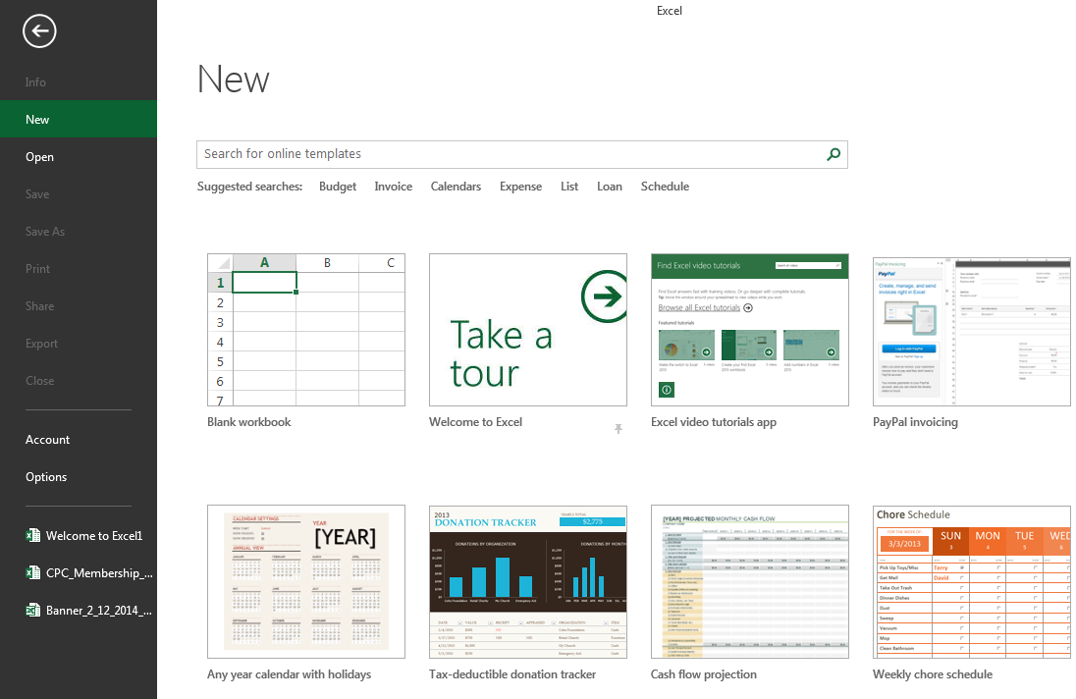
Videos at Excel New
Notes:
There are some at New right within Excel. Others from the Microsoft website.

Slide 61
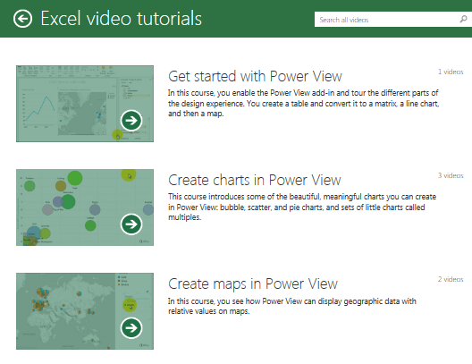
Excel Videos

Slide 62
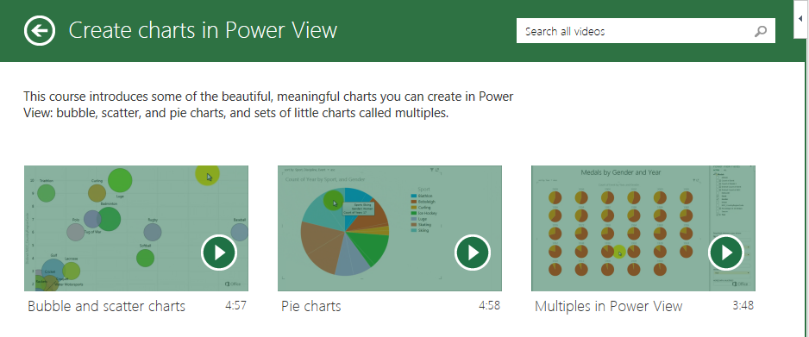
Excel Videos

Slide 63
Resources
Bill Jelen – Mr. Excel
http://www.youtube.com/user/bjele123
Notes:
website videos
http://office.microsoft.com/en-us/excel-help/power-view-and-power-pivot-videos-HA104009784.aspx?CTT=5&origin=HA102835634

Slide 64
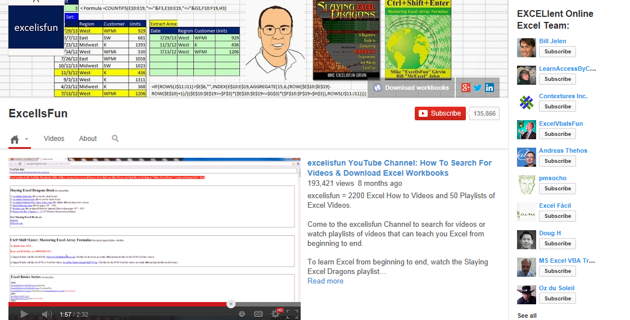
Resources
Mike Girven - Excel is Fun
http://www.youtube.com/user/ExcelIsFun
Notes:
website videos
http://office.microsoft.com/en-us/excel-help/power-view-and-power-pivot-videos-HA104009784.aspx?CTT=5&origin=HA102835634

Slide 65
Resources
Rob Collie – powerpivotpro.com
http://www.youtube.com/channel/UCoZckhwYkolkjBIdVXpSNSg

Slide 66
Discussion

