Slide 1
Aplia, Connect, MyStatLab, or WileyPlus: Which one is right for you?
Joan Donohue
University of South Carolina

Slide 2
Comparison of features in four prominent on-line HW managers
I used Aplia with Cengage’s ASW book for 5 years
Now we use Connect with McGraw-Hill’s Jaggia/Kelly book
I looked into using MyStatLab with Pearson’s Donnelly book
Recently, I did a “test drive” of WileyPlus with Black’s book
Each of these HW managers and ebooks have their own set of strengths and weaknesses
This session will compare features of these HW managers and ebooks

Slide 3
Aplia
Created in 2000 by Paul Romer at Stanford
Website launched by Cengage in May 2008
Has been used at 1700 institutions
Used by over 15,000 instructors
More than 4.9 million students have used it
Business Statistics textbooks supported:
Anderson, Sweeney, Williams (4 titles)
Keller (3 titles)
Notes:
Paul Romer – Economics professor

Slide 4
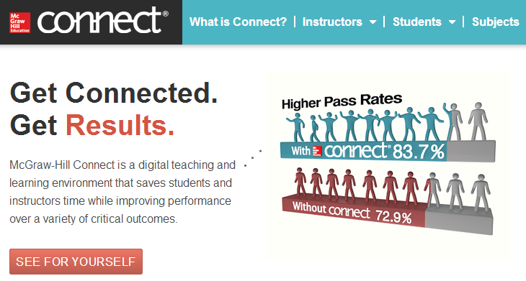
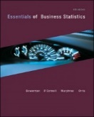
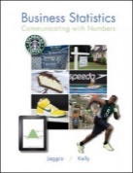
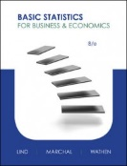
Connect
McGraw-Hill Launched Connect in 2009
Launched LearnSmart/SmartBook in 2012-2013
Business Statistics textbooks supported:
Bowerman (2 titles)
Doane, Seward (1 title)
Jaggia, Kelly (2 titles)
Lind, Marchal, Wathen (2 titles)

Slide 5
MyStatLab
Pearson started MyMathLab in 2001
It has been used at 1900 colleges
9 million students have used it
In 2008 MyStatLab became a standalone product
Last year it had 600,000 users
10 Business Statistics textbooks supported:
Berenson, Levine, Krehbiel McClave, Benson, Sincich
Levine, Krehbiel, Berenson Newbold, Carlson, Thorne
Levine, Stephan, Szbat Sharpe, DeVeaux, Vellaman (2)
Donnelly Stine, Foster
Groebner, Shannon, Fry

Slide 6
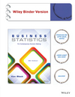
WileyPLUS
Started in Calculus about 10 years ago
Over 1 million students have used it
Only 1 Business Statistic textbook supported:
Black
Also supports 2 Operations Management textbooks.

Slide 7
Aplia – Basic Info
The instructor sets up the course by choosing assignments from a bank of exercises related to the textbook:
- Aplia “grade-it-now” exercises (algorithmic)
- Odd-numbered textbook exercises (some algorithmic)
- Test bank multiple choice questions (static)
- Create your own questions (static)
Removing parts of exercises or editing the wording of questions is not permitted.
Students complete exercises one-at-time and receive detailed feedback after each attempt at the “grade-it-now” exercises.
For textbook/textbank exercises, feedback is only given after the final attempt.
Scores can be based on the average or best of up to 3 attempts at an assignment.

Slide 8
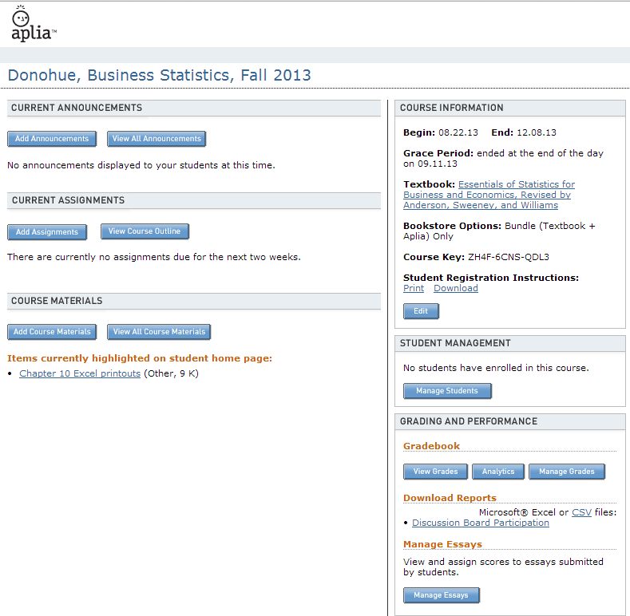
Aplia website

Slide 9
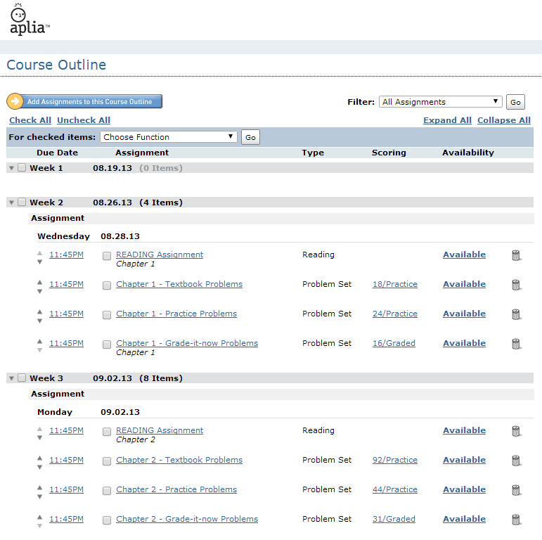
Aplia website

Slide 10
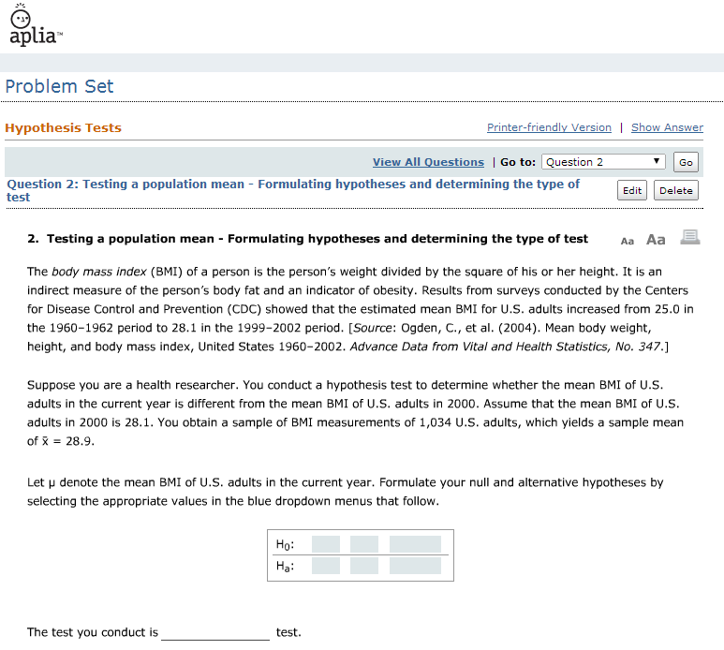

Slide 11
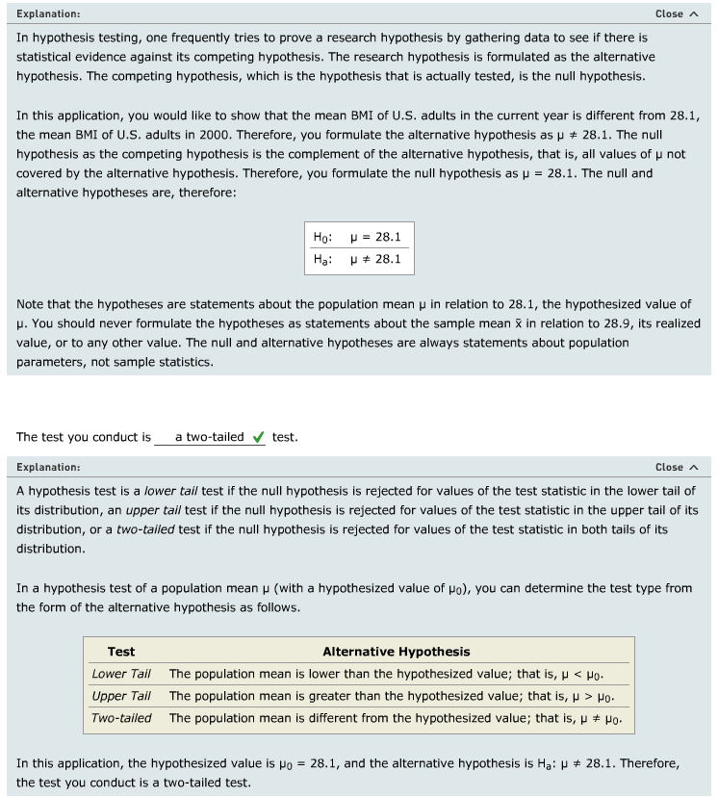
Aplia Feedback

Slide 12
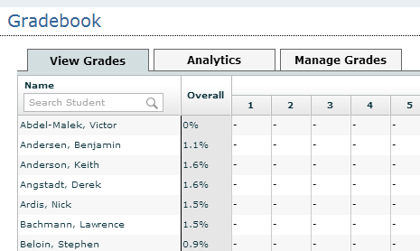
Aplia Gradebook
Scores can be exported, imported, and manually adjusted.
Instructors can only view the actual work for each student’s final attempt.

Slide 13
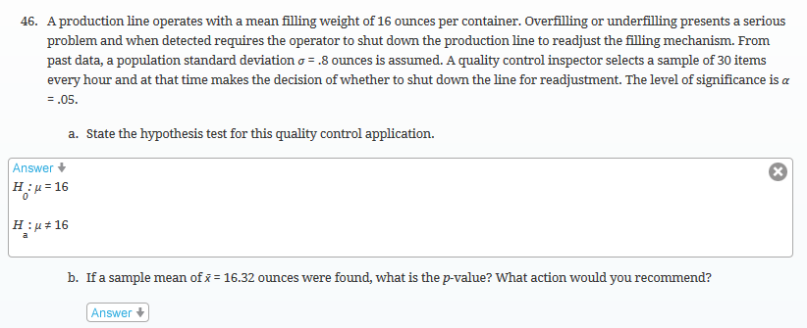
Aplia Ebook
Aplia uses the MindTap reader, which is more advanced than most ebooks.
Even-numbered exercises, for example, are interactive.
However, page numbers are not provided.

Slide 14
Aplia Strengths & Weaknesses
Strengths
Aplia exercises are of high quality
Aplia exercises aim to teach students something new
Customer support and service is excellent
Nice gradebook with ability to adjust scores easily
MindTap ebook is more advanced than most
Weaknesses
Exercises cannot be modified by instructors
Instructors can only see students’ final attempts at exercises
No hints or feedback is given on textbook exercises between attempts (only for Aplia exercises)
Tools available for help in solving Aplia exercises are not available elsewhere (finding z values etc.)
Many students think the Aplia exercises are tricky and very different from those in the textbook
Aplia is fairly expensive

Slide 15
Connect – Basic Info
The instructor sets up the course by choosing assignments from a bank of exercises related to the textbook:
- Algorithmic textbook exercises
- Static textbook exercises
- Test bank multiple choice questions (static)
- Create your own questions (static or algorithmic)
Removing parts of exercises is permitted but scoring sometimes gets messed up.
Instructors can choose to have students submit exercises either one-at-time or after all are completed.
LearnSmart/SmartBook is a very nice flashcard-based way to “adaptively” quiz students on the textbook reading.
The ebook is slightly advanced, with links to PowerPoints, guided example videos, and other chapters/sections.

Slide 16
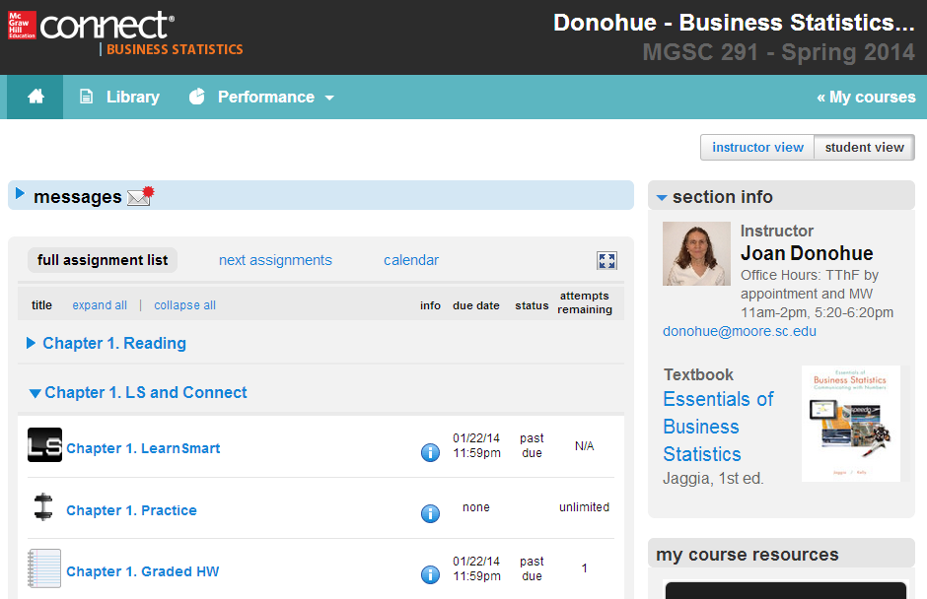
Connect Website

Slide 17
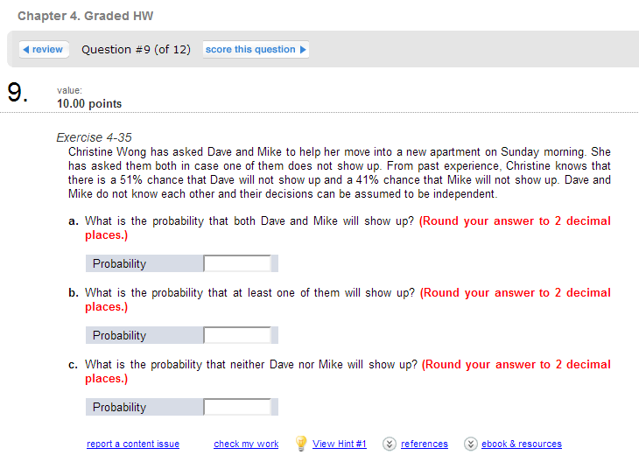
Connect Exercises

Slide 18
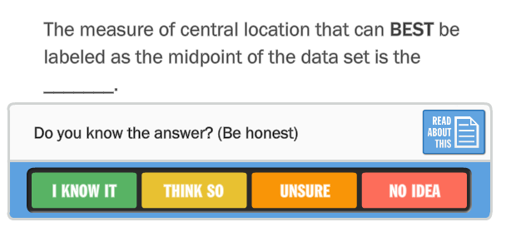
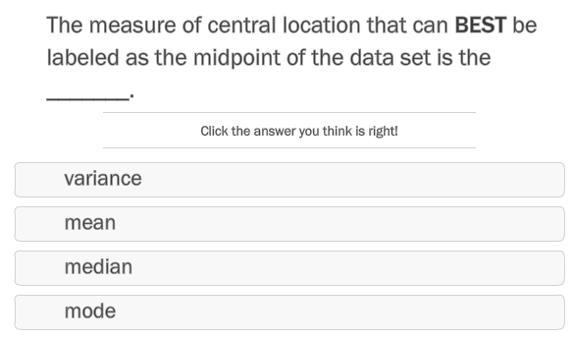
Connect LearnSmart/SmartBook

Slide 19
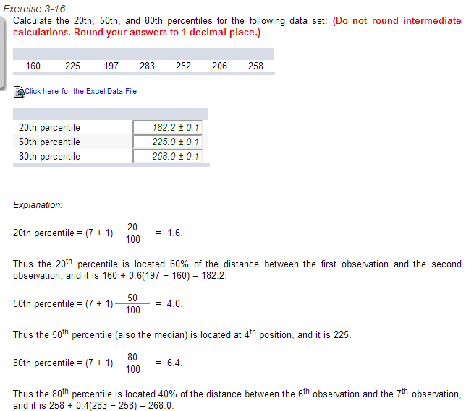
Connect Feedback

Slide 20
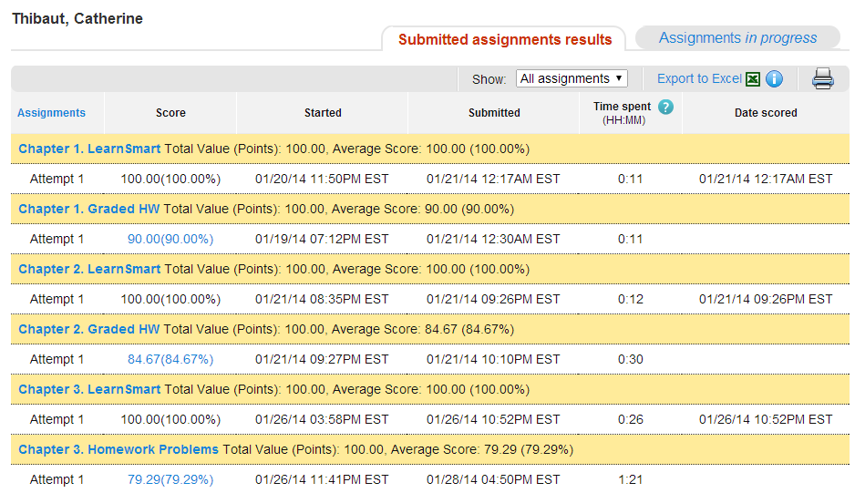
Connect Gradebook
Scores can be exported and analyzed.
Instructors can view each student’s work on each attempt.

Slide 21
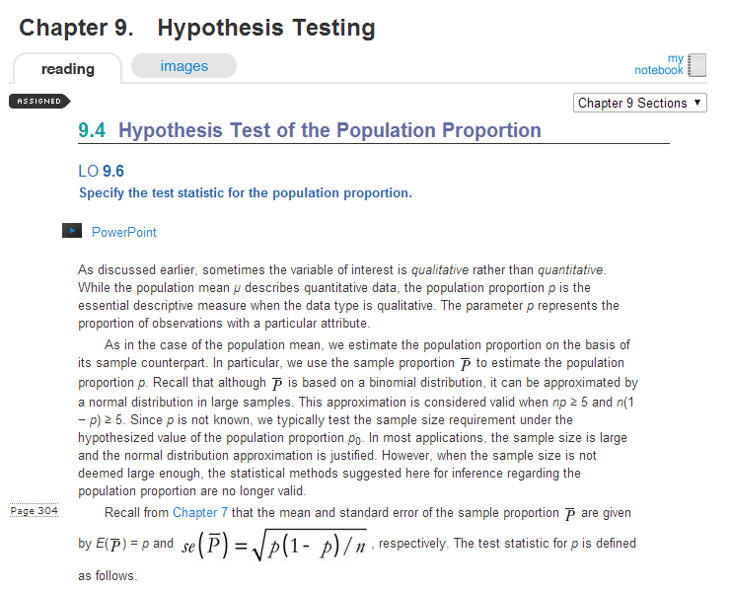
Connect Ebook
Connect’s ebook includes links to related on-line content.
It includes the textbook’s page numbers.

Slide 22
Connect Strengths & Weaknesses
Strengths
Connect has ~90% of the textbook exercises available
When solving problems, you can click on a link that opens an Excel worksheet with the algorithmic/static data in it
LearnSmart/SmartBook is a very nice feature
Hints (video tutorials in selected HW exercises) are well-liked by students
Weaknesses
Exercises should not be modified by instructors if they want corrections and updates to apply
Grade adjustment must be done one exercise at a time
In the Instructors assignment view, you cannot “expand all”
Errors exist in some algorithmic versions of exercises
Ask the instructor emails must be accessed within Connect

Slide 23
MyStatLab – Basic Info
The instructor sets up the course by choosing assignments from a bank of exercises related to the textbook:
- Textbook exercises (? which ones algorithmic)
- Test bank multiple choice questions (static)
- Create your own questions (static or algorithmic)
Many options exist for grading/scoring assignments
StatCrunch is available to solve exercises or data can be copied into an Excel file
The ebook is a navigable pdf file without embedded links

Slide 24
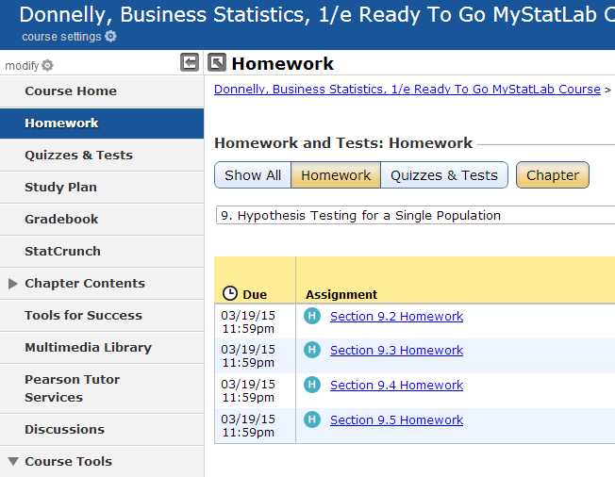
MyStatLab Website

Slide 25
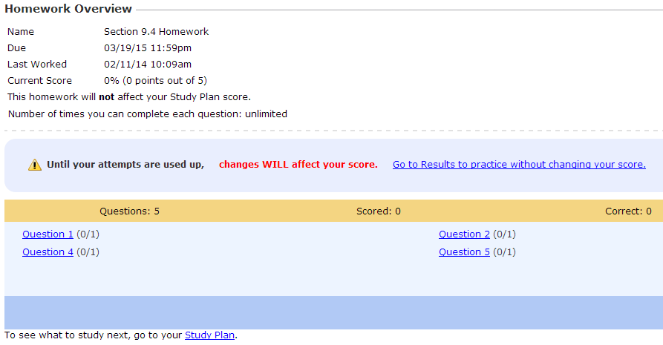
MyStatLab Exercises
Exercises can be done in any order and started and saved to come back later.

Slide 26
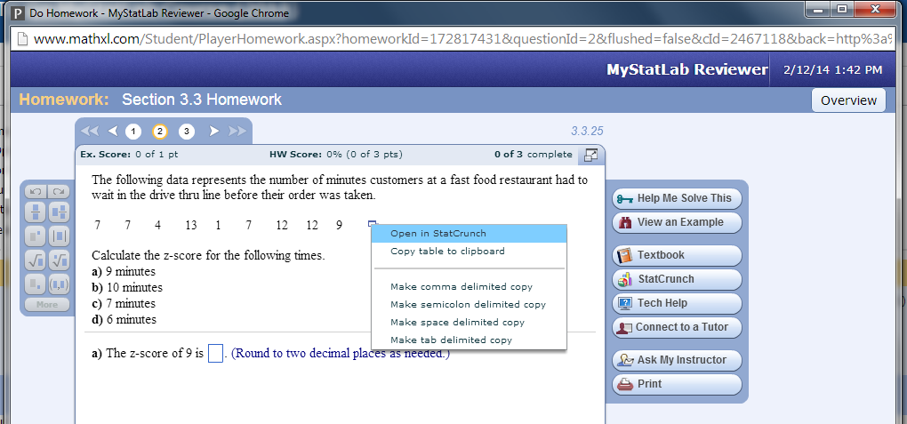
MyStatLab Exercise Window
Each exercise opens a pop-up window.
Data in exercises can be copied to the clipboard or opened in StatCrunch.
“Ask my instructor” goes to the instructor’s chosen email address.

Slide 27
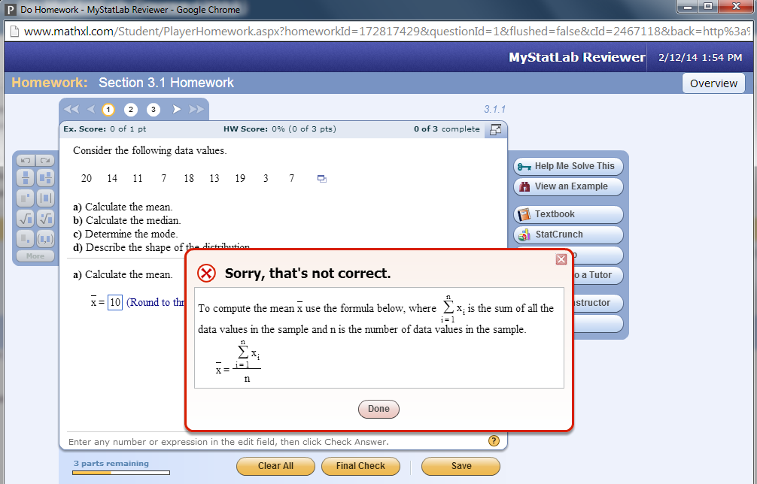
MyStatLab Feedback
Cannot move on to part (b) until part (a) is correctly answered.
Once scored, you mouse over incorrect answers one-at-time to see
the correct answers (tedious to do).

Slide 28
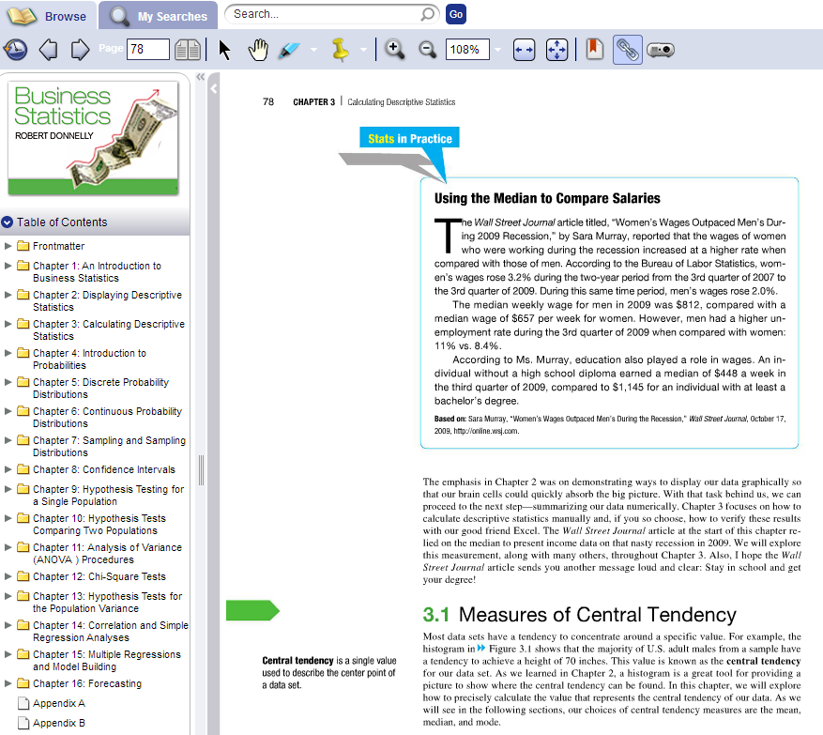
MyStatLab Ebook
The ebook is basically a navigable pdf file.
There are no links embedded in it.

Slide 29
MyStatLab Strengths & Weaknesses
Strengths
Many textbook titles available
When solving problems, you can click on links that open a guided example or get step-by-step help
Students can see all exercises assigned and complete them in order they want
Students get 30 minutes of free on-line tutoring
Weaknesses
I could not tell which exercises are algorithmic
Exercise numbering defaults to #1, 2, etc. rather than the textbook exercise number
End-of-chapter exercises are not available (only end-of-section)

Slide 30
WileyPlus – Basic Info
The instructor sets up the course by choosing assignments from a bank of exercises related to the textbook:
- Textbook exercises (static and algorithmic - ALL)
- Test bank multiple choice questions (static)
I did not have access to all the features during my trial but it seemed more difficult to use than the other 3 HW managers
In the ebook, the author embeds his lectures

Slide 31
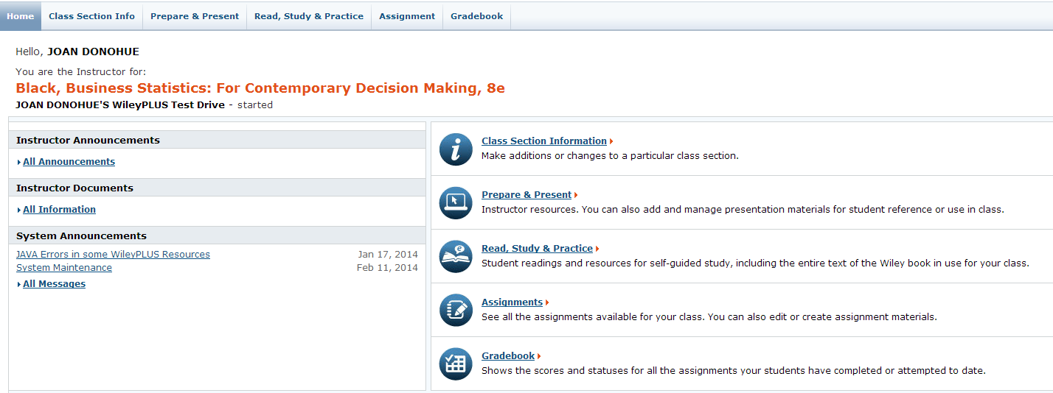
WileyPlus Website
Wiley only gave me a very limited “test drive.”
I could not create assignments or access anything other than Chapter 9.

Slide 32
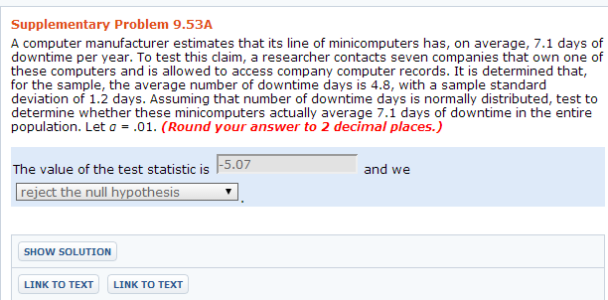
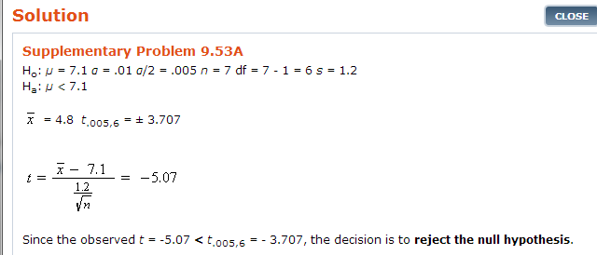
WileyPlus Exercises

Slide 33
WileyPlus Ebook

Slide 34
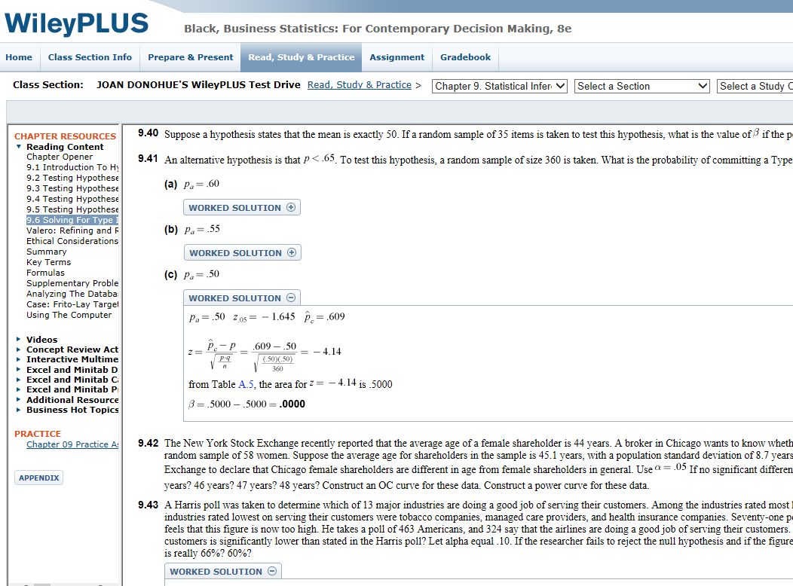
WileyPlus Ebook
The ebook is not just a flat pdf file.
It shows solutions to the odd-numbered exercises.
There are no textbook page numbers.

Slide 35
WileyPlus Strengths & Weaknesses
Strengths
All textbook exercises are included, some in both static and algorithmic format
Ebook has built in video lectures by the author
Weaknesses
Only 1 Business Statistics textbook is availabIe
It seemed to be more difficult for the instructor to use

