Slide 1

Using Race Data to Teach Basic Statistics
Tracy D. Rishel
The Citadel
November 23, 2015

Slide 2
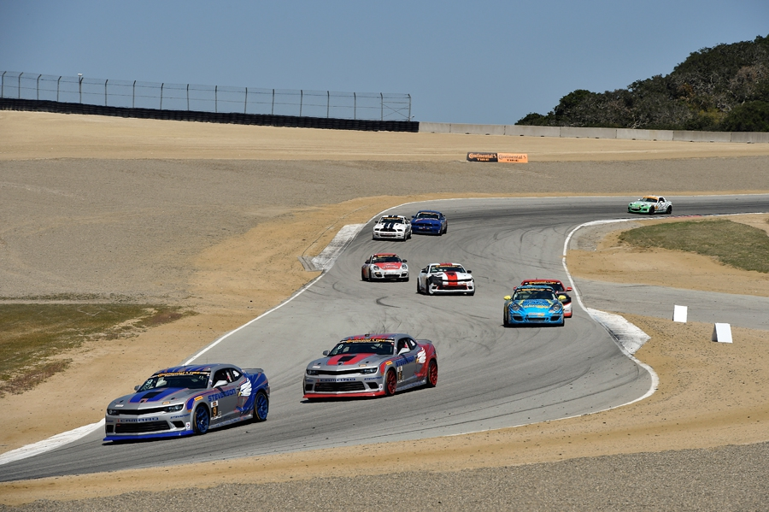
Why use sports data?
Many schools have incorporated sports management curriculum into their business programs
Students like and understand sports and sports data (ok not necessarily racing!)
Can easily be used for descriptive and inferential statistical applications, exercises, and projects
Data lends itself to developing tables and graphs, and enhancing Excel and critical thinking skills

Slide 3

Applications
Statistical
Excel
Probability
Descriptive statistics
  Mean, variance, standard deviation, range, graphs
Outliers
Box and whisker plots
Histograms
Normal probability distribution
F-test for two sample variances
T-tests
Sort and format data
Bar graphs
Line graphs
Descriptive statistics
Histograms
F-tests
T-tests

Slide 4

What is the plan?
Learn skills, how to conduct analyses, how to interpret results
Act as team manager to develop short term race strategy and longer term driver strategy (talent and team management)
Utilize last year’s data from a race to evaluate car/driver data in an effort to:
  Develop short term driver and race strategy for this year’s race
  Coach drivers for the race
  Determine long term driver strategy for development and retention as well as contract negotiations
Assign project

Slide 5
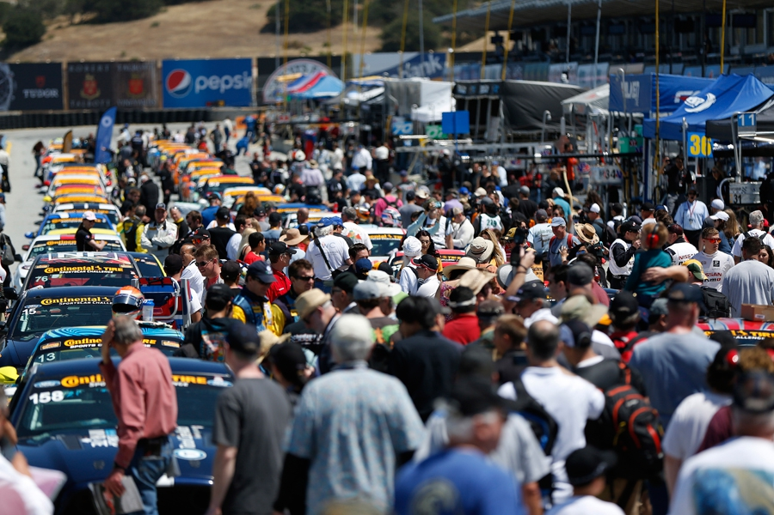
Laguna Seca track 2015
Mazda Raceway Laguna Seca
2.238 miles
Monterey, California
http://www.imsatiming.com/
Results/2015/CTSC/03-MRLS/

Slide 6
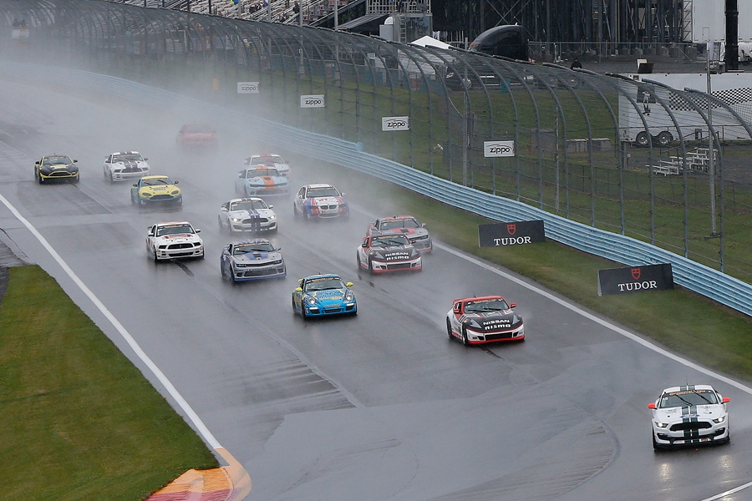
In-class statistical and Excel applications
CTSC MRLS Race CSV with Section Times.csv
Raw data – 3,308 data records
Sort data by car
Find car/drivers’ data – each car should have 84 laps if ran the full race
Copy and paste to new worksheet
Identify green/yellow flag data and set to 0 or 1
Develop bar graph of green/yellow flags
Calculate probability of a yellow flag for any given lap

Slide 7
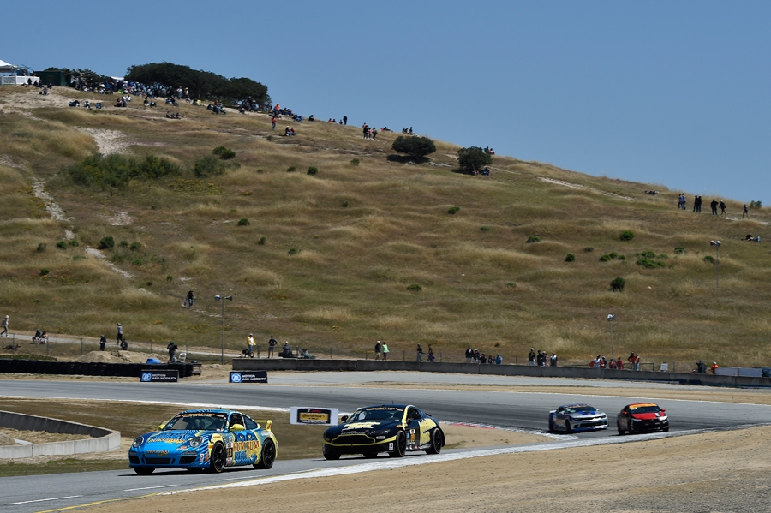
In-class statistical and Excel applications cont.
Copy driver, lap, and lap times to another worksheet
Convert lap time data to seconds
Develop a line plot of lap times in seconds for each driver
Look for outliers and assignable causes
Set up new worksheet for “green” lap time equivalents by driver
Develop a line plot of “green” lap times to compare drivers
Use descriptive statistics option in Excel to compare drivers based on “green” lap times: mean, standard deviation, range

Slide 8

In-class statistical and Excel applications cont.
Develop box and whisker plots to compare distributions for “green” lap times by driver
Use descriptive statistics to set up and run the histogram option in Excel for “green” lap times by driver
Discuss normal probability distribution
Conduct F-Test Two-Sample for Variances for “green” lap times by driver
Conduct the appropriate t-test for “green” lap times by driver to compare driver performance

Slide 9
In-class statistical and Excel applications cont.
Copy and paste “green” section times by driver to a new worksheet
Review track diagram with sections and section distances
Conduct t-test for each “green” section time by driver for coaching
Format driver data from previous year and conduct t-test to compare longitudinal performance
Interpret graphs, descriptive statistics, and statistical analyses to make decisions

Slide 10

Example Project
Part 1: write up an executive report for your team sponsors that lays out your race strategy for the Laguna Seca race. Include all supporting graphical, tabular, and statistical analyses to support your strategy.
Part 2: write up an executive report for next year’s driver choice and development, and ensuing contract negotiations. Include all supporting graphical, tabular, and statistical analyses to support your strategy.
Details to follow.

Slide 11

Process for project
Pick a team/drivers.
Overall, use the data provided and applications covered in class to determine:
  Short term race strategy based on historical flag, lap time, and driver data.
  Long term driver evaluation and contract negotiation.
Support your short term strategy with graphs and statistical analyses.
  Which driver should drive first, how long, why?
  How would you determine coaching needs and how would you apply the coaching?

Slide 12

Process for project cont.
Pick one of the two drivers and use their data to identify strengths and weaknesses for driver development and retention, and discuss how this information could be used in contract negotiations.
What additional data would you like to have to improve your decision making?
Apply critical thinking skills throughout!

Slide 13

Questions?

