Slide 1
MSMESB: Explain What It Means: Communication, Visualization, Presentation and Storytelling for Analysis Results Visualization of Textual Data Storytelling
Kellie Keeling
University of Denver
Notes:
1:30 PM Saturday, Explain What It Means: Communication, Visualization, Presentation and Storytelling for Analysis Results, Location: Ballard
Abstract: Discussion of approaches to and importance of incorporating communication in analytical courses. Whether through written analysis, creating presentations, data visualization, or storytelling, the practical relevance of any analysis is best realized when the analysis is communicated, understood, and turned into actionable information. Attendees are encouraged to contribute to the discussion.
Session chair: Linda Boardman Liu, Boston College
Presenters: Linda Boardman Liu, Boston College
Satish Nargundkar, Georgia State University
Wilma Andrews, Virginia Commonwealth University
Kellie Keeling, University of Denver
Wilma Andrews
Virginia Commonwealth University
Trends in Presentations Communicating Results
Satish Nargundkar
Georgia State University
Visual Communication Meaningful Summarization
Linda Boardman Liu
Boston College
Writing in Statistics
Kelly Keeling
University of Denver
Visualization of Textual Data Storytelling
15 min presentations, 30 min discussion
Send references to Linda Ahead of Time
Wilma – digital literacy, passion is presentations (helping a colleague by presenting in communication classes). Trends/what not to do, how to present more than just bullet points – what came up with and not just how they did the analysis
Satish
Specifics about Tables/Charts – Quantitative Data
Satish – teaching data mining/analytics, consulting: how to write a report in 'English' = focusing on highlighting the insights (design tables/charts and graphs). Data mining: how present a logistic regression, other predictive analytics techniques
Linda
Written communication in Statistics courses – write 3 sentences that communicates your ideas, handout turning a regular assignment into a written assignment
Kellie
Text Analytics
Cluster Analysis
Network Diagrams
Frequency Displays (Word Clouds, Heat Maps, Bar Charts)

Slide 3
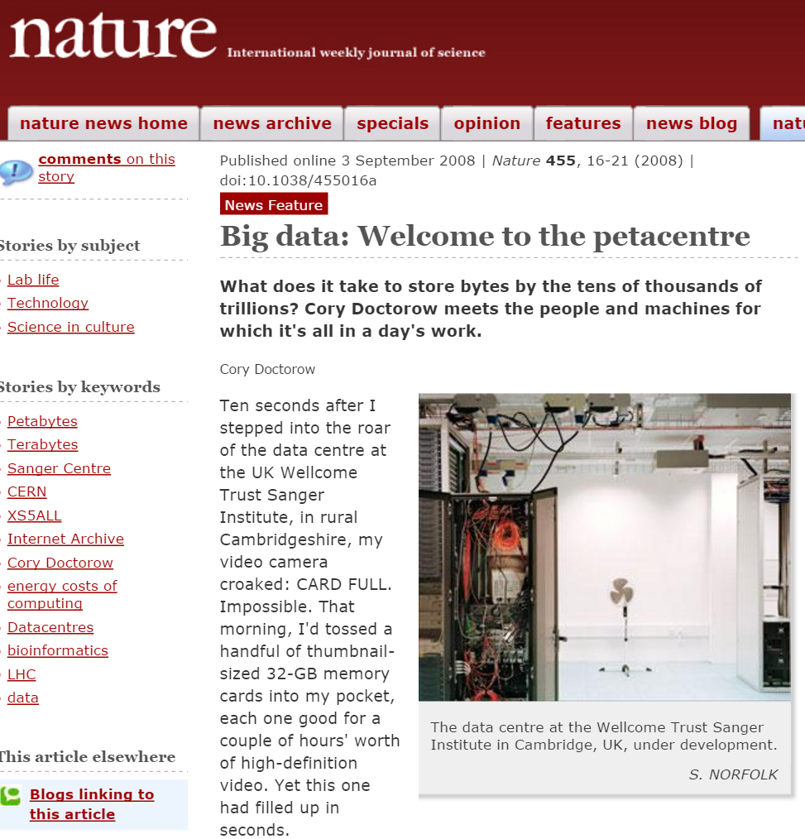

Slide 5
Visualizations for these Analyses
Word/Phrase Frequencies
Collocations (Phrases)
Clustering

Slide 6
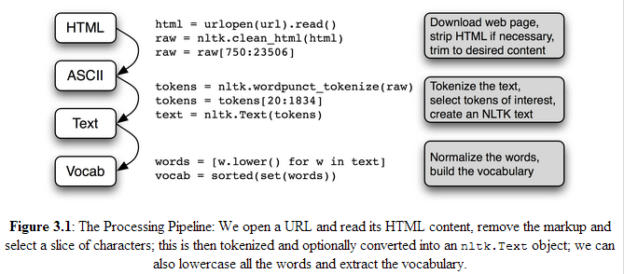
Natural Language Processing

Slide 7
Software that helps Process Text
Excel (manual process)
Commercial Products (student options)
SPSS Modeler Text Analytics
SAS Enterprise Miner
Alteryx (GUI for R)
Open Source Coding Languages
Python
R
Weka (GUI/Coding)

Slide 8
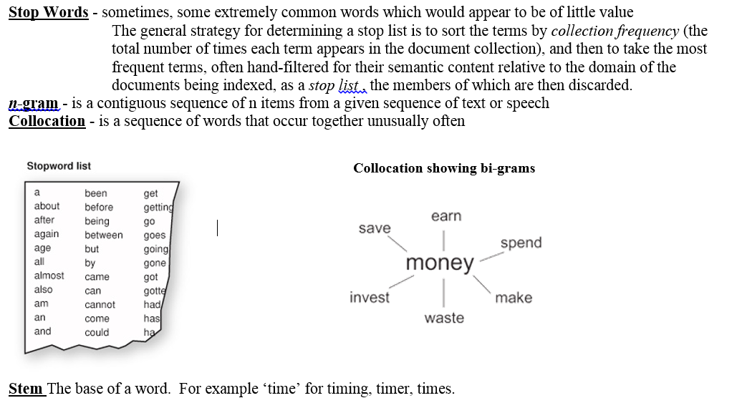
Natural Language Processing

Slide 9
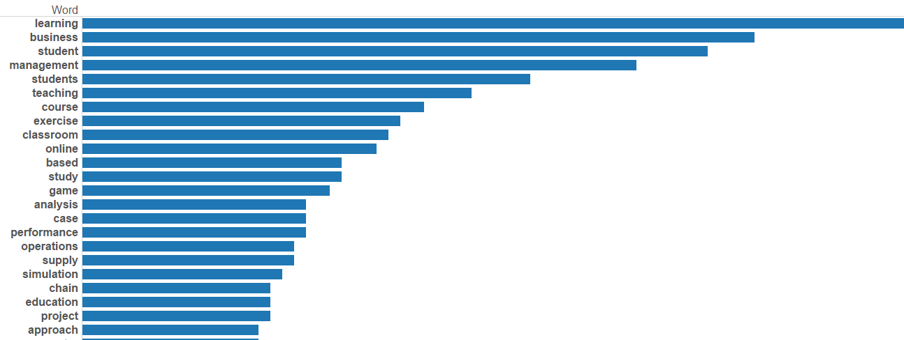
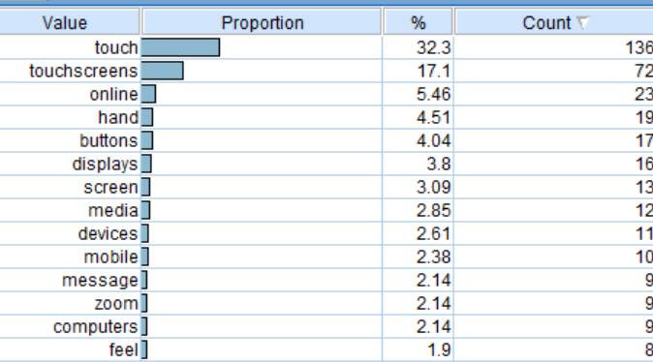
Word Frequencies
Tableau
R
SPSS Modeler

Slide 10
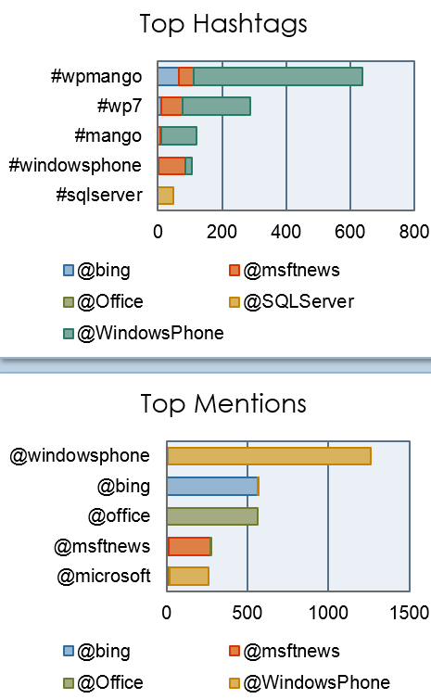
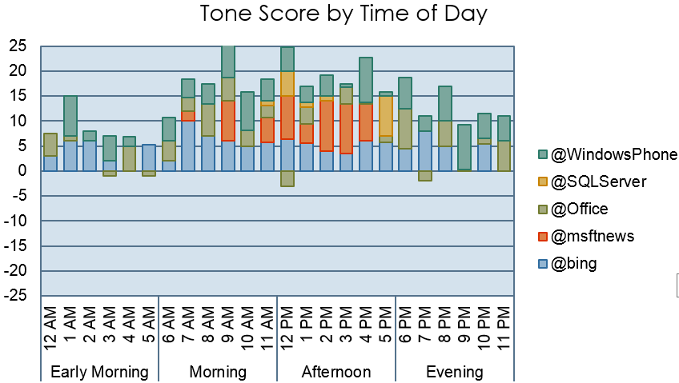
Tweets
Excel PowerPivot I(http://tinyurl.com/AnalyticsforTwitter)

Slide 11
Word Cloud
R

Slide 12
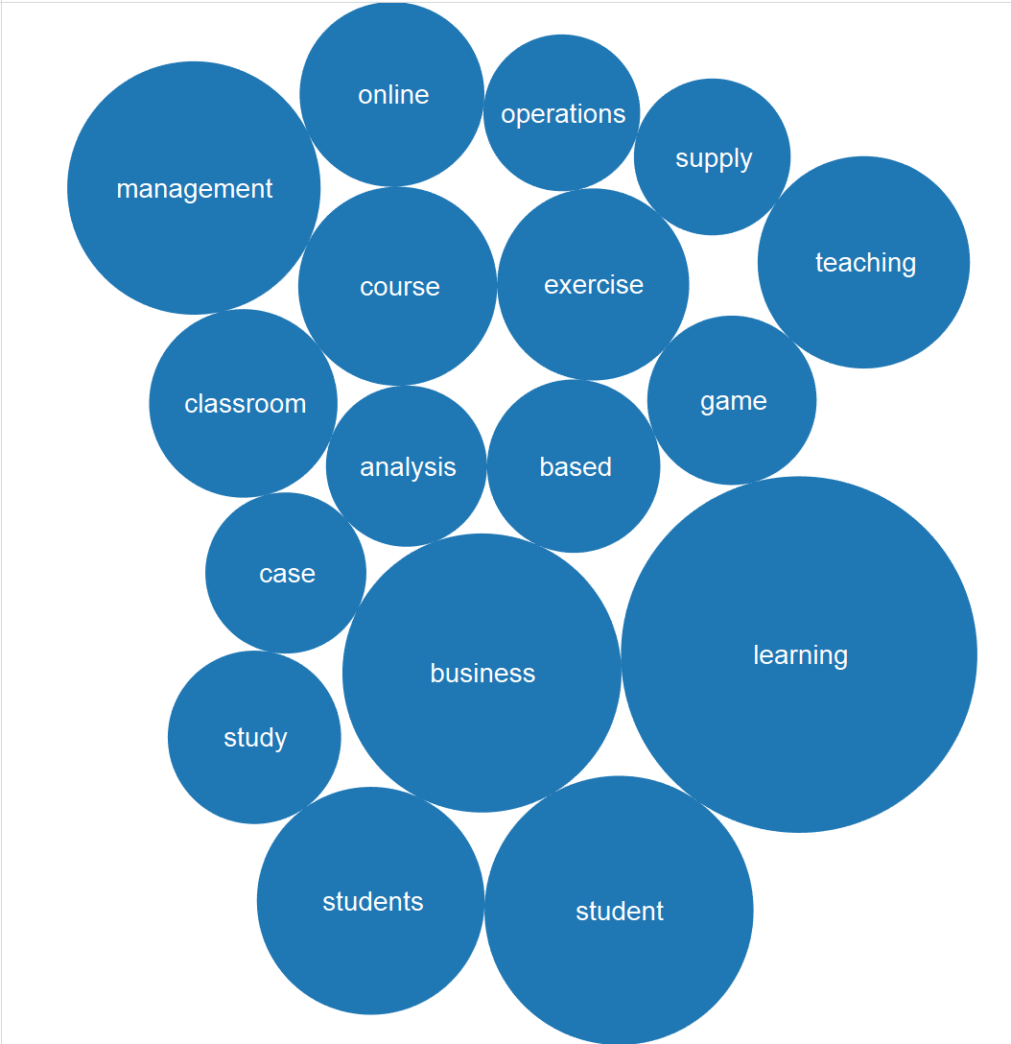
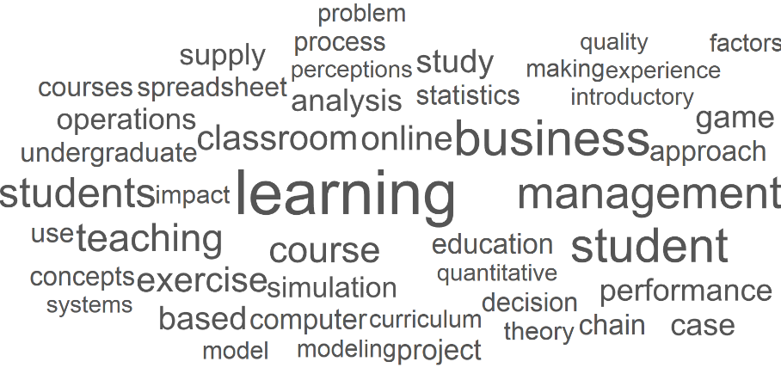
Filter (Freq > 8)
Tableau
R

Slide 13
Heat Map
Tableau

Slide 14
Heat Map (Filter Freq > 8)
Tableau

Slide 15
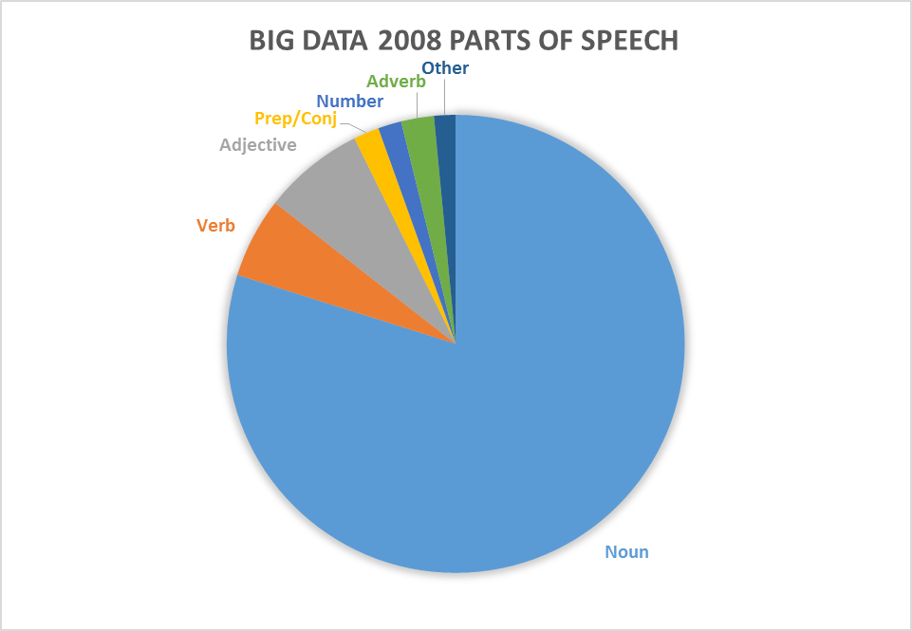
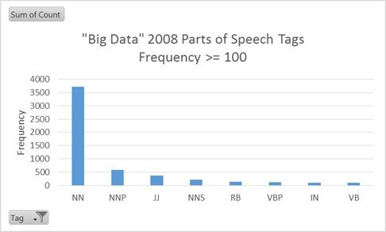
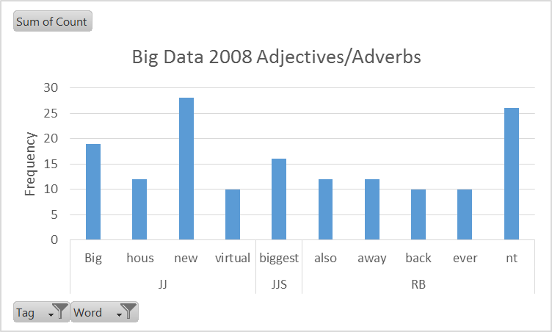
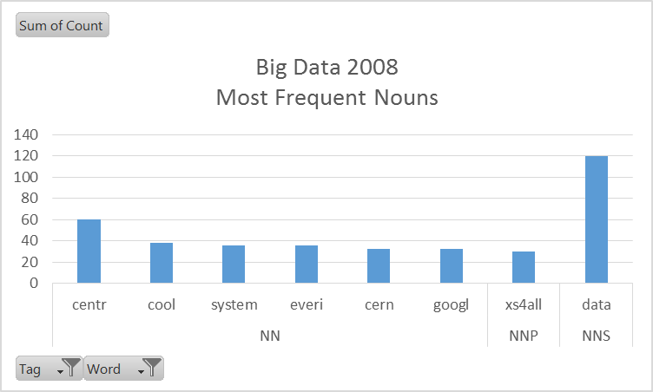
Parts of Speech
Excel Pivot Tables/Pie
NN: Noun, singular, NNP: Proper Noun, NNS: Noun, plural, JJ: Adjective, RB: Adverb
Notes:
Parts of Speech:
CC Coordinating conjunction 2. CD Cardinal number 3. DT Determiner 4. EX Existential there 5. FW Foreign word 6. IN Preposition or subordinating conjunction 7. JJ Adjective 8. JJR Adjective, comparative 9. JJS Adjective, superlative 10. LS List item marker 11. MD Modal 12. NN Noun, singular or mass 13. NNS Noun, plural 14. NNP Proper noun, singular 15. NNPS Proper noun, plural 16. PDT Predeterminer 17. POS Possessive ending 18. PRP Personal pronoun 19. PRP$ Possessive pronoun 20. RB Adverb 21. RBR Adverb, comparative 22. RBS Adverb, superlative 23. RP Particle 24. SYM Symbol 25. TO to 26. UH Interjection 27. VB Verb, base form 28. VBD Verb, past tense 29. VBG Verb, gerund or present participle 30. VBN Verb, past participle 31. VBP Verb, non-3rd person singular present 32. VBZ Verb, 3rd person singular present 33. WDT Wh-determiner 34. WP Wh-pronoun 35. WP$ Possessive wh-pronoun 36. WRB Wh-adverb

Slide 16
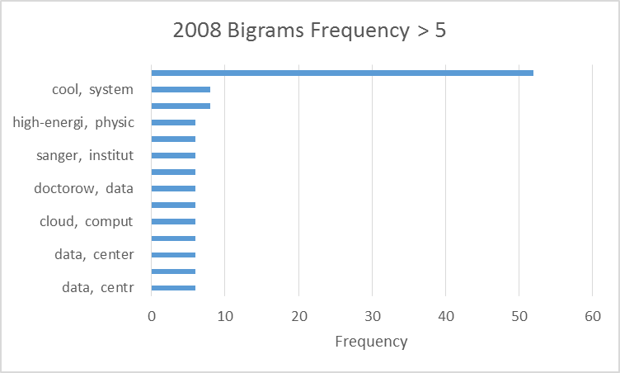
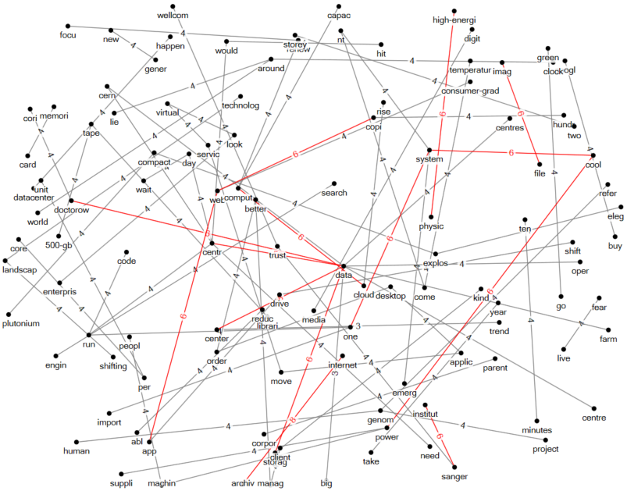
Collocations: Bigrams
2008 Bigrams occur more than twice
Excel
Node XL

Slide 17
Term by Document Matrix
Documents

Slide 18
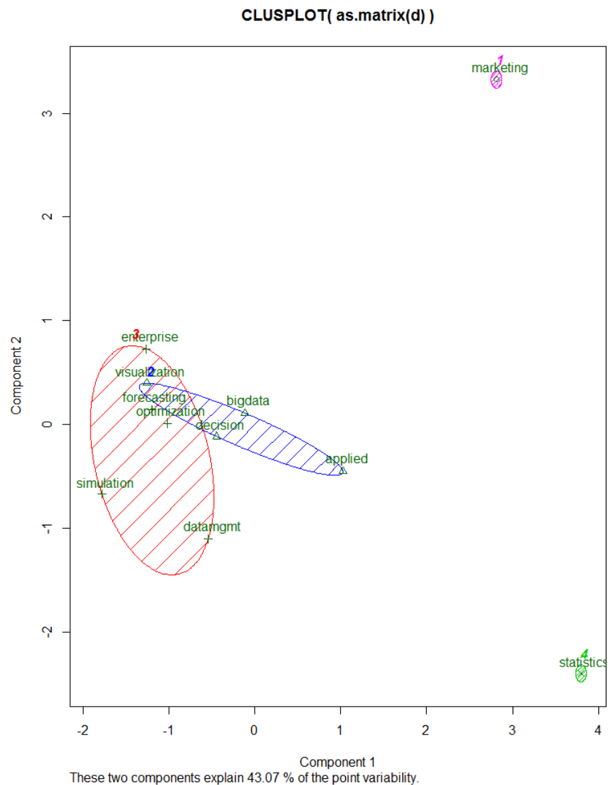
Clustering (k Means)
R

Slide 19
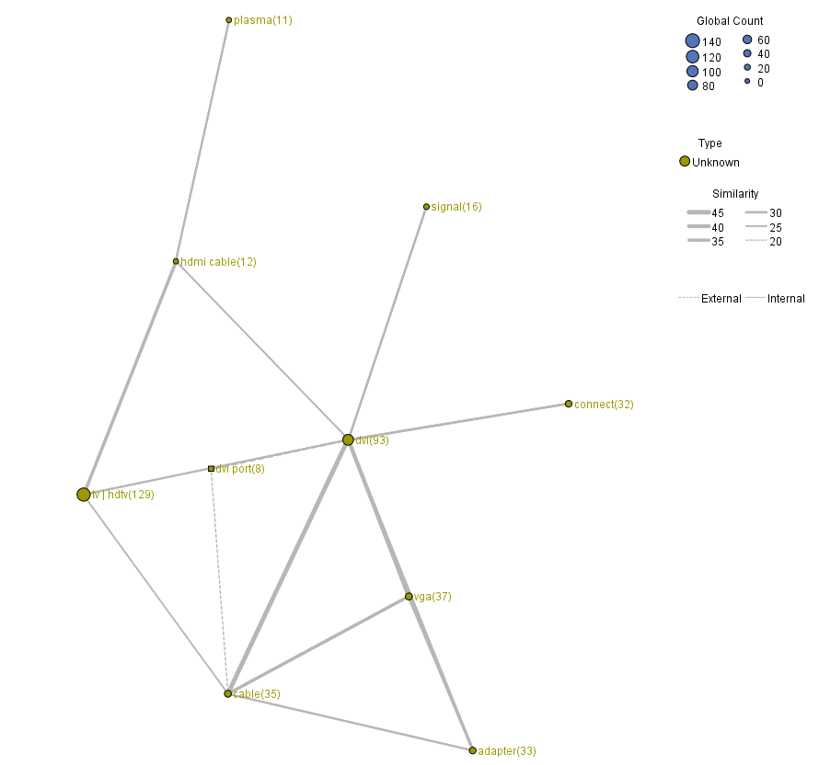
Clustering (SPSS Modeler) (Shows 1 cluster and dotted lines to external – dvi port)

Slide 20
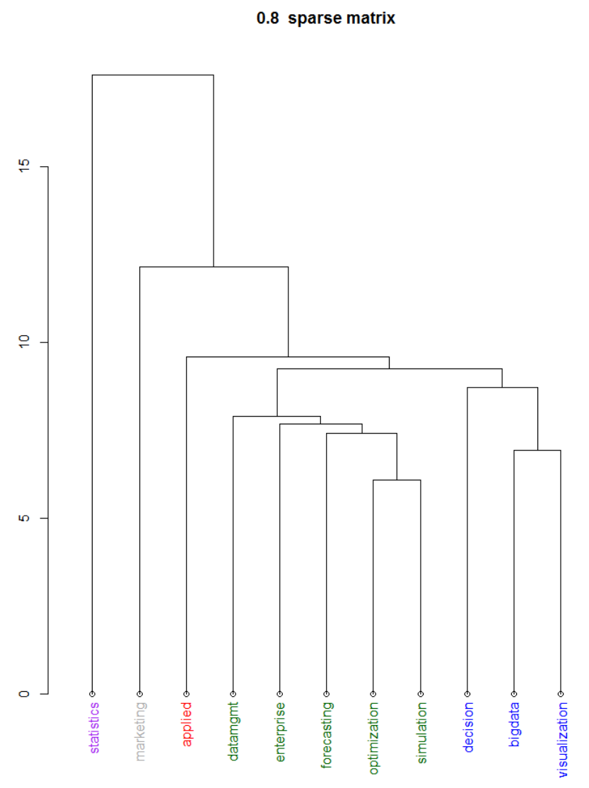
Clustering (Hierarchical)
R

Slide 21
Conclusions
Textual Data contains a large amount of information.
As you do your analysis, think of ways to use graphs/visualizations to help your reader easily absorb your textual data.
Consider filtering for higher frequencies
Make sure to 'clean' the data (remove stopwords) to focus on the important words/terms and combine similar terms: Statistic & Statistics
Thank You! Kellie.Keeling@du.edu

