Slide 1
Introducing Big Data in Stat 101 with Small Changes
John D. McKenzie, Jr.
Babson College
Babson Park, MA 02457-0310
mckenzie@babson.edu
DSI
Baltimore, MD
2013 November 18

Slide 2
Abstract
Today’s technology produces massive amounts of data from a variety of sources such as social networking activities, financial transactions, genetic sequences, and astronomical transmissions. Very few introductory applied statistics courses consider such ‘Big Data’, for which many standard descriptive and inferential methods fail. This presentation will consider a number of ways that students can be easily exposed to the three V’s of 'Big Data' (Volume, Velocity, and Variety) in such courses.

Slide 3
Agenda
Big Data and its Three⁺ V’s
Standard Introductory Applied Course
Big Data Sets
Volume
Velocity
Varieties

Slide 4
2012 Mathematics Awareness Month http://www.maa.org/mathematics-awareness-month-2012

Slide 5
Big Data in the News
OSTP’s Big Data Initiative (US$200,000,000)
(nsf.gov – search on Big Data)
McKinsey Global Institute Report (a shortage of 140,000 to 190,000 people with deep analytical skills as well as 1.5 million managers and analysts with the know-how to use the analysis of big data to make effective decisions)
Big Data Special Issue of Significance Magazine (August 2012)
NSA Disclosures,…

Slide 6
Bits and Bytes
Prefixes for multiples of bits (b) or bytes (B)
Decimal
Value | Metric
1000 | k | kilo
1000² | M | mega
1000³ | G | giga
1000⁴ | T | tera
1000⁵ | P | peta
1000⁶ | E | exa
1000⁷ | Z | zetta
1000⁸ | Y | yotta
Binary
Value | JEDEC |  | IEC
1024 | K | kilo | Ki | kibi
1024² | M | mega | Mi | mebi
1024³ | G | giga | Gi | gibi
1024⁴ |  |  | Ti | tebi
1024⁵ |  |  | Pi | pebi
1024⁶ |  |  | Ei | exbi
1024⁷ |  |  | Zi | zebi
1024⁸ |  |  | Yi | yo

Slide 7
The Three V’s of Big Data
Volume
Velocity
Variety
META Group (now Gartner) analyst, Doug Laney

Slide 8
Introductory Applied Course
Terminology and Sampling Methods
Descriptive Statistics (graphs and numeric measures)
Basic Probability
Fundamental Inference
Advanced Topics
Only one course (De Veaux)

Slide 9
Volume
Massive Data Sets
Practice Significance
Visualization

Slide 10
Big Data Sets
http://www.kdnuggets.com/datasets/
Over 60 Data Repositories
and
growing
Data Mining Competitions
KDD Cup Results Summary

Slide 11
Practical Significance
p-value > .05 from one-sample z-test and
versus
p-value = .000 from one-sample z-test with same sample mean and standard deviation but a 1000 times the sample size
Doane and Steward (2009), Applied Statistics in Business & Economics
pp. 364, 371, 374, 404, and 594 reinforcement

Slide 12
Practical Significance 2
Chi-Square Test of Independence
with p-value of .255 to
a p-value of .000 for
100 | 60
90 | 70
1000 | 600
900 | 700

Slide 13
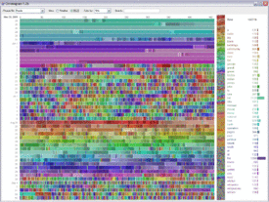
Data Visualization
A visualization created by IBM of Wikipedia edits. At multiple terabytes in size, the text and images of Wikipedia are a classic example of big data

Slide 14
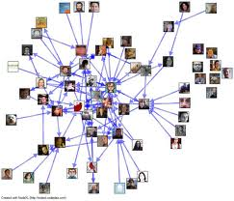
Data Visualization
Twitter Mentions

Slide 15
Velocity
Time Series Data
Process Data

Slide 16
Variety (structure)
Two Sample Data
Missing Data
Messy Data
Text Data
Date and Time Data

Slide 17
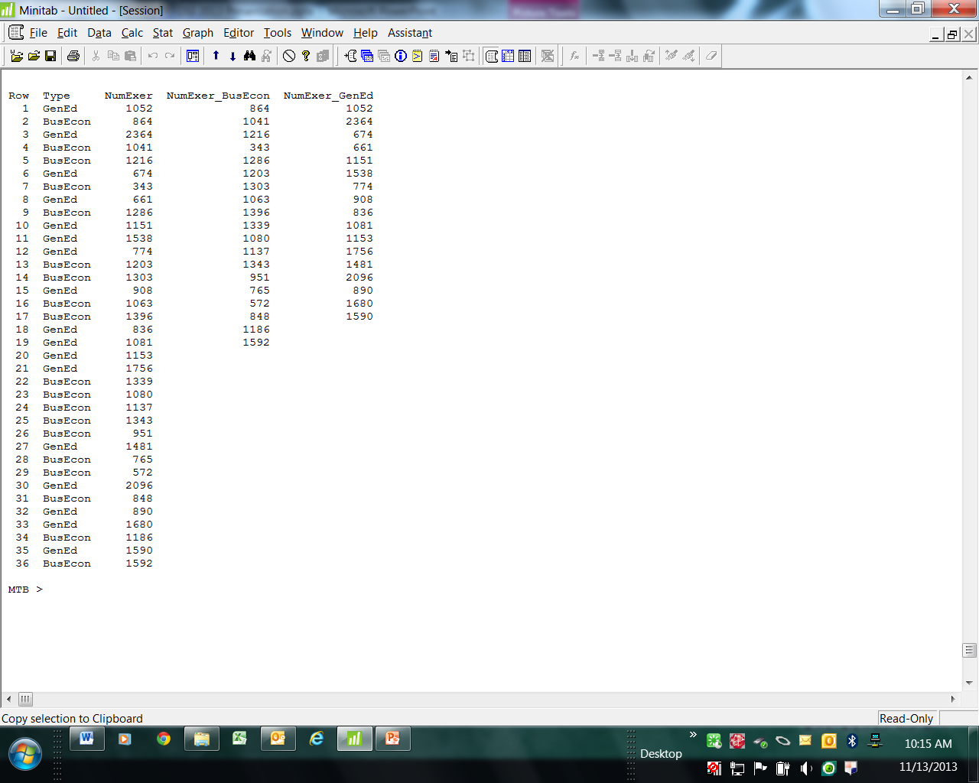
Variety: Two Sample Data

Slide 18
Text Data: Word Cloud

Slide 19
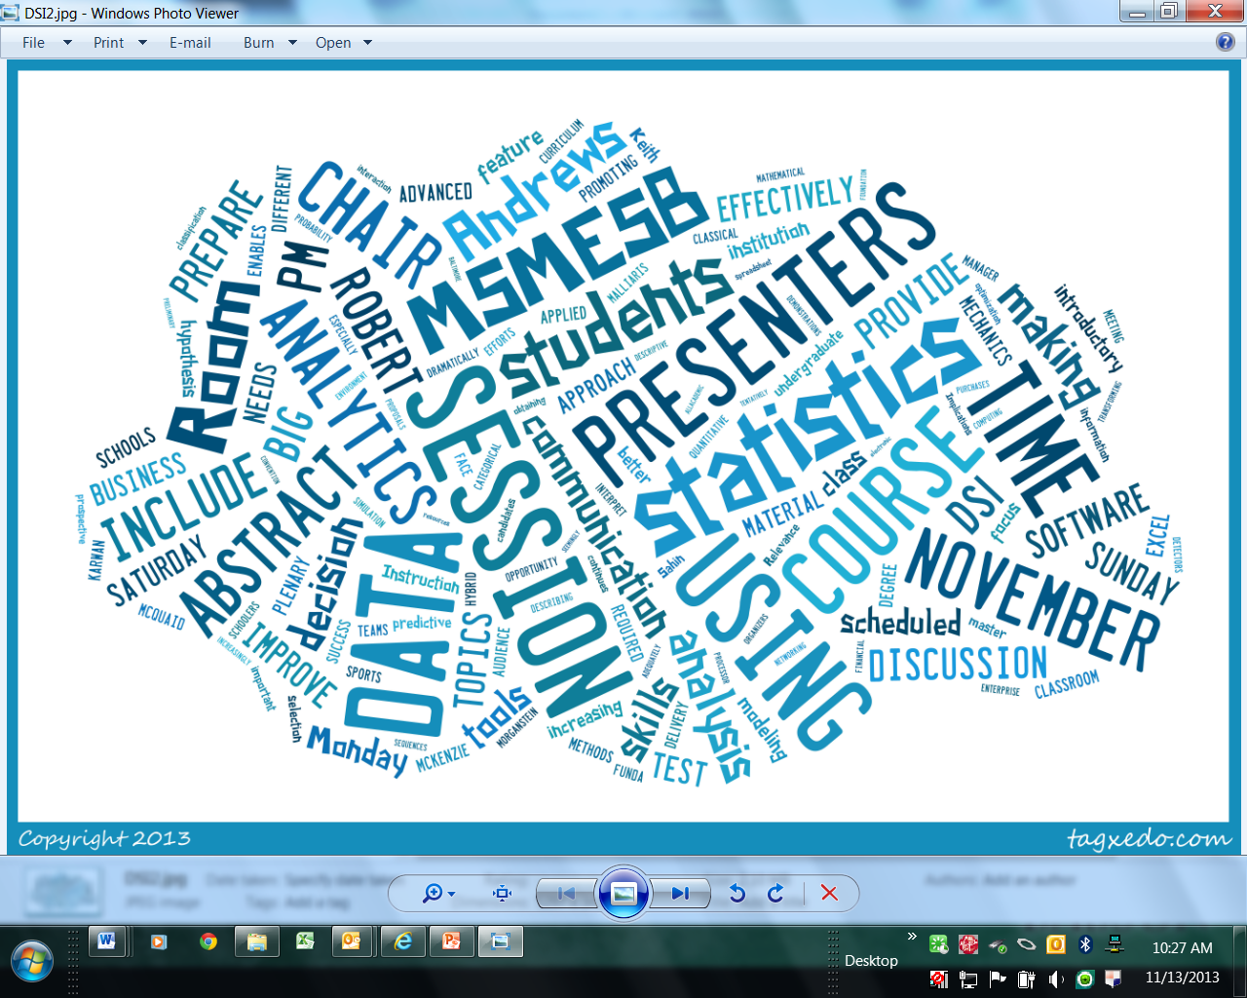
Text Data: Word Cloud

Slide 20
DSI Constitution and By-Laws

Slide 21
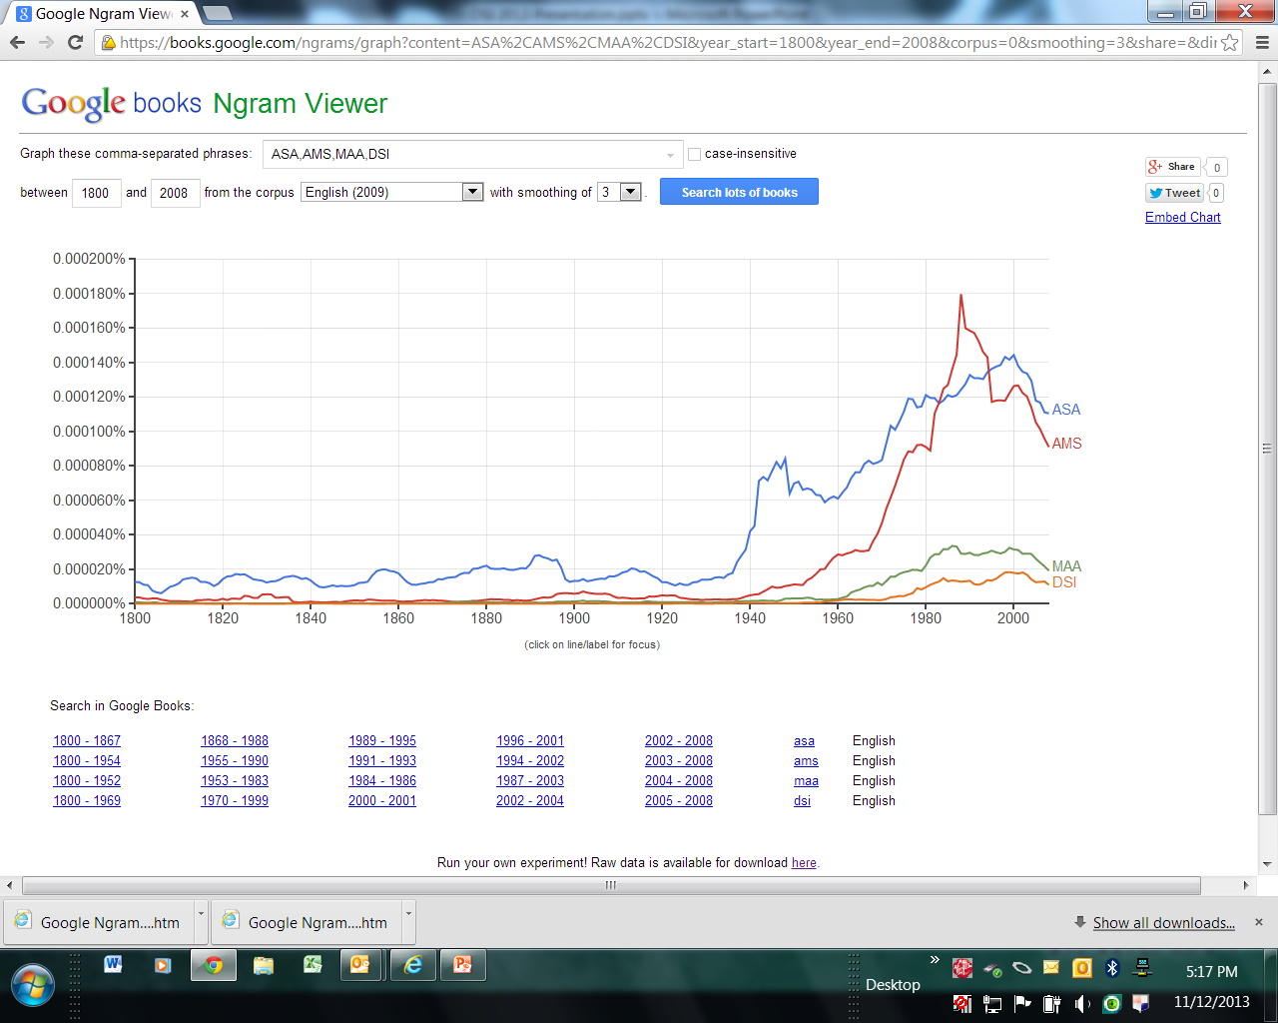
Text Data: N-Gram

Slide 22
Big Data, Business Analytics, Predictive Analytics , …, Data Science

Slide 23
Variety (sources)

Slide 24
Future Introductory Course
Math Common Core State Standards
will result in
Remedial Sections?
Today’s Course with More Topics?
Today’s Second Core?
Big Data Analytics Course?
or ?

Slide 25
Two Current Examples of Analytics
Sharpe, De Veaux, and Velleman (2012), Business Statistics, Second Edition, Chapter 25, Introduction to Data Mining (Paralyzed Veterans of America)
Berenson, Levine, and Krehbiel (2012), Basic Business Statistics, Twelfth Edition, Online Topic: Analytics and Data Mining
2015?

