Slide 1
Data Mining for Decision Making
DSI Annual Meeting
Baltimore
November 16, 2013
Mary Malliaris
Loyola University Chicago

Slide 2
What is Data Mining?
Searching for meaningful patterns in large data sets OR identifying valid, novel, and potentially useful patterns in large and complex data collections.
Notes:
Essential in definitions is:
... non-trivial extraction ...
... previously unknown or novel ...
... potentially useful information ...
... understandable and interesting ...
... large amounts of data ...
... prediction and modelling ...

Slide 3
What Type of Problems? [We will get to decisions later]
What occurs at the same time?
What similar groups occur in the data?
What determines the value of a target variable?
Can we predict?

Slide 4
Data Mining vs Statistics, Origin
 | Statistics Originally | Data Mining
 | Data gathered by hand | Data gathered by computer
 | Data hard to get | Data easy to get
 | Not much data available | Lots of data
 | Starting with no data, how much do I need to get | Starting with lots of data, what is best to use
 | Method: generalize from sample to population | Method: run on very large data sets and see if results continue to be true
 | Calculated by hand | Always done by machine

Slide 5
Data Mining vs. Statistics, Cont.
Statistics | Data Mining
Hypothesis | No Hypothesis
Distribution Assumed | No Distribution
Random Sample | Use All the Good Data
Conduct a Test | Use a Technique
Reject Null or Not | Results Interesting?
Meaning determined by hypothesis | Meaning determined by results [and application]
Test done ONE time | Model may be run many times

Slide 6
Two Styles of Data Mining (Each uses different techniques)
Directed data mining [also called supervised]
Has a Target variable
Training data has answers included so model can check against them
Undirected data mining [unsupervised]
No Target variable
Finds common occurrences in the data and leaves it up to the user to interpret

Slide 7
ASSOCIATION ANALYSIS
also called:
MARKET BASKET ANALYSIS
(What Happens Together?)

Slide 8
Introduction
These techniques were developed to analyze consumer shopping patterns
Want to find grouping of items that typically occur together
Output generates rules and is easy to understand
Decisions: which rules are useful, and how do we use them?
Notes:
Results are directly actionable, as decisions can be made about cross-marketing or new promotions by examining the associations
Could also be used to find common medical procedures of patients, or banking or telecom services used by customers, etc.

Slide 9
Terms
Rule [an if-then statement]
Antecedent [the “if” part]
Consequent [the “then” part]
Support is the percent of time the IF part is true
Confidence is the percent of time the THEN part is true when we already know the IF part is true

Slide 10
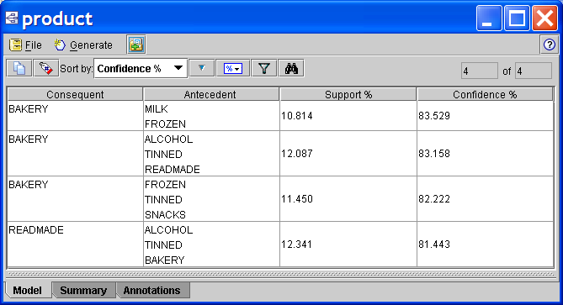
Table of Rules

Slide 11
Data Issues
The matrix of data can be very large, with millions of rows and tens of thousands of columns, and is generally very sparse, since a typical basket contains only a few possible items in a store.
The search problem is formidable given the exponential number of possible association rules.
Therefore, a retailer usually groups products into larger categories.

Slide 12
Suppose a rule tells us that soy sauce is often purchased when rice is, what decision might we make?

Slide 13
Soy sauce is often purchased when rice is; what decision might we make?
Put them closer together in the store.
Put them far apart in the store.
Package soy sauce with rice.
Package soy sauce + rice + poorly selling item.
Raise the price on one, and lower it on the other.
Offer soy sauce for proofs of purchase of rice.
Do not advertise soy sauce and rice together.
Introduce a new brand of soy sauce with the most popular selling rice.

Slide 14
Cluster Analysis

Slide 15
Clustering
In clustering, the groups you generate (called clusters) are not predefined
Instead, grouping is accomplished by finding similarities between data according to characteristics found in the actual data
Thus, clustering models focus on identifying groups of similar records.
Then the data miner finds words to describe the clusters

Slide 16
Clustering Problems
Interpreting the semantic meaning of each cluster may be difficult
There is no one correct answer to a clustering problem
There is no external standard by which to judge the model’s performance. Their value is determined by their ability to capture interesting groupings in the data.
Domain knowledge will play a role in deciding among alternative solutions

Slide 17
Prizm Clusters
PRIZM NE Social Groups
www.claritas.com/MyBestSegments/Default.jsp
You Are Where You Live
Scroll down to Zip Code lookup and explore the clusters of your zip code

Slide 18
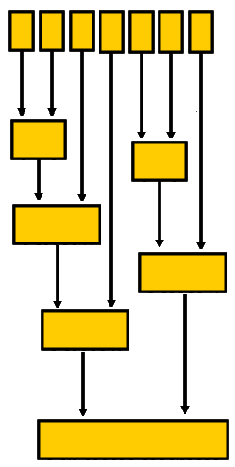
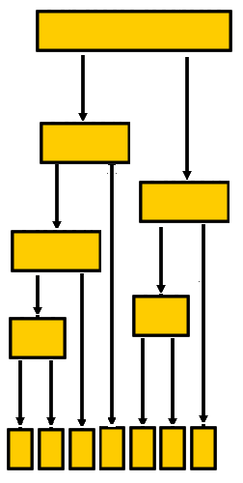
Hierarchical Clustering
Agglomerative
Divisive

Slide 19
Partitive Clustering
Initial State
Final State
X
X
X
X
X
X
X
X
X
X
X
X
reference vectors (seeds)
observations

Slide 20
Decisions Based on Clusters
Marketing: Use clusters to develop targeted marketing programs
Land use: Use clusters to identify areas of similar land use in an earth observation database
Insurance: Use clusters to identify groups of policy holders with a similar claim behavior
City-planning: Use clusters to find groups of houses with similar type and value
Finance: Identify groups with same financial structure

Slide 21
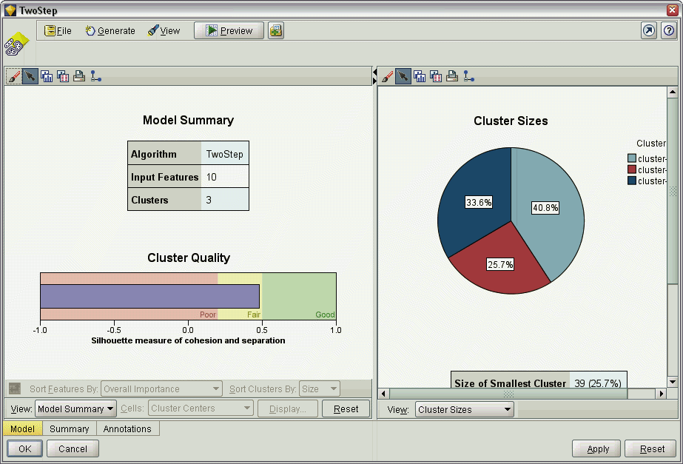
The Cluster Viewer

Slide 22
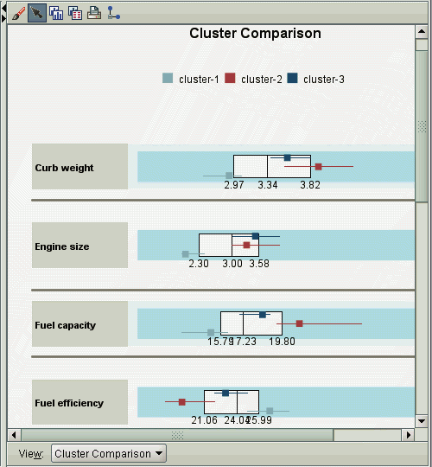
Cluster Comparison View

Slide 23
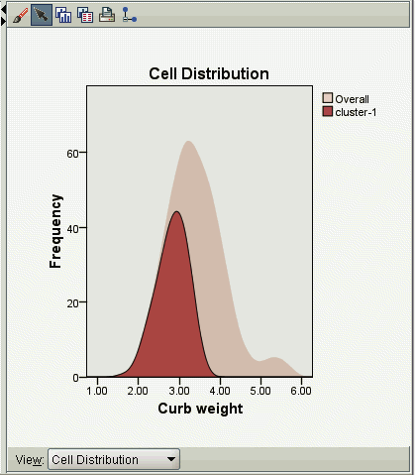
Cell Distribution View
Notes:
Distribution of the data for any feature cell you select in the table in the clusters main panel

Slide 24
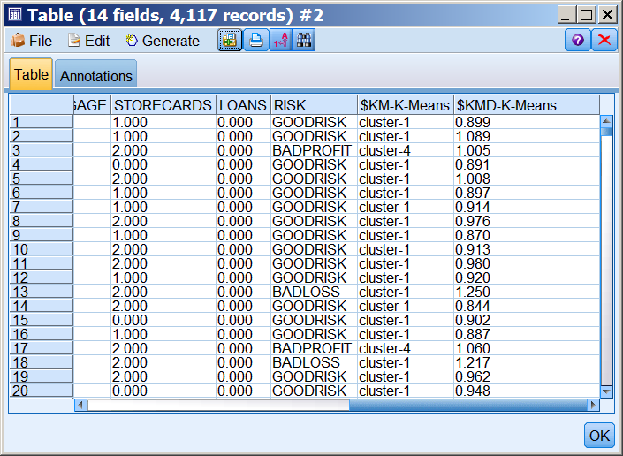
CLUSTER MEMBERSHIP AND DISTANCE FROM CLUSTER CENTER

Slide 25
Decision Trees

Slide 26
Decision Tree Models
A Decision Tree has one variable that is the Target variable
Decision trees divide up a large collection of records into successively smaller sets of records by applying a sequence of simple decision rules
A good decision tree model consists of a set of rules that results in homogeneous groups

Slide 27
Begin
Profile who bought a new car
10 No
3 Yes
Income <= 50K
Income > 50K
4 No
1 Yes
6 No
2 Yes
Gender = M
Gender = F
Age <= 35
Age > 35
2 No
2 No
1 Yes
1 No
1 Yes
5 No
1 Yes
Status = Married
Status = Single
HH Size <=4
HH Size >4
2 No
1 Yes
Gender= F
Gender= M
5 No
1 Yes
1 No
1 Yes

Slide 28
Advantages
Can handle a large number of predictor variables
Easy to understand
Maps nicely to a set of business rules
Identifies key relationships and thus give insight into the data set
Can process both numeric and category data

Slide 29
Method Comparison
 | TARGET | SPLITS
C5.0 | Category | Multiple
C&RT | Numeric or Category | Binary
QUEST | Category | Binary
CHAID | Numeric or Category | Multiple

Slide 30
Decision Tree Decisions
What type of car do I use in an ad in a women’s magazine?
Run a decision tree with gender as the target and car description variables as inputs
What type of customer is most likely to buy my product?
Run a decision tree with purchase-Yes-No as the target and customer description variables as inputs
What are the characteristics of companies that fail?
Run a decision tree with Fail-Succeed as the target and company characteristics as inputs
What dessert will be ordered at the end of a restaurant meal?
Run a decision tree with dessert choice as the target and appetizer & entree variables as inputs

Slide 31
Neural Networks

Slide 32
Brainmaker
Visit this site for many examples of problems neural networks have been useful for.
http://www.calsci.com/Applications.html

Slide 33
Neural Networks
A neural network is a simplified model of the way the human brain processes information
It simulates a large number of interconnected simple processing units
The most popular kind of neural network is called a feed forward back propagation network

Slide 34
The Architecture: Nodes
Input Layer
The input layer receives information from the external environment. This layer does not perform any calculation; it just sends information to the next level.

Slide 35
The Architecture:Nodes
Input Layer
Output Layer
The output layer produces the final result. This node corresponds to the variable you are trying to predict.

Slide 36
The Architecture: Nodes
Input Layer
Hidden Layer
Output Layer
The hidden layer takes data from the input variables and adapts it more closely to the data.

Slide 37
The Architecture: Nodes & Connections
Each node in one layer is connected to each node in the next layer

Slide 38
The Architecture: Nodes, Connections, & Weights
w1
w2
w3
w19
w20
w21
Each connection has a weight attached. The weights are assigned randomly in the beginning.
w17
w16
w18

Slide 39
The Architecture: Nodes, Connections, & Weights
w1
F(sum inputs*weights)=node output
w2
w3
w19
F(sum inputs*weights)=output
w20
w21
Each node in the hidden & output layers applies a function to the sum of the weighted inputs.
w17
w16
w18

Slide 40
Assumptions
In order to use a neural network, we make some assumptions
There are inputs that affect the pattern
We know the inputs, we just don’t know exactly how they are related.
3. The examples of input/output we have contain the pattern we want the neural network to recognize.

Slide 41
How good is your model?
Compare training and validation set results
Compare validation set results to some standard benchmark such as
Random walk model
Regression model
Typical measures for numeric data:
MSE
MAD

Slide 42
Techniques So Far
Association Analysis
Cluster Analysis
Decision Trees
Neural Networks

Slide 43
AA
DT
CA
NN
Undirected
No Single Target

Slide 44
AA
DT
CA
NN
Directed
One Target Field

Slide 45
Easy to Understand Results
Clear Rules; Clear Decision
AA
DT
CA
NN

Slide 46
AA
DT
CA
NN
Gives Result but Reasoning Hidden
You Figure It Out

Slide 47
BizEd Article recently
“What corporations really want are graduates with…the ability to use data in a persuasive manner and make an immediate impact.”
One employer told us, “We want students who can take a complex data set, review it, identify patterns, use those patterns to develop new business practices, and communicate those practices in a convincing way to senior management.”

