Slide 1
Introducing Students to the Analysis of Text Data
Increase Relevance by Shifting Focus Away from Classical Statistical Mechanics & Hypothesis Testing
Making Statistics More Effective in Schools of Business Mini-Conference
Kellie B. Keeling
Business Information & Analytics, University of Denver
Notes:
Directions here:
Red Color Value: R=151, G=27, B=30

Slide 2
An Example of Text Analysis Twitter Data
Analyze the Tweets from Panera Bread and Compare Tweets from McDonalds and Burger King
I used this free tool to pull down tweets (uses Power Pivot):
Analytics for Twitter.xlsx
http://www.extendedresults.com/products/twitteranalytics/
First Portion: Use Pivot Tables to Summarize Tweets from Panera Bread
Second Portion: Discuss Text Analytic terms (stop words, valence/tone) and compare dashboards of McDonalds and Burger King Tweets

Slide 3
Panera Tweets Data
Date/Hour/Time of Day
Author
Title (Text)
Retweet
Tweeter
Tone Score/Tone
Hashtag

Slide 4
Panera Tweets Data
Had them create 4 Pivot Charts from the data
Discuss what Panera Bread can learn from their Tweets based on your charts.
Goal: See how you can turn “text” data into something quantitative that can be “analyzed.

Slide 5
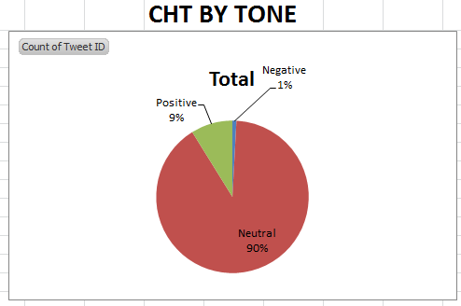

Slide 6
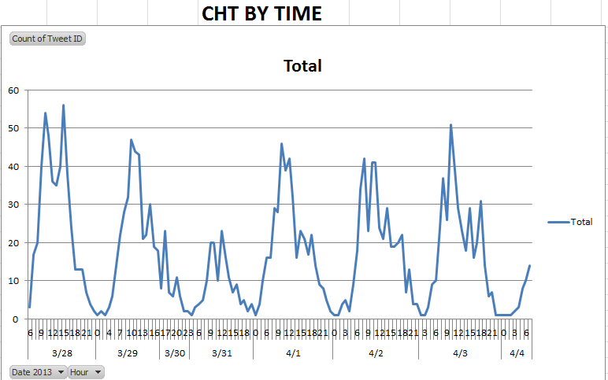

Slide 7
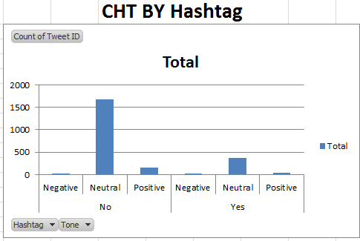

Slide 8
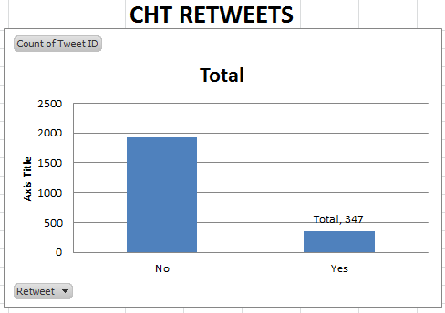

Slide 9
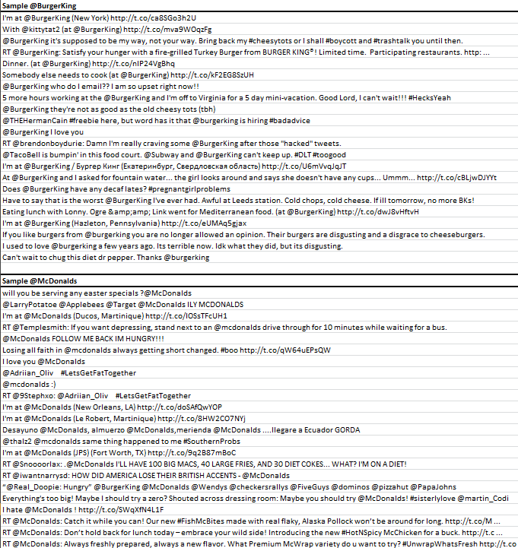
McDonalds Vs. Burger King Tweets
Goal: Discuss Text Analytic terms “stop words” and, “valence/tone” see ways this data can be displayed and interpreted.

Slide 10
Sample from Burger King!

Slide 11
Sample from McDonalds

Slide 12
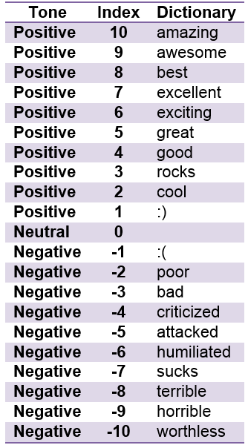
Tone Dictionary

Slide 13
Tone/Valence
For the page with the dashboard of charts, the Tone is noted as either “Neutral”, “Positive”, or “Negative.” To rate the tweets, the Tone Dictionary on the next page was used. Using the list of sample tweets, what other words do you think should be added?
POSITIVE NEGATIVE

Slide 14
Tone/Valence
What are some words that aren’t in these tweets that you think should be added to the Tone dictionary?
POSITIVE NEGATIVE

Slide 15
Stop Words
When a computer program or software tries to determine the meaning of a “tweet,” it uses a set of “stop words” that the computer skips over when interpreting the meaning. Fill in possible Stop Words:
STOP WORDS
a
an
the

Slide 16
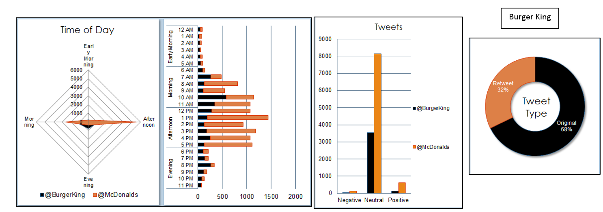
Dashboard of Tweets

Slide 17
Dashboard Summary
Which company has more tweets?
What time of day does each company have the most tweets?
What can you say about the tone of the tweets over the time period?
Comment on the number of retweets versus tweets by company.
Summarize what you have learned that you could tell an executive at Burger King or McDonalds.

Slide 18
Conclusion
I feel this is a great way to introduce the ideas of text analysis.
Worked very well as tool to introduce text analytics to middle school girls!
I plan to create a lesson similar to this for my “Statistics II” course (probability through simple regression) starting in January.

