Slide 1
What is AP Statistics?
Keith Ord
November 16, 2013

Slide 2
The AP Philosophy
The AP® Program unequivocally supports the principle that each individual school must develop its own curriculum for courses labeled “AP.”
The AP Course Audit provides each AP teacher with a set of expectations that college and secondary school faculty nationwide have established for college-level courses.
AP teachers are encouraged to develop or maintain their own curriculum that either includes or exceeds each of these expectations.

Slide 3
Cause and Effect?? [Source AP Website]
Multiple research studies have shown that AP students who earn credit and advanced placement for the corresponding introductory college course:
Perform well in subsequent courses within the same discipline
Take more, not fewer, courses in the discipline for which they’ve received AP credit
Tend to earn higher GPAs than non-AP students.
Are more likely to graduate from college in four or five years

Slide 4
What is AP Statistics?
The purpose of the course should be to introduce students to the major concepts and tools for collecting, analyzing and drawing conclusions from data.
Students enrolling in AP Statistics should have completed second-year algebra or its equivalent.
More Than 1 Million and Counting: The Growth of Advanced Placement Statistics
Robert Rodriguez, ASA President in AmStat News, September 2012

Slide 5
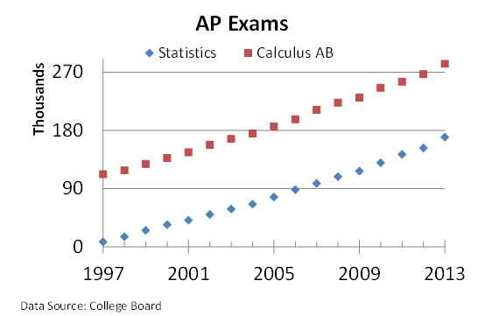
Growth of AP Programs
Student Numbers | Statistics | Calc AB | Calc BC | Comp Sci | Physics B | Physics C Mech
2012 | 152,750 | 266,994 | 94,403 | 26,103 | 80,584 | 38,630

Slide 6
AP Statistics: Topical Coverage
Exploring Data: Describing patterns and departures from patterns (20–30%)
Exploratory analysis of data makes use of graphical and numerical techniques to study patterns and departures from patterns.
Sampling and Experimentation: Planning and conducting a study (10–15%)
Data must be collected according to a well-developed plan. This plan includes clarifying the question and deciding upon a method of data collection and analysis
Anticipating Patterns: Exploring random phenomena using probability and simulation (20–30%)
Probability is the tool used for anticipating what the distribution of data should look like under a given model
Statistical Inference: Estimating population parameters and testing hypotheses (30–40%)
Statistical inference guides the selection of appropriate models.

Slide 7
The AP Examination
The AP Statistics Exam is 3 hours long and consists of two equally weighted components:
a 90-minute multiple-choice section testing proficiency in a wide variety of topics, and
a 90-minute free-response section requiring the student to answer open-ended questions and to complete an investigative task involving more extended reasoning
Students are provided with an extensive formula sheet and may use a “graphing calculator”. They are expected to use computers for data analysis during the course.

Slide 8
AP Score Qualification
5 Extremely well qualified
4 Well qualified
3 Qualified
2 Possibly qualified
1 No recommendation
AP Exam scores of 5 are equivalent to A grades in the corresponding college course.
AP Exam scores of 4 are equivalent to grades of A–, B+ and B in college.
AP Exam scores of 3 are equivalent to grades of B–, C+ and C in college.

Slide 9
Grade Distributions [Source: Wikipedia]
Grade | 5 | 4 | 3 | 2 | 1 | Mean Grade
Year
2001 | 11.5 | 23.4 | 24.9 | 19.1 | 21.1 | 2.85
2002 | 11.2 | 21.8 | 23.9 | 19.2 | 23.9 | 2.77
2003 | 13.2 | 22.3 | 26.4 | 19.5 | 18.6 | 2.92
2004 | 12.6 | 22.4 | 24.8 | 19.8 | 18.1 | 2.87
2005 | 12.6 | 22.8 | 25.3 | 19.2 | 20.1 | 2.88
2006 | 12.6 | 22.2 | 25.3 | 18.3 | 21.6 | 2.86
2007 | 11.9 | 21.5 | 25.4 | 17.1 | 24.1 | 2.80
2008 | 12.9 | 22.7 | 23.7 | 18.8 | 21.8 | 2.86
2009 | 12.3 | 22.3 | 24.2 | 19.1 | 22.2 | 2.83
2010 | 12.8 | 22.4 | 23.5 | 18.2 | 23.1 | 2.84
2011 | 12.1 | 21.3 | 25.1 | 17.7 | 23.8 | 2.80
2012 | 12.6 | 20.2 | 25.0 | 18.8 | 23.4 | 2.81
2013 | 12.2 | 20.9 | 25.7 | 18.1 | 23.1 | 2.80
Means | 12.3 | 22.0 | 24.9 | 18.7 | 21.9 | 2.84

Slide 10
Analysis of Top 30 Schools in Business Week Rankings [Guidelines refer to institutions, not necessarily their B-Schools; Source: data collected from AP website]

Slide 11
Questions for Discussion
Should we give credit for AP Statistics?
If so, what is the minimum grade that we should accept in order to give students credit for their AP Statistics?
How many semester-length credits should be awarded?
Are the College Board claims justified with respect to AP Statistics?
Perform well in subsequent courses within the same discipline
Take more, not fewer, courses in the discipline for which they’ve received AP credit
Tend to earn higher GPAs than non-AP students.
Are more likely to graduate from college in four or five years
Even if justified, can we identify ‘cause and effect’?

