Slide 1
Survey of Attitudes Toward Statistics American vs. Chinese Business Students
Ping Wang
wangpx at jmu.edu
Computer Information Systems/Business Analytics
College of Business, James Madison University, Harrisonburg, VA
SEDSI, February 22 – 24, Charleston, SC

Slide 2
Drivers for Learning Business Statistics
Interest
Career

Slide 3
Characteristics of Students
Google generation
Low attention span

Slide 4
Motivating Students to Learn Business Stats
Keep students interested, engaged
Affect
Value
Interest
Learning to teach problem solving
Cognitive competence
Difficulty
Effort
Pedagogical issues

Slide 5
Survey of Attitudes Toward Statistics (SATS) by Schau et al., 1995
Statistics anxiety relates to: negative experience, less appreciative of values and usefulness, less of confidence or competent, with negative feeling
Unfavorable attitudes often relate to poor achievements
Attitudes Components:
Affect: (6 items): positive and negative feelings about statistics. Such as, I enjoy taking statistics courses.
Cognitive Competence (6 items): intellectual knowledge and skills applied to statistics. Such as I understand statistics equations.
Value (9 items): usefulness, relevance, and worth of statistics in personal and professional life. Such as Statistics is irrelevant to my life.
Difficulty (7 items): perception of difficulty of statistics as a subject. Such as, Statistics is a complicated subject.
Interest (4 items): individual level of interest. Such as, I am interested in using statistics.
Effort (4 items): amount of work to learn statistics. Such as, I plan to work hard in my statistics course.
Atkinson 1957, Eccles and Wigfield 1995, Weiner 1979, Bandura 1977, Maehr 1984, Kamirez et al. 2012

Slide 6
 | Attitude toward Business Statistics --- USA vs. China
 |  | 41. Your sex: |  | Total
 |  | Male 1 | Female 2
 | USA | 129 | 99 | 228
 | China | 56 | 125 | 181
 |  | 185 | 224 | 409

Slide 7
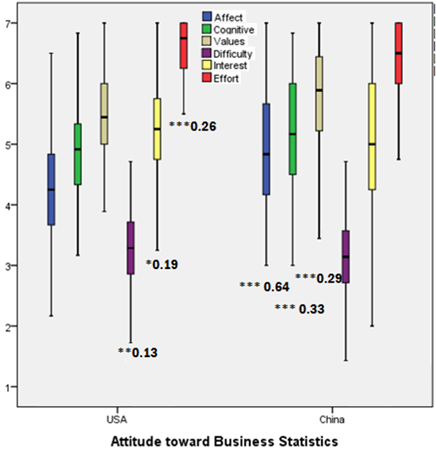
American vs. Chinese Students Group Comparison
Chinese students rated much higher on Affect, Cognitive Competence, and Value components
American students rated higher on Difficulty, Interest, and Effort components
Affect: American students rated just slightly over neutral while Chinese students rated moderately positive
Cognitive Competence & Interest: Both groups rated moderately positive
Value: Both groups rated very positive at around 5.5 to 6 out of 7
Difficulty: Both groups rated moderately negative
Effort: Both groups rated extremely positive
Remarks:
Group means are statistically significantly different at p – value of *** 0.01, ** 0.05, and * 0.10 levels
The number after * refers to the group difference, i.e., 0.64 of the 1 (strongly disagree) to 4 (neutral) to 7 (strongly agree) of Likert scale

Slide 8
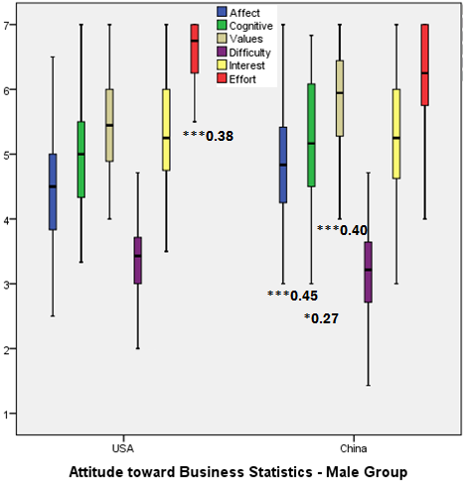
American vs. Chinese Male Business Students Group Comparison
Chinese male students rated much higher on Affect, Cognitive Competence, and Value components
American male students rated higher on Effort component
Both groups male students rated same levels on Difficulty and Effort components
Affect: Both groups male students rated moderately positive
Cognitive Competence & Interest: Both groups male students rated moderately positive
Value: American male students rated moderately positive while Chinese male students rated very positive
Difficulty: Both groups rated moderately negative
Effort: Both groups rated extremely positive
Remarks:
Group means are statistically significantly different at p – value of *** 0.01, ** 0.05, and * 0.10 levels
The number after * refers to the group difference, i.e., 0.64 of the 1 (strongly disagree) to 4 (neutral) to 7 (strongly agree) of Likert scale

Slide 9
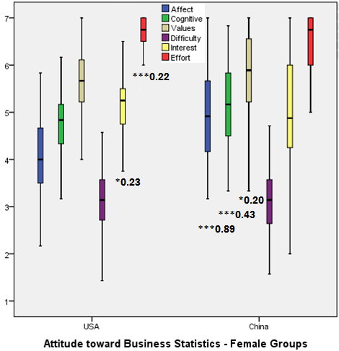
American vs. Chinese Female Business Students Group Comparison
Chinese female students rated much higher on Affect, Cognitive Competence, & Value components
American female students rated higher on Interest & Effort component
Both groups male students rated same level on Difficulty component
Affect: American female students rated neutral while Chinese female students rated moderately positive
Cognitive Competence & Interest: Both groups male students rated moderately positive
Value: Both groups female students rated very positive
Difficulty: Both groups rated moderately negative
Effort: Both groups rated extremely positive
Remarks:
Group means are statistically significantly different at p – value of *** 0.01, ** 0.05, and * 0.10 levels
The number after * refers to the group difference, i.e., 0.64 of the 1 (strongly disagree) to 4 (neutral) to 7 (strongly agree) of Likert scale

Slide 10
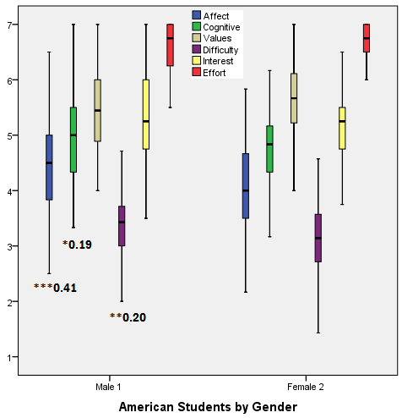
American Business Students by Gender Group Comparison
American male students rated much higher on Affect, Cognitive Competence, & Difficulty components
Both male and female groups rated same levels on Value, Interest, and Effort components
Affect: American male students rated moderately positive while American female students rated neutral
Cognitive Competence & Interest: Both groups rated moderately positive
Value: Both groups rated moderately to very positive
Difficulty: Both groups rated moderately negative
Effort: Both groups rated extremely positive
Remarks:
Group means are statistically significantly different at p – value of *** 0.01, ** 0.05, and * 0.10 levels
The number after * refers to the group difference, i.e., 0.64 of the 1 (strongly disagree) to 4 (neutral) to 7 (strongly agree) of Likert scale

Slide 11
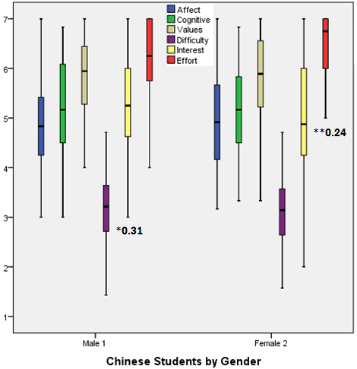
Chinese Business Students by Gender Group Comparison
Chinese male students rated much higher on Interest component while female students rated much higher on Effort component
Both male and female groups rated same levels on Affect, Cognitive Competence, Value, and Difficulty components
Affect, Cognitive Competence & Interest: Both male and female students rated moderately positive
Value: Both groups rated very positive
Difficulty: Both groups rated moderately negative
Effort: Chinese male students rated moderately positive while female students rated extremely positive
Remarks:
Group means are statistically significantly different at p – value of *** 0.01, ** 0.05, and * 0.10 levels
The number after * refers to the group difference, i.e., 0.64 of the 1 (strongly disagree) to 4 (neutral) to 7 (strongly agree) of Likert scale

