Slide 1
Be a WHIZ IN BIZ and Viz
Michelle Sisto
Associate Dean, Graduate Studies
EDHEC Business School
DASI section of Decision Sciences Institute
Washington, DC
November 18-20, 2017

Slide 2
"I’ve come to realize the power a great story holds in a modern business setting. We are bombarded each waking moment with data from varying sources and scope, but it’s only those data points, accompanied by a great story, which take hold. With the help of Tableau, and expert advice from Yvan Fornes, my team and I worked to embody this concept of data storytelling into our visualization." —Winston Green

Slide 3
Why Bring visualization to the Graduate classroom?
FUN – get the inquiry bite!
Employer demand
marketing, retail, healthcare, asset management, travel, IoT, education, …
Bentley Study – demand for Tableau in job listings up 1581% from 2011 to 2015
Empowering! Anyone can do it – only limit is ability to ask good questions
Notes:
Fun – get the inquiry bite! Interactive
Employer demand! - marketing, retail, healthcare, asset management, travel, IoT, education, … (Bentley Study – demand for Tableau in job listings up 1581% from 2011 to 2015)
Necessary skill as an effective manager in current business environment – data savvy and ask good questions
Shift of tools from IT to end users and self service
Leader: decide strategically which problems to examine through data
Dig deeper into data and move to interactive graphs and stories
change quite so quickly, but can shift every few years. Bentley University commissioned a study to find which business skills are growing in demand. By looking at millions of job listings posted on more than 40,000 online job sites, jobs analytics firm Burning Glass determined which skills saw the biggest increases in demand when comparing 2011 to 2015.
In this post we’re revealing the top ten technical skills. They’re ranked by how often they appeared in job descriptions. The categories in parenthesis show the type of job where the increases took place.
Shutterstock
Technical Skills With The Biggest Increases In Demand:
1. Big Data (Information Technology): 3,977%
2. Node.js (Design): 2,493%
3. Tableau (Research and Analysis): 1,581%
4. NoSQL (Information Technology): 1,002%
5. Apache Hadoop (Information Technology): 704%
6. HTML5 (Information Technology): 612%
7. Python (Research and Analysis): 456%
8. Oracle (Sales): 382%
9. JSON (Information Technology): 318%
10. Salesforce CRM (Sales): 292%

Slide 4
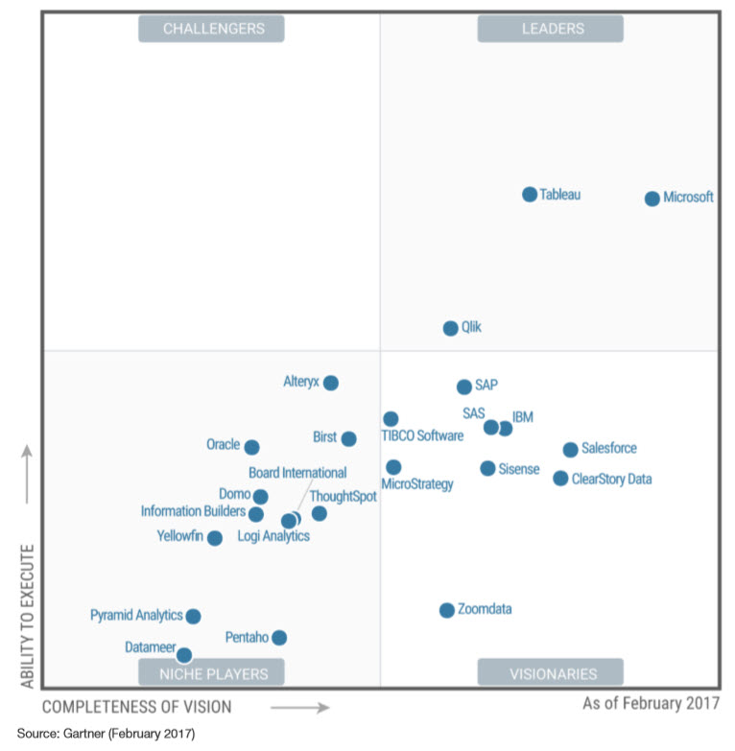
How to introduce visualization?
Choices:
Tools?
Pedagogy?
Context?

Slide 5
How to introduce visualization?
Peer review
Team work
Online tutorials
Aropa – free online tool for peer review
Build two viz versions: pre course and post course
Free resources
Choices:
Tools?
Pedagogy?
Context?

Slide 6
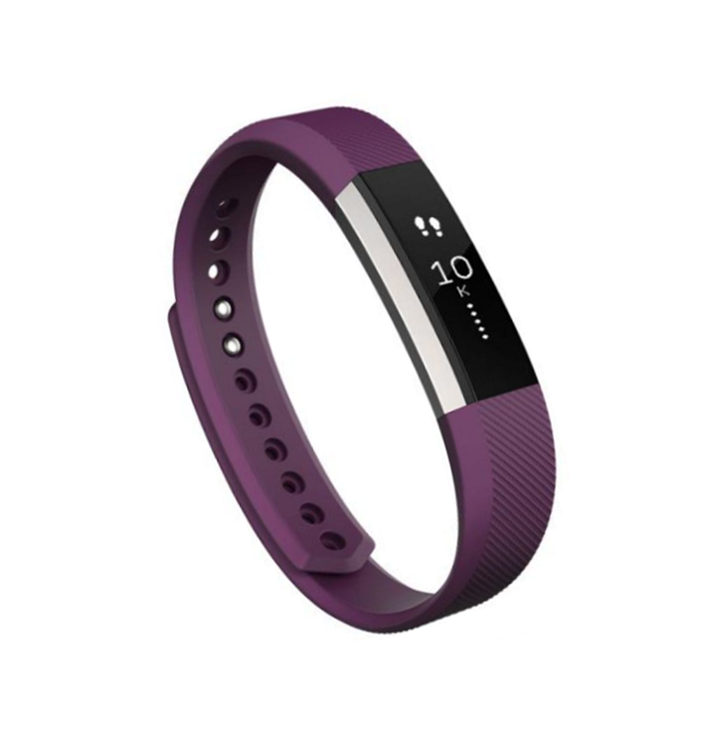
How to introduce visualization?
Airline industry – from eurostat – over 1 million rows
Row: month of traffic between two airports
Other sources:
Choices:
Tools?
Pedagogy?
Context?

Slide 7
assignment
Form a group of 2 or 3 classmates
Choose a business question
Give context
Build a dashboard – at least 3 elements and 2 levels
Publish dashboard on Tableau Public
Participate in class
Revamp your visualization based on best practice
Peer review the dashboards of two other groups and then evaluate the reviews you received
Notes:
Form a group of 2 or 3 classmates.
Get data
Choose a business question Give context: For which type of company you need to answer this question? in which market ? in which time frame ? ….
Build a dashboard to answer your question, it must include at least 3 elements (graphs, maps ….) with Tableau.
Publish your dashboard on Tableau Public
Participate in class
Revamp your visualization based on class
Peer review the dashboards of two other groups and then evaluate the reviews you received

Slide 8
BEST Practices
Start with intent
Keep simple but not boring
Unity, variety, hierarchy
2 colors, 2 fonts, overview to detail
Choose chart type
See Andrew Abela
Guardian visualizations

Slide 9
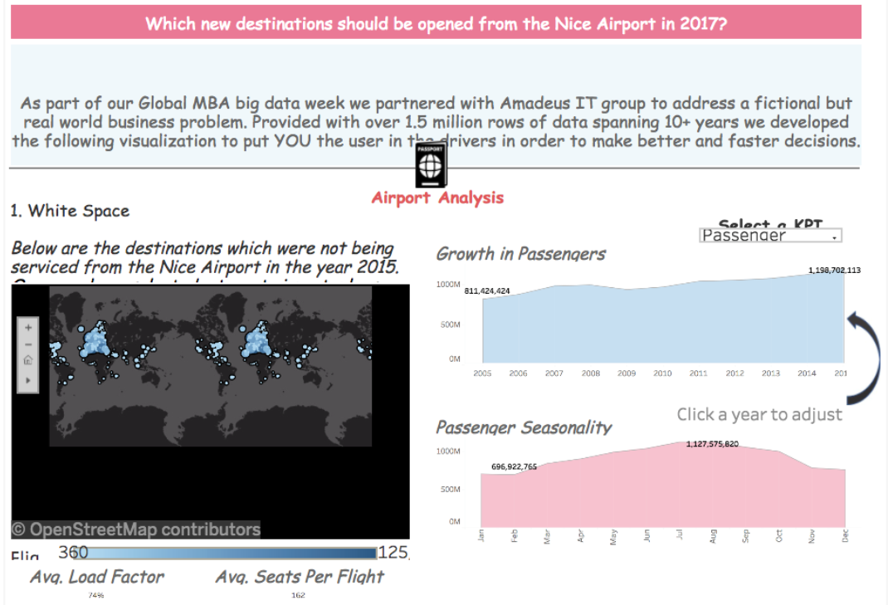
First prize team
Which new destinations should be opened from Nice Airport in 2017?

Slide 10
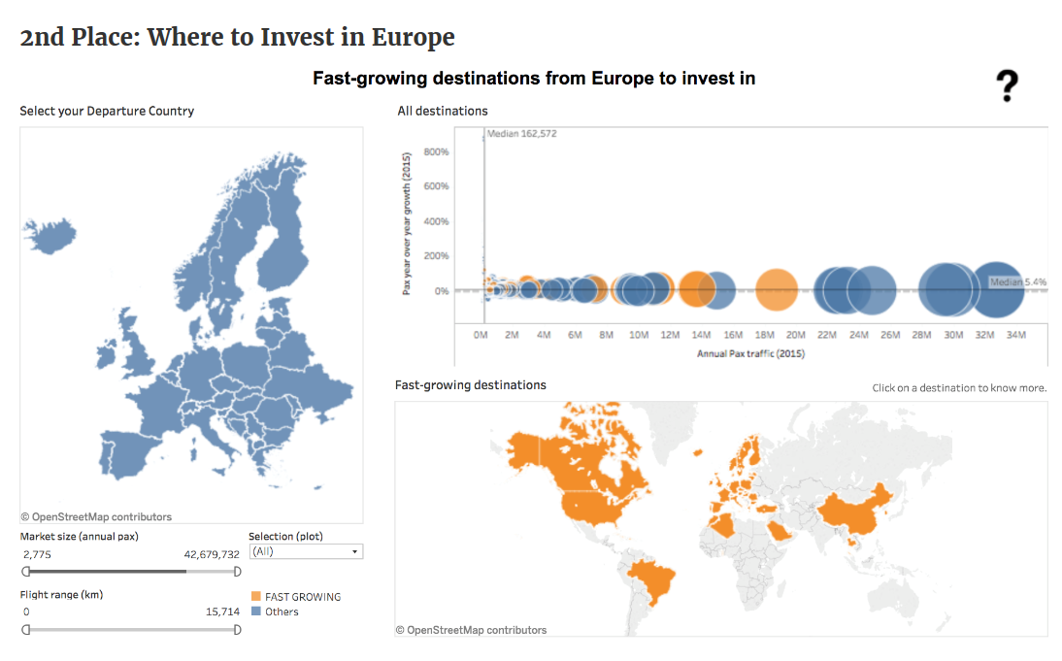
SEcond prize team
Where to invest in Europe?

Slide 11
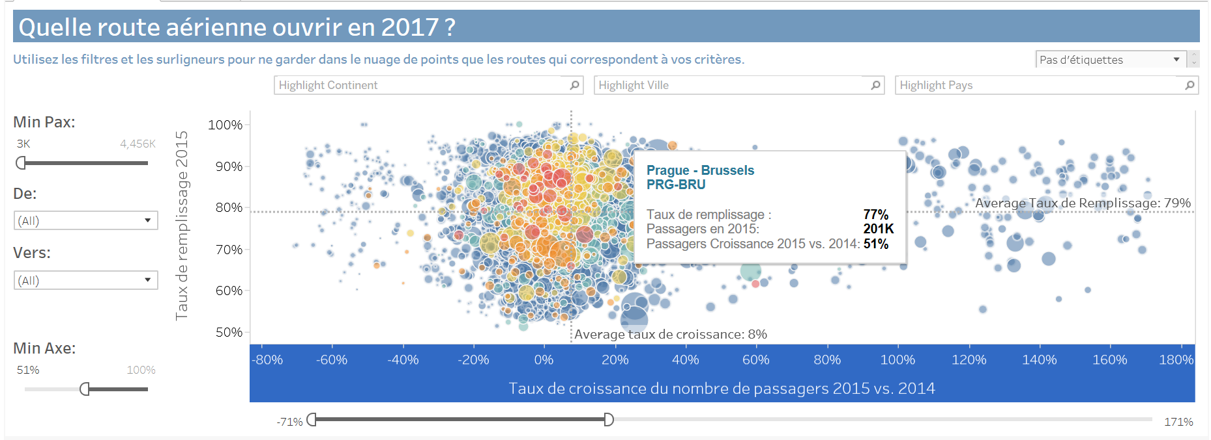
Professor example

Slide 12
Student feedback
"I discovered Tableau thanks to EDHEC MBA and Yvan Fornes, Tableau Zen Master at Amadeus. As a PMP project manager, I'm excited about using this tool in a professional context! In addition, the gallery of Tableau Public is a very valuable source of information I now regularly browse as a complement to traditional news media." —Julien Aimonino
"With the fast pace at which decisions have to be made, and the quantity of data now available, Tableau is a powerful tool to quickly see patterns, trends, narrow in on problems, and come up with quick solutions." —Christina Legodi
Read more at Article on Teaching Day EDHEC

Slide 13
Student feedback

Slide 14
Key Takeways for students
Learnt to learn
Team and community effort
Combine techie, marketing, business acumen, creative spirits
Real, messy and incorrect data
Critical and statistical thinking
Opened door to empowerment and fun in exploring data
Key Takeways for Me
Small steps work
Not about me being an expert
Leverage corporate relations
Develop business (or any subject) acumen

Slide 15
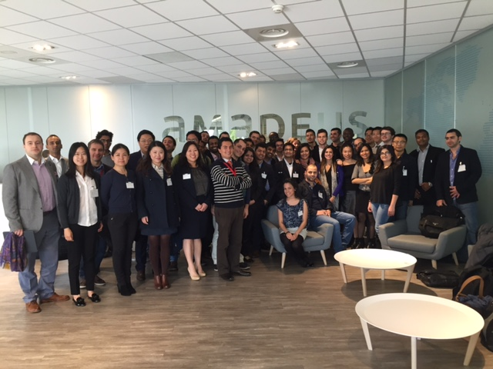
corporate Partnerships – how did this develop?
Round 1 – Corporate Treks
Round 2 – Integrate into course
What is in it for you/ us?

Slide 16
WWW.EDHEC.EDU

