Slide 1
Teaching with Tableau® and Best Practices
Mary Dunaway, PhD
Assistant Professor
University of Virginia

Slide 2
Teaching with Tableau
Free license for faculty/1 year full license for students
Teaching resources
On-demand video tutorials and training courses
Faculty User Group
Excellent Education Alliance Support
Tableau Public

Slide 3
Tableau Public
Free service that lets anyone publish interactive data visualizations to the web
Visualizations can be:
embedded into webpages and blogs,
shared via social media or email,
made available for download to other users.

Slide 4
Textbooks

Slide 5
Getting Started with Tableau in the Class
Familiarize yourself with the basics to understand concepts
Getting students started:
Getting started
Getting Started with Data
Getting Stated with Visual Analytics
Understanding the Understanding the data types (Dimensions vs Measure, Continuous vs Discrete)
Aggregation, granularity and ratio calculation
Getting started with dashboards and stories

Slide 6
Attend an advanced class or two to learn deeper concepts
Tableau Public Gallery – examples and class discussion
Practice, Practice, Practice

Slide 7
Getting Students Started
Hands-on dashboards
First Class: Students publish a draft visualization to Tableau Public
Assignment: Answer a business question with a public data set provided

Slide 8
Tableau
Pros
Cons
Easy software install
Excellent product support
Quick and easy data visualizations
Great interface
Create visualizations dragging and dropping on to the work area
Simple data import
Need time to train yourself in using the software correctly
Some of the functions are difficult to master quickly
Incorrect filtering can hamper expected results
Formatting may be difficult, depending on what is to be accomplished

Slide 9
The ways in which organizations deliver data analytics insights are evolving, notably in the rising use of what is called data storytelling
Data stories explore and explain how and why data changes over time, usually through a series of linked visualizations.
Data stories should always link data and time (or events) through a narrative flow.

Slide 10
Why visualize?
Data visualization is not a personal preference, to be done “just in case some people are more visual.” It is a necessity!
The previous slide is a classic example of how some insights can only be found through visualization.
The first step in understanding your data should always be to examine it visually. Visualization can play a critical role in helping you figure out what the interesting questions are.
Remember the picture superiority effect: pictures are retained at much higher rates than words.
Notes:
Picture superiority – this is backed up by decades of research. If you can communicate your data with a well-designed picture, people will remember that much better than a table of numbers…this is more important than ever given how much data is being used in business

Slide 11
Why visualize?
A good visualization reduces the time to insight. Here’s a simple example:
You receive a report of monthly revenues by product and region. Which were your five highest-revenue product/regions last month?

Slide 12
Why visualize?
Let’s add color:
Color automatically focused your brain – no mental calculations/comparisons needed!
For some applications, eliminating all distractions with a very simple viz can be effective:

Slide 13
Using Color
FACT: approximately 8% of men worldwide are color blind.
Avoid red/green palettes! Blue/orange is a good alternative.
For continuous data, color ramps are effective.
For discrete data, always try to limit colors (under 5 is ideal).
The use of too many colors makes it hard to distinguish, and also requires frequent referencing of the legend.
If you limit yourself to just a few colors, then your audience can actually remember what’s what. Be kind to your reader!

Slide 14
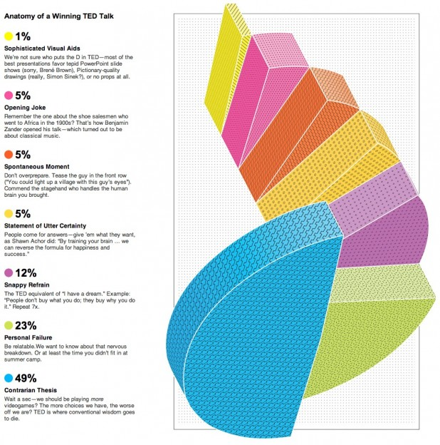

Slide 15
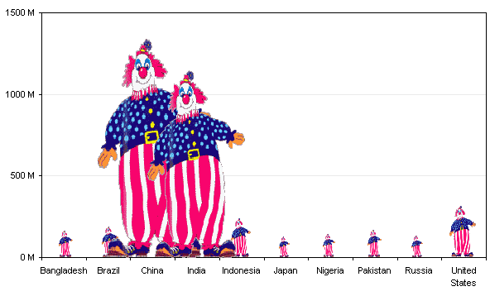

Slide 16
Notes:
This is a mistake that is pretty common. You have about 150 different data points and you’re mapping them to color but this is bad because I can’t tell if the blue is Albania or Cameroon

Slide 18
Notes:
When you’re working with quantitative data these two practices work really well. Negative profit as orange and positive profit as blue – red and green are more traditional, but this is color-blind friendly. If I had this bar chart without the colors, I might think that appliances, bookcases, and copiers were all performing about the same for us because their sales are roughly equal.
But when I add profit to color on this bar chart it’s immediately obvious that bookcases are actually losing money for us, as are supplies and tables
A word of caution – do not overuse color! With a bar chart, it is easy to see that one bar is about twice as long as another. On the other hand, it is nearly impossible to perceive that one color is twice as far along on a color ramp than another color. Color ramps can effectively display general information, but not specifics.

Slide 20
Importance of Context
Who is your audience?
What do you need them to know or do?
Situational context
Communication Mechanism
Desired Tone

Slide 21
Choosing an Effective Visual
Simple text
Table should have borders
Graphs that easily get the information across quickly
Avoid pie charts; replace with horizontal bar chart

Slide 22
Pie charts – NO!
From visualization guru Edward Tufte: “the only worse design than a pie chart is several of them.”
Pie charts are tempting because everyone understands what they are meant to convey (the various parts of a whole), but it is much harder to compare slices of a pie than it is to compare length or height (especially when slices become very thin):
Notes:
there is extensive research showing that people are MUCH worse at interpreting the left-hand chart vs. the right-hand chart.
This is a well-established best practice. It is shocking that you still see so many pie charts. Do not be part of the problem!

Slide 23
Lollipop Bar Chart
Notes:
New trend is Lollipop Bar Chart. Frequently you may have bars of the same length or near the same length. The main purpose is to show how the bars differ from on another.

Slide 24
Notes:
Relative proportions, proportions of the whole = tree maps / Relationships between data = scatter plot

Slide 25
Notes:
Orient data so people can read it easily. You read English from left to right so as much as possible, we want our data to go left to right.
How many of you have the urge to tilt your head to make the chart on the left easier to read? Don’t make your audience to that! Tilt it for them ☺

Slide 26
Notes:
Filled maps work well when you have defined areas like states or cities and only one measure.
For this map, we are looking at infant mortality across Cuban provinces – see can see that there are two pockets of 4-6 deaths per 1,000 live births

Slide 27
Notes:
What do you think the 5 second test is?
The goal is that you should know what is going on in the dashboard in 5 seconds.
This one is good b/c you know exactly what it is – good title, clear why map was used.

Slide 28
Notes:
And have a good title, too! This title immediately tells me what I am looking at. A title here such as “My Dashboard” would not be helpful.
Based on the 5 second dashboard test, the purpose of the dashboard should be immediately clear. What problem does this solve OR what question does it answer? Is this immediately clear?
2. Have you used the space effectively? Is there a better way to display the data?
3. Don’t add things just because you can. Make sure everything on the viz is useful and valuable to the end user. Oftentimes the simplest vizes tell the most compelling story.
4. Have you utilized filters, highlights and other actions to provide interactivity to the end user? Now go through each of these and make sure it displays as you would expect – be sure to check various scenarios and edge cases.
5. Make sure to include a color legend, etc.

Slide 29
Notes:
Draw on the 5 questions from the viz review:
What question does this answer? In this case, the question is “how do Facebook users see 2016 political candidates”
Is the information displayed in the best way?
Pie charts are hard to compare, no sorting of the individual candidates
Second row of red labels could be ambiguous
Does everything add value? Alternating the republicans and democrats titles and color schemes doesn’t help
Functional interactivity? no
Clear labels? Unclear title, All caps are hard to read

Slide 30
Focus your Audience’s Attention
Highlighting one aspect can make other things harder to see
Use color sparingly/be consistent
Design with colorblind in mind
Be thoughtful of tone that color conveys

Slide 31
Lessons in Storytelling
Start with the end in mind
Say what you meant to say
End with a call to action
Ensure chronological order is natural
Repetition is power
Crafting your story comes with time

