Slide 1
Teaching Cluster Analysis through a Marketing Sciences Application Kevin Potcner Minitab, Inc. University of San Francisco California State University - Fullerton

Slide 2
Audiences

Slide 3
Audiences
Business
Analytics

Slide 4
Audiences
Business
Analytics
Modern Data Science

Slide 5
Audiences
Business
Analytics
Traditional Statistical Sciences
Modern Data Science

Slide 6
Business
Analytics
Traditional Statistical Sciences
Modern Data Science

Slide 7
Focus
Business
Analytics
Traditional Statistical Sciences
Modern Data Science

Slide 8
Focus
Business
Analytics
Traditional Statistical Sciences
Modern Data Science
Insights
Interpretation
Business Decisions

Slide 9
Focus
Business
Analytics
Traditional Statistical Sciences
Modern Data Science
Insights
Interpretation
Business Decisions
Mathematics
Algorithm
Big Data

Slide 10
A vs. B Marketing Experiment

Slide 11
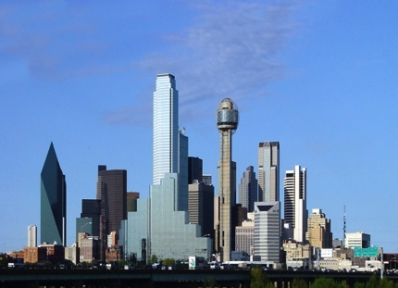
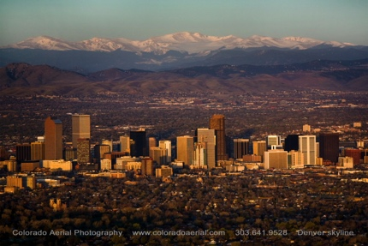
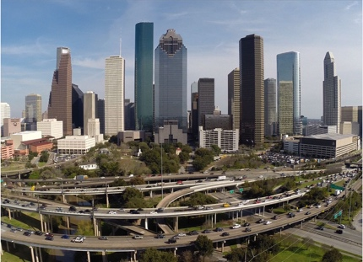
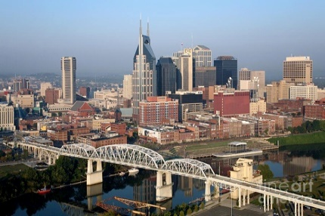
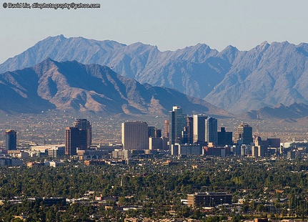
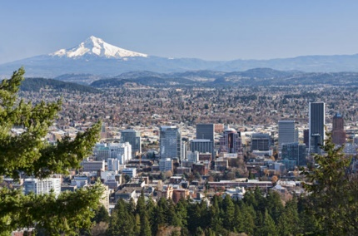
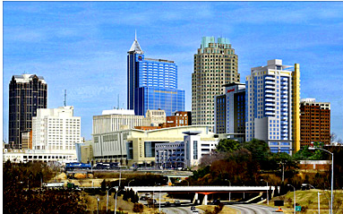
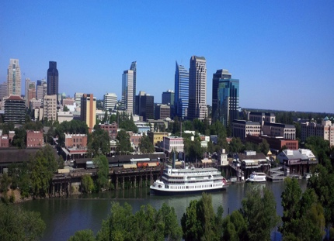
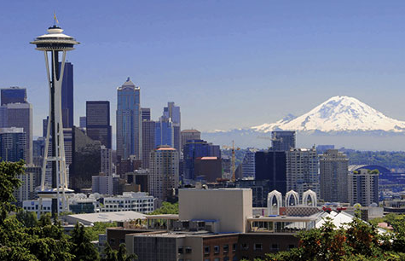
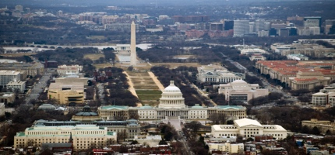
A vs. B Marketing Experiment

Slide 12
A vs. B Marketing Experiment
A
B

Slide 13
A vs. B Marketing Experiment
A
B

Slide 14
A vs. B Marketing Experiment
A
B
A
B

Slide 15
Problem Statement

Slide 16
Problem Statement
How can differences in geographical regions be controlled for in an A vs. B marketing experiment?

Slide 17
Solution

Slide 18
Solution
Cluster Observations Analysis

Slide 19
Solution
Cluster Observations Analysis
Intuitive and Accessible
Handles highly dimensional problems
Myriad applications

Slide 20
Data

Slide 21
Data
High-Net-Worth Retirees
High-Net-Worth Midlife
High-Net-Worth Young

Slide 22
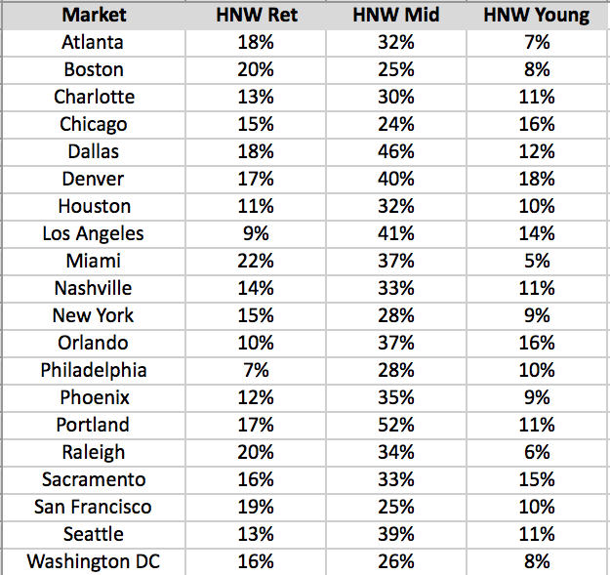
Data

Slide 23
Data

Slide 24
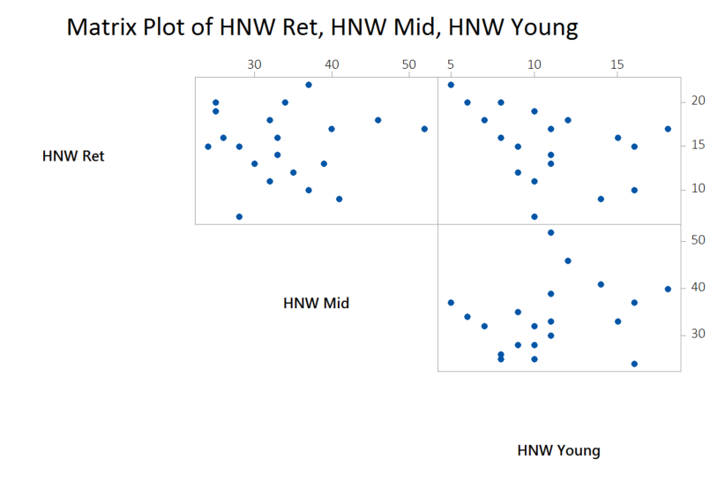
Data

Slide 25
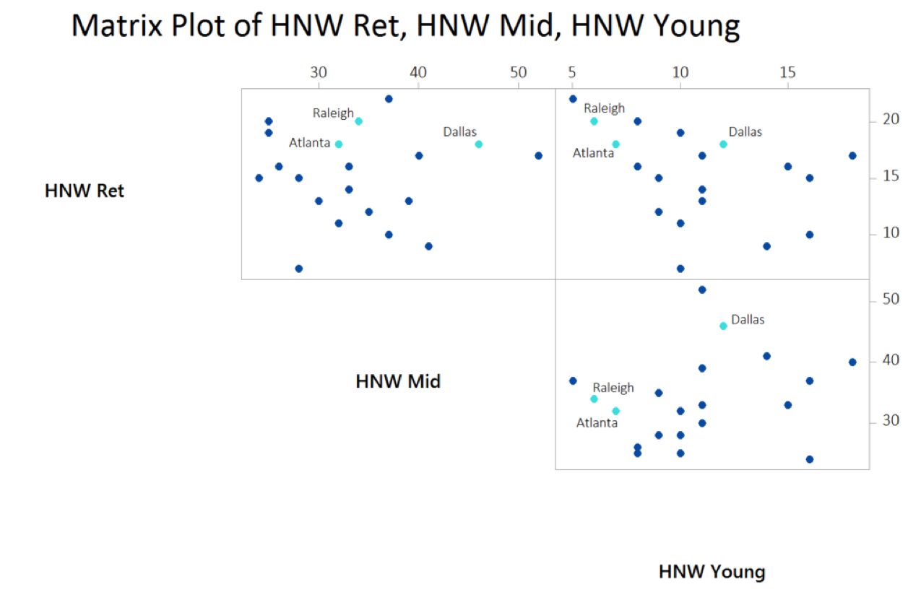
Data

Slide 26
Cluster Analysis in Minitab

Slide 27
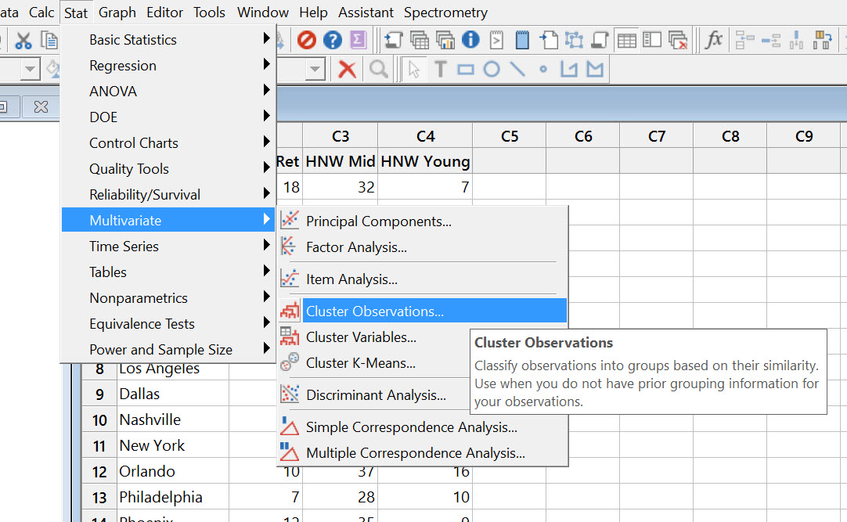
Cluster Analysis in Minitab

Slide 28
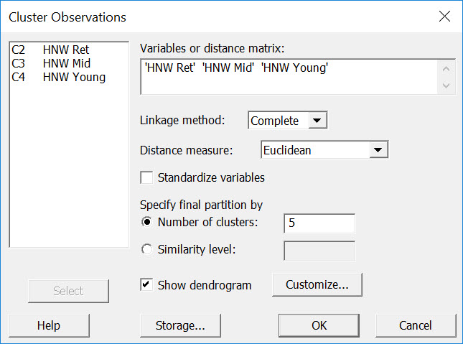
Cluster Analysis in Minitab

Slide 29
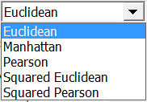
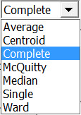
Cluster Analysis in Minitab

Slide 30
Cluster Analysis in Minitab

Slide 31
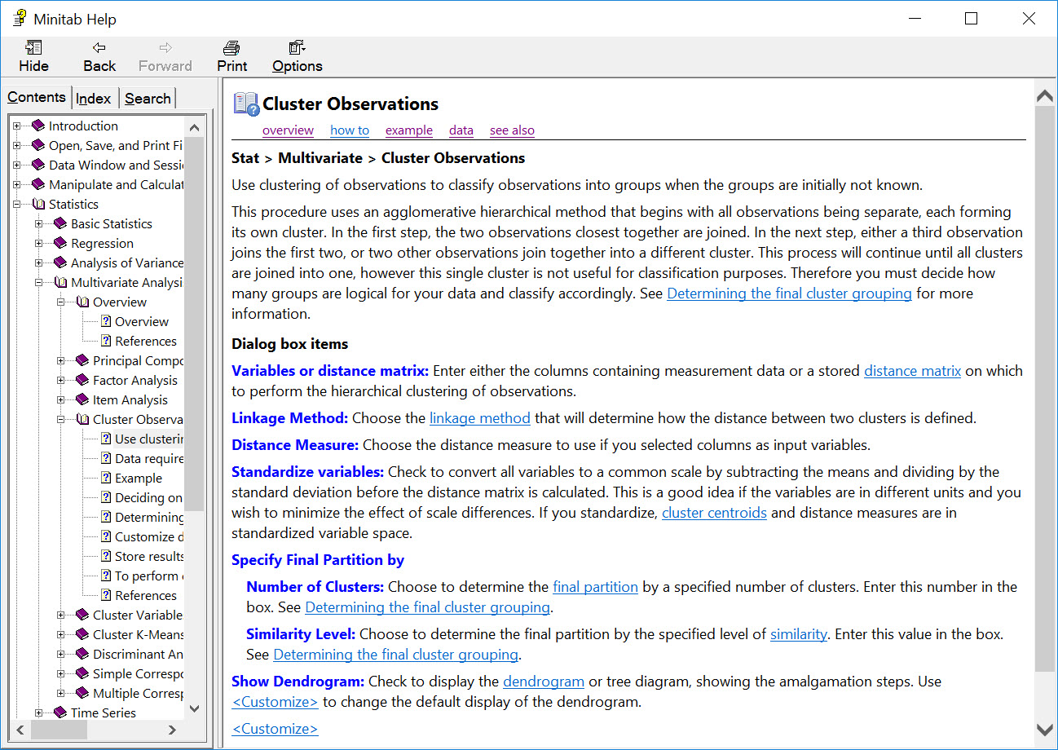
Cluster Analysis in Minitab

Slide 32
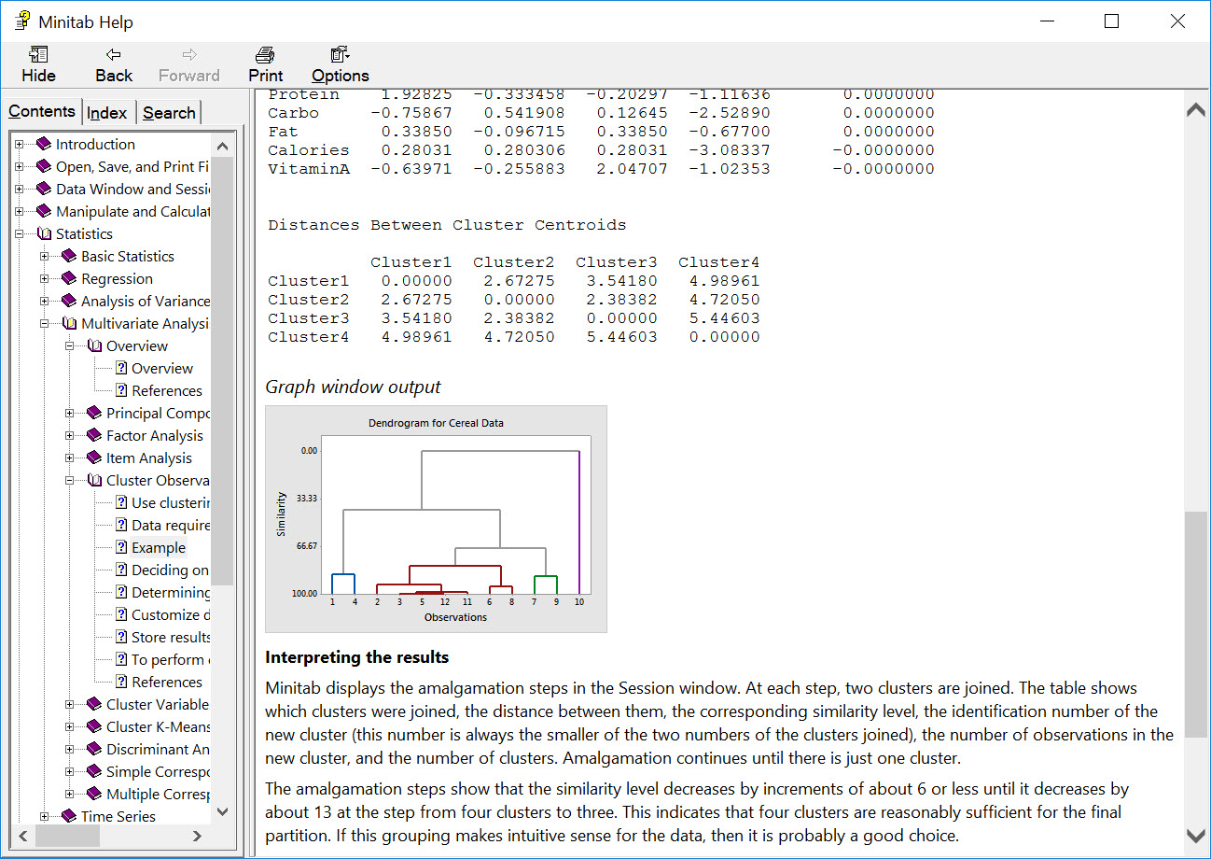
Cluster Analysis in Minitab

Slide 33
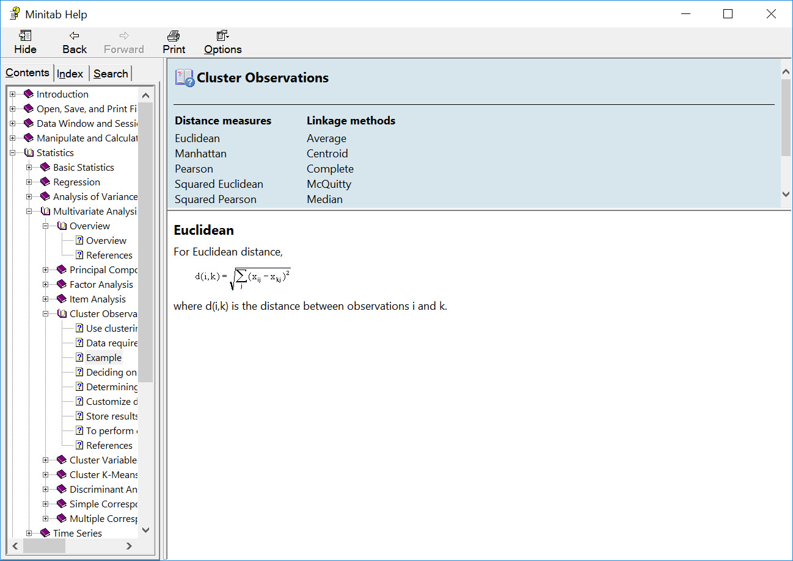
Cluster Analysis in Minitab

Slide 34
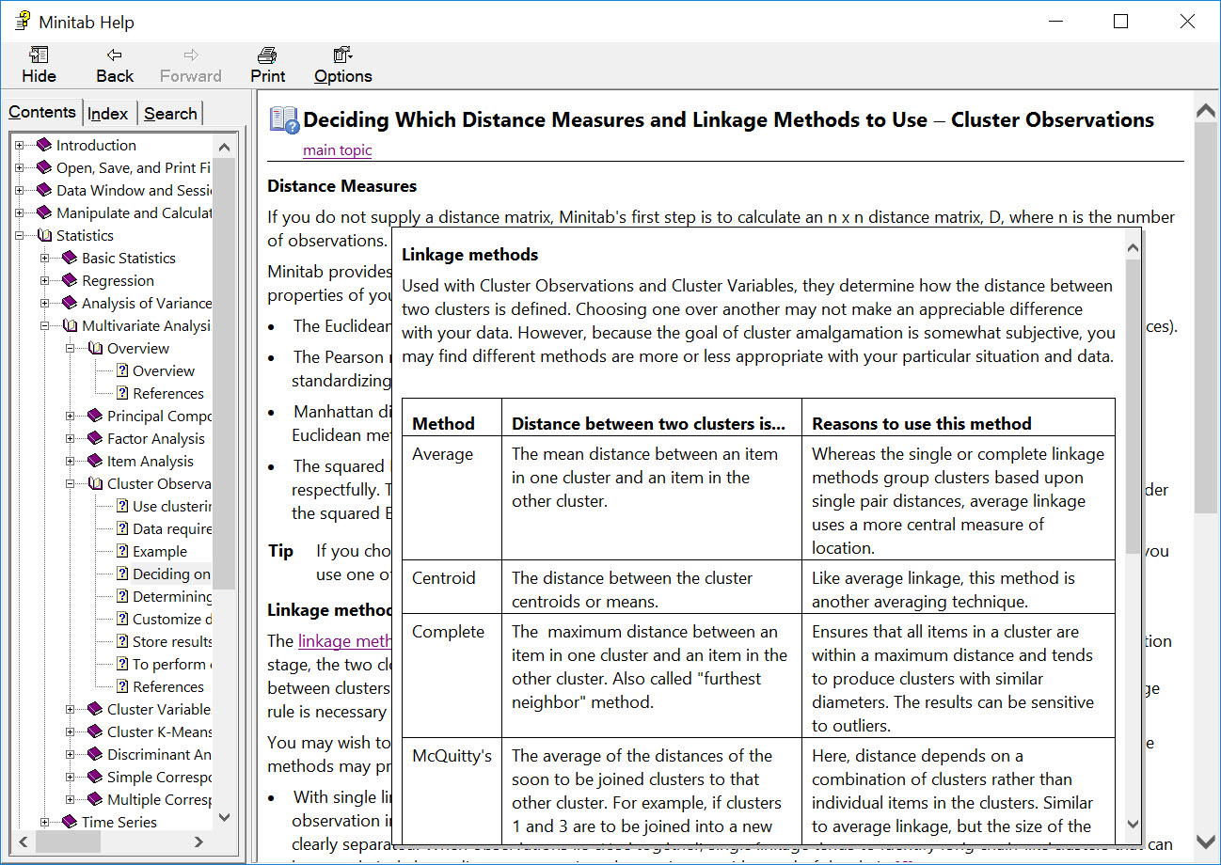
Cluster Analysis in Minitab

Slide 35
Cluster Analysis in Minitab

Slide 36
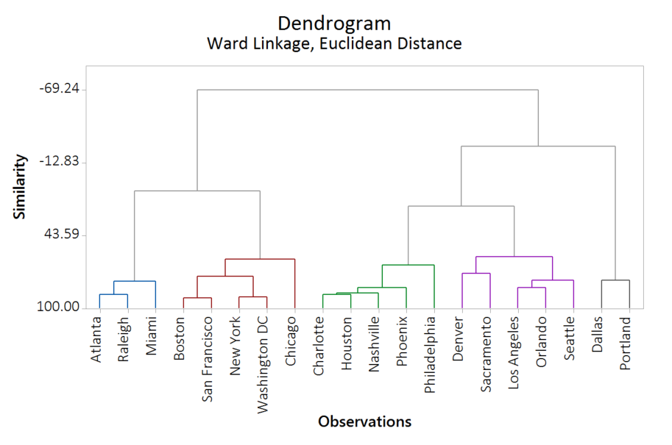
Cluster Analysis in Minitab

Slide 37
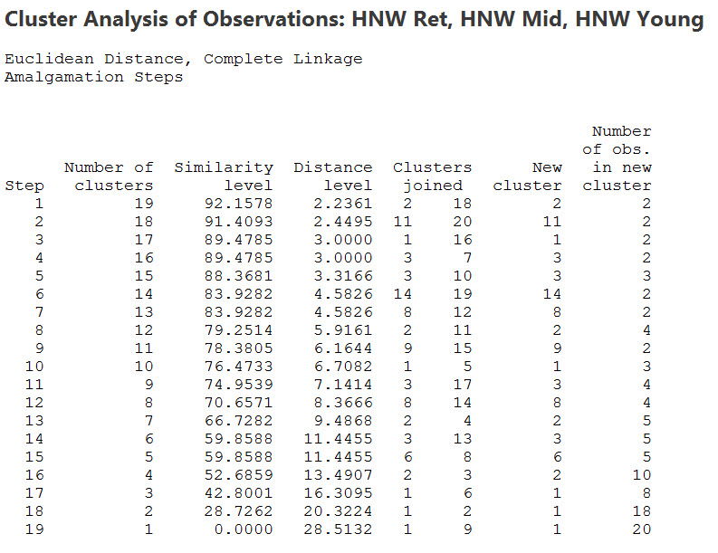
Cluster Analysis in Minitab

Slide 38
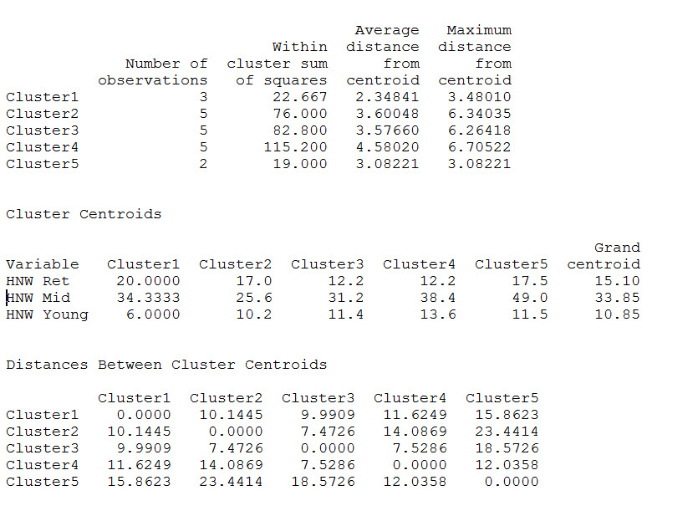
Cluster Analysis in Minitab

Slide 39
Cluster Analysis in Minitab

Slide 40
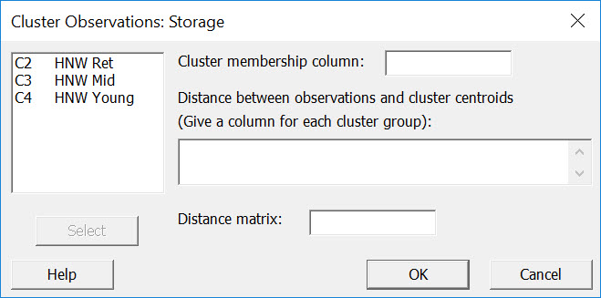
Cluster Analysis in Minitab

Slide 41
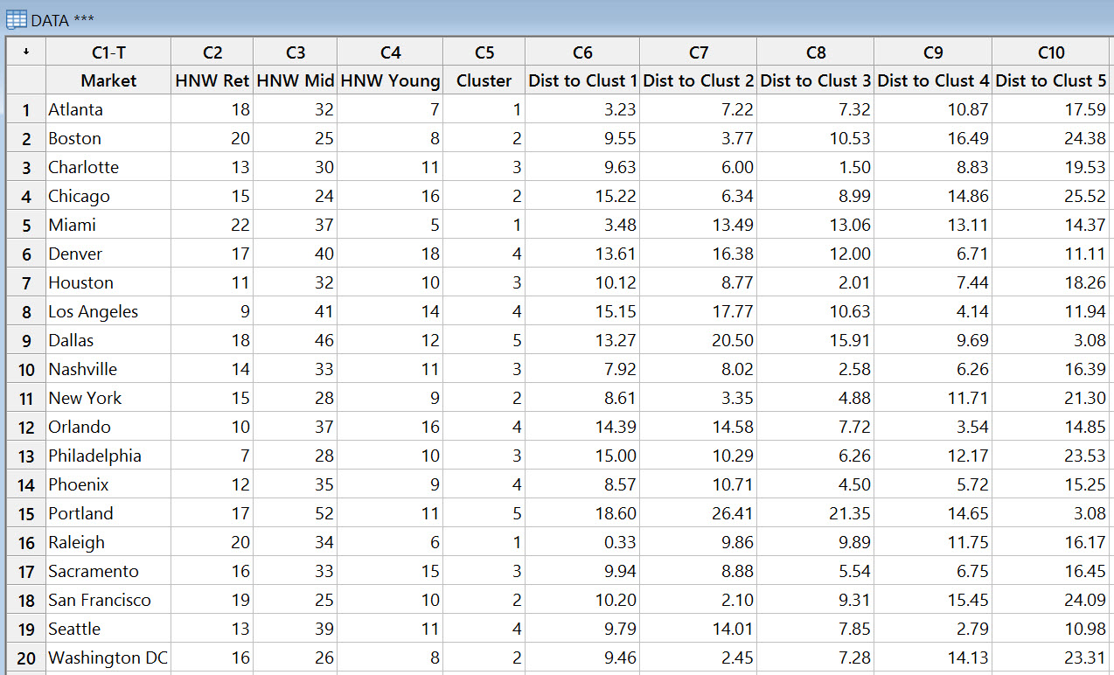
Cluster Analysis in Minitab

Slide 42
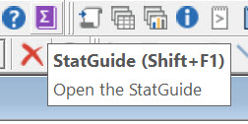
Cluster Analysis in Minitab

Slide 43
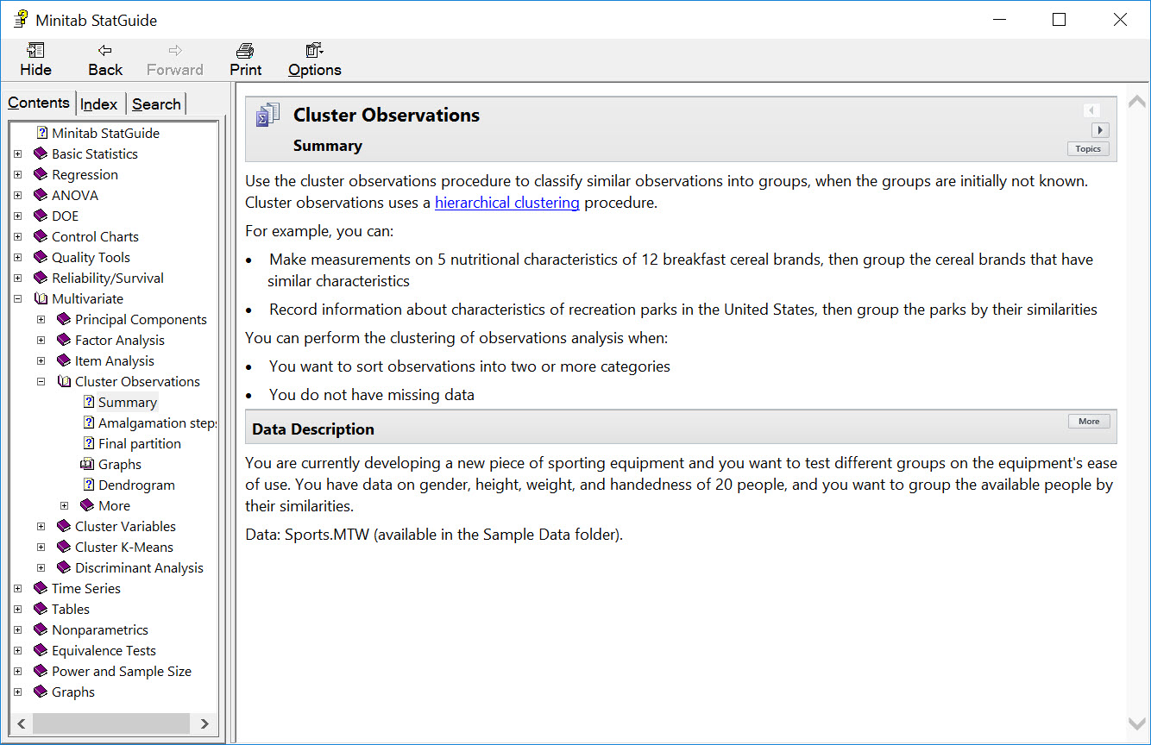
Cluster Analysis in Minitab

Slide 44
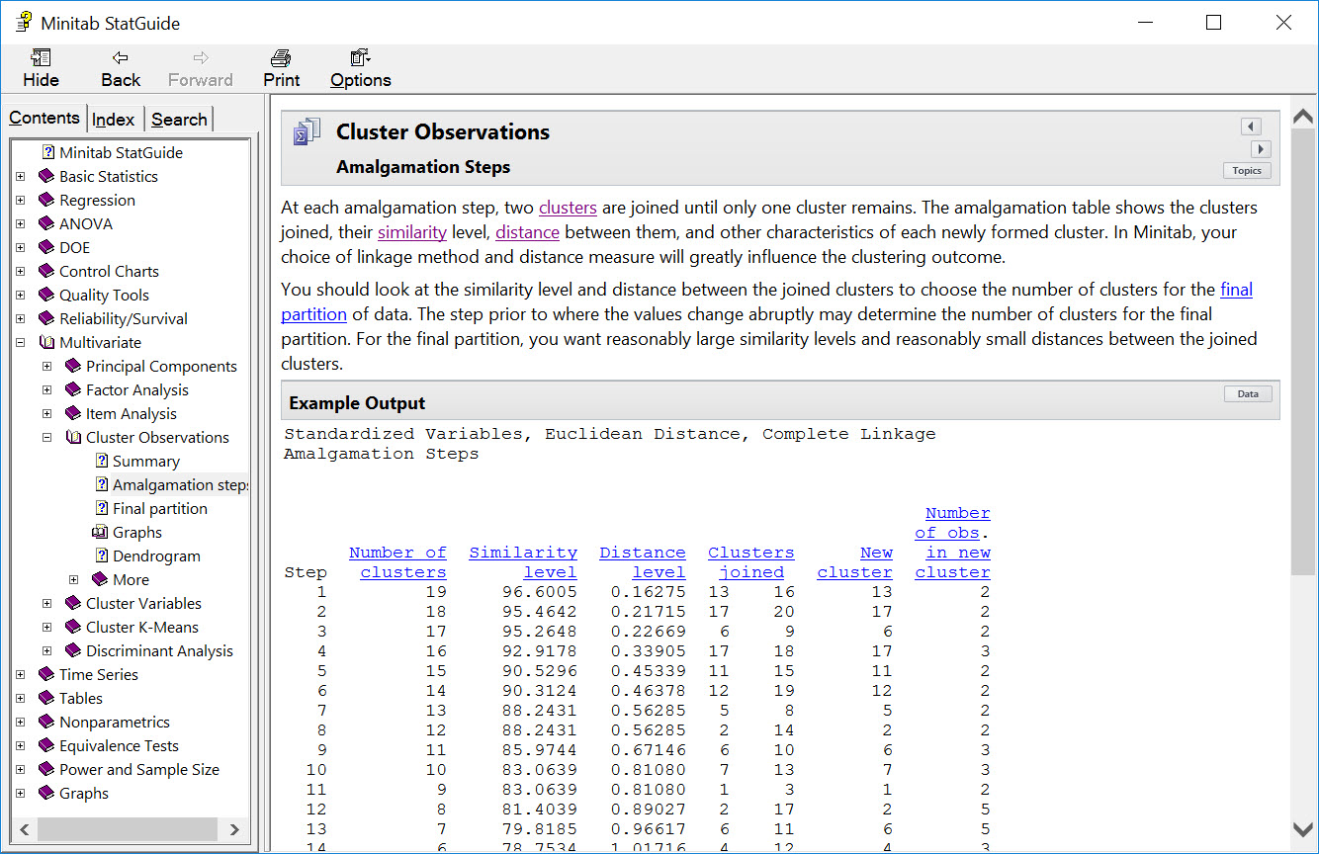
Cluster Analysis in Minitab

Slide 45
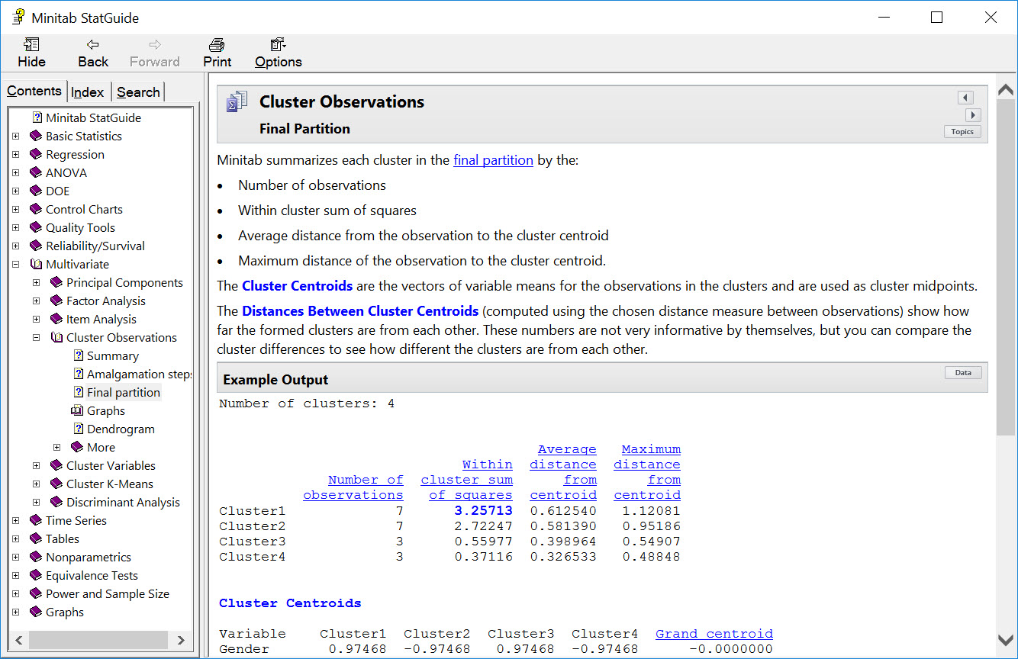
Cluster Analysis in Minitab

Slide 46
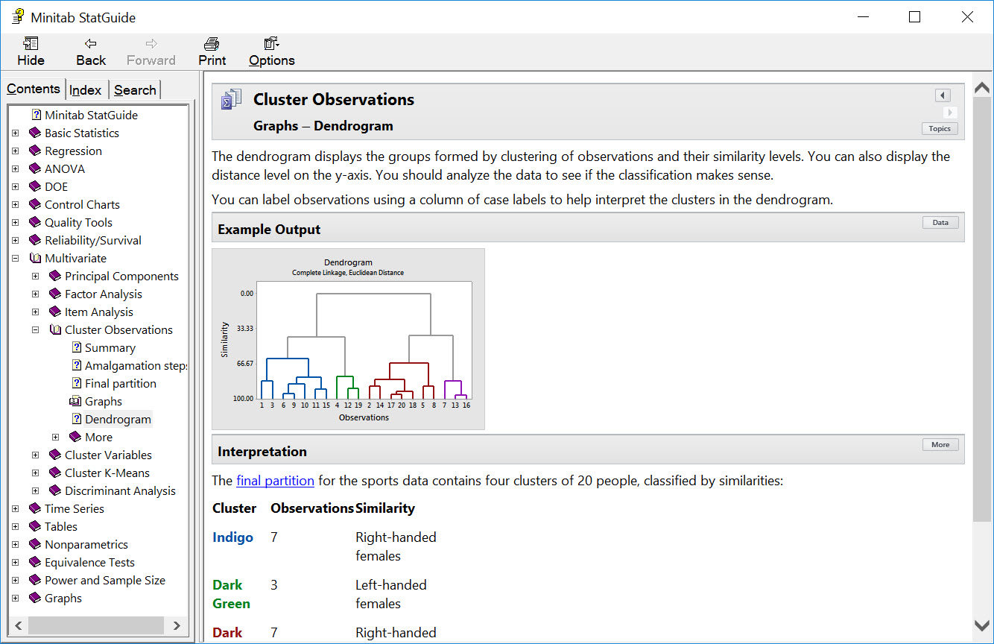
Cluster Analysis in Minitab

Slide 47
Cluster Analysis in Minitab

Slide 48
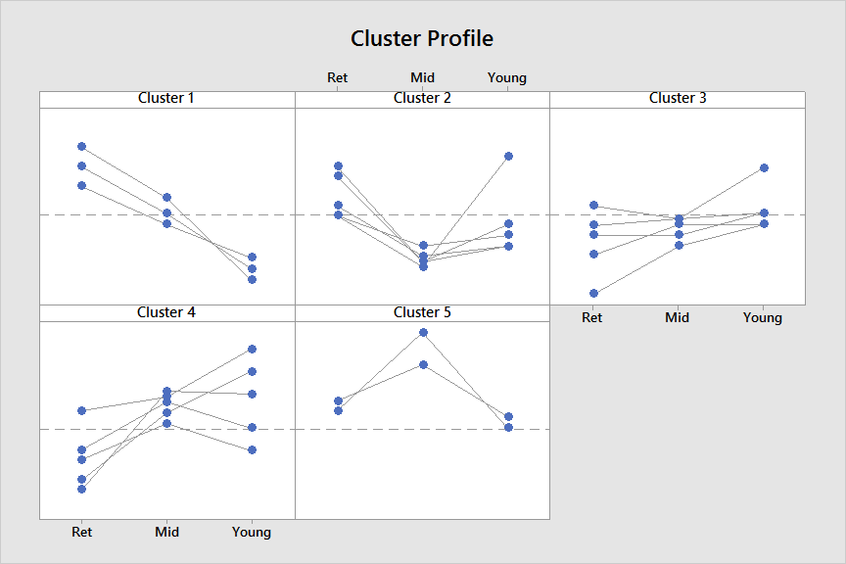
Cluster Analysis in Minitab

Slide 49
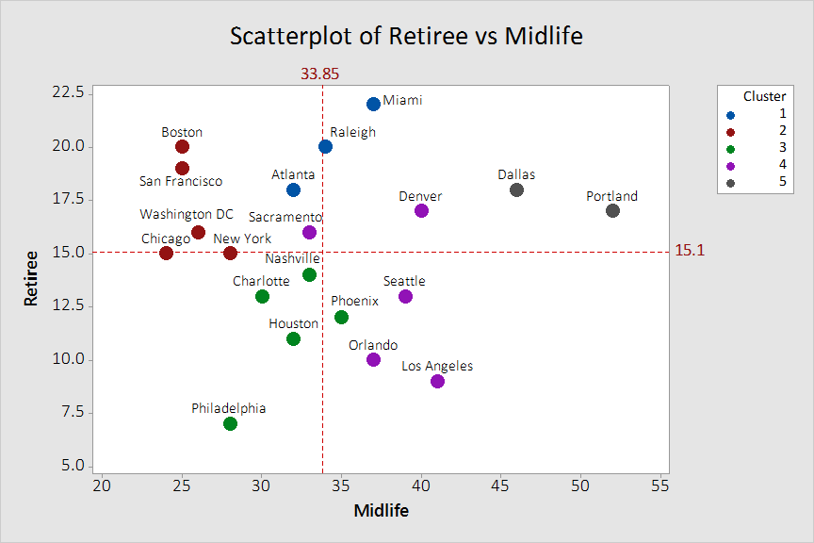
Cluster Analysis in Minitab

Slide 50
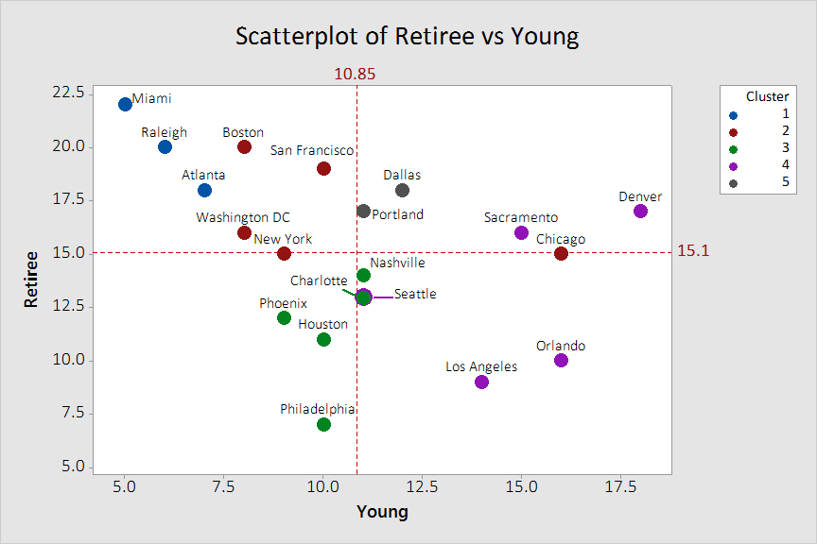
Cluster Analysis in Minitab

Slide 51
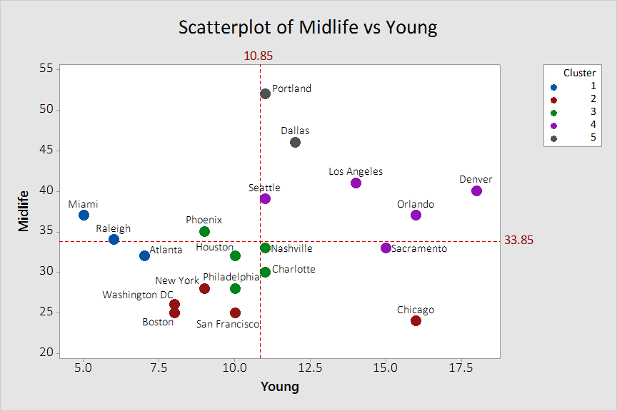
Cluster Analysis in Minitab

Slide 52
A vs. B Marketing Experiment
A
B

Slide 53
A vs. B Marketing Experiment

Slide 54
A vs. B Marketing Experiment

Slide 55
A vs. B Marketing Experiment

Slide 56
A vs. B Marketing Experiment
A
B

Slide 57
A vs. B Marketing Experiment
A
B

Slide 58
A vs. B Marketing Experiment
A
B

Slide 59
A vs. B Marketing Experiment
A
B

Slide 60
A vs. B Marketing Experiment
A
B

Slide 61
A vs. B Marketing Experiment
A
B

Slide 62
Case Study and Project Ideas…

Slide 63
Case Study and Project Ideas…

Slide 64
Case Study and Project Ideas…

Slide 65
Case Study and Project Ideas…

Slide 66
Case Study and Project Ideas…

Slide 67
Case Study and Project Ideas…

Slide 68
Case Study and Project Ideas…

Slide 69
A vs. B Marketing Experiment

Slide 70
Q & A and Discussion

