Slide 1
AACSB Resources – Building Data Analytics Programs

Slide 2
DRAFT
AACSB
fosters engagement
accelerates innovation
amplifies impact
in business education

Slide 3
Data Analytics
What we are trying to do
Enable [business] schools to develop distinctive analytics programs to meet the needs of business and society.
DRAFT
Why?

Slide 4
DRAFT
Our vision
AACSB’s data analytics initiative will enable & promote:
Innovation in both business practice and academia
Co-creation and dissemination of knowledge
Interdisciplinary collaboration across campuses
Engagement with a broad range of schools

Slide 5
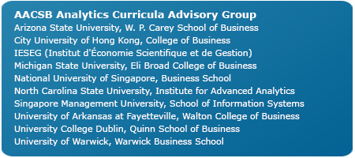

Slide 6
how
Accreditation standards and processes
Advocacy and awareness activities
Seminars and other educational events
IDEAS
Learning communities for creating new knowledge
Online platforms for sharing information and ideas
Increasing funding support for developing data analytics capacity
Connecting business education with other disciplines
Developing frameworks and other tools to assist business educators
Advancing efforts in doctoral education related to data analytics
Creating platforms for connecting education to practice

Slide 7
Data Analytics Seminar
Part of the AACSB Curriculum Development Series
5-6 December 2016 | Tampa, Florida, USA
AACSB World Headquarters
29–30 March 2017 | Taipei, Taiwan
Hosted by National Chengchi University
16–17 May 2017 |Amsterdam, the Netherlands
Hosted by Amsterdam Business School

