Slide 1
Analytics
Communicating Results
Wilma Andrews, Virginia Commonwealth University
Notes:
Here to help students better understand the importance of being able to communicate analytical results. Tell a story here about why presentations are important to you. Annie’s class story.
My story –
--

Slide 2
Notes:
You good at teaching
Find data
Pull together
Analyze
Communicate
Why do you have students do presentations?

Slide 3
What good at?
Data
Pull info together
Analyze
Communicate?
Notes:
How many of you require classroom presentations? Why?
Are they any good? Why/why not?
Are they learning how to present in their jobs or how to present to you?

Slide 4
What present?
Data
Pull info together
Analyze
Communicate?
Notes:
How many of you require classroom presentations? Why?
Are they any good? Why/why not?
Communication???

Slide 5
Presentations are becoming a more important vehicle for communicating, but presenters aren’t really getting any better at effectively using this important vehicle to get their message understood.
http://www.thinkoutsidetheslide.com/free-resources/latest-annoying-powerpoint-survey-results/
Notes:
Do you agree with this?

Slide 6
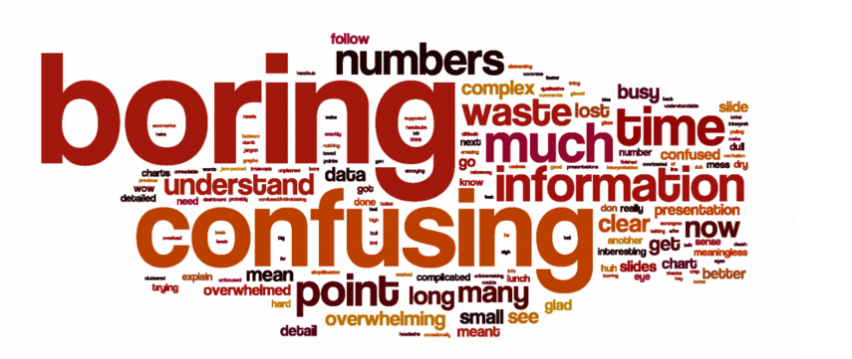
Notes:
This one was specific to accountants

Slide 7
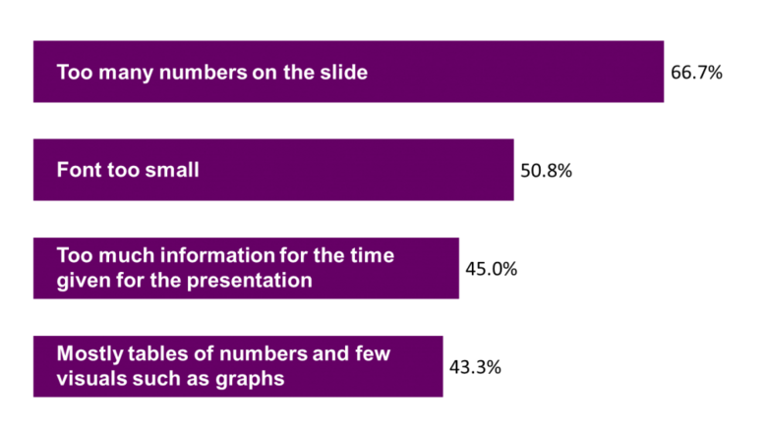
Audience overwhelmed with numbers
Notes:
But similarities between accountants and other “numbers” presentations.

Slide 8
Knowing how to develop and deliver a data-driven presentation is now a crucial skill for many professionals, since we often have to tell our colleagues a story about the success of a new initiative, the promise of a new business opportunity, or the imperative of a change in strategy — stories that are much more compelling when they’re backed by numbers.
Alexandra Samuel
https://hbr.org/2015/10/how-to-give-a-data-heavy-presentation
Notes:
As with any communication, start by thinking about your audience.

Slide 9
Your responsibilities
Notes:
You will teach them skills but need to also show them good examples of presentations.

Slide 10
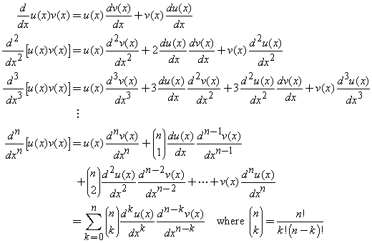
Notes:
How often have they tried to impress you by putting up info like this? Good for papers, need to show formulas but not presentations.

Slide 11
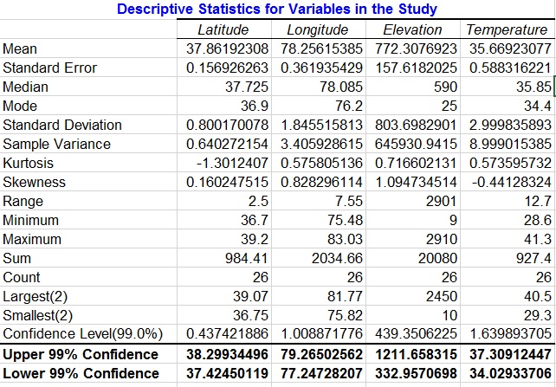
Notes:
Or this

Slide 12
Spreadsheets are for calculations
not for communication.
Include as hidden slides if more info is needed. (Slide #_Enter)
Notes:
Spreadsheets, formulas or graphs with far too much on them.
Slide # + Enter for hidden slides

Slide 13
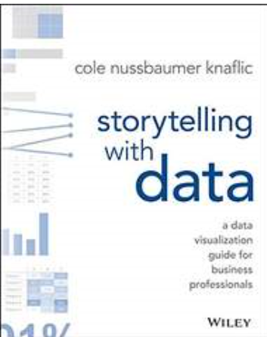
http://www.storytellingwithdata.com/

Slide 14
Data visualization
Science
Art
Notes:
Data visualization—and communicating with data in general—sits at the intersection of science and art

Slide 15
Communicate
Only part analytical process audience sees
Build Models
Analyze it
Pull together
Find Data
Notes:
data visualization is last step
hires quantitative backgrounds that suit them well for the other steps (finding the data, pulling it together, analyzing it, building models), but not necessarily any formal training in design to help them when it comes to the communication of the analysis—which, by the way, is typically the only part of the analytical process that your audience ever sees.

Slide 16
How help students
Understand context
Choose appropriate visual display
Eliminate clutter
Focus attention
Think like a designer
Tell a story

Slide 17
Understand the context
Exploratory vs explanatory
Notes:
100 oysters example, 2 pearls

Slide 20
Understand the context
Know your audience
Notes:
Bob’s story - Instructor maybe now, future manager, sales pitch,

Slide 21
Choose appropriate visual display
Many types
avoid pie, donut, 3D
Notes:
simple text, table, heatmap, line graph, slopegraph, vertical bar chart, vertical stacked bar chart, waterfall chart, horizontal bar chart, horizontal stacked bar chart, square area graph.

Slide 22
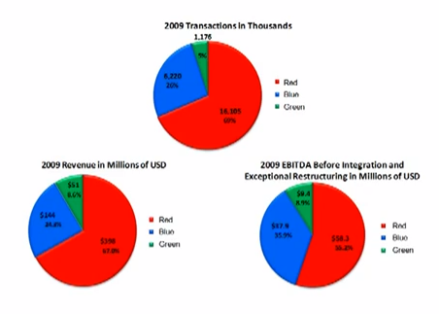
Take complex
http://www.youtube.com/watch?v=AYAtLlH3sgM
Notes:
Take complex graphics charts/tables that the audience won’t understand
PPT Slide Makeover #65 http://www.youtube.com/watch?v=AYAtLlH3sgM
Audience will not do math
Determine best denominator (per x)
Calculate the “per x” values
Show the differences in a simple graph

Slide 23
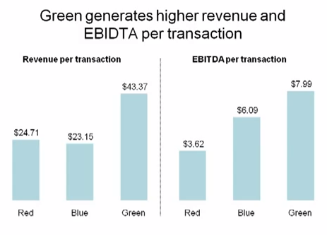
Break into pieces
http://www.youtube.com/watch?v=AYAtLlH3sgM
Notes:
Break it into pieces that the audience will understand.
http://www.youtube.com/watch?v=zXGeNydfPkw&feature=youtu.be
Visual Slide Revolution - visualsliderevolution.com

Slide 24
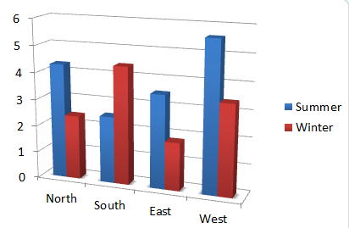
Charts
3-D
Notes:
Many of you will have charts in your presentations and PPT has many charting features, but just be aware that the trend is away from 3-D charts. Though pretty they are hard to read accurately because do you read the values from the front of the 3-D or the back?

Slide 25
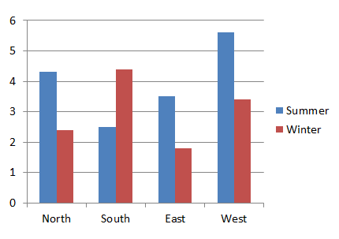
Charts
2-D
Notes:
2_D charts are better because 2-D ones are more accurate and simpler. Play around with removing white space too.

Slide 26
Eliminate clutter
Takes up brain power, causes confusion

Slide 27
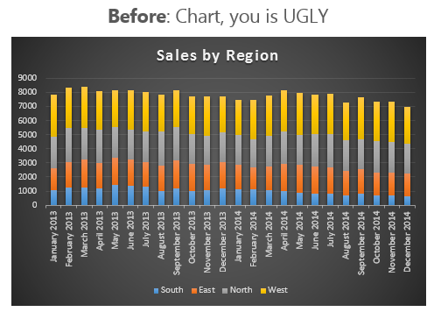
http://www.myonlinetraininghub.com/excel-chart-makeover
Notes:
http://www.myonlinetraininghub.com/excel-chart-makeover

Slide 28
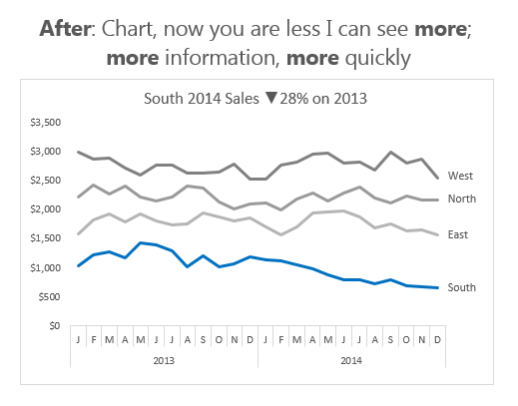
http://www.myonlinetraininghub.com/excel-chart-makeover
Notes:
http://www.myonlinetraininghub.com/excel-chart-makeover

Slide 29
Notes:
Tables are rarely good for presentations. Too much info
Sanitary Sewer Overflows. Table Red numbers – what do they mean? Title what does it mean?

Slide 30
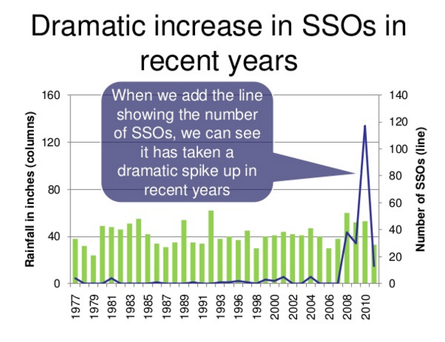
Notes:
Author took info and put into a graphical representation that “said” something.

Slide 31
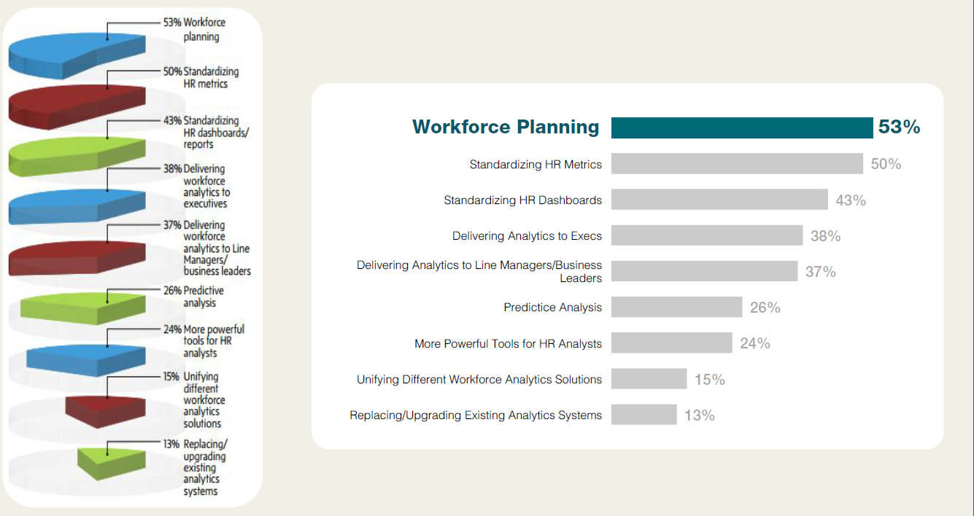
Notes:
Nolan Haims webinar Present Your Data. Took a lot of time to create the graph on the left but the one on the right is much easier to “read” and understand.

Slide 32
Focus attention
How brain “works”
Notes:
How brain works, use of color especially

Slide 33
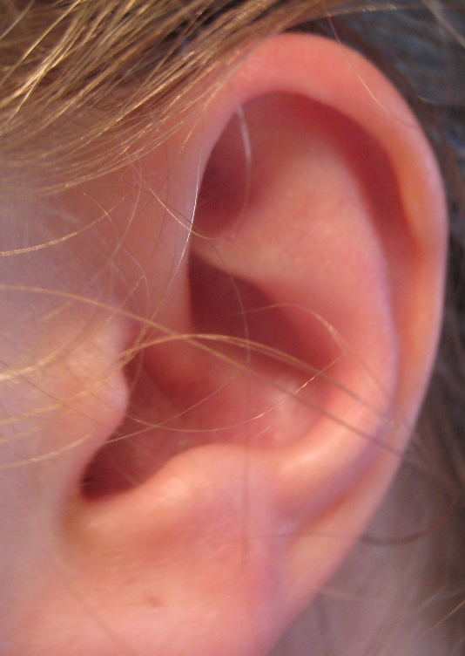
Look and listen
Notes:
If you have visual with listening, research shows that parts of your brain allows visual and listening to work. And the graphic “sticks” when reading doesn’t.

Slide 34
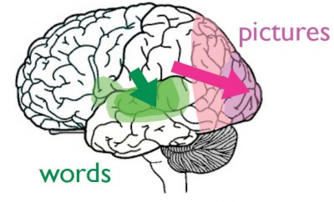
Notes:
Neuroscience: visual cortex, allowing the language areas of your brain to focus on what you’re saying.
http://www.billiondollargraphics.com/infographics.html

Slide 35
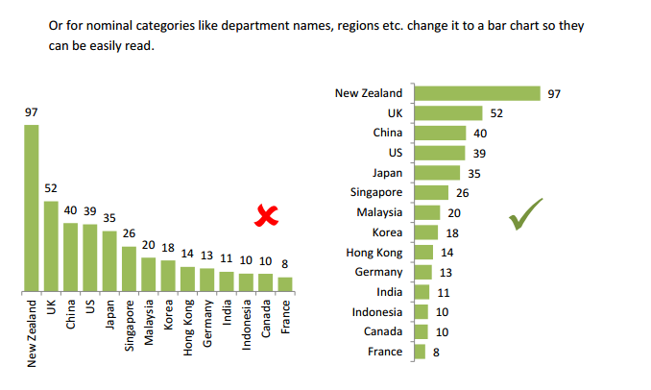
Bar charts vs. column charts
Myonlinetraininghub.com
Notes:
Bar charts often are better to visually understand. And reorder if appropriate so largest is on the top. myonlinetraininghub.com

Slide 36
Think like a designer
Emphasize important parts thru color, size, eliminate distractions, KISS
Notes:
Bold, color size, eliminate distractions (summarize),

Slide 37
Nolan Haims – PresentYourStory.com
Notes:
Nolan Haims – PresentYourStory.com. This is good but

Slide 38
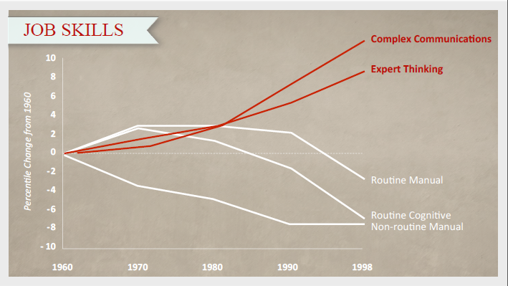
Nolan Haims – PresentYourStory.com
Notes:
Nolan Haims – PresentYourStory.com this is even better.

Slide 39
Notes:
PowerPoint has many templates but trend it toward simple rather than complex.

Slide 40
My Presentation
Notes:
Fussy backgrounds are very distracting

Slide 41
Presentation
www
xxxx
yyyy
zzzzz
Notes:
Colors that are distracting and hard to look at.
Logos on every screen.

Slide 42
Tell a story
Clear beginning, middle, end

Slide 43
Story telling
Notes:
Extremely effective way to get points across. Cooking example. Follow recipe or once understand how to cook, start experimenting on your own.
Tell a story if possible.
http://vimeo.com/8021694

Slide 44
Knowing how to develop and deliver a data-driven presentation is now a crucial skill for many professionals, since we often have to tell our colleagues a story about the success of a new initiative, the promise of a new business opportunity, or the imperative of a change in strategy — stories that are much more compelling when they’re backed by numbers.
Alexandra Samuel
https://hbr.org/2015/10/how-to-give-a-data-heavy-presentation
Notes:
As with any communication, start by thinking about your audience.

Slide 45
Notes:
What are your strength’s?
Helping them find data?
Showing them how to pull everything together
How to analyze
Communication?

Slide 46
Collect good/bad examples

Slide 47
Online Resources
Nolan Haims – www.PresentYourStory.com
Geetesh Bajaj – www.indezine.com – blogs/tips and newsletter
Camille & Taylor – www.nutsandboltsspeedtraining.com
Lea Pica - http://www.leapica.com/
Graphic Cheat Sheet – www.24hrco.com/GCS.pdf
EllenFinkelstein – www.ellenfinkelstein.com - blogs/tips/newsletter
Dave Paradi – www.thinkoutsidethebox.com – blogs/tips/newsletter
YouTubes
Notes:
Some suggested online resources

Slide 48
Resources
Nolan Hains – Data Webinar presentationXpert
Notes:
Printed/etext resources

Slide 50
Student understanding
Understand context
Choose appropriate visual display
Eliminate clutter
Focus attention
Think like a designer
Tell a story

Slide 51
Trends
Precise goal
Images
Few words
One point per slide
Simple backgrounds
Story tell
Limited animation
Don’t use bullet points
Avoid too much on one slide
Avoid repeating logos
Present to/for the audience
Don’t read slides
Notes:
Go over trends with students (and colleagues).

Slide 52
Better Presentations
Employment Goal
Good examples
NeuroScience
Software skills
Data Visualization
Classroom
Professionals
Tutorials
Newsletters
TED talks
YouTubes
Notes:
Help students remember their goal is employment, not just your grade.

Slide 53
Where are you going?
Where go from here?
Notes:
Hope this will help students (and faculty) rethink about how do presentations.
53

