Slide 1
Overview
New Excel 2013 Data Capabilities
Notes:
There are so many exciting new features in Excel 2013. We are going to give you some overviews just to make you aware of the expanded capabilities. Some of the features are fairly easy to use and you will include them in your basic courses. Other features are more complex and whole books are being written on the topics.

Slide 2
Data
obtain
manage
analyze
visualize
Notes:
Data how move from obtaining to visualizing.

Slide 3
Basic level
New Excel 2013 Features

Slide 4
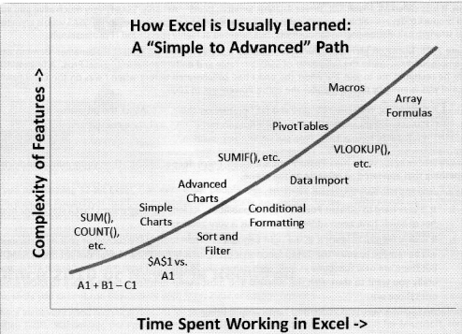
DAX FORMULAS FOR PowerPivot, Rob Collie, p.10

Slide 5
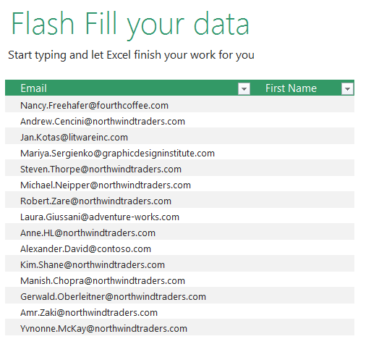
Notes:
If you are not aware of Flash Fill this is new to 2013 and Excel gets smart and tries to figure out what you are wanting to do. In this example, you may want to split out the first name from the cell to the left. You “do” 2 and then Excel will do the rest of the column for you and you can accept it.

Slide 6
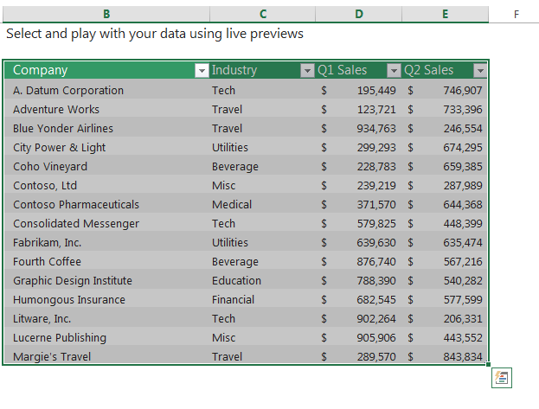
Quick Analysis
Notes:
Quick Analysis is also new. You select your data and a small icon appears bottom right.

Slide 7
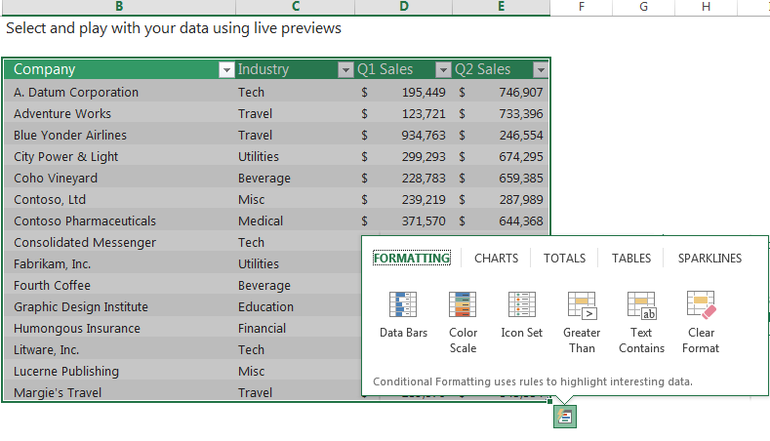
Quick Analysis
Notes:
When you click on it, you have options that pop-up on different tabs. And each tab has options.

Slide 8
Notes:
Sparklines have been around awhile and you probably will be using them. And you may also be using sliders and timelines.

Slide 9
Excel 2013 Data Capabilities
 | Obtain | Manage | Analyze | Visualize
Inquire |  | X
Recommended PivotTables |  |  | X
Recommended Charts |  |  |  | X
Power Query | X
Power Map |  |  |  | X
Power Pivot | X | X
Power View |  |  | X | X
 | Obtain | Manage | Analyze | Visualize
Inquire |  | X
Recommended PivotTables |  |  | X
Recommended Charts |  |  |  | X
Power Query | X
Power Map |  |  |  | X
Power Pivot | X | X
Power View |  |  | X | X
Commercial Add-Ins |  |  | X | X
Apps for Office |  |  | X | X
 | Obtain | Manage | Analyze | Visualize
Inquire |  | X
Recommended PivotTables |  |  | X
Recommended Charts |  |  |  | X
Power Query | X
Power Map |  |  |  | X
 | Obtain | Manage | Analyze | Visualize
Inquire |  | X
Recommended PivotTables |  |  | X
Recommended Charts |  |  |  | X

Slide 10
INQUIRE
Analyze workbook for problems or inconsistencies
See links between workbooks, worksheets or cells
Compare versions of workbook - graphical dependency maps
Worksheet relationship diagram
Notes:
You may or may not use this in this course, but you might at work, so good to know about. The ability to compare two workbooks, highlighting cells that differ and ability to visualize the relationships between cells This is particularly useful during an audit. Understanding the audit trail of how a figure came to be is a great way of maintaining the integrity and accuracy of the data.
http://www.microsofttraining.net/b/exceltraining/2013/04/excel-2013-audit-your-spreadsheet-with-the-inquire-add-in/#ixzz2tpQl0uoG

Slide 11
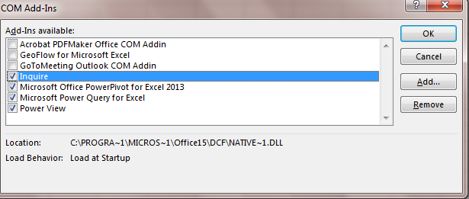
INQUIRE
File/Options/Add-ins/COM

Slide 12
INQUIRE
Workbook analysis
Shows workbook links
Relationships – workbook, worksheet, cells
Clean excess cell formatting
Manage passwords
Compare files
Notes:
The Workbook Analysis command creates an interactive report showing detailed information about the workbook and its structure, formulas, cells, ranges, and warnings.
Show workbook links
Workbooks connected to other workbooks through cell references can get confusing. Use the Workbook Relationship Diagram to create an interactive, graphical map of workbook dependencies created by connections (links) between files. The types of links in the diagram can include other workbooks, Access databases, text files, HTML pages, SQL Server databases, and other data sources. In the relationship diagram, you can select elements and find more information about them, and drag connection lines to change the shape of the diagram.
This diagram shows the current workbook on the left and the connections between it and other workbooks and data sources. It also shows additional levels of workbook connections, giving you a picture of the data origins for the workbook.
The Compare Files command lets you see the differences, cell by cell, between two workbooks. You need to have two workbooks open in Excel to run this command.
Results are color coded by the kind of content, such as entered values, formulas, named ranges, and formats. There's even a window that can show VBA code changes line by line. Differences between cells are shown in an easy to read grid layout, like this:
The Compare Files command uses Microsoft Spreadsheet Compare to compare the two files.
Clean excess cell formatting
Ever open a workbook and find it loads slowly, or has become huge? It might have formatting applied to rows or columns you aren't aware of. Use the Clean Excess Cell Formatting command to remove excess formatting and greatly reduce file size. This helps you avoid "spreadsheet bloat," which improves Excel's speed.
Manage passwords
If you're using the Inquire features to analyze or compare workbooks that are password protected, you'll need to add the workbook password to your password list so that Inquire can open the saved copy of your workbook. Use the Workbook Passwords command on the Inquire tab to add passwords, which will be saved on your computer. These passwords are encrypted and only accessible by you

Slide 13
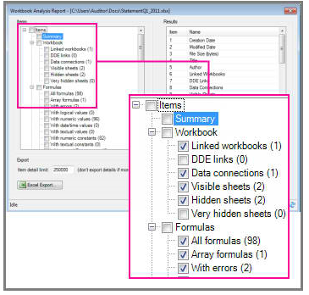
Workbook Analysis Report
Excel Help – Analyze a workbook
Notes:
The Workbook Analysis command creates an interactive report showing detailed information about the workbook and its structure, formulas, cells, ranges, and warnings. The picture here shows a very simple workbook containing two formulas and data connections to an Access database and a text file.

Slide 14
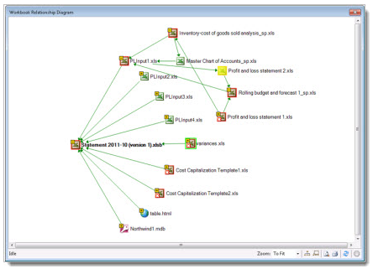
Workbook Relationships
Excel Help - What you can do with Spreadsheet Inquire
Notes:
This diagram shows the current workbook on the left and the connections between it and other workbooks and data sources. It also shows additional levels of workbook connections, giving you a picture of the data origins for the workbook.

Slide 15
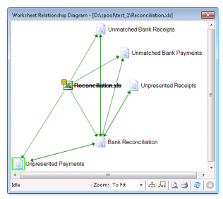
Worksheet Relationships
http://www.microsofttraining.net/b/exceltraining/2013/04/excel-2013-audit-your-spreadsheet-with-the-inquire-add-in/

Slide 16
Recommended PivotTables
Notes:
Another new features at the Insert tab is recommended PivotTables. With data in the spreadsheet, put cursor within the data and click on Recommend PivotTables.

Slide 17
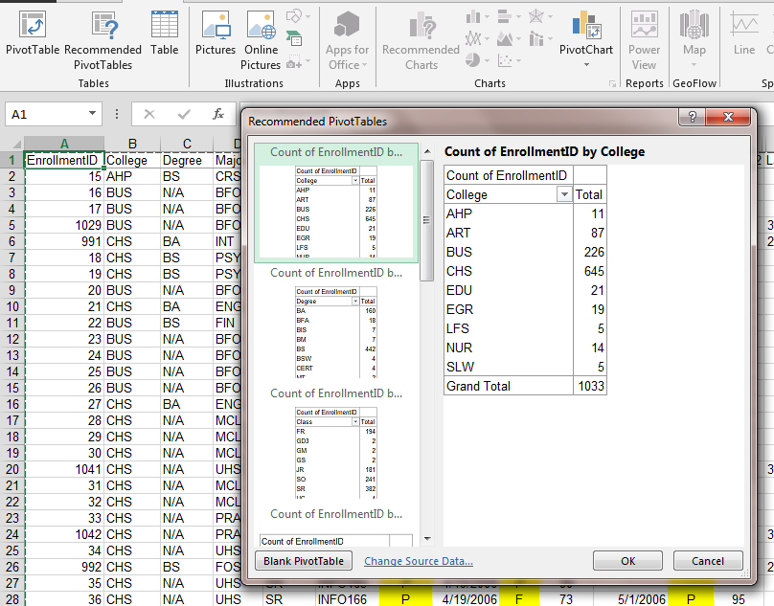
Recommended PivotTables
Notes:
Excel looks at the data and comes up with options. Scroll to see all of them. But you need to be able to understand what you need from your data.

Slide 18
Recommended Charts
Notes:
Again, cursor within the data, click on Recommended Charts and Excel will pick out options.

Slide 19
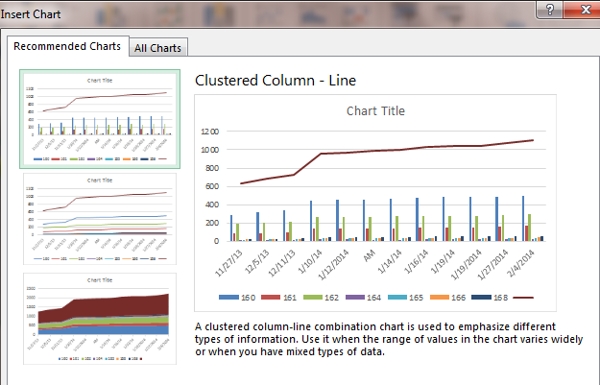
Recommended Charts

Slide 20
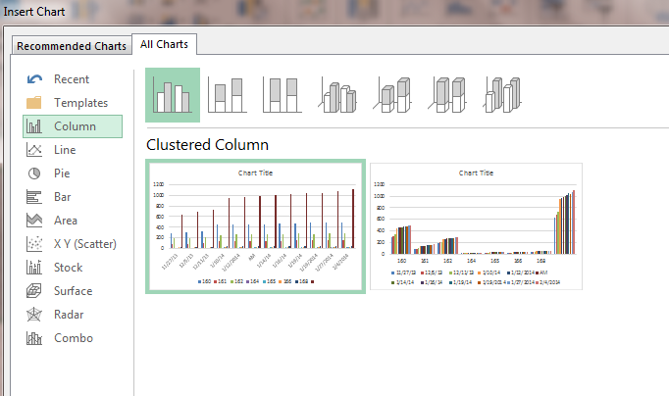
Recommended Charts
Notes:
Click on All Charts and still use the selected data to show what it will look like.

Slide 21
One step up
Power User
Basic Excel

Slide 22
Power User
New Excel Features
Notes:
Defined Power User as anyone who truly uses PivotTables.

Slide 23
>300 Million Excel users worldwide
Those who create Pivot Tables
10% - Pivot Pros (Rob Collie)

Slide 24
Microsoft’s 4 BI Capabilities
Power Query
Power Map
Power Pivot
Power View
Notes:
BI - Business Intelligence
Self Service BI
ETL - extract, transform, and load

Slide 25
Excel 2013 Data Capabilities
 | Obtain | Manage | Analyze | Visualize
Inquire |  | X
Recommended PivotTables |  |  | X
Recommended Charts |  |  |  | X
Power Query | X
Power Map |  |  |  | X
Power Pivot | X | X
Power View |  |  | X | X
 | Obtain | Manage | Analyze | Visualize
Inquire |  | X
Recommended PivotTables |  |  | X
Recommended Charts |  |  |  | X
Power Query | X
Power Map |  |  |  | X
Power Pivot | X | X
Power View |  |  | X | X
Commercial Add-Ins |  |  | X | X
Apps for Office |  |  | X | X
 | Obtain | Manage | Analyze | Visualize
Inquire |  | X
Recommended PivotTables |  |  | X
Recommended Charts |  |  |  | X
Power Query | X
Power Map |  |  |  | X
 | Obtain | Manage | Analyze | Visualize
Inquire |  | X
Recommended PivotTables |  |  | X
Recommended Charts |  |  |  | X

Slide 26
Power Query
Data discovery and query tool
Enhances self-service BI experience
Public search feature
Notes:
Power Query, an Excel add-in enhances the self-service Business Intelligence experience in Excel by simplifying data discovery and access. Power Query enables users to easily discover, combine, and refine data for better analysis in Excel. Power Query includes a public search feature that is currently intended for use in the United States only.
http://office.microsoft.com/en-us/excel-help/how-power-query-and-power-pivot-work-together-HA104125038.aspx

Slide 27
Power Query
Notes:
Will have its own tab but has to be downloaded.

Slide 28
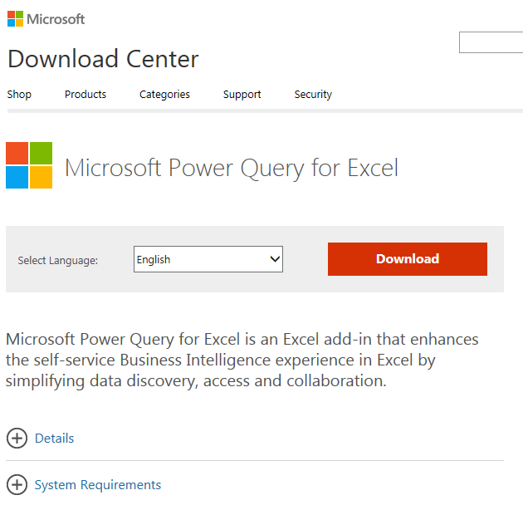
Power Query
Notes:
Microsoft Power Query is an Excel add-in that enhances the self-service Business Intelligence experience in Excel by simplifying data discovery and access. Power Query enables users to easily discover, combine, and refine data for better analysis in Excel. Power Query includes a public search feature that is currently intended for use in the United States only.

Slide 29
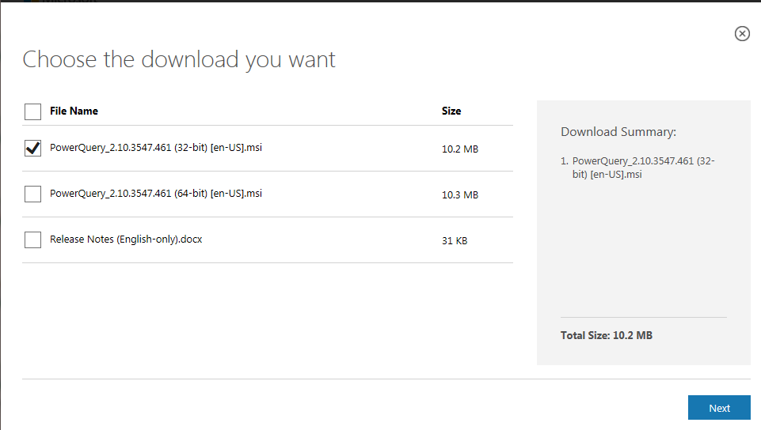
Power Query
32 or 64 bit
Notes:
32 or 64 bit versions, then run. 64 bit is recommended.

Slide 30
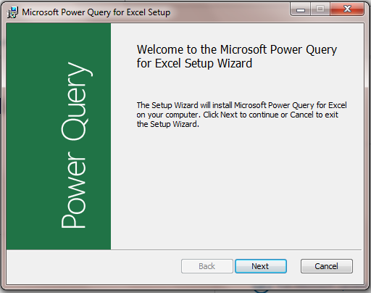
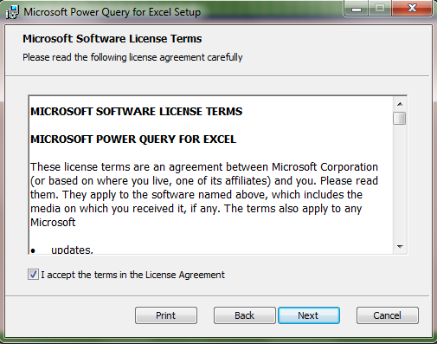
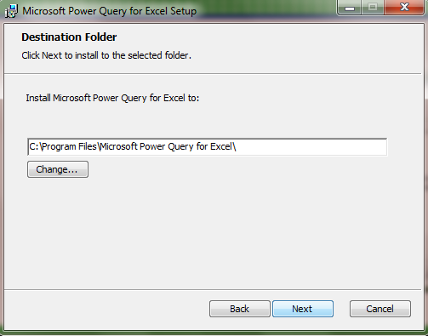
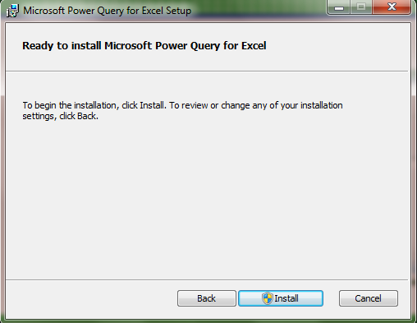
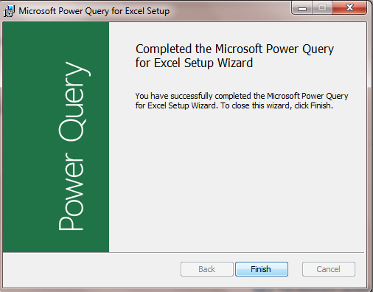
Power Query

Slide 31
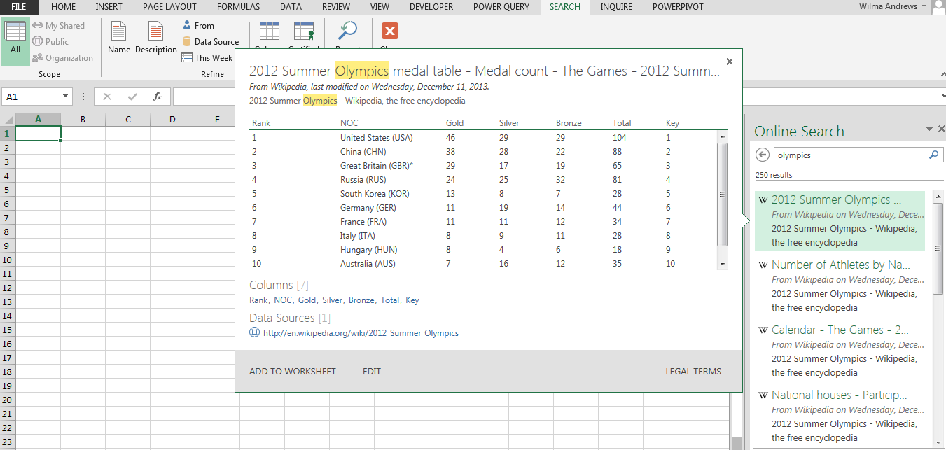
Notes:
Type in a search word at Online Search – here Olympics. Option to add to worksheet. If do it again, can add another one to another worksheet

Slide 32
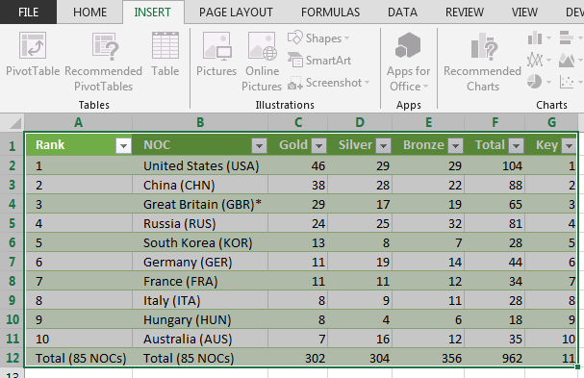
Table format
Notes:
Inserts it in a table format – this format is used a lot in new features so learn how to use it.

Slide 33
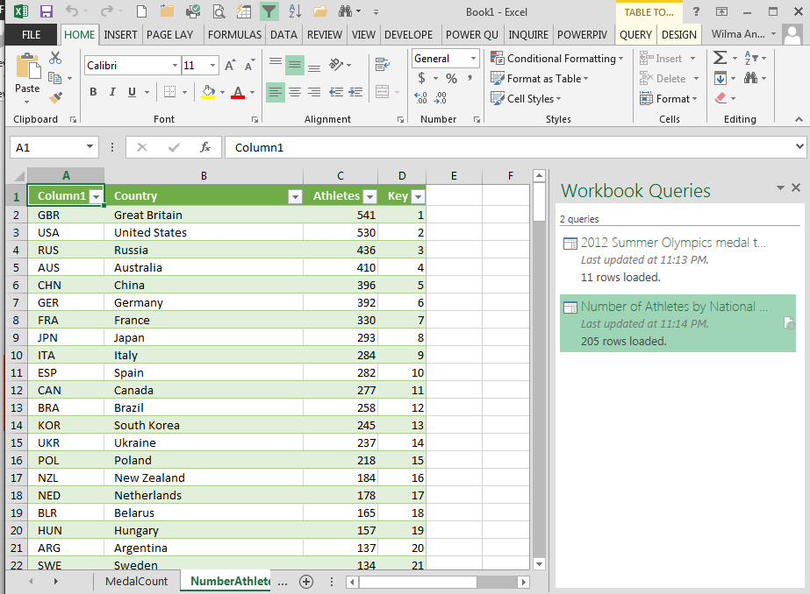
Notes:
Will put additional queries in on new worksheets.

Slide 34
Power Map (GeoFlow)
3-D data visualization of data sets
Notes:
This is a great feature. It was scheduled to go away from all versions except Office 365 but that has changed. There are still some questions about student and faculty access to Office 365.

Slide 35
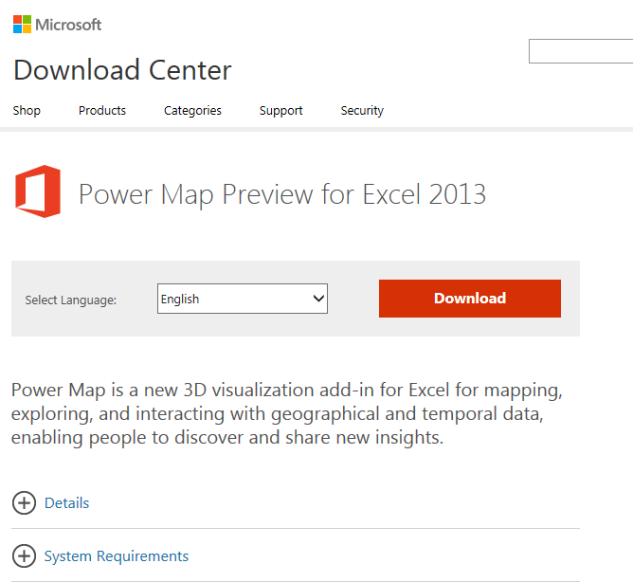
Power Map (GeoFlow)
Download

Slide 36
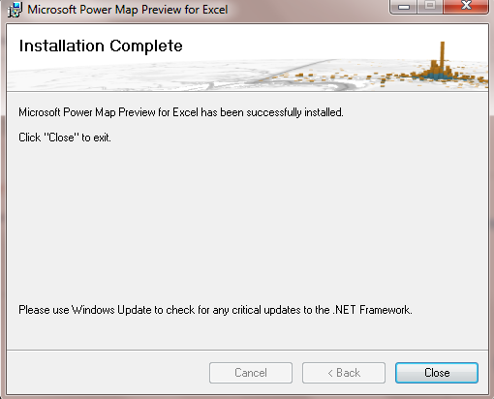

Slide 37
Power Map (GeoFlow)

Slide 38
Power Map
Notes:
Shown here are links to Virginia Weather Stations latitude/longitude/elevation.

Slide 39
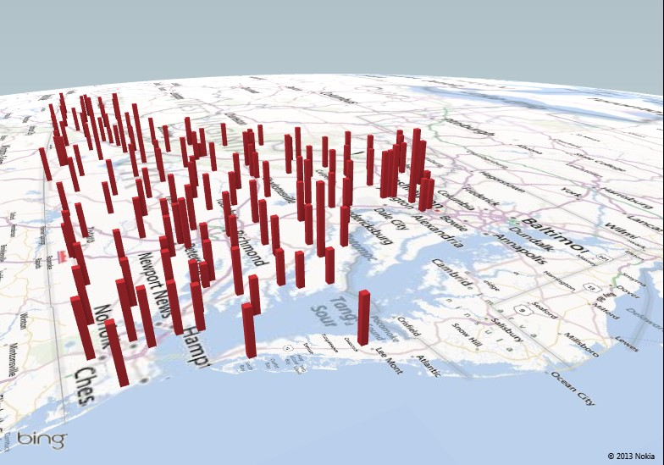
% Population 65 and Older by Locality
Notes:
Another GeoFlow example

Slide 40
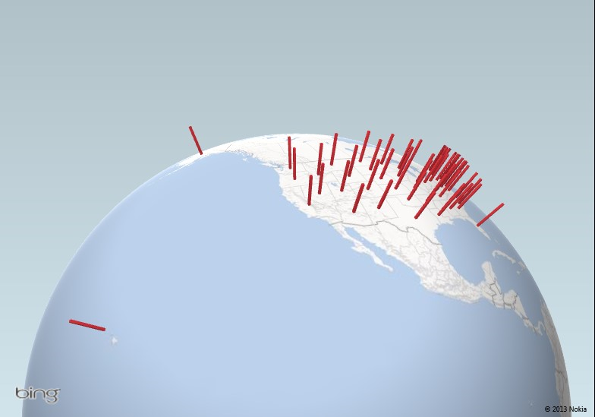
% People in Poverty by State

Slide 41
Another step up
Power Pro
Power User
Basic Excel

Slide 42
Power Pro
New Excel Features

Slide 43
Power Pivot
“The best thing to happen to Excel in 20 years.”
Bill Jelen, Mr. Excel
“This is the rare technology that can (and will) fundamentally change the lives of millions of people.”
Rob Collie, PowerPivotPro

Slide 44
Power Pivot
By far, the biggest “competitor” to Power Pivot is…
In other words, lack of awareness that Power Pivot even EXISTS is still the biggest “competitor” to Power Pivot today.
Excel itself.
http://www.powerpivotpro.com/2014/01/what-is-power-pivots-1-competitor/#more-8854

Slide 45
Power Pivot
Handles massive volumes of data
Builds on known pivot table skills
Possible multi-table pivots
“Save As” - for interactive web application
Notes:
In Excel 2013, Power Pivot only in Professional Plus.^{[1]} It extends the capabilities of the PivotTable data summarization and cross-tabulation feature with new features such as expanded data capacity, advanced calculations, ability to import data from multiple sources, and the ability to publish the workbooks as interactive web applications.^{[2]} As such, Power Pivot falls under Microsoft's Business Intelligence offering, complementing it with its self-service, in-memory capabilities. http://office.microsoft.com/en-us/excel-help/start-power-pivot-in-microsoft-excel-2013-add-in-HA102837097.aspx

Slide 46
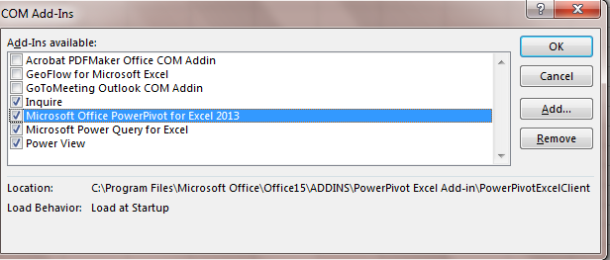
Power Pivot
File/Options/Add-ins/COM Add-Ins
Notes:
Simple add-in

Slide 47
Power Pivot
Notes:
http://office.microsoft.com/en-us/excel-help/start-power-pivot-in-microsoft-excel-2013-add-in-HA102837097.aspx

Slide 48
PowerPivot Features
Filter data
Rename tables and columns
Manage model
Create relationships
Apply formatting
Define calculated fields
Notes:
Filter data when importing. Import data in both Excel and Power Pivot, but when importing data in Power Pivot, you can filter out unnecessary data to import just a subset.
Rename tables and columns as you import data in Power Pivot.
Manage the model and create relationships using drag and drop in the Diagram View.
Apply formatting (to be used in Power View and PivotTable reports).
Define your own calculated fields to use throughout a workbook.
Define key performance indicators (KPIs) to use in PivotTables.
Create user-defined hierarchies to use throughout a workbook.
Define perspectives.
Author your own calculations by writing advanced formulas that use the Data Analysis Expressions (DAX) expression language.
Use other more advanced data and modeling operations.

Slide 49
DAX FORMULAS FOR PowerPivot, Rob Collie, p.10

Slide 50
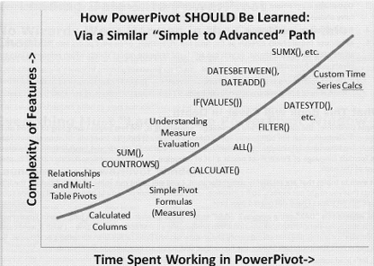
DAX FORMULAS FOR PowerPivot, Rob Collie, p.11

Slide 51
Power Query vs Power Pivot
Power Query - discover, connect to, and import data.
Power Pivot - model imported data
Both use Excel data in Excel to explore and visualize with Power Map, Power View, PivotTables and Pivot Charts.
Notes:
Power Query is the recommended experience for discovering, connecting to, and importing data.
Power Pivot is great for modeling the data you’ve imported. Use both to mold your data in Excel so you can explore and visualize it with Power Map, Power View, PivotTables, and PivotCharts, and then interact with the resulting workbook in SharePoint, on Power BI sites in Office 365, and in the Power BI Windows Store app.

Slide 52
Power View
Explore
Visualize
Present
Notes:
Sometimes the Power View icon is grayed out. If so, you may need to turn on the Power View add-in.
TIP It’s a good practice to work with Excel tables rather than just ranges of data. Before you insert a Power View sheet based on your data, create an Excel table.
USE TABLES ONLY

Slide 53
Power View
Power Pivot models intuitive data visualization
Joins data together in a cohesive unit = data model
Data models created behind the scenes between tables and relationships
Notes:
Microsoft describes a Data Model as "a new approach for integrating data from multiple tables, effectively building a relational data source inside an Excel workbook."
videos - http://office.microsoft.com/en-us/excel-help/power-view-and-power-pivot-videos-HA104009784.aspx?CTT=5&origin=HA104048146

Slide 54
Data Model
“a new approach for integrating data from multiple tables, effectively building a relational data source inside an Excel workbook”

Slide 55
Power View
Charts
Filtering
Slicers
Sorting
Reports with multiple views
Notes:
http://office.microsoft.com/en-us/excel-help/power-view-explore-visualize-and-present-your-data-HA102835634.aspx#_Toc378340898

Slide 56
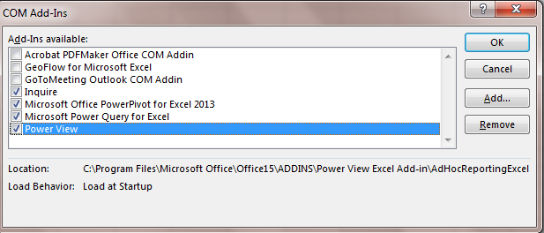
Power View
File/Options/Add-ins/COM Add-Ins

Slide 57
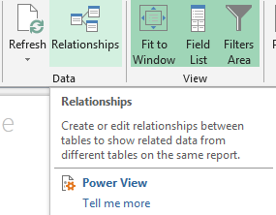
Power View
Notes:
Sometimes the Power View icon is grayed out. If so, you may need to turn on the Power View add-in.
TIP It’s a good practice to work with Excel tables rather than just ranges of data. Before you insert a Power View sheet based on your data, create an Excel table.
NOTE

Slide 58
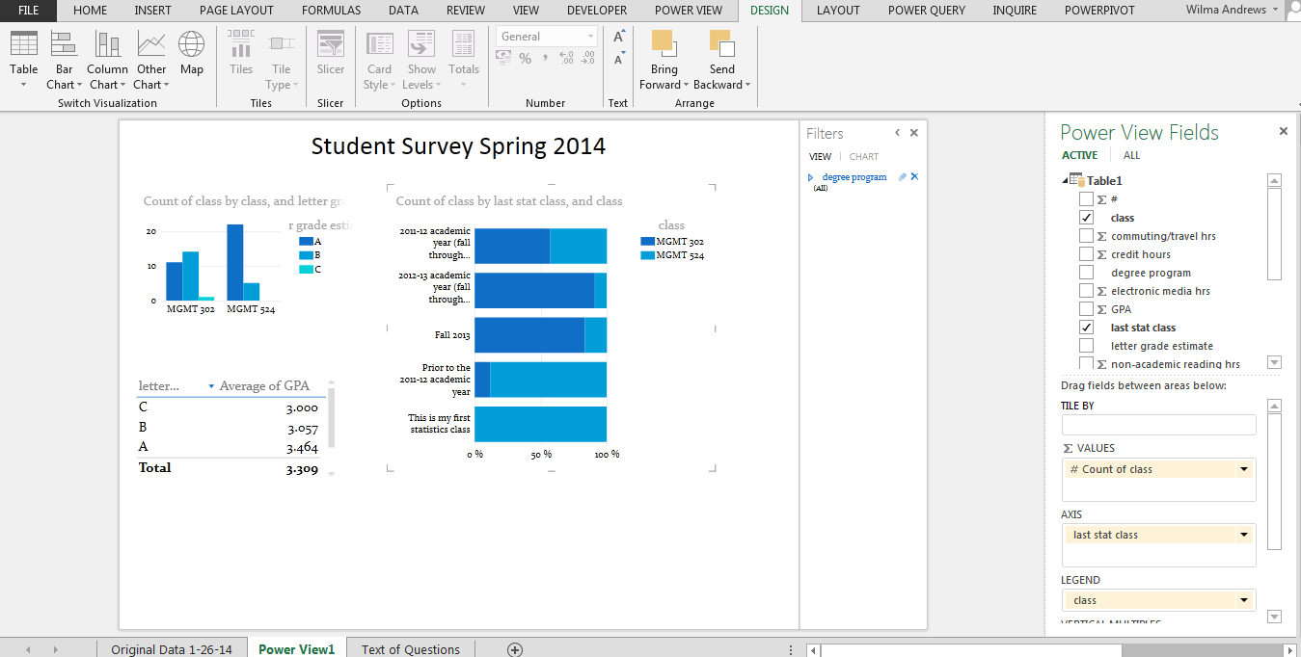
Notes:
TIP It’s a good practice to work with Excel tables rather than just ranges of data. Before you insert a Power View sheet based on your data, create an Excel table.
NOTE If you open an Excel 2010 workbook in Excel 2013 and try to insert a Power View sheet, you may see the message that the workbook has a Power Pivot data model created using a previous version of the Power Pivot add-in. If so, you can upgrade the workbook so you can add a Power View sheet. However, you won’t be able to open the upgraded workbook in Excel 2010 after you upgrade it. http://office.microsoft.com/en-us/excel-help/create-a-power-view-sheet-in-excel-2013-HA102899553.aspx

Slide 59
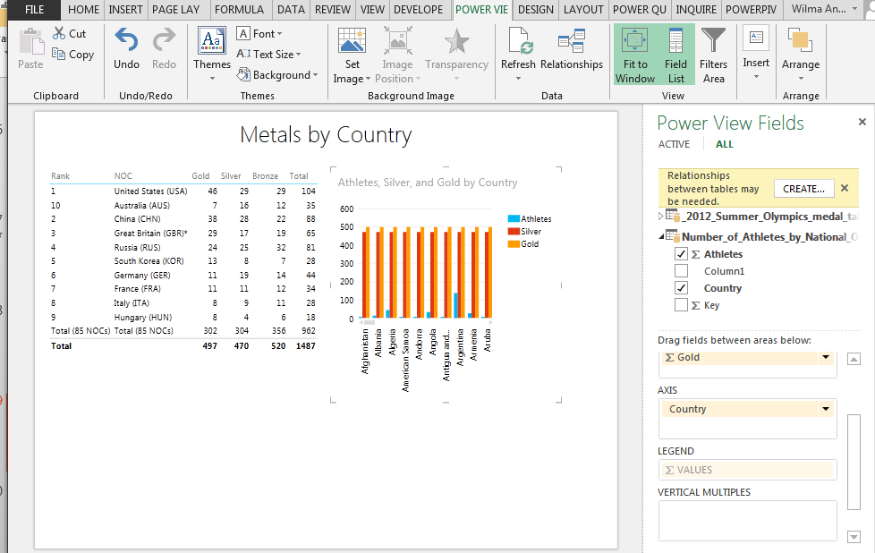

Slide 60
Microsoft’s position in Business Intelligence

Slide 61
Microsoft’s 4 BI Capabilities
Power Query
Power Map
Power Pivot
Power View
Notes:
data discovery techniques to make analytics beyond traditional reporting more accessible and pervasive to a broader range of users and use cases.
BI - Business Intelligence
Self Service BI
ETL - extract, transform, and load

Slide 62
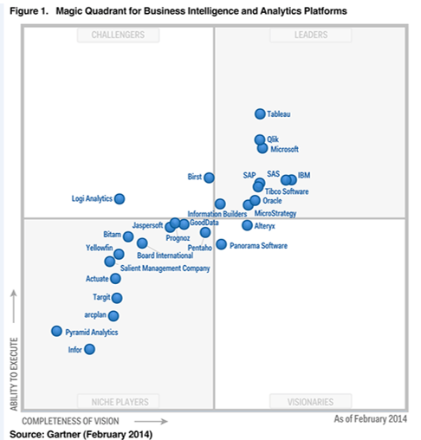
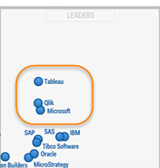
Magic Quadrant for Business Intelligence
Notes:
Gartner, a company that delivers technology research to global technology business leaders to make informed decisions on key initiatives, has put Microsoft in the Leader’s quadrant for Business Intelligence. - data discovery techniques to make analytics beyond traditional reporting more accessible and pervasive to a broader range of users and use cases.

Slide 63
PowerBI Blog
http://blogs.msdn.com/b/powerbi/

Slide 64
Additional Add-ins/downloads

Slide 65
Commercial Excel Add-ins
http://www.jmp.com/support/help/Import_Data_Using_the_Excel_Add-In.shtml
http://www.jmp.com/support/help/Import_Data_Using_the_Excel_Add-In.shtml
JMP - http://www.jmp.com/support/help/Import_Data_Using_the_Excel_Add-In.shtml
StatTools - https://www.palisade.com/stattools/
XLMiner - http://www.solver.com/xlminer-data-mining
XLSTAT - http://www.xlstat.com/en/

Slide 66
Apps for Office
Notes:
New to this version are Office Apps and as more and more are being developed, you will see an even broader range of uses especially for Excel in the business world.
Click on See all and will have something like this come up. Then to see more, click on Office Store

Slide 67
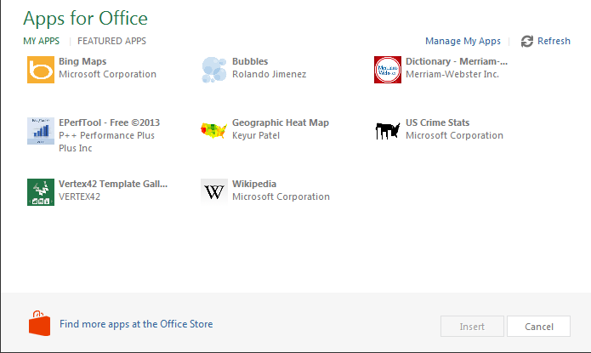
Apps for Office

Slide 68
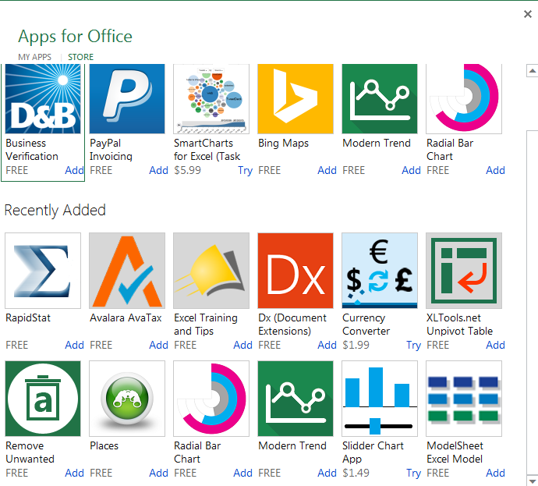
Apps for Office
Notes:
Some free, some have to pay for.

Slide 69
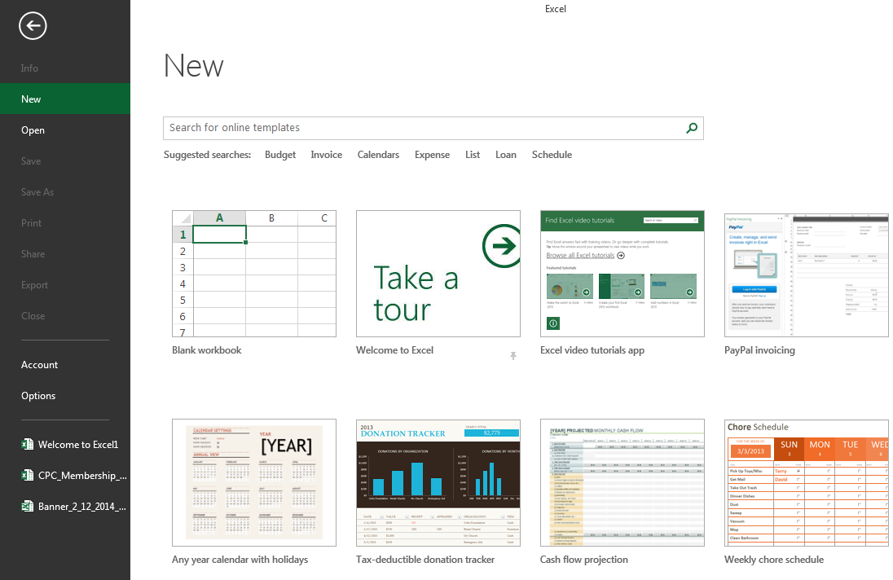
Videos at Excel/New
Notes:
There are some at File/New right within Excel. Others from the Microsoft website.

Slide 70
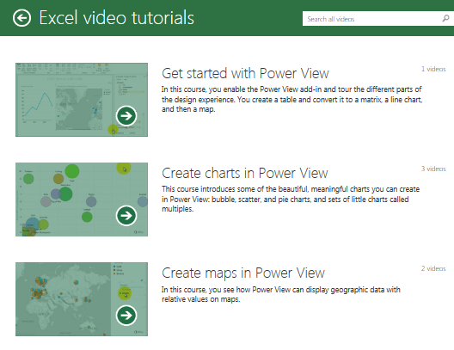
Excel Videos

Slide 71
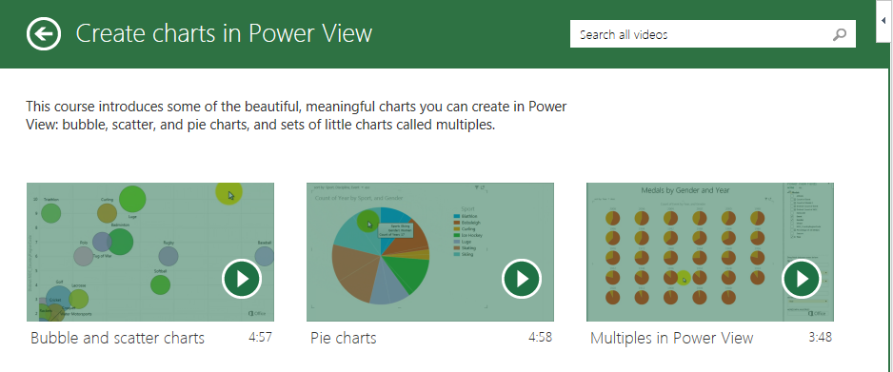
Excel Videos

Slide 72
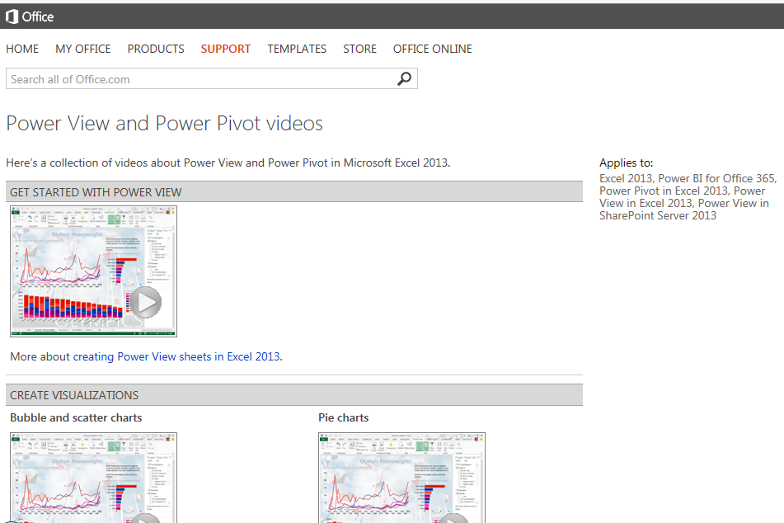
Microsoft Support site
Notes:
Many tutorials at Microsoft website

Slide 73
Mr. Excel
Bill Jelen – Mr. Excel
http://www.youtube.com/user/bjele123

Slide 74
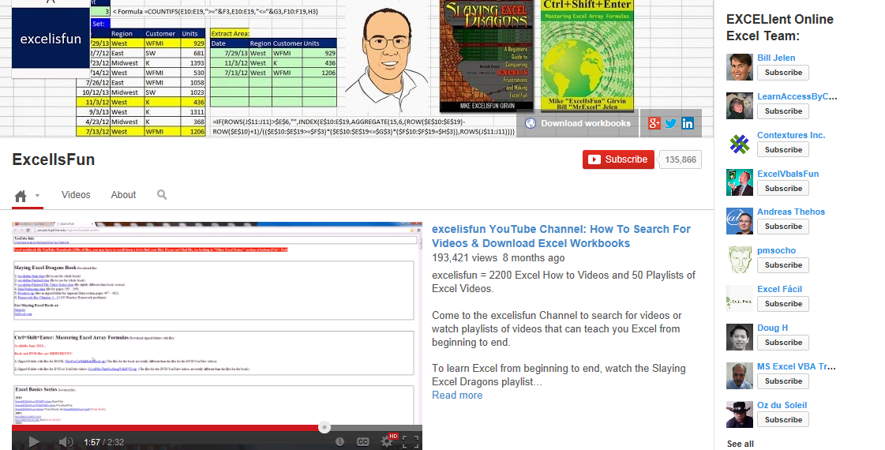
Excel is Fun
Mike Girven - Excel is Fun
http://www.youtube.com/user/ExcelIsFun

Slide 75
powerpivot(pro)
Rob Collie – powerpivotpro.com
http://www.youtube.com/channel/UCoZckhwYkolkjBIdVXpSNSg

Slide 76
Excel Blogs
http://blogs.office.com/excel/

Slide 77
Printed Resources
Visualizing Data with Microsoft Power View,
Larson, Davis, English and Purington
Dax Formulas for PowerPivot, Collie
Microsoft Excel 2013, Building Data Models with PowerPivot, Ferrai and Russo
Microsoft websites videos
Notes:
website videos
http://office.microsoft.com/en-us/excel-help/power-view-and-power-pivot-videos-HA104009784.aspx?CTT=5&origin=HA102835634

Slide 78
Excel 2013 Data Capabilities
 | Obtain | Manage | Analyze | Visualize
Inquire |  | X
Recommended PivotTables |  |  | X
Recommended Charts |  |  |  | X
Power Query | X
Power Map |  |  |  | X
Power Pivot | X | X
Power View |  |  | X | X
 | Obtain | Manage | Analyze | Visualize
Inquire |  | X
Recommended PivotTables |  |  | X
Recommended Charts |  |  |  | X
Power Query | X
Power Map |  |  |  | X
Power Pivot | X | X
Power View |  |  | X | X
Commercial Add-Ins |  |  | X | X
Apps for Office |  |  | X | X
 | Obtain | Manage | Analyze | Visualize
Inquire |  | X
Recommended PivotTables |  |  | X
Recommended Charts |  |  |  | X
Power Query | X
Power Map |  |  |  | X
 | Obtain | Manage | Analyze | Visualize
Inquire |  | X
Recommended PivotTables |  |  | X
Recommended Charts |  |  |  | X

Slide 79
Lots to learn…..

