Slide 1
Chapter 12: Introduction to Data Mining
Business Analytics: Methods, Models,
and Decisions, 1st edition
James R. Evans

Slide 2
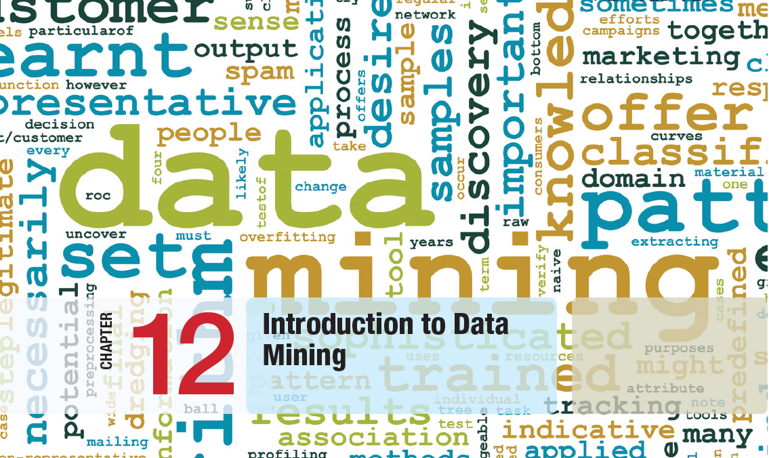

Slide 3
Chapter 12 Topics
The Scope of Data Mining
Data Exploration and Reduction
Classification
Classification Techniques
Association Rule Mining
Cause-and-Effect Modeling

Slide 4
Data Mining
Data mining is a rapidly growing field of business analytics focused on better understanding of characteristics and patterns among variables in large data sets.
It is used to identify and understand hidden patterns that large data sets may contain.
It involves both descriptive and prescriptive analytics, though it is primarily prescriptive.

Slide 5
The Scope of Data Mining
Some common approaches to data mining
Data Exploration and Reduction
- identify groups in which elements are similar
Classification
- analyze data to predict how to classify new
elements
Association
- analyze data to identify natural associations
Cause-and-effect Modeling
- develop analytic models to describe
relationships (e.g.; regression)

Slide 6
Data Exploration and Reduction
Cluster Analysis
Also called data segmentation
Two major methods
1. Hierarchical clustering
a) Agglomerative methods (used in XLMiner)
proceed as a series of fusions
b) Divisive methods
successively separate data into finer groups
2. k-means clustering (available in XLMiner)
partitions data into k clusters so that each element belongs to the cluster with the closest mean

Slide 7
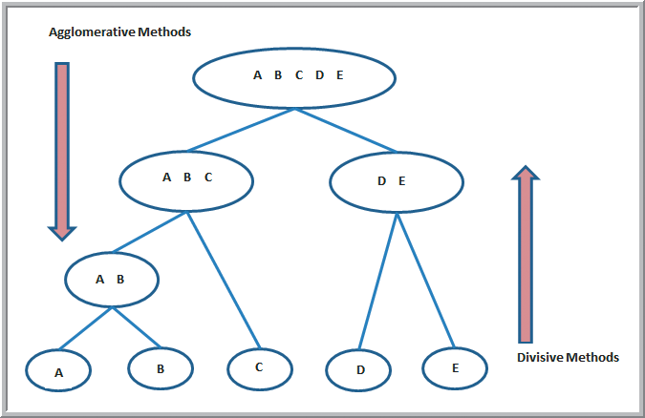
Data Exploration and Reduction
Agglomerative versus Divisive
Hierarchical Clustering Methods
Divisive
Not
Agglomerative
Agglomerative not Divisive!
Figure 12.1
Edited by Robert Andrews

Slide 8
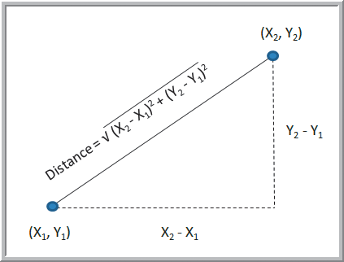
Data Exploration and Reduction
Cluster Analysis – Agglomerative Methods
Dendrogram – a diagram illustrating fusions or divisions at successive stages
Objects “closest” in distance to each other are gradually joined together.
Euclidean distance is
the most commonly
used measure of the
distance between
objects.
Euclidean
Figure 12.2

Slide 9
Data Exploration and Reduction
Cluster Analysis – Agglomerative Methods
Single linkage clustering (nearest-neighbor)
- distance between clusters is the shortest link
- at each stage, the closest 2 clusters are merged
Complete linkage clustering
- distance between clusters is the longest link
Average linkage clustering
- distance between clusters is the average link
Ward’s hierarchical clustering
- uses a sum of squares criterion

Slide 10
Data Exploration and Reduction
Example 12.1 Clustering Colleges and Universities
Cluster the Colleges and Universities data using the five numeric columns in the data set.
Use the hierarchical method
Figure 12.3

Slide 11
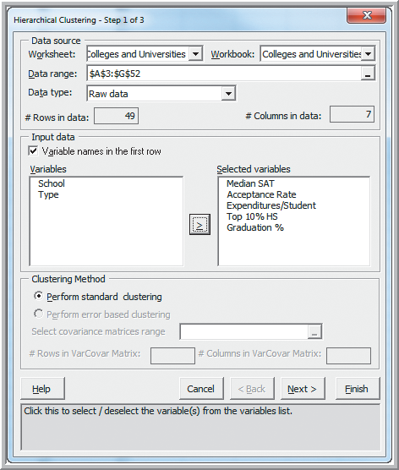
Data Exploration and Reduction
Example 12.1 (continued) Clustering Colleges and Universities
Add-Ins
XLMiner
Data Reduction and
Exploration
Hierarchical Clustering
Step 1 of 3:
Data Range: A3:G52
Selected Variables:
Median SAT
: :
Graduation %
Figure 12.4

Slide 12
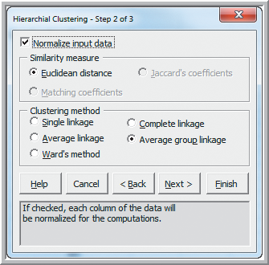
Data Exploration and Reduction
Example 12.1 (continued) Clustering Colleges and Universities
Step 2 of 3:
Normalize input data
Similarity Measure:
Euclidean distance
Clustering Method:
Average group linkage
Figure 12.5

Slide 13
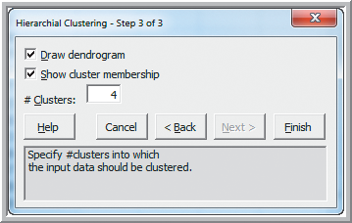
Data Exploration and Reduction
Example 12.1 (continued) Clustering Colleges and Universities
Step 3 of 3:
Draw dendrogram
Show cluster membership
# Clusters: 4
(this stops the method
from continuing until
only 1 cluster is left)
Figure 12.6

Slide 14
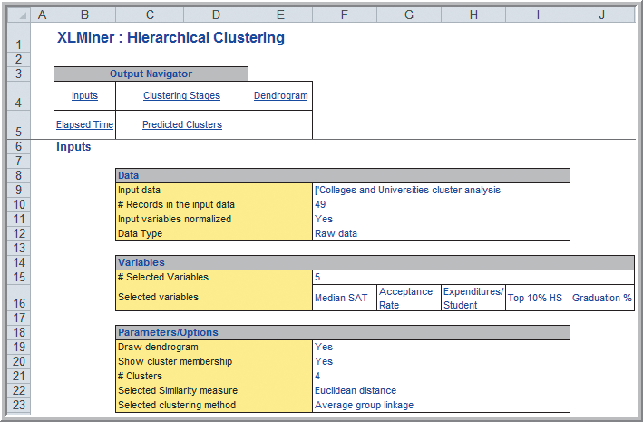
Data Exploration and Reduction
Example 12.1 (continued) Clustering Colleges and Universities
Hierarchical clustering results:
Inputs section
Figure 12.7

Slide 15
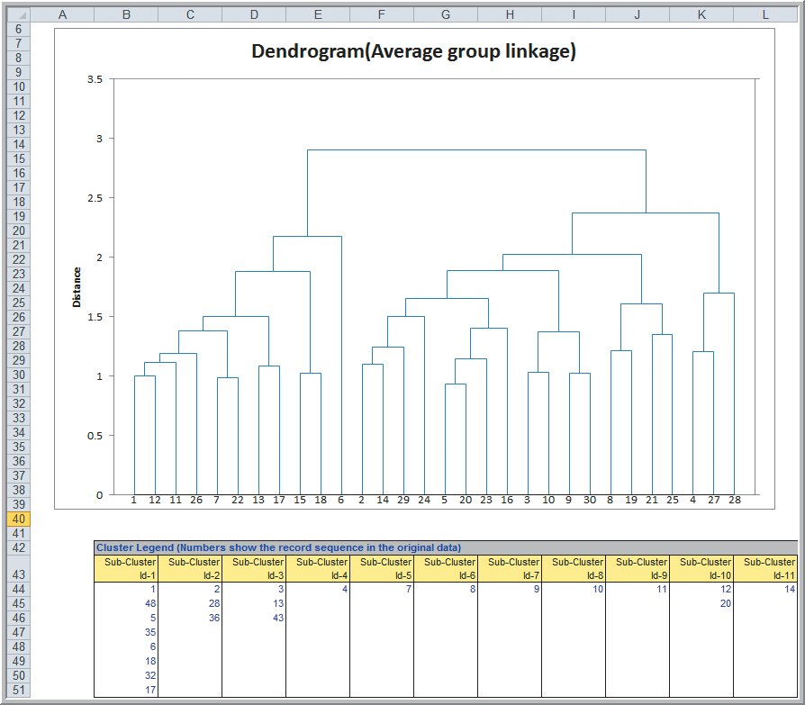
Data Exploration and Reduction
Example 12.1 (continued) Clustering Colleges and Universities
Hierarchical clustering results: Dendogram
y-axis measures intercluster distance
x-axis indicates Subcluster ID’s
Figure 12.8

Slide 16
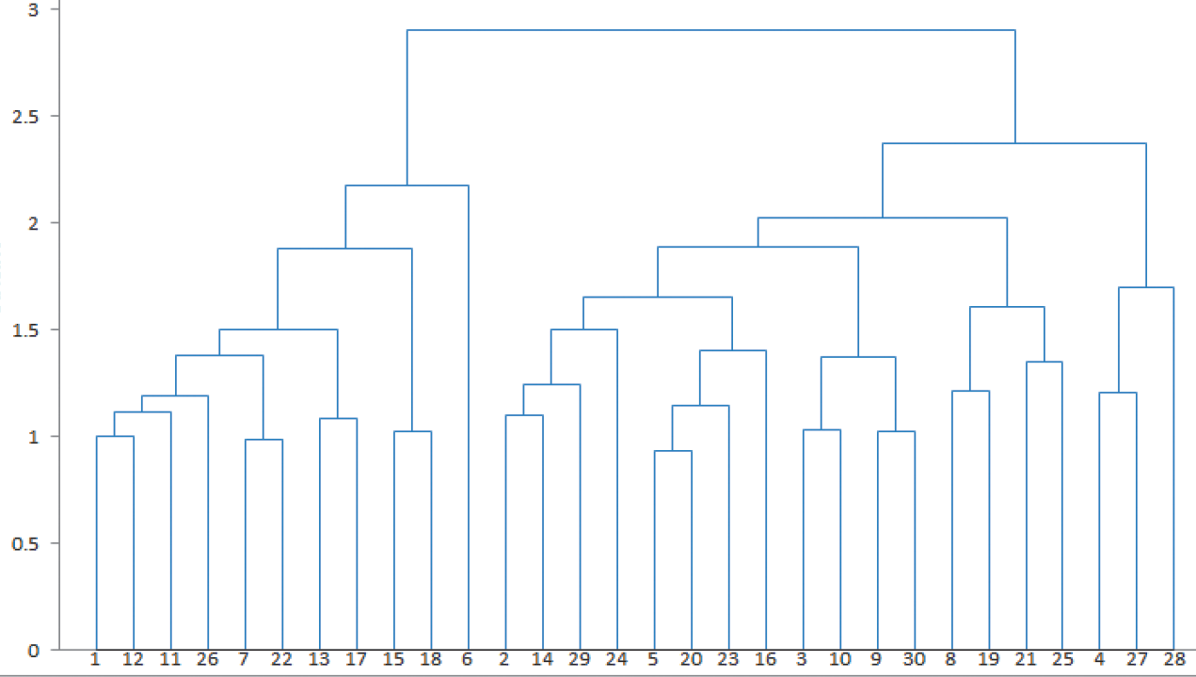
Data Exploration and Reduction
Example 12.1 (continued) Clustering of Colleges
Hierarchical clustering results: Dendrogram
From Figure 12.8

Slide 17
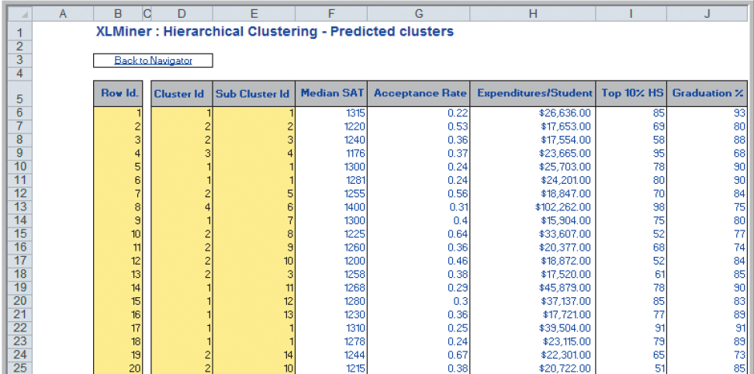
Data Exploration and Reduction
Example 12.1 (continued) Clustering of Colleges
Hierarchical clustering results: Predicted clusters
From Figure 12.9

Slide 18
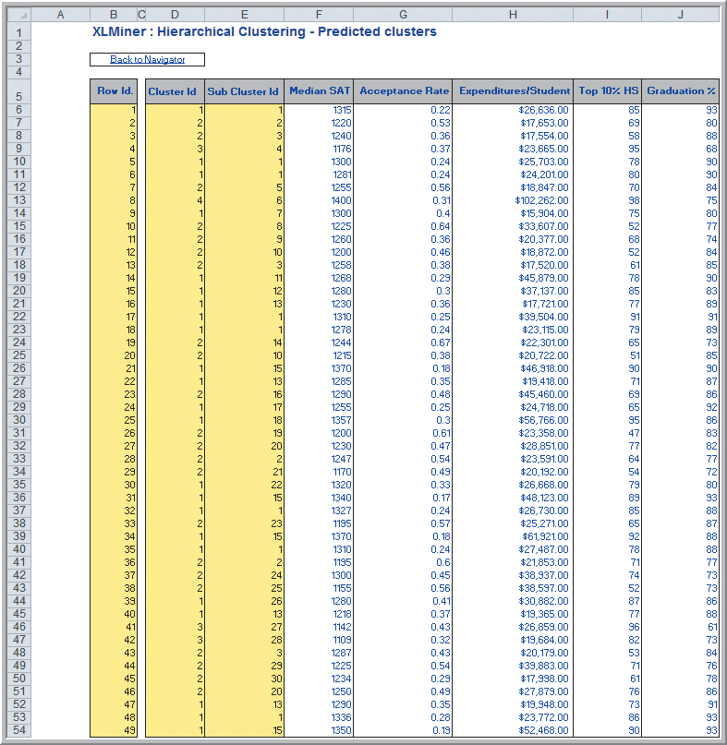
Data Exploration and Reduction
Example 12.1 (continued) Clustering of Colleges
Hierarchical clustering results: Predicted clusters
Cluster # Colleges
1 23
2 22
3 3
4 1
Figure 12.9

Slide 19
Data Exploration and Reduction
Example 12.1 (continued) Clustering of Colleges
Hierarchical clustering results for clusters 3 and 4
Schools in cluster 3 appear similar.
Cluster 4 has considerably higher Median SAT and Expenditures/Student.

Slide 20
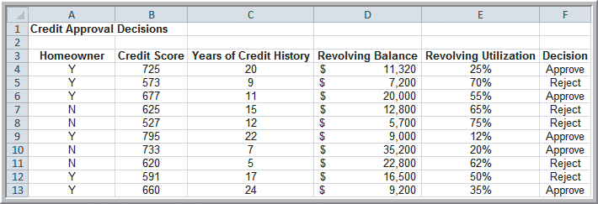
Classification
We will analyze the Credit Approval Decisions data to predict how to classify new elements.
Categorical variable of interest: Decision (whether to approve or reject a credit application)
Predictor variables: shown in columns A-E
Figure 12.10

Slide 21
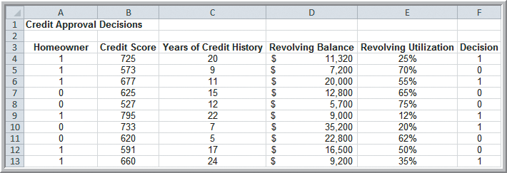
Classification
Modified Credit Approval Decisions
The categorical variables are coded as numeric:
Homeowner - 0 if No, 1 if Yes
Decision - 0 if Reject, 1 if Approve
Figure 12.11

Slide 22
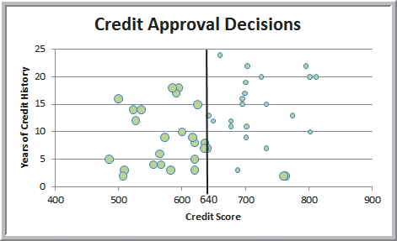
Classification
Example 12.2
Classifying Credit-Approval Decisions
Large bubbles correspond to rejected applications
Classification rule: Reject if credit score ≤ 640
2 misclassifications
out of 50 → 4%
Figure 12.12

Slide 23
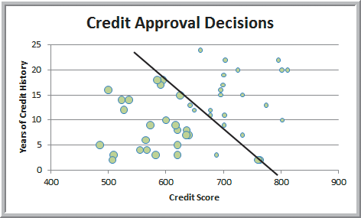
Classification
Example 12.2 (continued)
Classifying Credit-Approval Decisions
Classification rule: Reject if 0.095(credit score) +
(years of credit history) ≤ 74.66
3 misclassifications out of 50 → 6%
Figure 12.13

Slide 24
Classification
Example 12.3 Classification Matrix for Credit-Approval Classification Rules
Off-diagonal elements are the misclassifications
4% = probability of a misclassification
Table12.1
Figure 12.12

Slide 25
Classification
Using Training and Validation Data
Data mining projects typically involve large volumes of data.
The data can be partitioned into:
training data set – has known outcomes and is used to “teach” the data-mining algorithm
validation data set – used to fine-tune a model
test data set – tests the accuracy of the model
In XLMiner, partitioning can be random or user-specified.

Slide 26
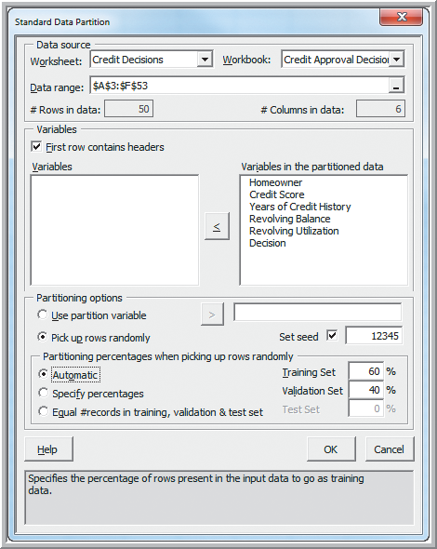
Classification
Example 12.4 Partitioning Data Sets in XLMiner
(Modified Credit Approval
Decisions data)
XLMiner
Partition Data
Standard Partition
Data Range: A3:F53
Pick up rows randomly
Variables in the
partitioned data: (all)
Partitioning %: Automatic
Figure 12.14

Slide 27
Classification
Example 12.4 (continued) Partitioning Data Sets in XLMiner
Partitioning choices when choosing random
Automatic 60% training, 40% validation
Specify % 50% training, 30% validation, 20% test (training and validation % can be modified)
Equal # records 33.33% training, validation, test
XLMiner has size and relative size limitations on the data sets, which can affect the amount and % of data assigned to the data sets.

Slide 28
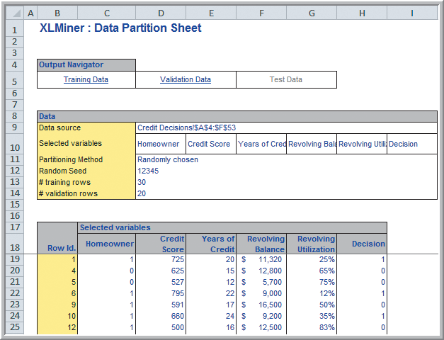
Classification
Example 12.4 (continued) Partitioning Data Sets in XLMiner
Portion of the output from a Standard Partition
First 30 rows:
Training data
Last 20 rows:
Validation data
Figure 12.15

Slide 29
Classification
Example 12.5 Classifying New Data for Credit Decisions Using Credit Scores and Years of Credit History
Use the Classification rule from Example 12.2:
Reject if 0.095(credit score) + (years of credit history) ≤ 74.66
Figure 12.16

Slide 30
Classification
Example 12.5 (continued) Classifying New Data for Credit Decisions Using Credit Scores and Years of Credit History
New data to classify
Reject if this is > 74.66
*

Slide 31
Classification Techniques
Three Data-Mining Approaches to Classification:
1. k-Nearest Neighbors (k-NN) Algorithm
find records in a database that have similar numerical values of a set of predictor variables
2. Discriminant Analysis
use predefined classes based on a set of linear discriminant functions of the predictor variables
3. Logistic Regression
estimate the probability of belonging to a category using a regression on the predictor variables

Slide 32
Classification Techniques
k-Nearest Neighbors (k-NN) Algorithm
Measure the Euclidean distance between records in the training data set.
If k = 1, then the 1-NN rule classifies a record in the same category as its nearest neighbor.
If k is too small, variability is high.
If k is too large, bias is introduced.
Typically various values of k are used and then results inspected to determine which is best.

Slide 33
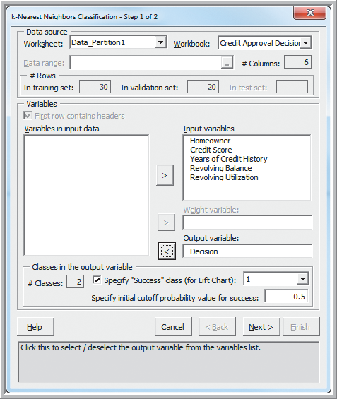
Classification Techniques
Example 12.6 Classifying Credit Decisions Using the k-NN Algorithm
Partition the data (see Example 12.4) to create the
Data_Partition1 worksheet.
Step 1
XLMiner
Classification
k-Nearest Neighbors
Worksheet: Data_Partition1
Input Variables: (5 of them)
Output variable: Decision
Figure 12.17

Slide 34
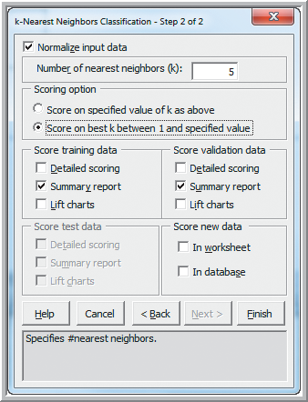
Classification Techniques
Example 12.6 (continued) Classifying Credit Decisions Using the k-NN Algorithm
Step 2
Normalize input data
Number of nearest neighbors (k): 5
Score on best k between 1 and
specified value
Figure 12.18

Slide 35
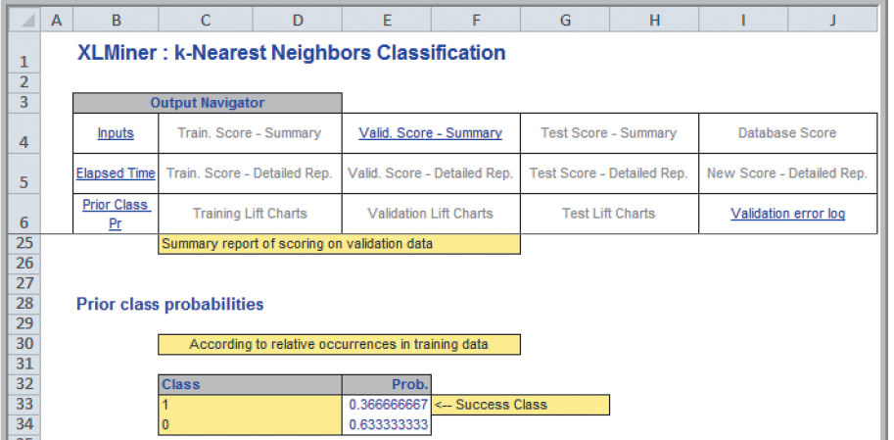
Classification Techniques
Example 12.6 (continued) Classifying Credit Decisions Using the k-NN Algorithm
A portion of the Input Section results
From Figure 12.19

Slide 36
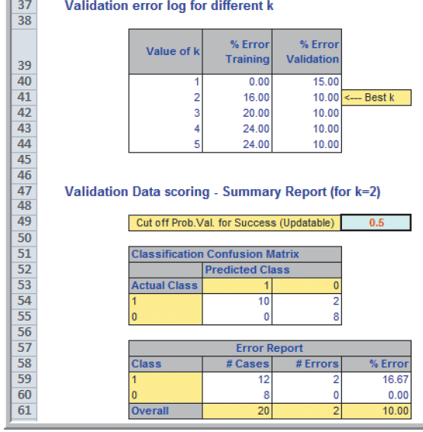
Classification Techniques
Example 12.6 (continued) Classifying Credit Decisions Using the k-NN Algorithm
Best Model: k = 2
2/20 = 10% misclassifications
From Figure 12.19

Slide 37
Classification Techniques
Example 12.7 Classifying New Data Using k-NN
Partition the data (see Example 12.4) to create the
Data_Partition1 worksheet.
Follow Step 1 in Example 12.6
Step 2
Normalize input data
Number of nearest neighbors (k): 5
Score on best k …
Score new data: In worksheet
Figure 12.18

Slide 38
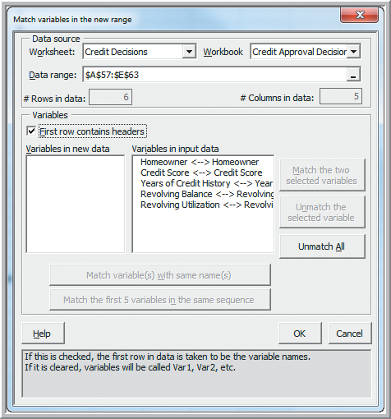
Classification Techniques
Example 12.7 (continued) Classifying New Data Using k-NN
Match variables in new range:
Worksheet: Credit Decisions
Data range: A57:E63
Match variables with same
names
Figure 12.20

Slide 39
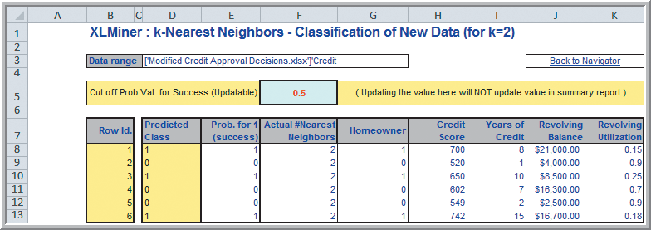
Classification Techniques
Example 12.7 (continued) Classifying New Data Using k-NN
Half of the applicants are in the “Approved” class
Figure 12.21

Slide 40
Classification Techniques
Discriminant Analysis
Determine the class of an observation using linear discriminant functions of the form:
b_{i} are the discriminant coefficients (weights)
b_{i} are determined by maximizing between-group variance relative to within-group variance
One discriminant function is formed for each category. New observations are assigned to the class whose function L has the highest value.

Slide 41
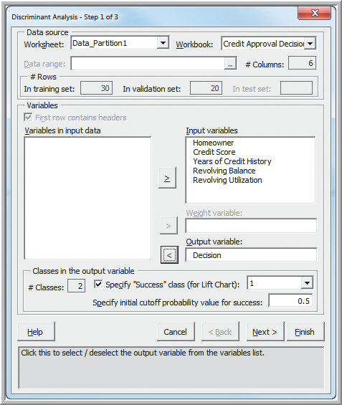
Classification Techniques
Example 12.8 Classifying Credit Decisions Using Discriminant Analysis
Partition the data (see Example 12.4) to create the
Data_Partition1 worksheet.
Step 1
XLMiner
Classification
Discriminant Analysis
Worksheet: Data_Partition1
Input Variables: (5 of them)
Output variable: Decision
Figure 12.22

Slide 42
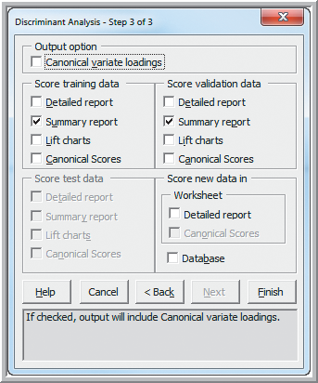
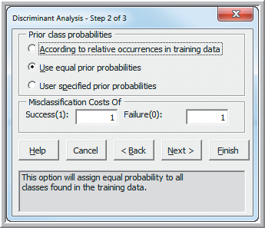
Classification Techniques
Example 12.8 (continued) Classifying Credit Decisions Using Discriminant Analysis
Steps 2 and 3
Figure 12.23
Figure 12.24

Slide 43
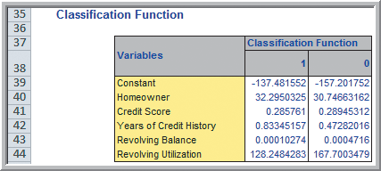
Classification Techniques
Example 12.8 (continued) Classifying Credit Decisions Using Discriminant Analysis
Figure 12.25

Slide 44
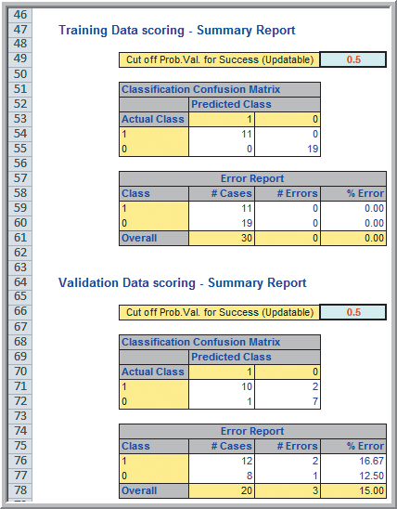
Classification Techniques
Example 12.8 (continued)
Classifying Credit Decisions
Using Discriminant Analysis
No misclassifications in the training data set.
15% misclassifications in the validation data set.
Figure 12.26

Slide 45
Classification Techniques
Example 12.9 Using Discriminant Analysis for Classifying New Data
Partition the data (see Example 12.4) to create the
Data_Partition1 worksheet.
Follow Steps 1 and 2
in Example 12.8.
Step 3
Score new data in:
Detailed Report
√
From Figure 12.24

Slide 46
Classification Techniques
Example 12.9 (continued) Using Discriminant Analysis for Classifying New Data
Match variables in new range:
Worksheet: Credit Decisions
Data range: A57:E63
Match variables with same names
Figure 12.20

Slide 47
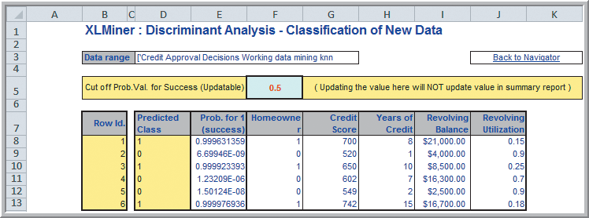
Classification Techniques
Example 12.9 (continued) Using Discriminant Analysis for Classifying New Data
Figure 12.27
Half of the applicants are in the “Approved” class
(the same 3 applicants as in Example 12.7).

Slide 48
Classification Techniques
Logistic Regression
A variation of linear regression in which the dependent variable is categorical, typically binary; that is, Y = 1 (success), Y = 0 (failure).
The model predicts the probability that the dependent variable will fall into a category based on the values of the independent variables p = P(Y = 1).
The odds of belonging to the Y = 1 category is equal to the ratio p/(1 − p).

Slide 49
Classification Techniques
Logistic Regression
The logit function is defined as:
where p is the probability that Y = 1, X_{i} are the independent variables, and β_{i} are unknown parameters to be estimated from the data.
The logit function can be solved for p

Slide 50
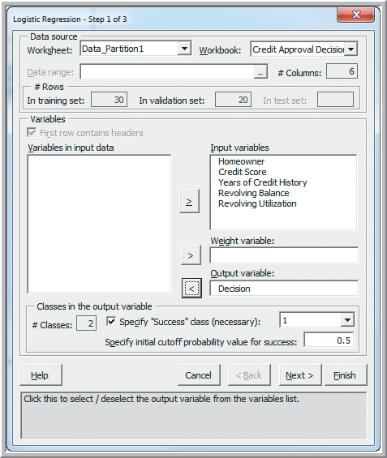
Classification Techniques
Example 12.10 Classifying Credit Approval Decisions Using Logistic Regression
Partition the data (see Example 12.4) to create the
Data_Partition1 worksheet.
Step 1
XLMiner
Classification
Logistic Regression
Worksheet: Data_Partition1
Input Variables: (5 of them)
Output variable: Decision
Figure 12.28

Slide 51
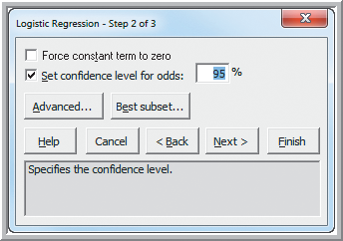
Classification Techniques
Example 12.10 (continued) Classifying Credit Approval Decisions Using Logistic Regression
Step 2:
Set confidence level
for odds: 95%
Best subset…
Figure 12.29

Slide 52
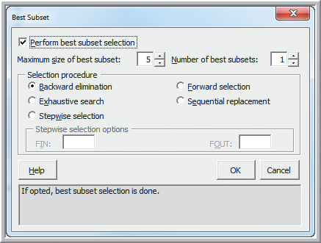
Classification Techniques
Example 12.10 (continued) Classifying Credit Approval Decisions Using Logistic Regression
Choose:
Perform best subset selection
Selection procedure:
Backward elimination
Note:
Best subset selection evaluates models containing subsets of the independent variables.
Figure 12.30

Slide 53
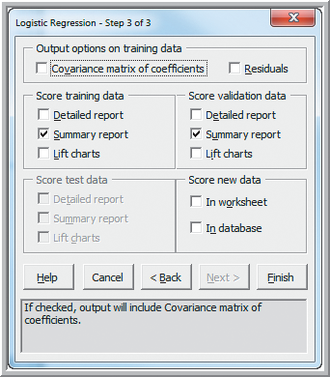
Classification Techniques
Example 12.10 (continued) Classifying Credit Approval Decisions Using Logistic Regression
Figure 12.31

Slide 54
Classification Techniques
Example 12.10 (continued) Classifying Credit Approval Decisions Using Logistic Regression
From Figure 12.32
Cp should be roughly equal to the number of model parameters.
Probability is an estimate of P(subset is acceptable).
The “full” model with 6 coefficients appears to be the best.

Slide 55
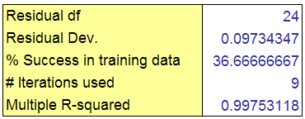
Classification Techniques
Example 12.10 (continued) Classifying Credit Approval Decisions Using Logistic Regression
This regression model is for the full model with 5 independent variables
(6 parameter coefficients).
From Figure 12.32

Slide 56
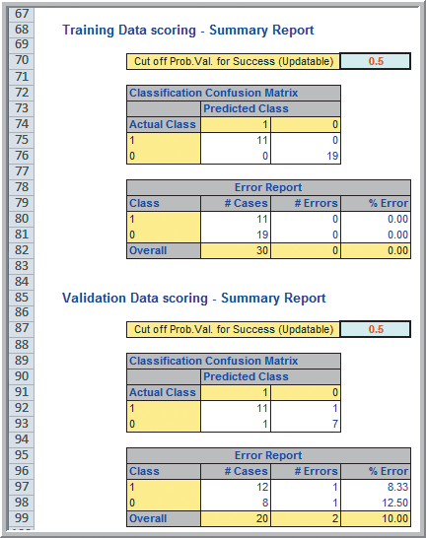
Classification Techniques
Example 12.10 (continued) Classifying Credit Approval Decisions Using Logistic Regression
No misclassifications in the training data set
10% misclassifications in the validation data set
From Figure 12.33

Slide 57
Classification Techniques
Example 12.11 Using Logistic Regression for Classifying New Data
Partition the data (see Example 12.4) to create the Data_Partition1 worksheet. Then follow steps 1 and 2 below (as in Example 12.10).
Figure 12.29
Figure 12.30
Figure 12.28

Slide 58
Classification Techniques
Example 12.11 (continued) Using Logistic Regression for Classifying New Data
Step 3
Score new data:
In worksheet
From Figure 12.31

Slide 59
Classification Techniques
Example 12.11 (continued) Using Logistic Regression for Classifying New Data
Match variables in new range:
Worksheet: Credit Decisions
Data range: A57:E63
Match variables with same names
Figure 12.20

Slide 60
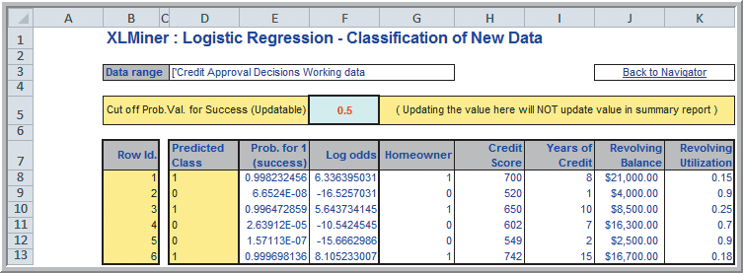
Classification Techniques
Example 12.11 (continued) Using Logistic Regression for Classifying New Data
Half of the applicants are in the “Approved” class
(the same result as in Examples 12.7 and 12.9).
Figure 12.34

Slide 61
Association Rule Mining
Association Rule Mining (affinity analysis)
Seeks to uncover associations in large data sets
Association rules identify attributes that occur together frequently in a given data set.
Market basket analysis, for example, is used determine groups of items consumers tend to purchase together.
Association rules provide information in the form of if-then (antecedent-consequent) statements.
The rules are probabilistic in nature.

Slide 62
Association Rule Mining
Example 12.12 Custom Computer Configuration
(PC Purchase Data)
Suppose we want to know which PC components are often ordered together.
Figure 12.35

Slide 63
Association Rule Mining
Measuring the Strength of Association Rules
Support for the (association) rule is the
percentage (or number) of transactions that
include all items both antecedent and consequent.
= P(antecedent and consequent)
Confidence of the (association) rule:
= P(consequent|antecedent)
= P(antecedent and consequent)/P(antecedent)
Expected confidence = P(antecedent)
Lift is a ratio of confidence to expected confidence.

Slide 64
Association Rule Mining
Example 12.13 Measuring Strength of Association
A supermarket database has 100,000 point-of-sale transactions:
2000 include both A and B items
5000 include C
800 include A, B, and C
Association rule:
If A and B are purchased, then C is also purchased.
Support = 800/100,000 = 0.008
Confidence = 800/2000 = 0.40
Expected confidence = 5000/100,000 = 0.05
Lift = 0.40/0.05 = 8

Slide 65
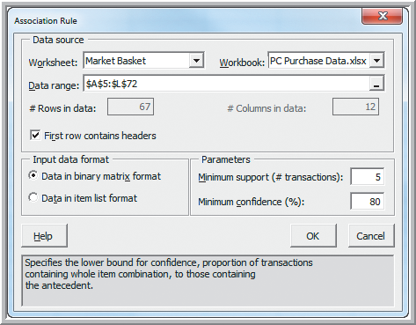
Association Rule Mining
Example 12.14 Identifying Association Rules for PC Purchase Data
XLMiner
Association
Affinity
Worksheet: Market Basket
Data range: A5:L72
First row headers
Minimum support: 5
Minimum confidence: 80
Figure 12.36

Slide 66
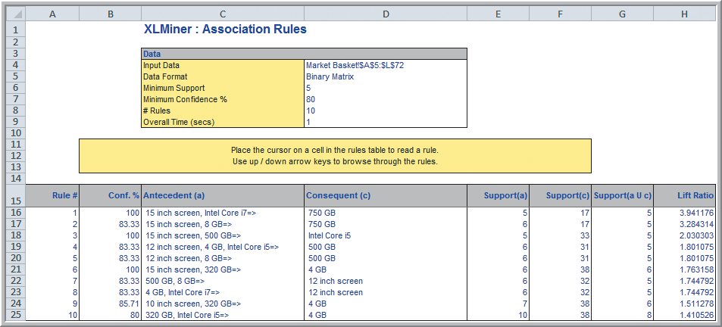
Association Rule Mining
Example 12.14 (continued) Identifying Association Rules for PC Purchase Data
Figure 12.37

Slide 67
Association Rule Mining
Example 12.14 (continued) Identifying Association Rules for PC Purchase Data
Figure 12.38
Rules are sorted by their Lift Ratio (how much more likely one is to purchase the consequent if they purchase the antecedents).

Slide 68
Cause-and-Effect Modeling
Correlation analysis can help us develop cause-and-effect models that relate lagging and leading measures.
Lagging measures tell us what has happened
- they are often external business results such as
profit, market share, or customer satisfaction.
Leading measures predict what will happen
- they are usually internal metrics such as
employee satisfaction, productivity, and turnover.
Figure 12.39

Slide 69
Cause-and-Effect Modeling
Example 12.15 Using Correlation for Cause-and-Effect Modeling (Ten Year Survey data)
Results of 40 quarterly satisfaction surveys for a major electronics device manufacturer
Satisfaction was measured on a 1-5 scale.
Figure 12.39

Slide 70
Cause-and-Effect Modeling
Example 12.15 (continued) Using Correlation for Cause-and-Effect Modeling
From Figure 12.40
Correlation analysis does not prove cause-and-effect but we can logically infer that a cause-and-effect relationship exists.

Slide 71
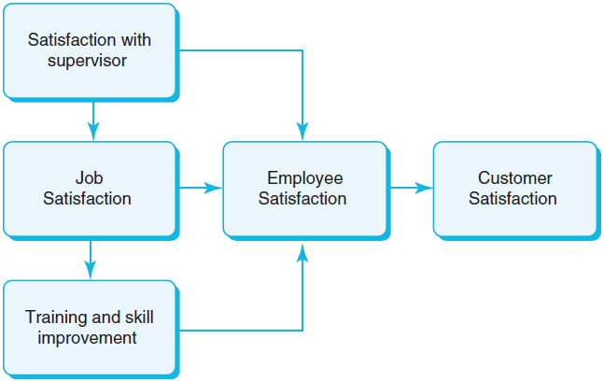
Cause-and-Effect Modeling
Example 12.15 (continued) Using Correlation for Cause-and-Effect Modeling
Figure 12.41

Slide 72
Cause-and-Effect Modeling
Example 12.15 (continued) Using Correlation for Cause-and-Effect Modeling
0.88
0.61
0.84
0.49
0.71
0.83
From Figures 12.40 and 12.41

Slide 73
Data Mining
Analytics in Practice: Successful
Business Applications of Data Mining
Pharmaceutical companies – use data mining to target physicians and tailor market activities
Credit card companies – identify customers most likely to be interested in new credit products
Transportation companies – identify best prospects for their services
Consumer package goods – selects promotional strategies to meet their target customers

Slide 74
Chapter 12 - Key Terms
Agglomerative clustering methods
Association rule mining
Average group linkage clustering
Average linkage clustering
Classification matrix
Cluster analysis
Complete linkage clustering
Confidence of the (association) rule
Data mining
Dendogram

Slide 75
Chapter 12 - Key Terms (continued)
Discriminant analysis
Discriminant function
Divisive clustering methods
Euclidean distance
Hierarchical clustering
k-nearest neighbors (k-NN) algorithm
Lagging measures
Leading measures
Lift
Logistic regression

Slide 76
Chapter 12 - Key Terms (continued)
Logit
Market basket analysis
Odds
Single linkage clustering
Support for the (association) rule
Training data set
Validation data set
Ward’s hierarchical clustering

Slide 77
Case Study Performance Lawn Equipment (12)
Recall that PLE produces lawnmowers and a medium size diesel power lawn tractor.
A third party survey obtained data related to predicting business usage.
The data consists of 13 variables related customer perceptions of the company and its products.
Apply appropriate data mining techniques to determine if PLE can segment customers.
Also, use cause-and effect models to provide insight and write a formal report of your results.

