Slide 1
Chapter 5: Probability Distributions and Data Modeling
Business Analytics: Methods, Models,
and Decisions, 1st edition
James R. Evans

Slide 3
Chapter 5 Topics
Basic Concepts of Probability
Random Variables and Probability Distributions
Discrete Probability Distributions
Continuous Probability Distributions
Random Sampling from Probability Distributions
Data Modeling and Distribution Fitting

Slide 4
Basic Concepts of Probability
Probability is the likelihood that an outcome occurs.
An experiment is the process that results in an outcome.
The outcome of an experiment is a result that we observe.
The sample space is the collection of all possible outcomes of an experiment.
An event is a collection of one or more outcomes from a sample space.

Slide 5
Basic Concepts of Probability
Probabilities may be defined from one of three perspectives:
Classical definition: probabilities can be deduced from theoretical arguments
Relative frequency definition: probabilities are based on empirical data
Subjective definition: probabilities are based on judgment and experience

Slide 6
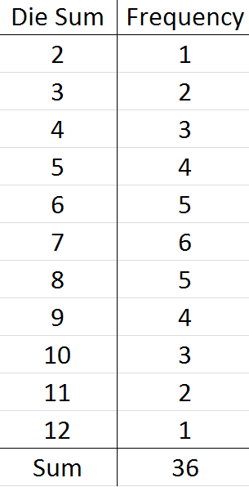
Basic Concepts of Probability
Example 5.1 Classical Definition of Probability
Suppose we roll 2 dice
Probability die rolls sum to three = 2/36
Suppose two consumers try a new product.
Assume equally likely possible outcomes:
1. like, like
2. like, dislike
3. dislike, like
4. dislike, dislike
Probability at least one dislikes product = 3/4

Slide 7
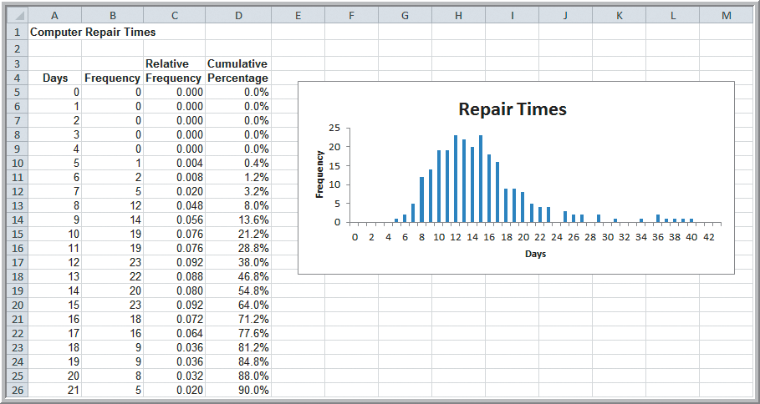
Basic Concepts of Probability
Example 5.2
Relative Frequency Definition of Probability
Probability a computer is repaired in 10 days
= 0.076
Figure 5.1

Slide 8
Basic Concepts of Probability
Two Basic Facts Govern Probability
The probability associated with any outcome must be between 0 and 1.
0 ≤ P(O_{i}) ≤ 1 for each outcome O_{i}
The sum of the probabilities over all possible outcomes must be equal to 1.
P(O₁) + P(O₂) + … + P(O_{n}) = 1
(n is the number of outcomes in the sample space.)

Slide 9
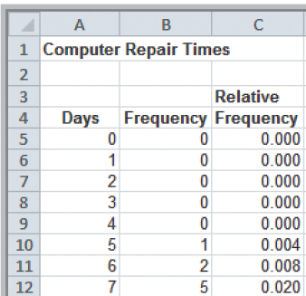
Basic Concepts of Probability
Example 5.3
Computing the Probability of an Event
Consider the events:
Rolling 7 or 11 on two dice
Probability = 6/36 + 2/36 = 8/36.
Repair a computer in 7 days or less
Probability =
= O₁ + O₂ + O₃ + O₄ + O₅ + O₆ + O₇
= 0 + 0 + 0 + 0 + .004 + .008 + .002
= 0.032
From Figure 5.1

Slide 10
Basic Concepts of Probability
Example 5.4 Computing the Probability of the Complement of an Event
A^{c}, the complement of A, consists of all outcomes in the sample space not in A.
Dice example:
A = {7, 11}
P(A) = 8/36
A^{c} = {2, 3, 4, 5, 6, 8, 9, 10, 12}
P(A^{c}) = 1 − 8/36 = 28/36

Slide 11
Basic Concepts of Probability
Example 5.5 Computing the Probability of Mutually Exclusive Events
Mutually exclusive events have no outcomes in common.
Dice Example:
A = {7, 11}
B = {2, 3, 12}
P(A or B) = UNION of events A and B
= P(A) + P(B)
= 8/36 + 4/36 = 12/36

Slide 12
Basic Concepts of Probability
Example 5.6 Computing the Probability of Non-Mutually Exclusive Events
Dice Example:
A = {2, 3, 12}
B = {even number}
P(A or B) = UNION of events A and B
= P(A) + P(B) − P(A and B)
= 4/36 + 18/36 − 2/36
= 20/36

Slide 13
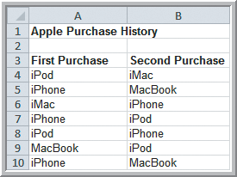
Basic Concepts of Probability
Example 5.7 Conditional Probability in Marketing
The Data shows the first and
second purchases for a
sample of 200 customers.
Probability of purchasing an
iPad given already purchased
an iMac = 2/13
Figure 5.2
Figure 5.3

Slide 14
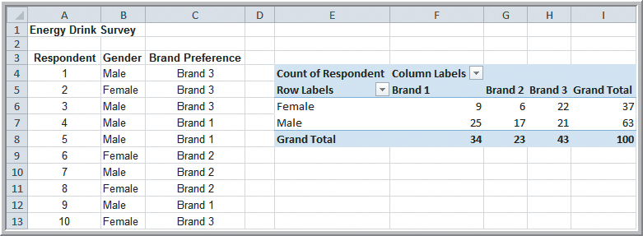
Basic Concepts of Probability
Example 5.8 Computing a Conditional Probability in a Cross-Tabulation
Probability of preferring Brand 1 given that a respondent is male = 25/63
Figure 5.4

Slide 15
Basic Concepts of Probability
Example 5.9
Using the Conditional Probability Formula
Probability of A given B:
P(B₁|M) = P(B₁ and M)/ P(M)
= (25/100)/(63/100)
= 25/63 = 0.397
Summary of conditional probabilities:

Slide 16
Basic Concepts of Probability
Example 5.10
Using the Multiplication Law of Probability
Texas Hold ‘Em Poker Game
Probability of pocket aces (two aces in hand):
P(Ace on first card and Ace on second card)
= P(A₁ and A₂)
= P(A₂|A₁) P(A₁)
= (3/51) (4/52)
= 0.004525

Slide 17
Basic Concepts of Probability
Example 5.11 Determining if Two Events are Independent
Are Gender and Brand Preference Independent?
Is P(B₁|M) = P(B₁)?
0.397 ≠ .34
Gender and Brand Preference are Dependent.

Slide 18
Basic Concepts of Probability
Example 5.12
Using the Multiplication Law for Independent Events
Dice Roll Example:
Rolling pairs of dice are independent events since they do not depend on the previous rolls.
A = {roll a sum of 6 on first pair die rolls}
B = {roll a sum of 2, 3, or 12 on second pair rolls}
P(A and B) = P(A) P(B)
= (5/36) (4/36) = 0.0154

Slide 19
Random Variables and Probability Distributions
A random variable is a numerical description of the outcome of an experiment.
A discrete random variable is one for which the number of possible outcomes can be counted.
A continuous random variable has outcomes over one or more continuous intervals of real numbers.
A probability distribution is a characterization of the possible values that a random variable may assume along with the probability of assuming these values.

Slide 20
Random Variables and Probability Distributions
Example 5.13
Discrete and Continuous Random Variables
Examples of Discrete Variables:
outcomes of dice rolls
whether a customer likes or dislikes a product
number of hits on a Web site link today
Examples of Continuous Variables:
weekly change in DJIA
daily temperature
time between machine failures

Slide 21
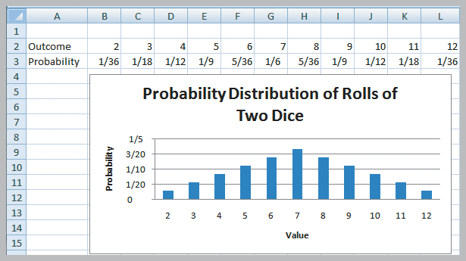
Random Variables and Probability Distributions
Example 5.14
Probability Distribution of Dice Rolls
Figure 5.5

Slide 22
Random Variables and Probability Distributions
Empirical Probability Distribution - Sample data is used to approximate a probability distribution
Figure 5.1

Slide 23
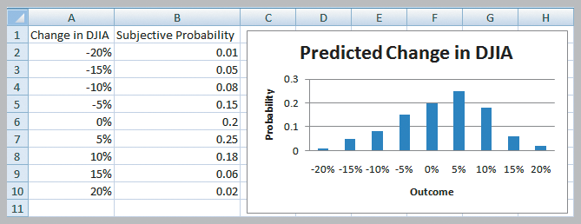
Random Variables and Probability Distributions
Example 5.15 A Subjective Probability Distribution
Distribution of an expert’s assessment of how the DJIA might change next year.
Figure 5.6

Slide 24
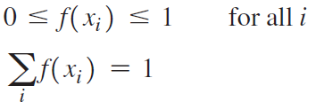
Discrete Probability Distributions
Probability Mass Function
a mathematical function f(x) specifying the probability of the random variable X.
x_{i} represents the i ^{th} value of X.
Properties:
Cumulative distribution function:
F(x) = P(X ≤ x)

Slide 25
Discrete Probability Distributions
Example 5.16
Probability Mass Function for Rolling Two Dice
f(x₂) = 1/36
f(x₃) = 2/36
f(x₄) = 3/36
f(x₅) = 4/36
f(x₆) = 5/36
:
f(x₁₂) = 1/36
Figure 5.5

Slide 26
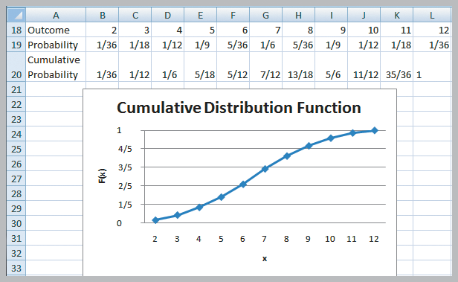
Discrete Probability Distributions
Example 5.17
Using the Cumulative Distribution Function
Probability of rolling between 4 and 8:
= P(4 ≤ X ≤ 8)
= P(3 < X ≤ 8)
= F(x₈) – F(x₃)
=13/18 – 1/12
= 23/36
Figure 5.7

Slide 27
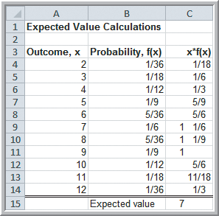
Discrete Probability Distributions
Example 5.18 Computing the Expected Value
of the sum of values on 2 die rolls
E[X] = 2(1/36) + 3(1/18) + …
12(1/36) = 7
Figure 5.8

Slide 28
Discrete Probability Distributions
Example 5.19 Expected Value on Television
Apprentice example
Teams were required to select an artist (mainstream or avant-garde) and sell their art for the most money possible.
Deal or No Deal example
Contestant had 5 briefcases left with $100, $400, $1000, $50,000 or $300,000 in them.
Expected value of briefcases is $70,300.
Banker offered contestant $80,000 to quit.

Slide 29
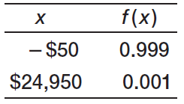
Discrete Probability Distributions
Example 5.20 Expected Value of Charitable Raffle
Cost of raffle ticket is $50
1000 raffle tickets were sold.
Prize for winning raffle is $25,000
E[X] = −$25

Slide 30
Discrete Probability Distributions
Example 5.21 Airline Revenue Management
Full and discount airfares are available for a flight.
Full-fare ticket costs $560
Discount ticket costs $400
X = ticket price paid
p = 0.75 (the probability of selling a full-fare ticket)
E[X] = 0.75($560) + 0.25(0) = $420
The airline should not discount full-fare tickets because the expected value of a full-fare ticket is greater than the cost of a discount ticket.
Break-even point: $400 = p($560) or p = 0.714

Slide 31
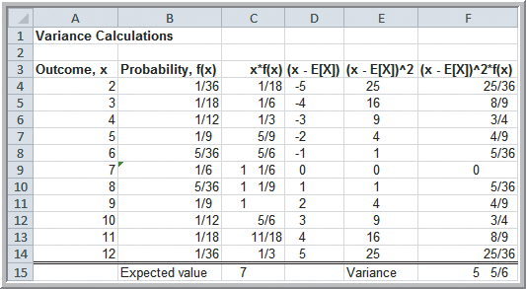
Discrete Probability Distributions
Example 5.22
Computing the Variance of a Random Variable
Figure 5.9

Slide 32
Discrete Probability Distributions
Bernoulli Distribution
two possible outcomes each with a constant probability of occurrence
typically “success” is x = 1 and “failure” x = 0
p is the probability of a success outcome
E[X] = p
Var[X] = p(1 − p)

Slide 33
Discrete Probability Distributions
Example 5.23 Using the Bernoulli Distribution
Model whether an individual responds positively to a telemarketing promotion.
You have a box with 20 red and 80 white marbles.
You ask individuals exposed to the telemarketing promotion to select a marble and then replace it.
If the customer selects a red marble, the customer makes a purchase.
If the customer selects a white marble, the customer does not make a purchase.

Slide 34
Discrete Probability Distributions
Binomial Distribution
Models n independent replications of a Bernoulli experiment
X represents the number of successes in these n experiments

Slide 35
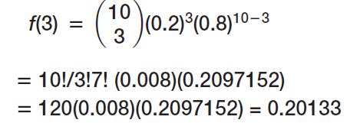
Discrete Probability Distributions
Example 5.24 Computing Binomial Probabilities
Suppose 10 individuals receive the telemarking promotion.
Each individual has a 0.2 probability of making a purchase.
Find the probability that exactly 3 of the 10 individuals make a purchase.

Slide 36
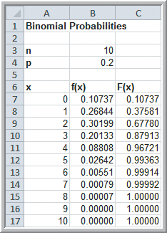
Discrete Probability Distributions
Example 5.25
Using Excel’s Binomial Distribution Function
P(x = 3) = 0.20133
= f(3)
=BINOM.DIST(3, 10, 0.2, true)
P(x ≤ 3) = 0.87913
= F(3)
=BINOM.DIST(3, 10, 0.2, false)
True: F(x)
False: f(x)
Figure 5.10

Slide 37
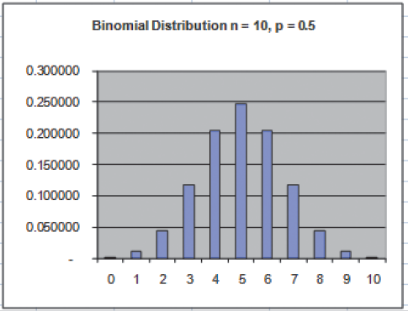
Discrete Probability Distributions
Histogram Example of the Binomial Distribution
Symmetric when p = 0.5
Figure 5.11a

Slide 38
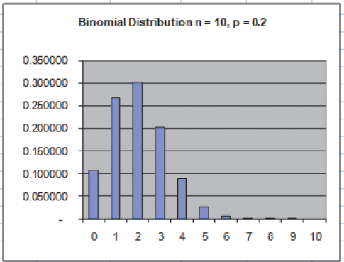
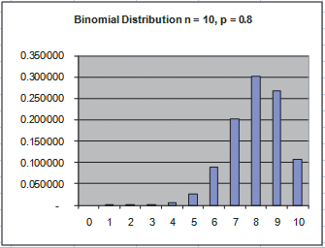
Discrete Probability Distributions
Histogram Examples of the Binomial Distribution
Positively skewed when p < 0.5
Negatively skewed when p < 0.5
Figure 5.11b
Figure 5.11c

Slide 39
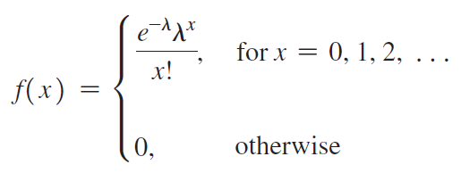
Discrete Probability Distributions
Poisson Distribution
Models the number of occurrences in some unit of measure (often time or distance).
There is no limit on the number of occurrences.
The average number of occurrence per unit is a constant denoted as λ.

Slide 40
Discrete Probability Distributions
Example 5.26 Computing Poisson Probabilities
Suppose the average number of customers arriving at a Subway restaurant during lunch hour is λ =12 per hour.
The probability that exactly x customers arrive during the hour is given by the Poisson distribution.
Find the probability that exactly 5 arrive during lunch hour:
f(5) = e⁻¹²(12⁵)/5!
= (0.000006144)(248,832)/120
= 0.1274

Slide 41
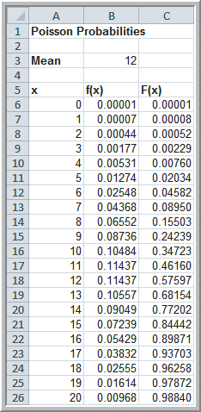
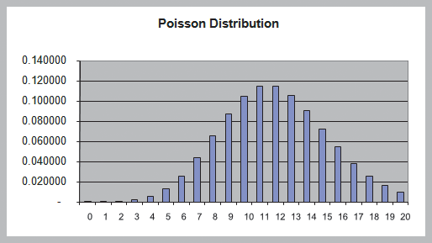
Discrete Probability Distributions
Example 5.27 Using Excel’s
Poisson Distribution Function
POISSON.DIST(x, mean, cumulative)
True: F(x)
False: f(x)
Figure 5.13
Figure 5.12

Slide 42
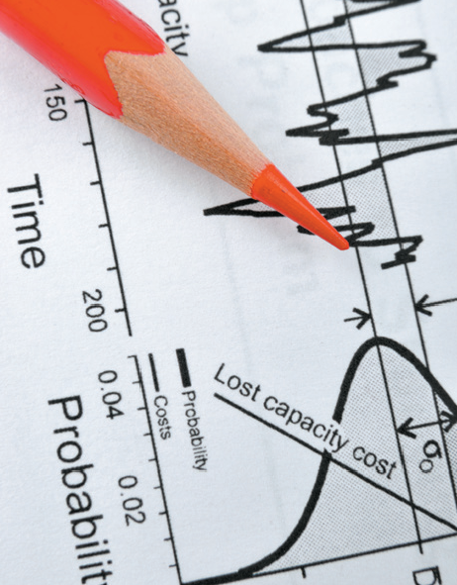
Discrete Probability Distributions
Analytics in Practice: Using the Poisson Distribution for Modeling Bids on Priceline
Pricing strategies for Kimpton
hotels on Priceline is modeled
using a Poisson distribution.
The number of bids placed
per day 3 days before arrival
is f(x) = e^{-6.3}(6.3^{x})/x! .
Using the model increased
sales 11% in one year.

Slide 43
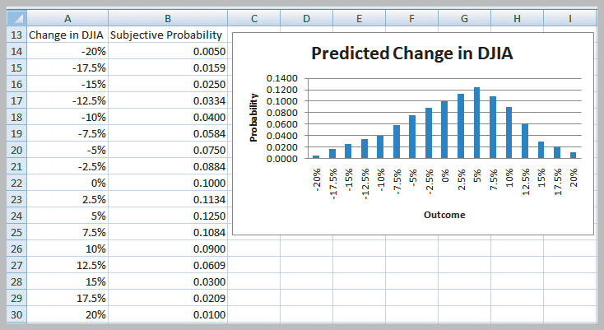
Continuous Probability Distributions
Change in DJIA using
5% increments
Figure 5.6
Change in DJIA using
2.5% increments
Approaching a smooth curve
Figure 5.14

Slide 44
Continuous Probability Distributions
Probability density function
A curve described by a mathematical function that characterizes a continuous random variable
Properties of a probability density function
f(x) ≥ 0 for all values of x
Total area under the density function equals 1.
P(X = x) = 0
Probabilities are only defined over an interval.
P(a ≤ X ≤ b) is the area under the density function between a and b.

Slide 45
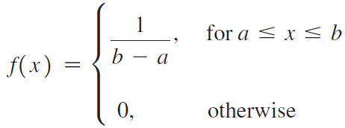
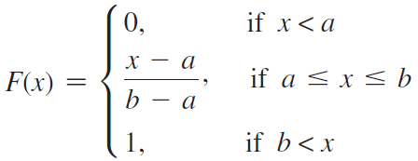
Continuous Probability Distributions
Uniform Distribution
All outcomes between a minimum (a) and a maximum (b) are equally likely.
Area = 1

Slide 46
Continuous Probability Distributions
Uniform Distribution
Expected Value =
Variance =

Slide 47
Continuous Probability Distributions
Example 5.28
Computing Uniform Probabilities
Sales revenue for a product varies uniformly each week between $1000 and $2000.
f(x) = 1/(2000-1000)
= 1/1000
Area = 1
Figure 5.15

Slide 48
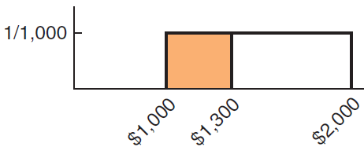
Continuous Probability Distributions
Example 5.28 (continued)
Computing Uniform Probabilities
Find the probability sales revenue will be less than $1,300.
P(X < 1300) = (1300-1000)(1/1000) = 0.30
Figure 5.16

Slide 49
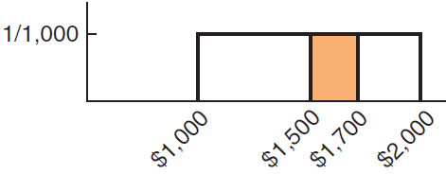
Continuous Probability Distributions
Example 5.28 (continued) Uniform Probabilities
Find the probability that revenue will be between
$1,500 and $1,700.
P(1500 ≤ X ≤ 1700) = P(X ≤ 1700) − P(X ≤ 1500)
= F(1700) − F(1500)
= 300/1000 − 500/1000
=0.20
Figure 5.17

Slide 50
Continuous Probability Distributions
Normal Distribution
- f(x) is a bell-shaped curve
- Characterized by 2 parameters
μ (mean)
σ (standard deviation)
- Properties
Symmetric
Mean = Median = Mode
Unbounded
Empirical rules apply

Slide 51
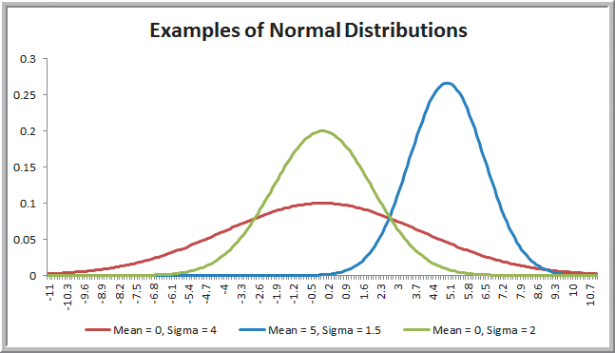
Continuous Probability Distributions
Figure 5.18
=NORM.DIST(x, mean, stdev, cumulative)
True: F(x)
False: f(x)

Slide 52
Continuous Probability Distributions
Example 5.29 Using NORM.DIST to Compute Normal Probabilities
The distribution for customer demand (units per month) is normal with:
mean = 750
stdev. = 100
Find the probability that demand will be:
a) at most 900 units/month
b) exceed 700 units/month
c) be between 700 and 900 units/month

Slide 53
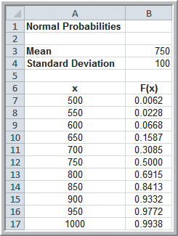
Continuous Probability Distributions
Example 5.29 (continued) Using
NORM.DIST to Compute
Normal Probabilities
Cumulative probabilities
are computed as:
=NORM.DIST(x, 750, 100, true)
a) P(X < 900) = 0.9332
b) P(X > 700) = 1−0.3085 = 0.6915
c) P(700 < X < 900) = 0.9332−0.3085
= 0.6247
Figure 5.19

Slide 54
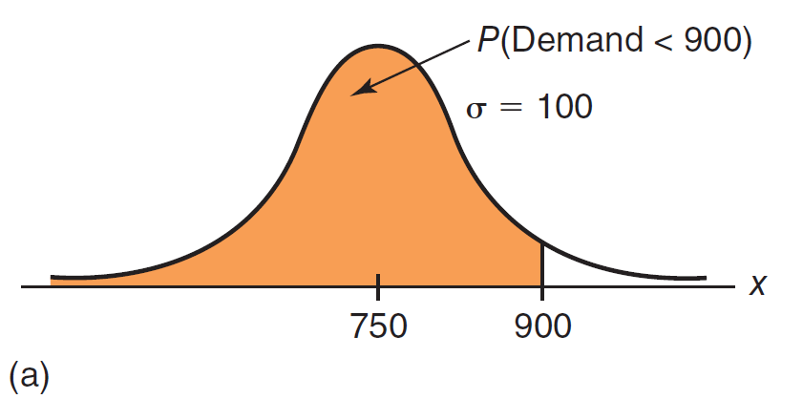
Continuous Probability Distributions
Example 5.29 (continued) Using NORM.DIST to Compute Normal Probabilities
0.9332
Figure 5.20a

Slide 55
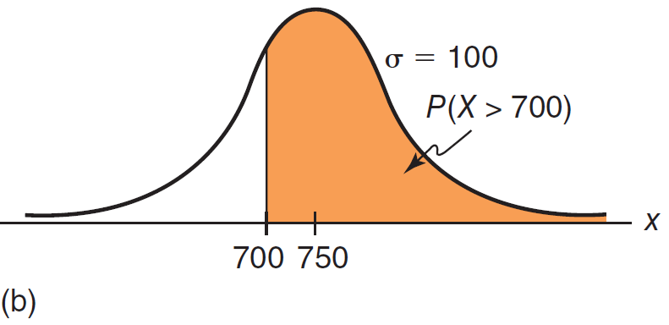
Continuous Probability Distributions
Example 5.29 (continued) Using NORM.DIST to Compute Normal Probabilities
0.6915
Figure 5.20b

Slide 56
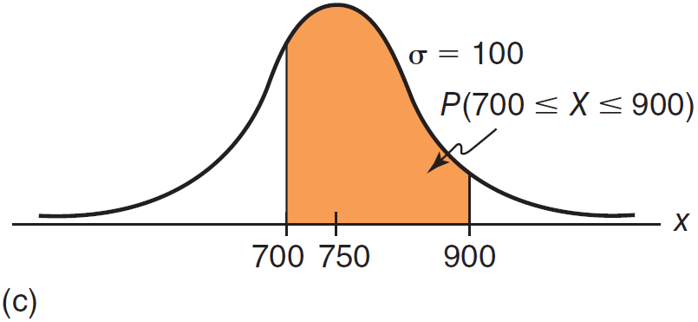
Continuous Probability Distributions
Example 5.29 (continued) Using NORM.DIST to Compute Normal Probabilities
0.6247
Figure 5.20c

Slide 57
Continuous Probability Distributions
Example 5.30 Using the NORM.INV Function
=NORM.INV(probability, mean, stdev)
provides the x value with F(x)= probability
What level of demand would be exceeded at most 10% of the time?
Find x such that F(x) = 90%
= NORM.INV(0.90, 750, 100)
results in x = 878.155

Slide 58
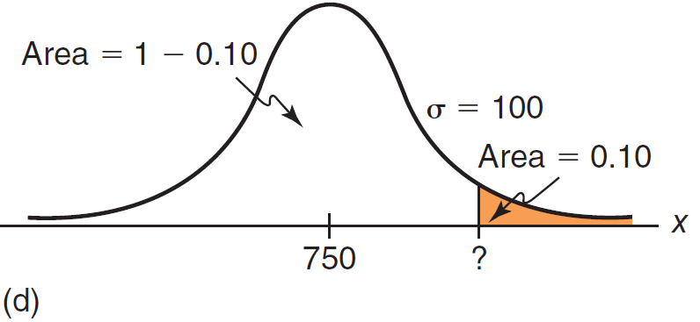
Continuous Probability Distributions
Example 5.30 (continued)
Using the NORM.INV Function
90%
878.155
Figure 5.20d

Slide 59
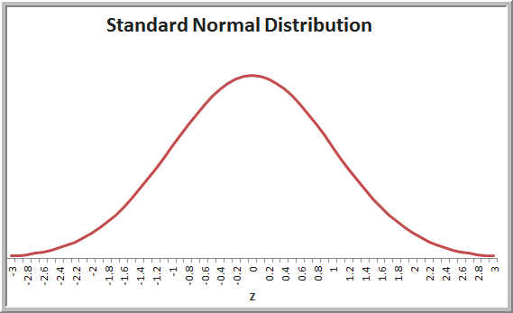
Continuous Probability Distributions
Standard Normal Distribution
Z is the standard normal random variable with:
Mean = 0
Stdev = 1
Figure 5.21

Slide 60
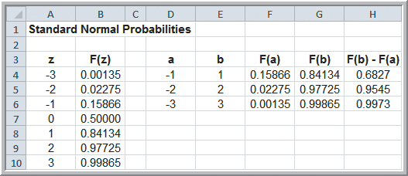
Continuous Probability Distributions
Example 5.31 Computing Probabilities with the Standard Normal Distribution
Verify the empirical rules using Excel.
P(-1 < Z < 1 )
= NORMS.DIST(1) – NORMS.DIST(-1)
= 0.84134 – 0.15866
= 0.6827
~ 68%
Figure 5.22

Slide 61
Continuous Probability Distributions
Example 5.32 Computing Probabilities with the Standard Normal Tables
From Example 5.29, what is the probability that demand will be at least 900 units/month?
Use the equation:
Z = (900 − 750)/100
= 1.50
Using Table 1 in Appendix B, we find:
P(X < 900) = P(Z < 1.50)
= 0.93319

Slide 62
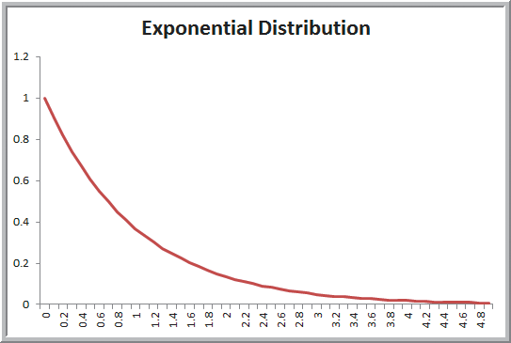
Continuous Probability Distributions
Exponential Distribution
Models the time between randomly occurring events (arrivals, machine failures, etc.)
where λ is the mean
rate of occurrences
(from the discrete
Poisson distribution)
with λ=1
Figure 5.23

Slide 63
Continuous Probability Distributions
Example 5.33 Using the Exponential Distribution
The mean time to failure of a critical engine component is µ = 8,000 hours.
What is the probability of failing before 5000 hours?
P(X < x) =EXPON.DIST(x, lambda, cumulative)
Since , we can solve for
λ = 1/8000
P(x < 5000) =EXPON.DIST(5000, 1/8000, true)
= 0.4647

Slide 64
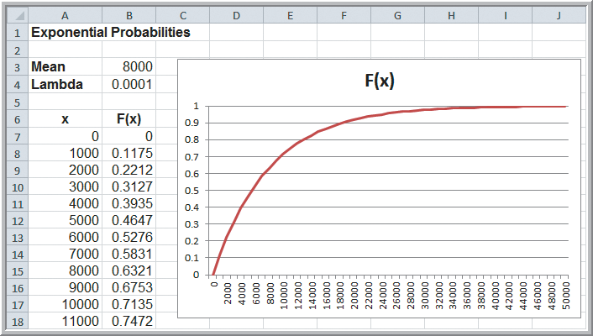
Continuous Probability Distributions
Example 5.33 (continued)
Using the Exponential Distribution
Figure 5.24

Slide 65
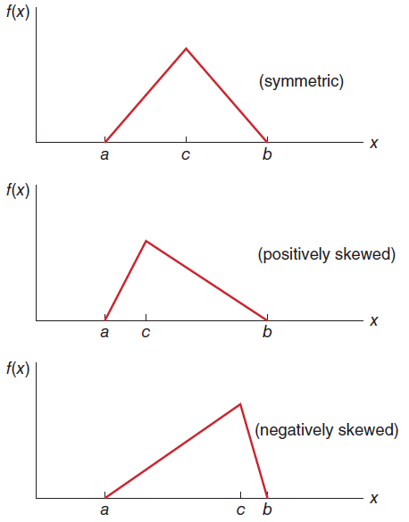
Continuous Probability Distributions
Other Useful Continuous
Distributions
Triangular Distribution
Lognormal Distribution
Beta Distribution
Figure 5.25

Slide 66
Random Sampling from Probability Distributions
Many application in Business Analytics require random samples from specific probability distributions.
For example, cumulative discounted cash flow can be described using probability distributions for sales, sales growth rate, operating expenses, and inflation factors (all uncertain variables).
Random numbers are the basis for generating random samples from probability distributions.
Random numbers are uniformly distributed on the interval from 0 to 1.

Slide 67
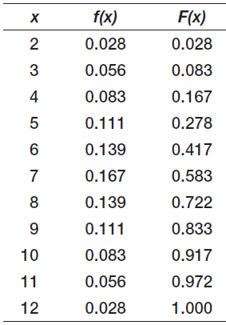
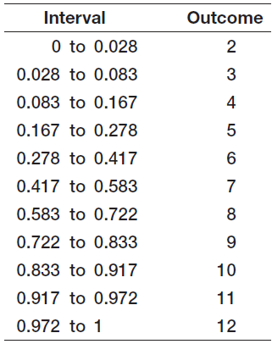
Random Sampling from Probability Distributions
Example 5.34 Sampling from the Distribution of Dice Outcomes
Probability distribution
Intervals for random sampling

Slide 68
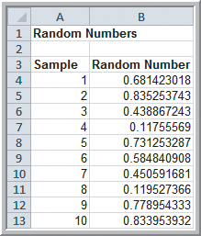
Random Sampling from Probability Distributions
Example 5.34 (continued) Sampling from the Distribution of Dice Outcomes
=RAND( ) generates random numbers in Excel
Outcome = 8 since 0.681 is
between 0.583 and 0.722
Outcome = 4 since 0.119 is
between 0.083 and 0.167
Figure 5.26

Slide 69
Random Sampling from Probability Distributions
Example 5.35 Using the VLOOKUP Function
Generate a random sample of Changes in DJIA.
First compute F(x)
Assign intervals to outcomes
Generate random numbers using =RAND( )
=VLOOKUP(H2, $E2:$G$10, 3)
Figure 5.27

Slide 70
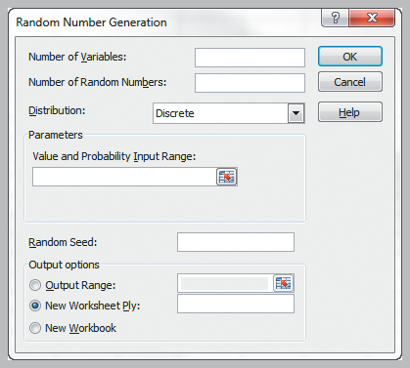
Random Sampling from Probability Distributions
Example 5.36
Using Excel’s Random Number Generation Tool
Generate 100 outcomes from a Poisson distribution with a mean of 12.
Data
Data Analysis
Random Number Generation
Number of Variables: 1
Number of Random Numbers: 100
Distribution: Poisson
Parameter: Lambda = 12
Figure 5.28

Slide 71
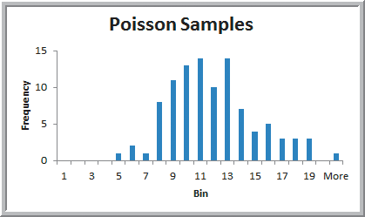
Random Sampling from Probability Distributions
Example 5.36 (continued) Using Excel’s Random Number Generation Tool
Histogram of 100 random outcomes
Figure 5.29

Slide 72
Random Sampling from Probability Distributions
Probability Distributions available in Excel’s Data Analysis Toolpak under Random Number Generation
Bernoulli
Binomial
Discrete
Normal
Patterned
Poisson
Uniform

Slide 73
Random Sampling from Probability Distributions
Sampling From Various Probability Distributions Using Standard Excel Functions
Uniform: =RANDBETWEEN(a, b)
You can also replace probability with RAND( ) in many inverse probability distribution functions:
Binomial: =BINOM.INV(trials, p, RAND( ))
Normal: =NORM.INV(RAND( ), mean, stdev)
Logormal: =LOGNORM.INV(RAND( ), mean, stdev)
Beta: =BETA.INV(RAND( ), alpha, beta, A, B)

Slide 74
Random Sampling from Probability Distributions
Example 5.37 A Sampling Experiment for Evaluating Capital Budgeting Projects
In finance, one way of evaluating capital budgeting projects is to compute:
Profitability index PI = PV / I
where PV is the present value of future cash flows
and I is the initial investment

Slide 75
Random Sampling from Probability Distributions
Example 5.37 (continued) A Sampling Experiment for Evaluating Capital Budgeting Projects
Suppose PV is normally distributed with a mean of $12 million and standard deviation of $2.5 million.
I is also normally distributed with a mean of $3 million and standard deviation of $0.8 million.
Use a sampling experiment to generate a probability distribution for PI = PV / I.

Slide 76
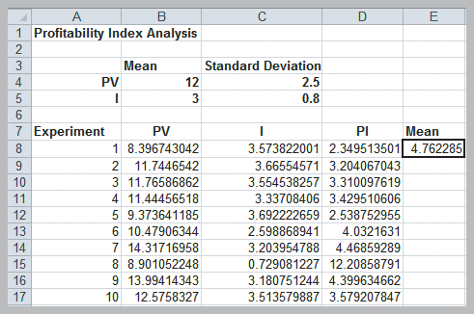
Random Sampling from Probability Distributions
Example 5.37 (continued)
For PV: =NORM.INV(RAND( ), 12, 2.5)
For I: =NORM.INV(RAND( ), 3, 0.8)
PI = PV/I
Profitability Index mean
= 4.76
Figure 5.30

Slide 77
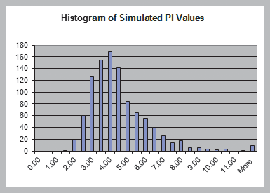
Random Sampling from Probability Distributions
Example 5.37 (continued) A Sampling Experiment for Evaluating Capital Budgeting Projects
Profitability Index is skewed to the right
Figure 5.31

Slide 78
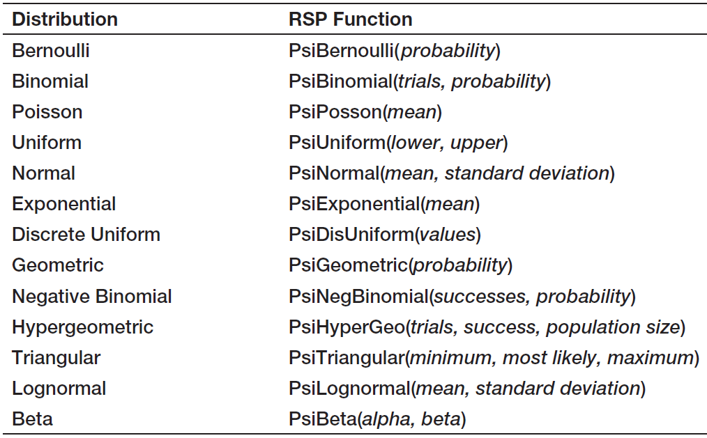
Random Sampling from Probability Distributions
Risk Solver Platform
Probability Distribution Functions
Table 5.1

Slide 79
Random Sampling from Probability Distributions
Example 5.38 Using Risk Solver Platform Distribution Functions
An energy company is considering offering a new product and needs to estimate the growth in PC ownership. The expected growth rates are:
Minimum = 5%
Most likely = 7.7%
Maximum =10%
Generate 500 samples of PC ownership growth rate using: =PsiTriangular(5%, 7.7%, 10%)

Slide 80
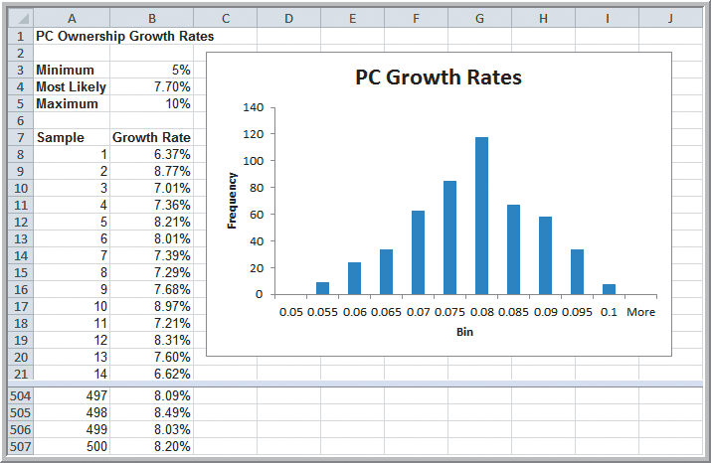
Random Sampling from Probability Distributions
Example 5.38 (continued) Using Risk Solver Platform Distribution Functions
Figure 5.32

Slide 81
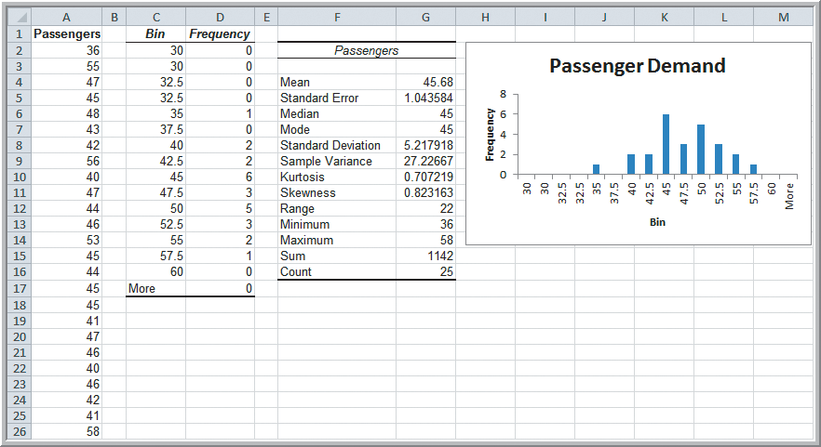
Data Modeling and Distribution Fitting
Example 5.39 Analyzing Airline Passenger Data
Sample data on passenger demand for 25 flights
Can we assume normally distributed?
Figure 5.33

Slide 82
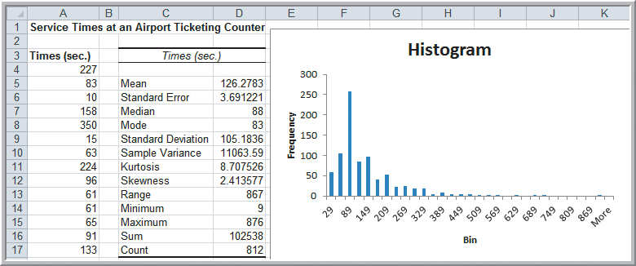
Data Modeling and Distribution Fitting
Example 5.40 Analyzing Airport Service Times
Sample data on service times for 812 passengers at an airport’s ticketing counter
Can we assume normally distributed?
Figure 5.34

Slide 83
Data Modeling and Distribution Fitting
Goodness of Fit
The basis for fitting data to a probability distribution
Attempts to draw conclusions about the nature of the distribution
Three statistics measure goodness of fit:
Chi-square
Kolmogorov-Smirnov
Anderson-Darling

Slide 84
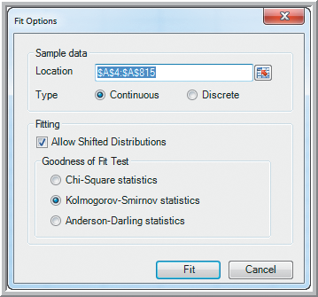
Data Modeling and Distribution Fitting
Example 5.41
Fitting a Distribution to Airport Service Times
1. Highlight the data
Risk Solver
Tools
Fit
2. Fit Options dialog
Type: Continuous
Test: Kolmorgov-Smirnov
Figure 5.35

Slide 85
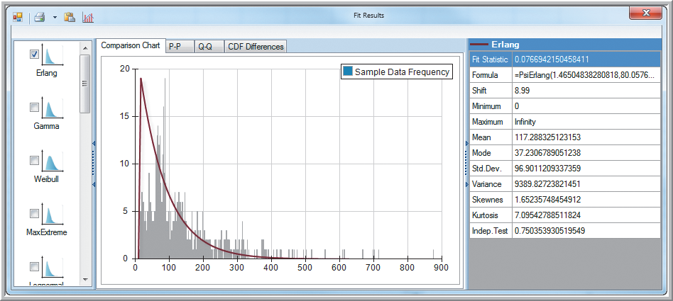
Data Modeling and Distribution Fitting
Example 5.41 (continued)
Fitting a Distribution to Airport Service Times
Erlang is the best-fitting distribution
Figure 5.36

Slide 86
Data Modeling and Distribution Fitting
Analytics in Practice: The Value of
Good Data Modeling in Advertising
Gross’s model:
A mathematical model that relates the relative contributions of creative and media dollars to total advertising effectiveness.
Often used to identify the best number of ads to purchase.
Analysis found that the optimal number of ads can vary significantly depending on the shape of the distribution of effectiveness for a single ad.

Slide 87
Chapter 5 – Key Terms
Bernoulli distribution
Binomial distribution
Complement
Conditional probability
Continuous random variable
Cumulative distribution function
Discrete random variable
Discrete uniform distribution
Empirical probability distribution
Event
Expected value
Experiment
Exponential distribution
Goodness of fit
Independent events

Slide 88
Chapter 5 – Key Terms (continued)
Multiplication law of probability
Mutually exclusive
Normal distribution
Outcome
Poisson distribution
Probability
Probability density function
Probability distribution
Probability mass function
Random number
Random number seed
Random variable
Random variate
Sample space
Standard normal distribution
Uniform distribution
Union

Slide 89
Case Study Performance Lawn Equipment (5)
Recall that PLE produces lawnmowers and a medium size diesel power lawn tractor.
Determine probability distributions appropriate for modeling mower failures and blade weights.
Determine the sampling distribution of the mean mower failures for a sample size of 100.
Determine the sampling distribution of the proportion blade weights below specification for a sample size of 350.
Analyze your results and write up a formal report.

