Slide 1
Chapter 3: Visualizing and Exploring Data
Business Analytics: Methods, Models,
and Decisions, 1st edition
James R. Evans

Slide 3
Chapter 3 Topics
Data Visualization
Data Queries: Using Sorting and Filtering
Statistical Methods for Summarizing Data
Exploring Data Using PivotTables

Slide 4
Data Visualization
Creating Charts in Microsoft Excel
Select the insert tab.
Highlight the data.
Click on chart type, then subtype.
Use chart tools to customize.
Figure 3.1
Figure 3.2

Slide 5
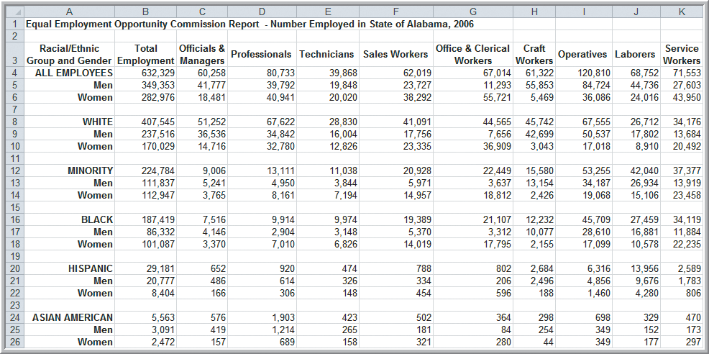
Data Visualization
Example 3.1 Creating a Column Chart
Highlighted Cells
Figure 3.3

Slide 6
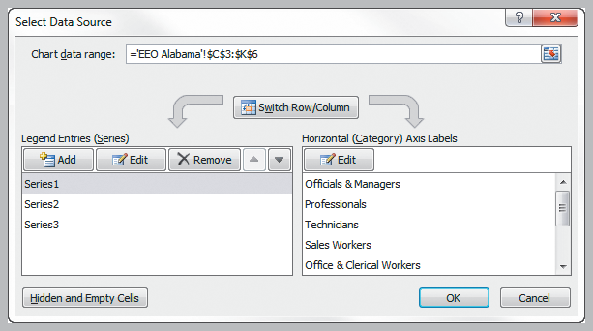
Data Visualization
Example 3.1 (continued) Creating a Column Chart
Choose column chart (clustered or stacked).
Add chart title (Alabama Employment).
Rename Series1, Series2, and Series3
(ALL EMPLOYEES, Men, Women).
Figure 3.4

Slide 7
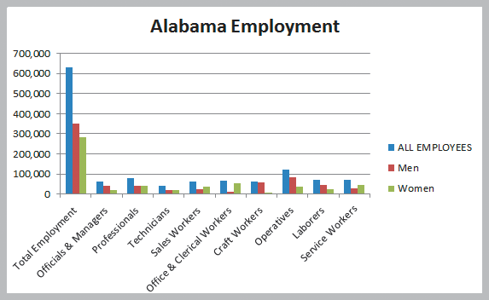
Data Visualization
Example 3.1 (continued) Creating a Column Chart
Clustered
Column
Chart
Figure 3.5

Slide 8
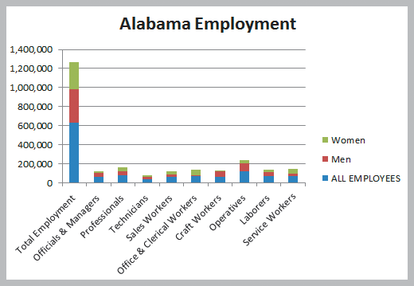
Data Visualization
Example 3.1 (continued) Creating a Column Chart
Stacked
Column
Chart
Figure 3.6

Slide 9
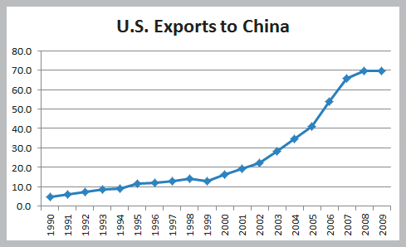
Data Visualization
Example 3.2 Line Chart for U.S. Exports to China
Figure 3.7

Slide 10
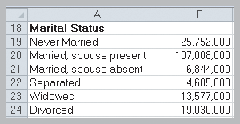
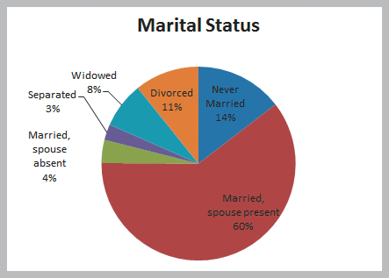
Data Visualization
Example 3.3 Pie Chart for Census Data
Figure 3.8
Figure 3.9

Slide 11
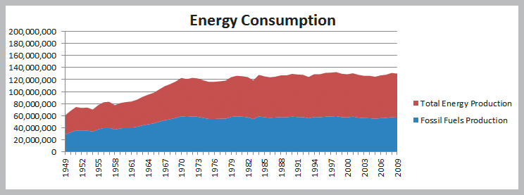
Data Visualization
Example 3.4 Area Chart for Energy Consumption
Figure 3.10

Slide 12
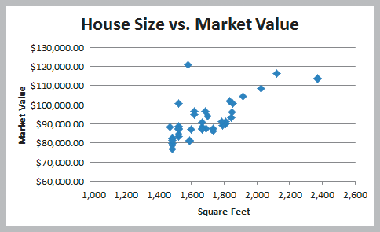
Data Visualization
Example 3.5 Scatter Chart for Real Estate Data
Figure 3.11

Slide 13
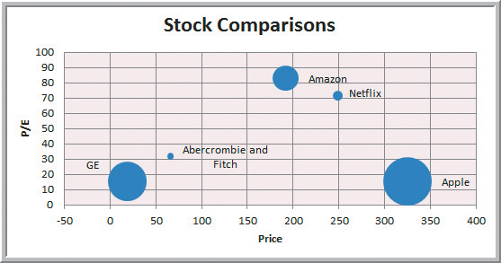
Data Visualization
Example 3.6
Bubble Chart for Comparing Stock Characteristics
Figure 3.12

Slide 14
Data Visualization
Miscellaneous Excel Charts
Stock chart
Surface chart
Doughnut chart
Radar chart
Geographic mapping

Slide 15
Data Queries: Using Sorting and Filtering
Example 3.7
Sorting Data in the Purchase Orders Database
Sort by Supplier
Figure 3.13
Figure 3.14

Slide 16
Data Queries: Using Sorting and Filtering
Pareto Analysis
An Italian economist, Vilfredo Pareto, observed in 1906 that a large proportion of the wealth in Italy was owned by a small proportion of the people.
Similarly, businesses often find that a large proportion of sales come from a small proportion of customers.
A Pareto analysis involves sorting data and calculating cumulative proportions.

Slide 17
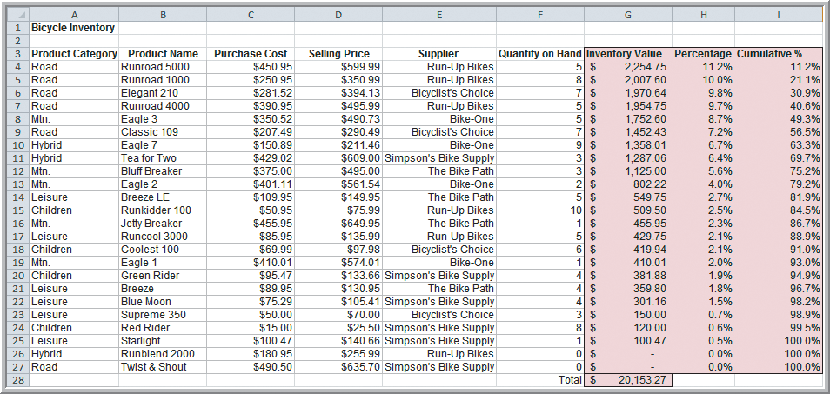
Data Queries: Using Sorting and Filtering
Example 3.8 Applying the Pareto Principle
Sort by
75% of the bicycle inventory value comes from 40% (9/24) of items.
Figure 3.15

Slide 18
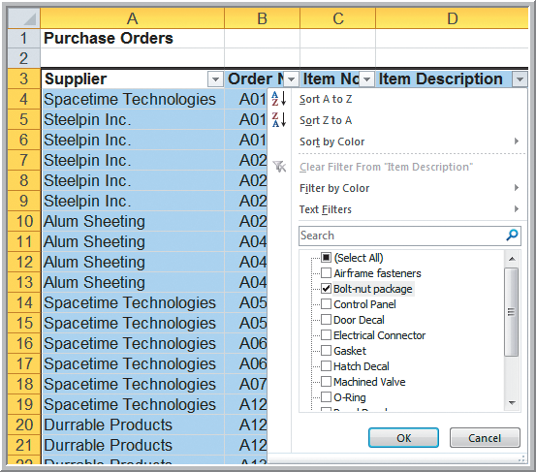
Data Queries: Using Sorting and Filtering
Example 3.9 Filtering Records by Item Description
Highlight A3:J97
Data tab
Sort & Filter group
Filter
Click on the D3
dropdown arrow.
Select Bolt-nut
package to filter out
all other items.
Figure 3.16

Slide 19
Data Queries: Using Sorting and Filtering
Example 3.9 (continued)
Filtering Records by Item Description
Filter results for the bolt-nut package
Figure 3.17

Slide 20
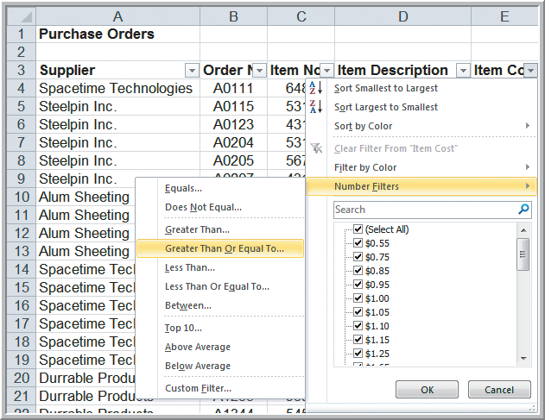
Data Queries: Using Sorting and Filtering
Example 3.10 Filtering Records by Item Cost
To identify items that
cost at least $200
Click on dropdown
arrow for item cost
Number Filters
Greater Than Or
Equal To…
Figure 3.18

Slide 21
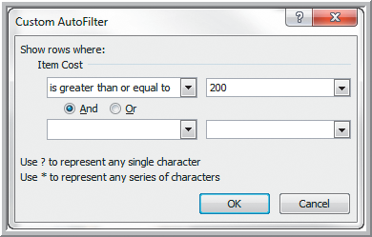
Data Queries: Using Sorting and Filtering
Example 3.10 (continued) Filtering by Item Cost Custom AutoFilter dialog box
Click OK
Only items
costing at least
$200 is then
displayed.
Figure 3.19

Slide 22
Data Queries: Using Sorting and Filtering
AutoFilter criteria is based on the data type.
Number Filters includes numerical criteria.
Date Filters include tomorrow, next week, etc.
AutoFilter can be used sequentially.
First filter by one variable.
Then filter those data by another variable.

Slide 23
Data Queries: Using Sorting and Filtering
Analytics in Practice: Discovering Value
of Data Analysis at Alders International
Duty free operations at airports, seaports, etc.
Maintain a data warehouse to track point-of-sale information and inventory levels.
Pareto analysis revealed that 80% of profits were generated from 20% of their product lines.
Allows selective elimination of less profitable items.

Slide 24
Statistical Methods for Summarizing Data
A statistic is a summary measure of data.
Descriptive statistics are methods that describe and summarize data.
Microsoft Excel supports statistical analysis in two ways:
1. Statistical functions
2. Analysis Toolpak add-in for PCs
(for Macs, StatPlus is similar)
Statistical methods are essential to Business Analytics

Slide 25
Statistical Methods for Summarizing Data
Example 3.11 Constructing a Frequency Distribution
for Items in the Purchase Order Database
Copy Column D (Item Description) to Column A in a new worksheet
Figure 3.20

Slide 26
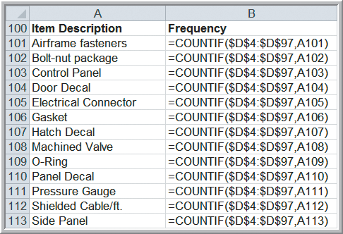
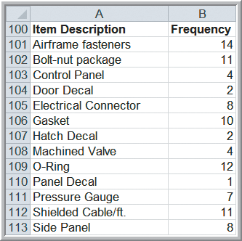
Statistical Methods for Summarizing Data
Example 3.11 (continued) Constructing a Frequency Distribution for Items in the Purchase Order Database
Figure 3.21
Figure 3.22

Slide 27
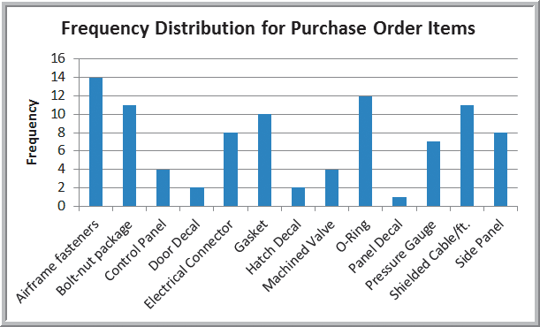
Statistical Methods for Summarizing Data
Example 3.11 (continued) Constructing a Frequency Distribution for Items in the Purchase Order Database
Figure 3.23

Slide 28
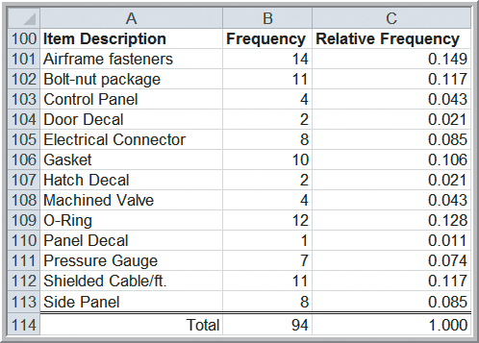
Statistical Methods for Summarizing Data
Example 3.12 Constructing a Relative Frequency Distribution for Items Purchased
Compute relative frequencies by
dividing each frequency by 94.
Figure 3.24

Slide 29
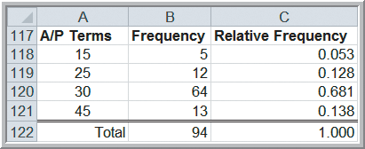
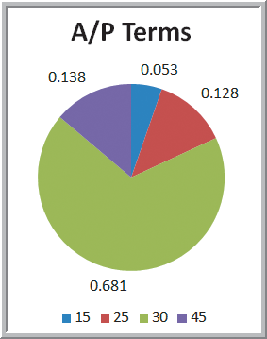
Statistical Methods for Summarizing Data
Example 3.13 Frequency and Relative Frequency Distribution for A/P Terms
Figure 3.25
Figure 3.26

Slide 30
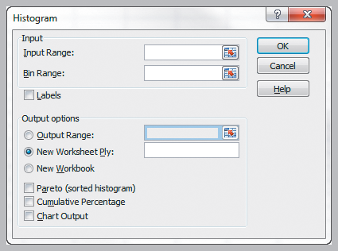
Statistical Methods for Summarizing Data
Excel’s Histogram Tool
Using the Analysis Toolpak
Data
Data Analysis
Histogram
Fill in the Input Range and Bin Range (optional).
Choose Labels if columns have headers rows.
Choose Chart Output.
Figure 3.27

Slide 31
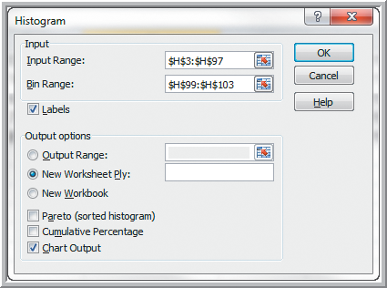
Statistical Methods for Summarizing Data
Example 3.14
Using the Histogram Tool for A/P Terms
A/P data in H3:H97
Bins below in H99:H103
Month
15
25
30
45
Figure 3.28

Slide 32
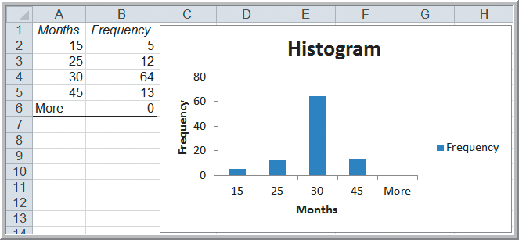
Statistical Methods for Summarizing Data
Example 3.14 (continued)
Using the Histogram Tool for A/P Terms
Table above is not linked to chart.
Figure 3.29

Slide 33
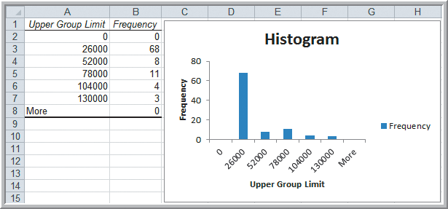
Statistical Methods for Summarizing Data
Example 3.15 Constructing a Frequency Distribution and Histogram for Cost Per Order
5 groups with a
$26,000 group width
Figure 3.30

Slide 34
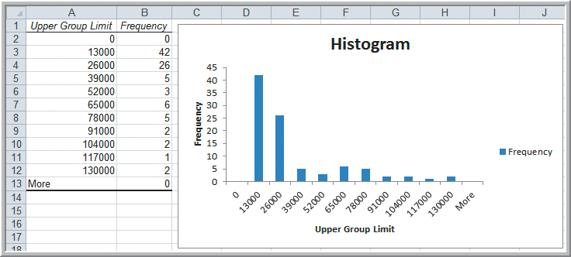
Statistical Methods for Summarizing Data
Example 3.15 (continued) Constructing a Frequency Distribution and Histogram for Cost Per Order
10 groups with a
$13,000 group width
Figure 3.31

Slide 35
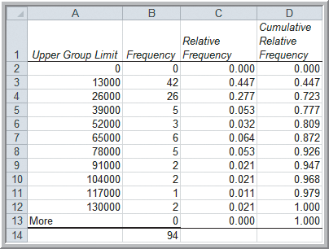
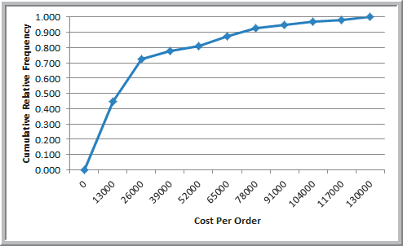
Statistical Methods for Summarizing Data
Example 3.16 Computing Cumulative Relative Frequencies for the Cost Per Order Data
Ogive
Figure 3.33
Figure 3.32

Slide 36
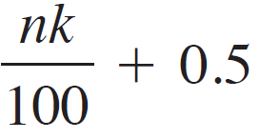
Statistical Methods for Summarizing Data
Example 3.17 Computing Percentiles
Compute the 90th percentile for cost per order in the Purchase Orders Data.
Rank of k^{th} percentile =
n = 94 observations
k = 90
Rank of 90th percentile = 94(90)/100+0.5
= 85.1 (round to 85)
Value of the 85th observation = $74,375

Slide 37
Statistical Methods for Summarizing Data
Example 3.18 Computing Percentiles in Excel
Compute the 90th percentile for cost per order.
Excel function for the k^{th} percentile: =PERCENTILE.INC(array, k)
=PERCENTILE.INC(G4:G97, 0.90)
= $73,737.50
Excel does not use the formula on previous slide.

Slide 38
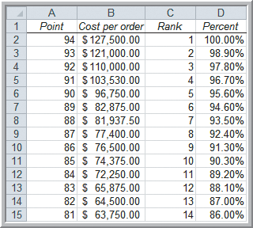
Statistical Methods for Summarizing Data
Example 3.19 Excel’s Rank and Percentile Tool
Data
Data Analysis
Rank and Percentile
90.3rd percentile
= $74,375
(same result as
manually computing
the 90th percentile)
Figure 3.34

Slide 39
Statistical Methods for Summarizing Data
Example 3.20 Computing Quartiles in Excel
Compute the Quartiles of the Cost per Order data
Excel function for quartiles: =QUARTILE.INC(array, quart)
=QUARTILE.INC(G4:G97, 1) = $6,757.81
=QUARTILE.INC(G4:G97, 2) = $15,656.25
=QUARTILE.INC(G4:G97, 3) = $27,593.75
=QUARTILE.INC(G4:G97, 4) = $127,500.00

Slide 40
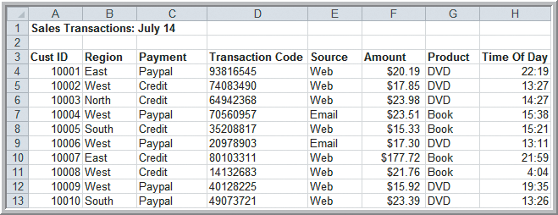
Statistical Methods for Summarizing Data
Example 3.21 Constructing a Cross-Tabulation
Sales Transactions database
Identify the number (and percentage) of books and DVDs ordered by region.
Figure 3.35

Slide 41
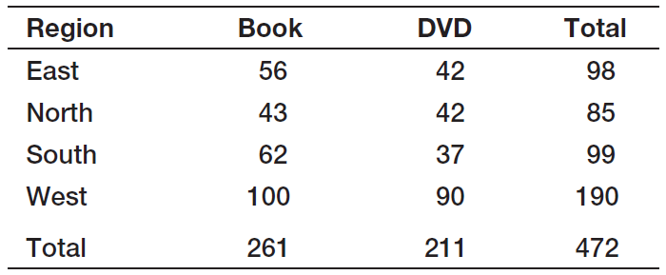
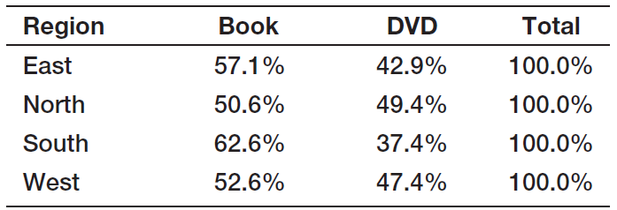
Statistical Methods for Summarizing Data
Example 3.21 (continued) Constructing a Cross-Tabulation
Table 3.1
Table 3.2

Slide 42
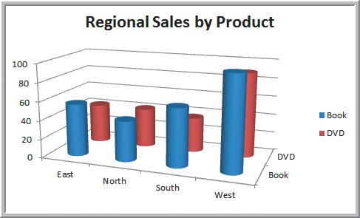
Statistical Methods for Summarizing Data
Example 3.21 (continued) Constructing a Cross-Tabulation
Excel’s PivotTable (covered next) makes this easy.
Table 3.1
Figure 3.36

Slide 43
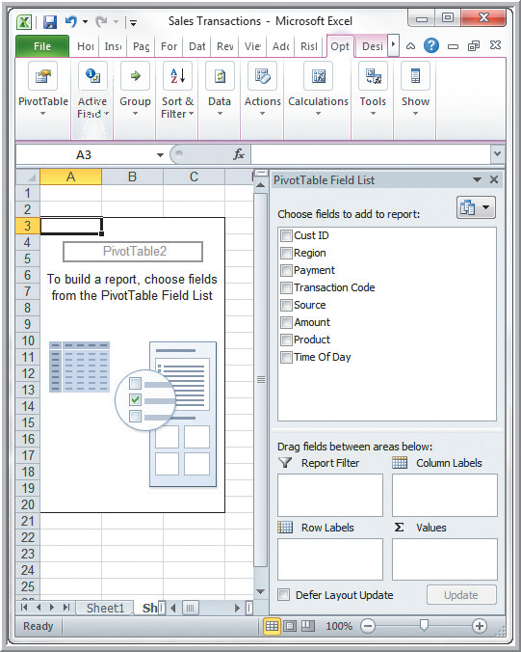
Exploring Data Using PivotTables
Data
Tables
PivotTable
Follow wizard steps.
PivotTables allow:
Quick creation of cross tabulations
Numerous custom-made summary tables and charts
Figure 3.37

Slide 44
Exploring Data Using PivotTables
PivotTable Field List
Select the fields for:
Report Filter
Column Labels
Row Labels
Σ Values
Or, before choosing PivotTable, you can select a cell in the data and let Excel prepare a default PivotTable.
Figure 3.37

Slide 45
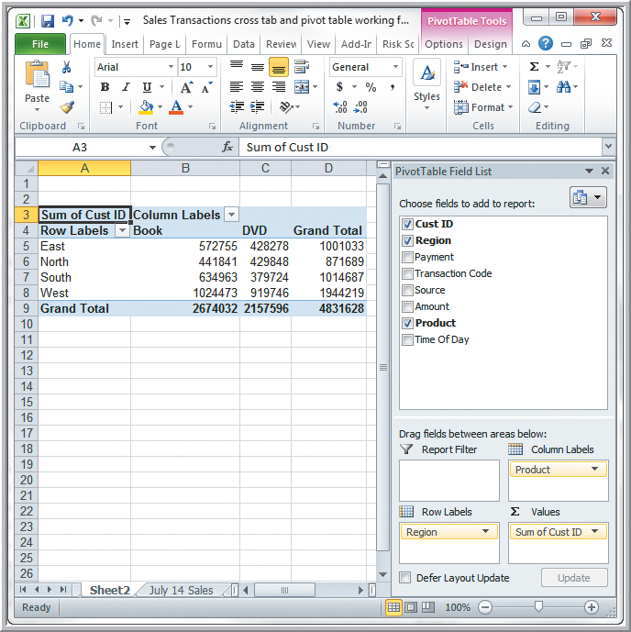
Exploring Data Using PivotTables
Example 3.22
Creating a PivotTable
Default PivotTable for Regional Sales by Product
(sum of CustID is meaningless)
Figure 3.38

Slide 46
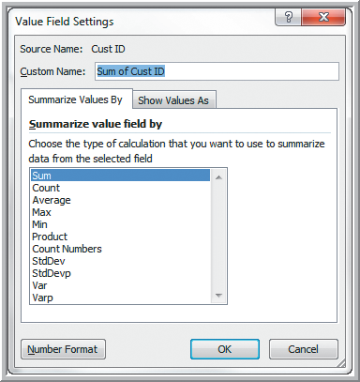
Exploring Data Using PivotTables
Example 3.22 (continued) Creating a PivotTable
Pivot Table Tools
Options
Active Field
Field Settings
Change summarization
method in Value Field
Settings dialog box
Select Count
Figure 3.39

Slide 47
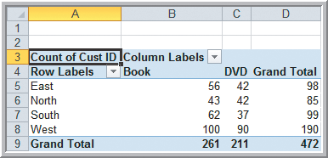
Exploring Data Using PivotTables
Example 3.22 (continued) Creating a PivotTable
PivotTable for Count of Regional Sales by Product
PivotTable results match those shown earlier in Table 3.1.
Figure 3.40
Table 3.1

Slide 48
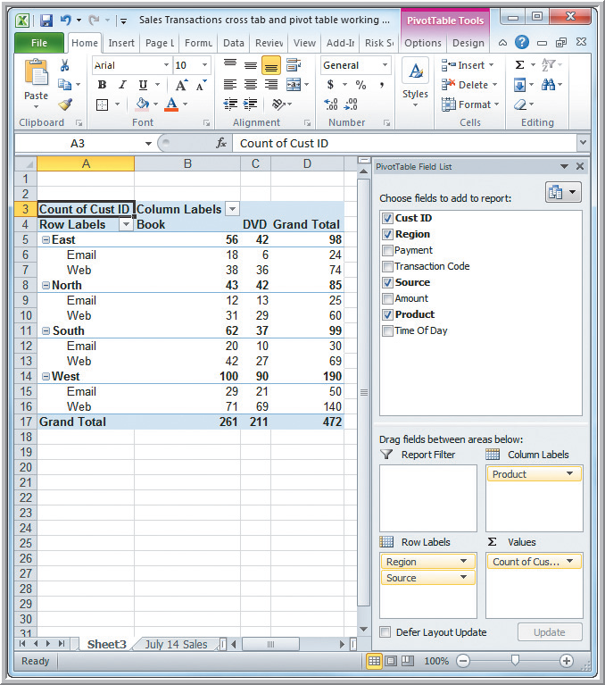
Exploring Data Using PivotTables
Example 3.22 (continued)
Creating a PivotTable
Drag Source into the Row Labels box.
PivotTable for Sales by Region, Product, and Order Source
Figure 3.41

Slide 49
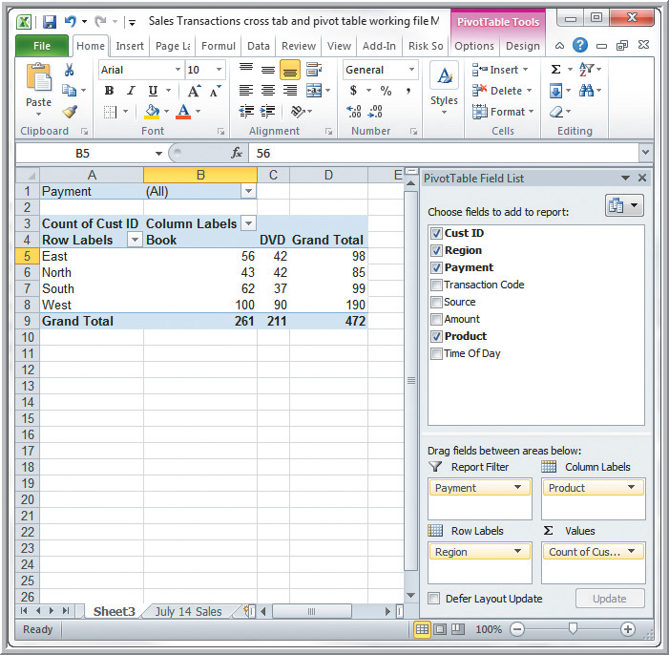
Exploring Data Using PivotTables
Example 3.23
Using the Pivot
Table Report Filter
Drag Payment into Report Filter box.
PivotTable Filtered by Payment Type.
Figure 3.42

Slide 50
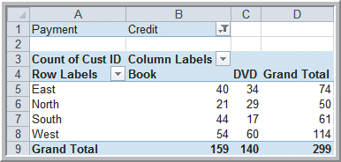
Exploring Data Using PivotTables
Example 3.23 (continued)
Using the PivotTable Report Filter
Click on the drop-down arrow in row 1.
Choose Credit-Card.
Obtain this cross-tabulation PivotTable for credit card transactions.
Figure 3.43

Slide 51
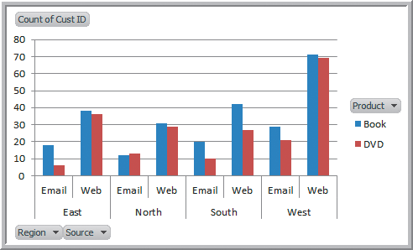
Exploring Data Using PivotTables
Example 3.24 A PivotChart for Sales Data
Create a chart using the PivotTable for
Sales by Region, Product, and Order Source.
Insert
Column Chart
To display only Book
data, click on the
Product button and
deselect DVD.
Figure 3.44

Slide 52
Key Terms
Area chart
Bar chart
Bubble chart
Column chart
Contingency table
Cross-tabulation
Cumulative relative frequency
Cumulative relative frequency distribution
Data profile (fractile)
Descriptive statistics
Doughnut chart
Frequency distribution
Histogram
k^{th} percentile
Line chart
Ogive
Pareto analysis
Pie chart

Slide 53
Chapter 3 - Key Terms (continued)
PivotChart
PivotTable
Quartile
Radar chart
Relative frequency
Relative frequency distribution
Scatter chart
Statistic
Statistics
Stock chart
Surface chart

Slide 54
Case Study Performance Lawn Equipment (3)
Recall that PLE produces lawnmowers and a medium size diesel power lawn tractor.
Create charts of the satisfaction data, sales data, delivery time data, and other variables of interest.
Compare shipping costs for existing and proposed plant locations.
Examine customer attributes by region and write a formal report summarizing your results.

