Slide 1
Chapter 2: Analytics on Spreadsheets
Business Analytics: Methods, Models,
and Decisions,1st edition
James R. Evans

Slide 3
Chapter 2 Topics
Basic Excel Skills
Excel Functions
Spreadsheet Add-ins for Business Analytics
Spreadsheet Modeling and Spreadsheet Engineering

Slide 4
Basic Excel Skills
Many commercial software packages can be used for Business Analytics.
Spreadsheet software, such as Microsoft Excel, is widely used across all areas of business.
Spreadsheets provide a flexible modeling environment for manipulating data and developing and solving models.
This chapter provides a summary of the basic features in Microsoft Excel for solving problems in Business Analytics.

Slide 5
Basic Excel Skills
Opening, saving, and printing files
Navigation
Selecting ranges
Inserting/deleting rows and columns
Entering and editing text, data, and formulas
Formatting data (number, currency, decimal)
Working with text strings
Performing basic arithmetic calculations
Formatting text
Modifying the appearance of a spreadsheet

Slide 6
Basic Excel Skills
Ribbon in Excel 2010 for Windows
Tabs - Home, Insert, Page Layout, Formulas, …
Groups - Font, Alignment, Number, Styles, …
Buttons and Menus
- Buttons appear as small icons.
- Menus of additional choices are indicated by
small triangles.
Figure 2.1

Slide 7
Basic Excel Skills
Excel Formulas
Common mathematical operators are used
a− bP⁵ + would be entered into Excel as:
=a− b*P^5 + c/d
Cell references can be relative or absolute.
Using a dollar sign before a row or column label creates an absolute reference.
Relative references: A2, C5, D10
Absolute references: $A$2, $C5, D$10

Slide 8
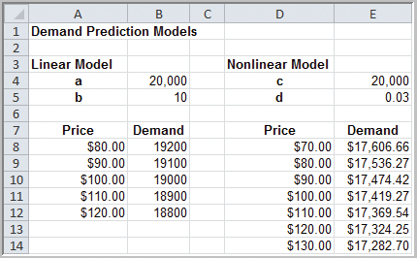
Basic Excel Skills
Example 2.1
Implementing Price-Demand Models in Excel
Two models for predicting price using demand
Linear
D = a – bP
=B4 – B5*A8
(in cell B8)
Nonlinear
D = cP^{-d}
=E4*D8^-E5
(in cell E8)
Figure 2.2

Slide 9
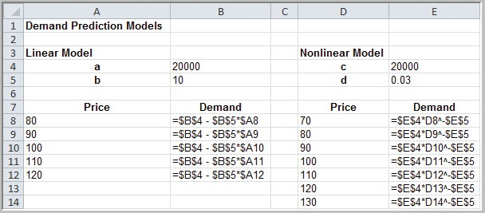
Basic Excel Skills
Example 2.1 (continued) Implementing Price-Demand Models in Excel
D = a – bP (linear)
D = cP^{-d} (nonlinear)
Figure 2.5

Slide 10
Basic Excel Skills
Copying Excel Formulas
Cells can be copied in many ways.
Use the Copy button in the Home tab, then Paste
Use Ctrl-C, then Ctrl-V
Drag the bottom right corner of a cell (the fill handle) across a row or column
Double click on the fill handle of a cell and its value (or formula) is copied to the cells below if there is data in an adjacent column

Slide 11
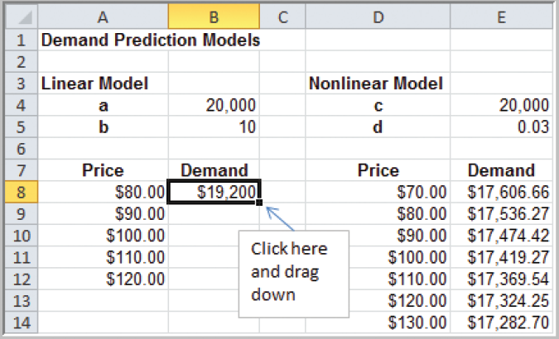
Basic Excel Skills
Example 2.2 Copying Excel Formulas by Dragging
Figure 2.3

Slide 12
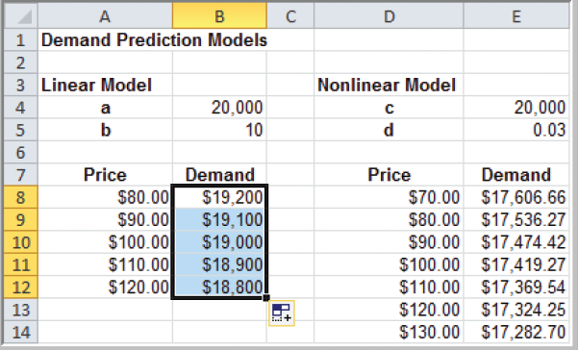
Basic Excel Skills
Example 2.2 (continued)
Copying Excel Formulas by Dragging
Figure 2.4

Slide 13
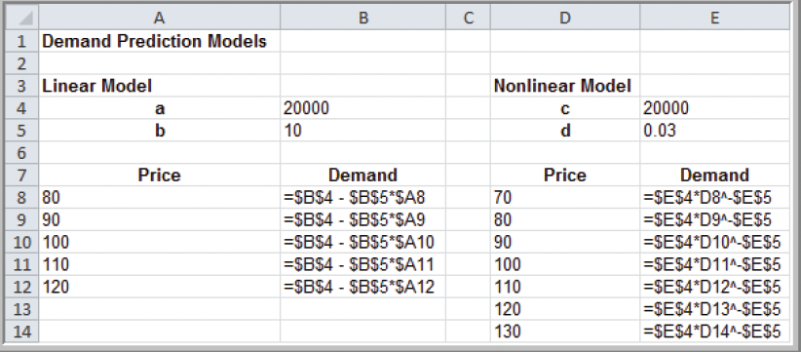
Basic Excel Skills
Example 2.2 (continued)
Copying Excel Formulas by Dragging
Figure 2.5

Slide 14
Basic Excel Skills
Other Useful Excel Tips
Split Screen
Paste Special
Column and Row Widths
Displaying Grid Lines and Column Headers for Printing
Filling a Range with a Series of Numbers

Slide 15
Excel Functions
Basic Excel Functions
=MIN(range)
=MAX(range)
=SUM(range)
=AVERAGE(range)
=COUNT(range)
=COUNTIF(range,criteria)

Slide 16
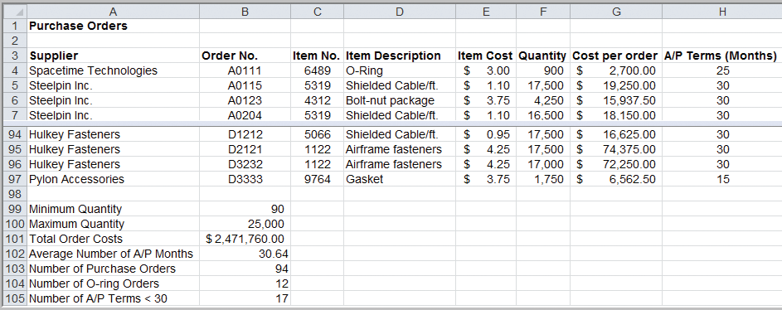
Excel Functions
Example 2.3 Using Basic Excel Functions
=MIN(F4:F97)
=MAX(F4:F97)
=SUM(G4:G97)
=AVERAGE(H4:H97)
=COUNT(B4:B97)
=COUNTIF(D4:D97,”=O-Ring”)
=COUNTIF(H4:H97,”<30”)
Figure 2.6

Slide 17
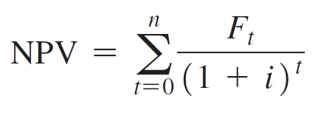
Excel Functions
Functions for Specific Applications:
=NPV(rate,value1,value2,…)
Net present value (or discounted cash flow) measures the worth of a stream of cash flows, taking into account the time value of money.
F is the cash flow ($)
i is the discount rate
t is the number of time
periods into the future,
where t = 0, 1, …, n

Slide 18
Excel Functions
Example 2.4 Using the NPV Function
=NPV(rate,value1,value2,…)
Cell B8:
=NPV(B6, C4:H4) – B5
Figure 2.7

Slide 19
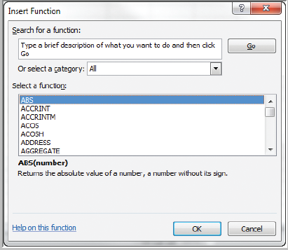
Excel Functions
Insert Function:
Click the f_{x} button or choose Insert Function.
You may type in a description or search.
Figure 2.8

Slide 20
Excel Functions
Logical Functions:
=AND(condition1, condition2, …)
=OR(condition1, condition2, …)
=IF(condition, value if true, value if false)
You may nest up to 7 IF functions, replacing the value if false with another IF function.
Conditions may include the following:
= equal <> not equal to
> greater than >= greater than or equal to
< less than <= less than or equal to

Slide 21
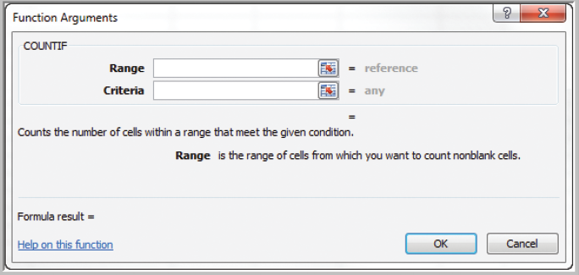
Excel Functions
Basic Excel Functions:
=COUNTIF(range,criteria)
Figure 2.9

Slide 22
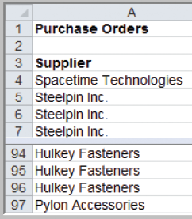
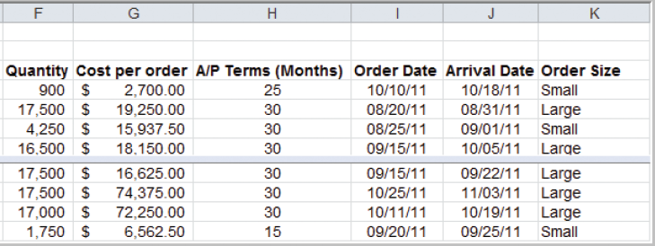
Excel Functions
Example 2.5 Using the IF statement
=IF(condition, value if true, value if false)
Cell K4: =IF(F4 >= 10000, “Large”, “Small”)
Figure 2.10

Slide 23
Excel Functions
Lookup Functions:
These functions are useful for finding specific data in a spreadsheet.
=VLOOKUP(lookup_value, table_array, col_index_num)
=HLOOKUP(lookup_value, table_array, row_index_num)
=INDEX(array, row_num, col_num)
=MATCH(lookup_value, lookup_array, match_type)

Slide 24
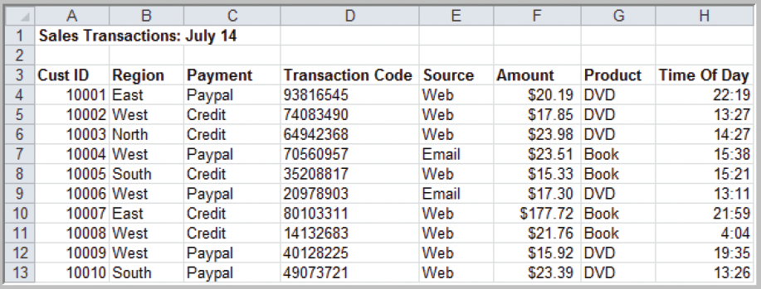
Excel Functions
Example 2.6 Using the VLOOKUP Function
Figure 2.11
=VLOOKUP(10007, $A$4:$H$475,3)
returns the payment type of Credit.

Slide 25
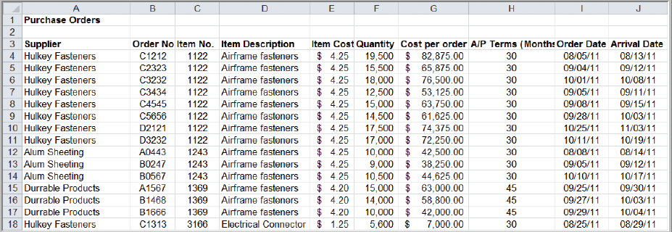
Excel Functions
Example 2.7 Using the INDEX and MATCH Functions
=MATCH(1369,$C$4:$C$475,0)
returns 12 (the first instance of 1369 is the 12th item)
=MATCH(1369,$C$4:$C$475,1)
returns 14 (the last instance of 1369 is the 14th item)
Figure 2.12

Slide 26
Excel Functions
Example 2.7 (continued) Using INDEX and MATCH
=INDEX($A$4:$J$475, MATCH(1369,$C$4:$C$475,0),7)
returns 63,000 (the 12th value in the 7th column)
=SUM(INDEX($A$4:$G$475,MATCH(1369,$C$4:$C$475,0),7):INDEX($A
$4:$G$475,MATCH(1369,$C$4:$C$475,1),7))
returns 163,800 (the sum of the 3 costs for item 1369)

Slide 27
Spreadsheet Add-Ins for Business Analytics
Microsoft Excel (Windows only) provides a number of add-ins for Business Analytics:
- Analysis Toolpak
- Analysis Toolpak VBA
- Solver
Frontline Systems provides:
- Risk Solver Platform
- Premium Risk Solver Platform
- XLMiner add-in

Slide 28
Spreadsheet Modeling and Engineering
Spreadsheet Engineering is the process of developing good, useful, and correct spreadsheet models.
Spreadsheet models characterize the relationship between inputs and outputs.
It is important not to use input data in model formulas, but to instead reference the spreadsheet cells that contain the data.

Slide 29
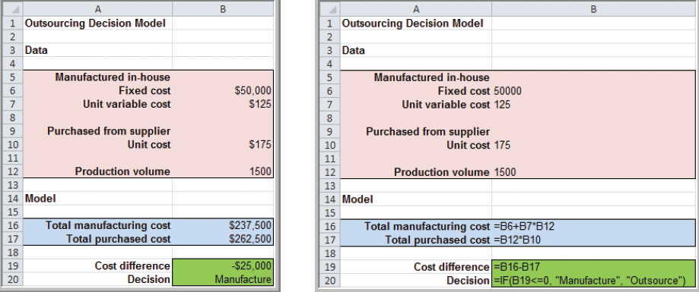
Spreadsheet Modeling and Engineering
Example 2.8
Spreadsheet Model for the Outsourcing Decision
Total manufacturing cost = $50,000 + $125 x Q
Total outsourcing cost = $175 x Q
Figure 2.13

Slide 30
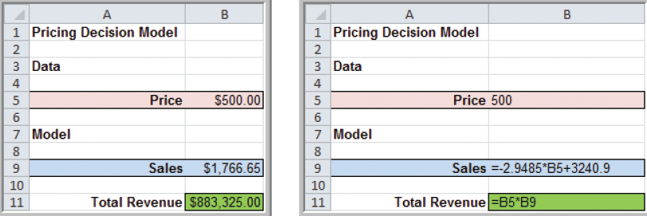
Spreadsheet Modeling and Engineering
Example 2.9 Pricing Decision Spreadsheet Model
Sales = -2.9485 x price + 3,240.9
Total Revenue = price x sales
Figure 2.14

Slide 31
Spreadsheet Modeling and Engineering
Spreadsheet Quality
Verification is the process of ensuring that a model is accurate and free from logical errors.
Below are three approaches to spreadsheet engineering that can improve spreadsheet quality:
Improve the design and format of the spreadsheet itself.
Improve the process used to develop a spreadsheet.
Inspect your results carefully and use appropriate tools available in Excel.

Slide 32
Spreadsheet Modeling and Engineering
Example 2.10 Modeling Net Income on a Spreadsheet
Gross profit = sales – cost of goods sold
Operating expenses = administrative expenses
+ selling expenses
+ depreciation expenses
Net operating income = gross profit
– operating expenses
Earnings before taxes = net operating income
– interest expense
Net income = earnings before taxes – taxes

Slide 33
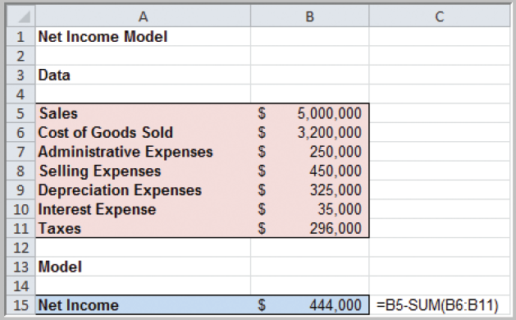
Spreadsheet Modeling and Engineering
Simple Spreadsheet Model
for Computing Net Income
Figure 2.15

Slide 34
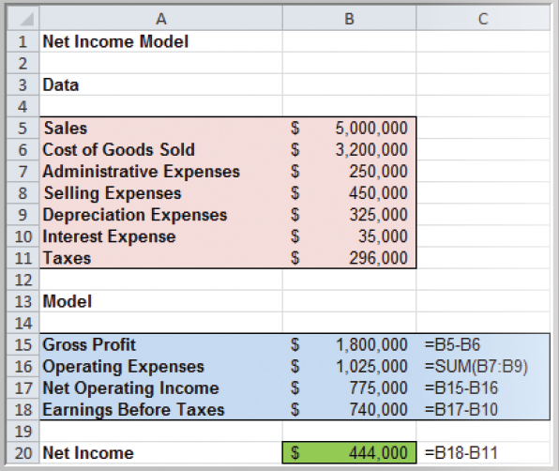
Spreadsheet Modeling and Engineering
Data-Model Format for Computing Net Income
Figure 2.16

Slide 35
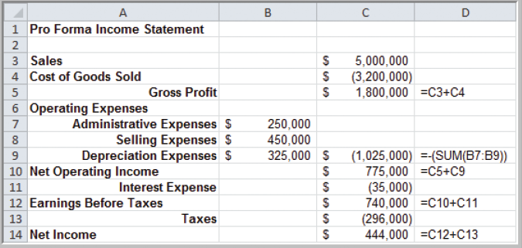
Spreadsheet Modeling and Engineering
Pro Forma Income Statement Format for Computing Net Income
Figure 2.17

Slide 36
Spreadsheet Modeling and Engineering
Analytics in Practice:
Spreadsheet Engineering at Proctor & Gamble
Problem: How to manage safety stock inventory.
Solution: The Western European BA group created
a spreadsheet model that eventually
grew into a suite of global inventory models.
- It displayed all important data on one screen.
- Allowed users constant access to current data.
- Helped supply chain managers make better
decisions regarding safety stocks.

Slide 37
Chapter 2 - Key Terms
Absolute address
Discount rate
Net present value (discounted cash flow)
Pro forma income statement
Relative address
Spreadsheet engineering
Verification

Slide 38
Case Study Performance Lawn Equipment (2)
Recall that PLE produces lawnmowers and a medium size diesel power lawn tractor.
The Excel workbook Performance Lawn Equipment contains data on PLE’s operations.
As chief analyst to the production and operations manager, you need to update the Excel workbook with additional information and prepare a pro forma income statement for 2012.

