Slide 1
Office Mix
Google Search
Office Mix Free Download
https://mix.office.com/en-us/Home
or
https://www.microsoft.com/en-us/download/details.aspx?id=47682

Slide 2
https://mix.office.com/en-us/Home

Slide 3
https://www.microsoft.com/en-us/download/details.aspx?id=47682 Note: Windows Office 2013 or newer required
Click on Run

Slide 4
Once Mix is installed. A Mix tab will be on PowerPoint
I suggest you open your Excel or PowerPoint info and
open a new PowerPoint for recording your Mix.

Slide 5
Click on Mix tab. Then on Screen Recording

Slide 6
Click on Select Area, then expand dotted line to include your screen

Slide 7
To start the recording click on Record
Notes:
You should also have the power point presentation you want to record open.

Slide 8
Mix will count down 3, 2, 1 before it starts recording your voice

Slide 9
After you hit the Record button, open the application you want to show on the screen while you talk.
Office Mix will record what is showing on your screen simultaneously with your your voice.
When you finish, move your mouse to the top of the screen to get the dropdown menu shown below.
Click here to stop the recording.
The length of time for your Mix appears here.

Slide 10
From the Mix tab, select Preview to preview your recording

Slide 11
Once you have a good recording, go to Mix tab Select Upload to Office Mix

Slide 12
After you have clicked on
Upload to Office Mix
The box to the right will appear.
Click on Next to walk through the steps.

Slide 13
After clicking on Next a message saying LOADING will appear.
Then you will get the box to the right.
You need to Sign in with one of the options.

Slide 14
After signing in, the box to the right will appear.
You do not need to create a video for the class assignment.
Click on Next.

Slide 15
Uploading takes time. The box shows you the % completed.
Once both are at 100% then
Click on Show me my mix

Slide 16
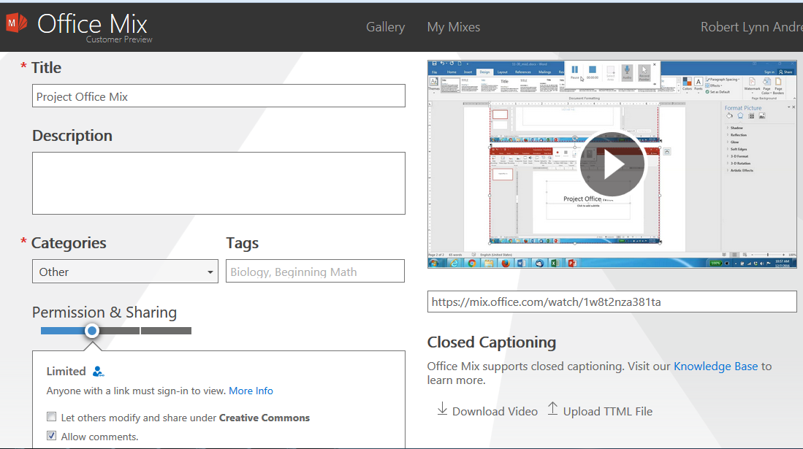
Your Mix URL appears here.

Slide 17
Once you are finished.
E-mail to scma.stat@gmail.com
Put SCMA 524 Test 1 Presentation in subject line
In the e-mail
Attach PowerPoint or Excel file
For Office Mixes Include the URL
Give your name

