Slide 1
Generators in Nuclear Medicine
Mark H. Crosthwaite, M.Ed., CNMT, PET, NMTCB(RS), FSNMMI-TS
Associate Professor and Program Director
Virginia Commonwealth University

Slide 2


Let’s Take a Look at Generators

Slide 3
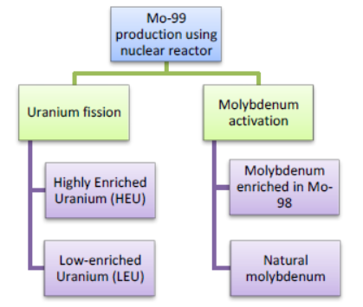
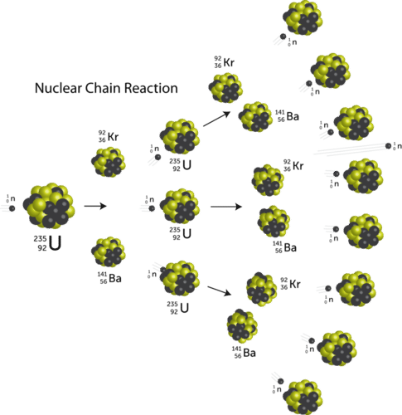

Types of Medical Reactors
Two types of fission targets are in use today: highly enriched uranium (HEU) typically containing more than 90 wt% of ²³⁵Uand low-enriched uranium (LEU) with less than 20 wt% of ²³⁵U. However, an international effort is currently underway to reduce and eventually eliminate the use of HEU targets given that they contain weapon-grade uranium [1]

Slide 4
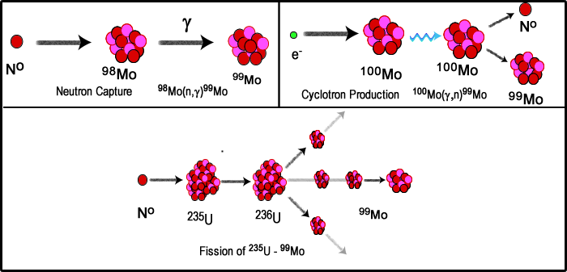
Methods to Produce ⁹⁹Mo
¹⁰⁰Mo(p,2n)^{99m}Tc
Neutron Activation
¹⁰⁰Mo(p,2n)⁹⁹M
photo-fission of ²³⁸U
https://www.ncbi.nlm.nih.gov/books/NBK215146/

Slide 5
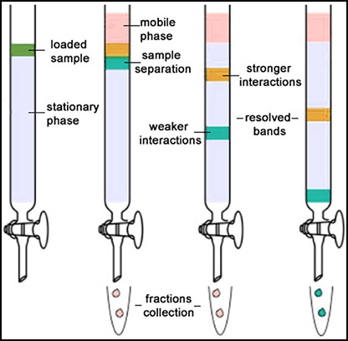
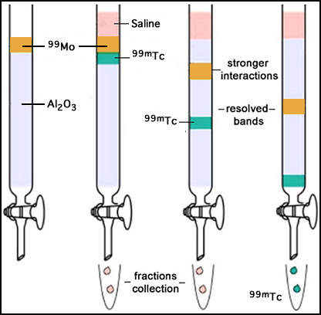
Generators and Methods of Extraction
Column chromatography – most common
  Separation technique
  Mobile phase (liquid or gas) enters the column
  Mixes with a stationary phase that has a substance(s) “fixed” to it
  As the mobile phase moves through the stationary substance separation occurs
  Required – right solvent to remove the element of interest
https://microbenotes.com/column-chromatography/
Images were modified

Slide 6
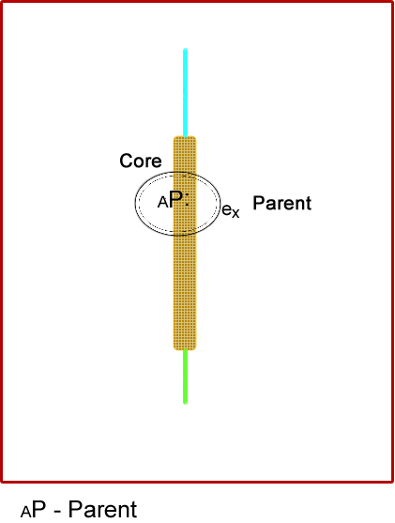
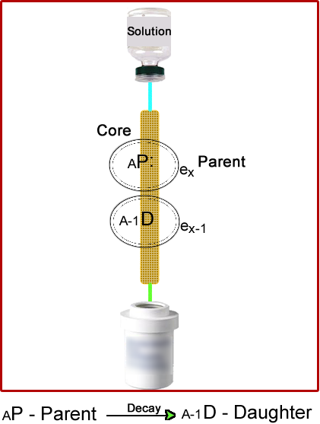
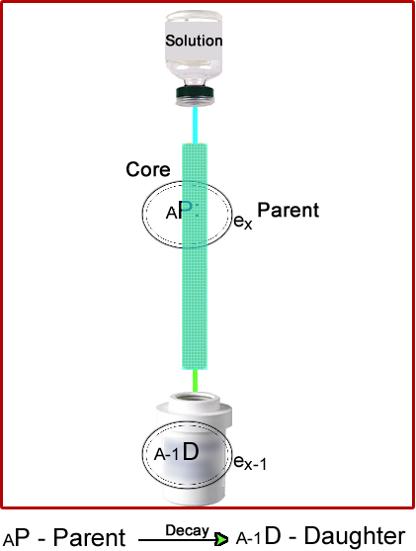
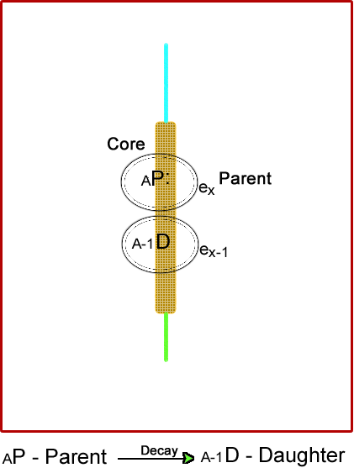
Radiopharmaceutical Column Chromatography
Radioactive Parent (_{A}P) is bound onto a porous
stationary phase - anionic attraction
As the _{A}P decays a daughter is produced _{A-1}D
  The loss of an electron (e _{x – 1}) weakens the
  bond with the stationary phase
  _{A-1}D – has a cationic or neutral charge
Mobile phase moves through the column
liberating _{A-1}D
_{A-1}D is collected in a elution vial
Ready to compound

Slide 7
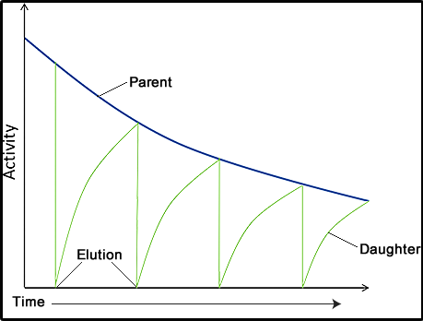
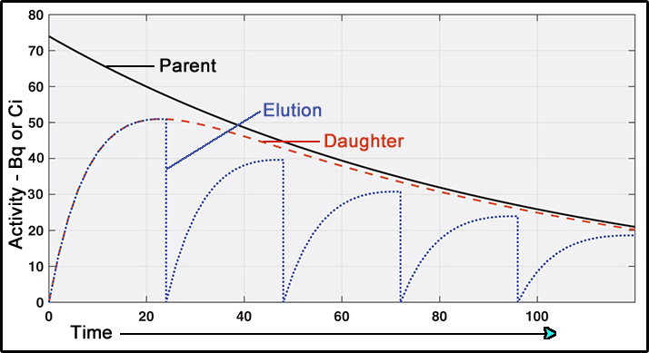
Concept --- Generators
Long-lived parent and a short-lived daughter
  Secular vs transient
The parent decays to the daughter
  Daughter builds up as parent decays
  Eluting the generator liberates the daughter
  Daughter then builds up (again) via parent decay
  Equilibrium occurs when daughter activity = parent activity
Key
  Chemical properties must be different
  Only the daughter should be in the elution
  Shielding
  Sterile
https://www.radiologycafe.com/radiology-trainees/frcr-physics-notes/production-of-radioisotopes
Modified from the original image

Slide 8
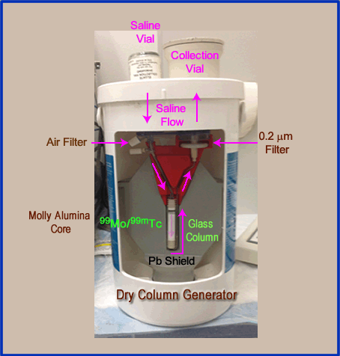
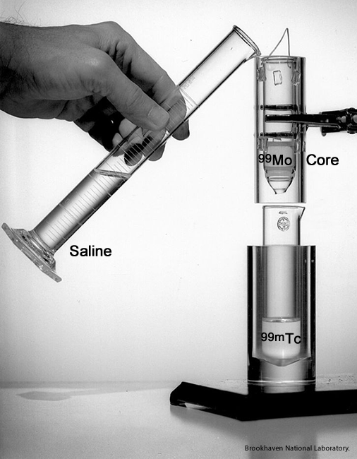
⁹⁹Mo/^{99m}Tc Generator – Wet Column
Dry Column
Usually produced by fission of ²³⁶U
⁹⁹Mo is bonded to the Al₂O_{3.}
column
^{99m}Mo decays to ^{99m}Tc it lacks affinity of the Al₂O₃
Usually yields >80% ^{99m}Tc yield
⁹⁹Mo breakthrough should be <5.6kBq of Molly per 37 MBq of ^{99m}Tc
When saline washes across the molly/alumina core ^{99m}Tc is liberated and collected

Slide 9
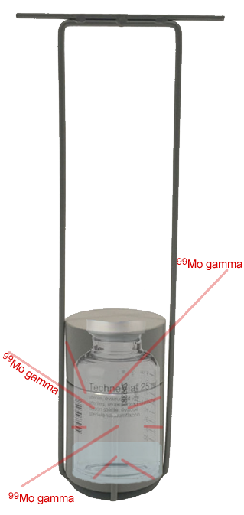
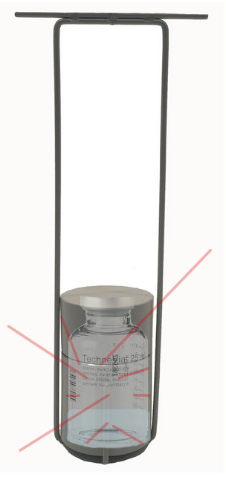
What Might Cause ⁹⁹MoBreakthrough
Testing for radionuclide purity
Shield blocks low energy gammas, but not in the 740/780 keV
Reasons for Breakthrough
Too much ⁹⁹Mo and not enough Al₂O₃ on the column
Saline pH is greater than 7
Fine particles of Al in the saline elution
Poor manufacture of the column
Excessive elations to the point that ⁹⁹Mo is at the bottom of the column
I heard this happened in Chicago years ago where the column was put upside down

Slide 10
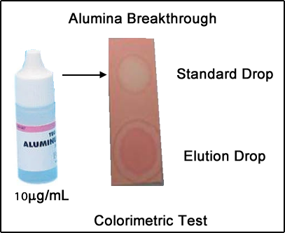
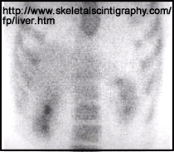
Chemical Purity – Colorimetric Test
Alumina breakthrough is tested by applying a standard that contains 10µg/mL
This litmus test changes white if the elution drop is 10µg/mL or >
High levels of alumina can effect the tagging of ^{99m}Tc to sulfur colloid and labeled red cells
Alumina can also cause flocculation – note RES uptake from radio-tagged Alumina
Question – If ⁹⁹Mo breaks though would the alumina?

Slide 11
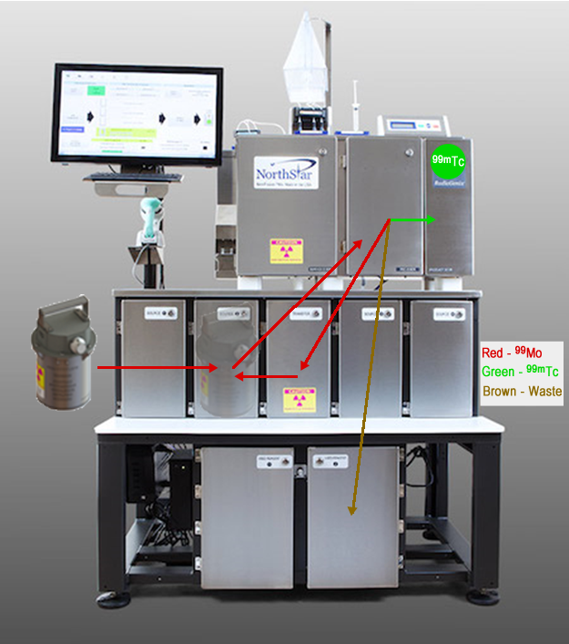
RadioGenixTM Liquid ⁹⁹Mo Generator
⁹⁹Mo is made by neutron activation hence the mixture also contains ^{98/100} Mo all in liquid form
⁹⁹Mo is pumped into PSC cabinet where it passes though the chromographic column but ^{99m}Tc adheres to the column
⁹⁹Mo eventually returns to the source cabinet
^{99m}Tc remains on the first column then washed with specific solutions and then sent to the Production Cabinet.
0.9% saline removes ^{99m}Tc from the column and it is ready for compounding
Waste is then sent to the Discard cabinet
https://physicstoday.scitation.org/do/10.1063/PT.6.2.20180216a/full/

Slide 12

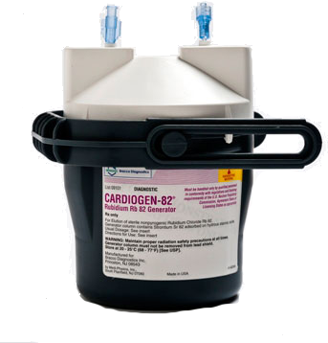
⁸²Sr/⁸²Rb Generator System
⁸⁵Rb(p,4n)⁸²Sr
T_{1/2} ⁸²Sr = 25 days, ⁸⁵Sr = 64.8 days, and ⁸²Rb – 1.25 minutes
Typical generator has between 3.7GBq to 5.55 GBq of ⁸²Sr activity
Stationary phase is made of SnO₂ that binds ⁸²Sr and ⁸⁵Sr to the column
⁸²Rb yield is 40 to 90% with a pH of 7
pH factor – lower pH (<7) releases greater amounts of Sr while higher levels (9) reduce Sr, but increase Rb
Higher infusion rates increase the % yield of ⁸²Rb and ^{82/85}Sr
Generator equilibrium takes <10 minutes

Slide 13
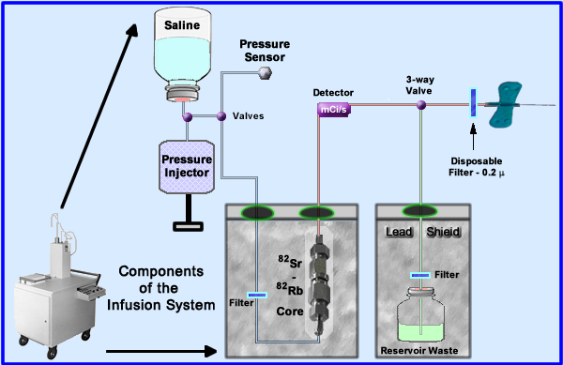
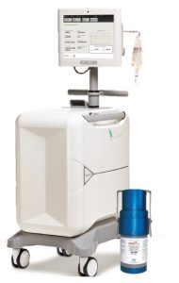
⁸²Sr/⁸²Rb Generator System

Slide 14
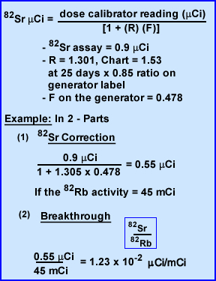


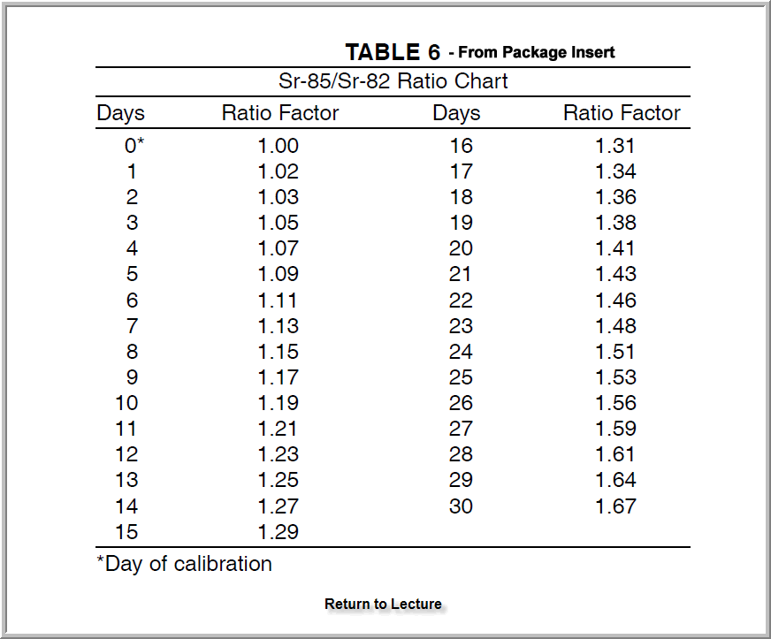
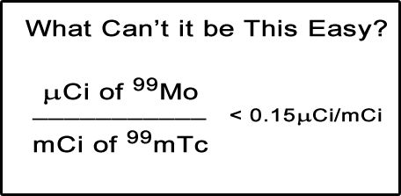
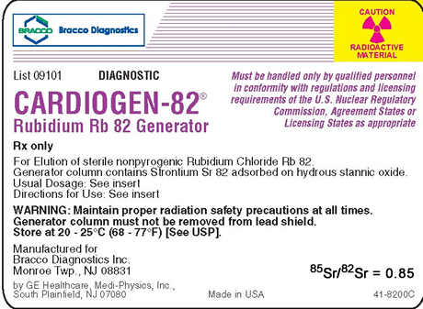

⁸²Sr Breakthrough
From generator elution calculate back
to time zero for ⁸²Rb
Determine R
  Generator label has the ⁸⁵/⁸²Sr ratio
  T_{1/2} ⁸²Sr = 25 days ⁸⁵Sr = 64.8 days
  Define ratio factor based on decay
Now determine ⁸²Sr level
  Dose calibrator reading
  Plug in R
  F is always 0.478
  Calculate
Now you’re ready to apply

Slide 15

Too Much ^{82/85}SrBreakthrough
Summer 2011 two individuals triggered sensors at the Canadian Board – ⁸²Sr and ⁸⁵Sr
Generators called – 113 tested negative
New QC implemented
New breakthrough limits (daily)
    Less than one-tenth of 0.02µ (⁸²Sr/⁸⁵Sr) per mCi of ⁸²Rb
    If limit is reached complete breakthrough test x2 per day
  Breakthrough to be done if 750 mL passes through the system in one day
Use additive-free Sodium Chloride
Breakthrough is >0.02µCi with ⁸²Sr or >0.2 with ⁸⁵Sr discontinue use and contact the distributor

Slide 16
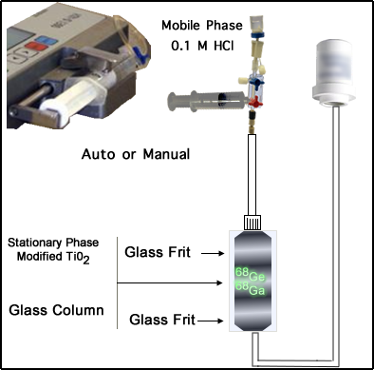
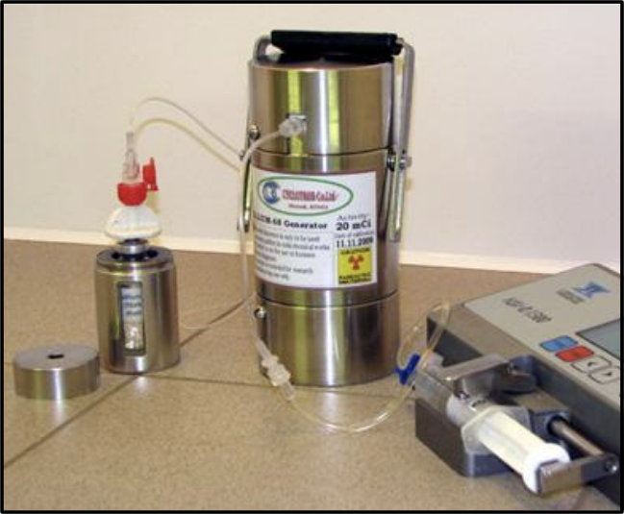
⁶⁸Ge/⁶⁸Ga Generator
⁶⁸Zn(p,n)⁶⁸Ge
Chromatographic column surrounded by glass with a TiO₂ core
  ⁶⁸Ge bonds to the TiO₂ and has a T_{1/2} of 271 days
  ⁶⁸Ga is the daughter with a 68 minutes
Elute with 0.1M HCl in 5 mL
⁶⁸Ga yield ~75% in a 3 mL elution
⁶⁸Ge breakthrough is <0.005%
You are now ready to tag it to DOTATATE or PMSA
In US PMSA is in clinical trials

Slide 17

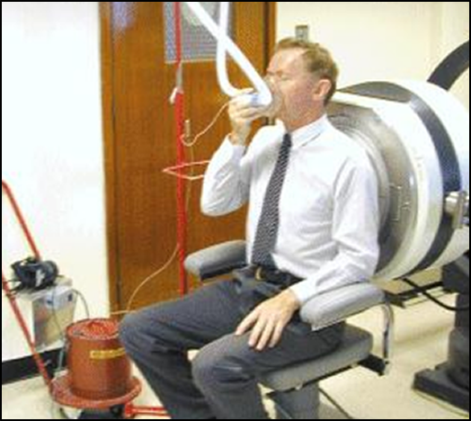
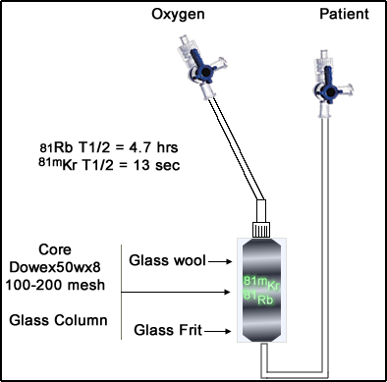
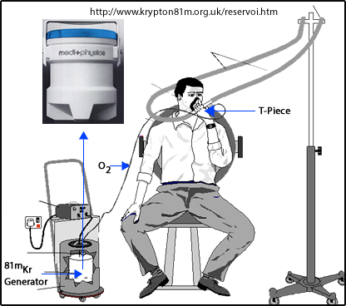
⁸¹Rb/⁸¹mKr Generator
⁸⁴Kr(p,4n)⁸¹Rb or ⁸⁵Rb(p,p4n)⁸¹Rb
⁸¹Rb is bonded to a cation-exchange resin (Dowex50wx8)
Generator activity ranges from 111MBq to 925 MBq at calibration
Elution – lungs (gas phase) or RV (liquid phase)
Moist air or O₂ (at 1 L/min) liberates the ^{81m}K or continues elution with IV administration (5% glucose)
0.9% NaCl solution yields similar extraction results
^{81m}Kr yields 90% - breakthrough “<10⁻⁸/mL”
Apparently still made by Cyclotron^{VU}
My experience – SLO after 3pm on any given day

Slide 18
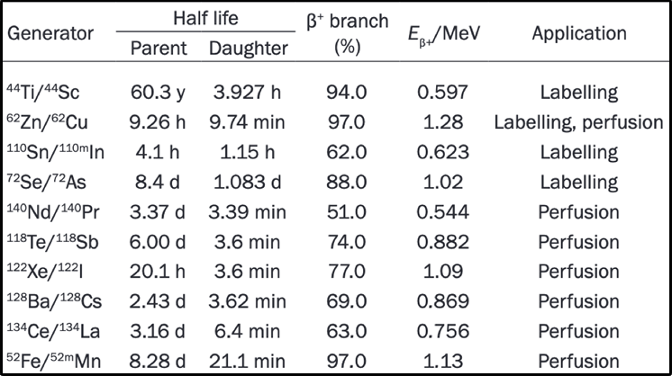
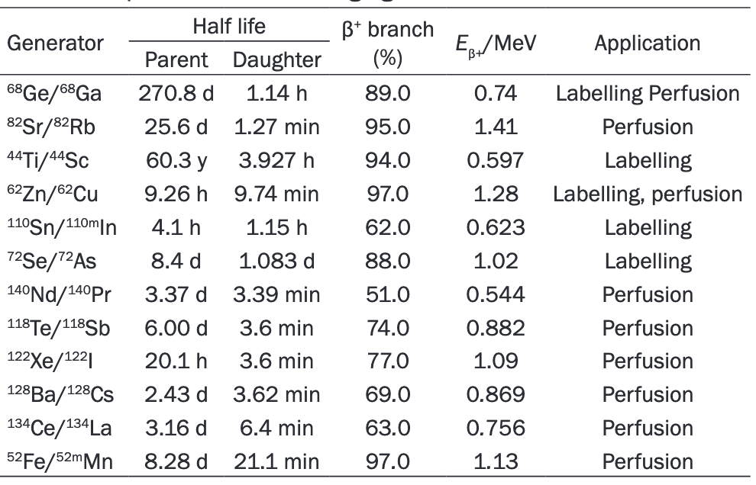
Honorable Mention– How About a Few More Generators

Slide 19


Slide 20
References
Chattopadhyay, S. et al. (2019) A compact solvent extraction based ⁹⁹Mo/⁹⁹ ^{99m}Tc generator for hospital radiopharmacy. (online) https://www.sciencedirect.com/science/article/pii/S0969804318307619 APPL RADIAT ISOTOPES 143:41-46 (accessed 5 Oct 2019)
Skliarova H. (2019) Recovery of Molybdenum Precursor Material in Cyclotron-Based Technetium-99m Production Cycle. (online) https://www.mdpi.com/2410-390X/3/1/17/htm Instruments (accessed Oct 5 2019)
Sharma S. (2014) Radionuclide Generators. (online) https://www.slideserve.com/umika/radionuclide-generators. Depart of Nuc Med, AIIMAS PPT (accessed Oct 5 2019)
Package Insert Technetium Tc99m Generator (online) https://www.accessdata.fda.gov/drugsatfda_docs/label/2013/017693s025PI.pdf NDA 17693/S-025 (accessed Oct 5 2019)
Cyclotron Produced Radionuclides: Physical Characteristics and Production Methods ( (online) https://www-pub.iaea.org/MTCD/publications/PDF/trs468_web.pdf Technical Report Series #468 2009) IAEA. (accessed 6 Oct 2019)
Mausner, LF, et al. The Production of 82Rb/81mKr Generators with =60-MeV Protons at BLIP (online) https://www.osti.gov/servlets/purl/5944453 International Symposium on Single-Photon Ultra-Short-Lived Radionuclides (accessed 6 Oct 2019)
Dulugeac S.D., (2013) Neutronic Analysis For The Fission Mo99 Production By Irradiation of LEU Targets INTRIGA 14 MW Reactor. (online) Institute of Nuclear Research, Pitesti, Romania https://inis.iaea.org/collection/NCLCollectionStore/_Public/47/053/47053341.pdf?r=1&r=1 (accessed 18 Sept 2019)
Phillips D. (1996) Radionuclide generator systems for nuclear medicine. (online) https://pharmacyce.unm.edu/nuclear_program/freelessonfiles/Vol5Lesson1.pdf Univ of NM College of Pharmacy. Volume V, Number 1. (accessed Oct 5 2019)
Fennell E.J., The RadioGenixTM System. (online) https://apha2018.pharmacist.com/sites/default/files/slides/Radioisotope_Procurement_Fennell_3-19-18_105A_HO.pdf (accessed 19 Sept 2019)
Zoller, F. (2006) The Role of Copper in Nuclear Medicine. NCSS (online) https://www.slideshare.net/brucelee55/the-role-of-copper-in-nuclear-medicine (accessed 19 Sept 2019)

Slide 21
References
Assessment Report. (2012) Cuprymina (online) https://www.ema.europa.eu/en/documents/assessment-report/cuprymina-epar-public-assessment-report_en.pdf (assessed 3 Oct 2019)
Sylvester P, et. al. (2004) Method of separation of 90Y from 90Sr. Priority 2002 -06-18 (online) https://patentimages.storage.googleapis.com/e8/73/95/056650ffbcfb37/US20040005272A1.pdf (accessed 3 Oct 2019)
Injarean U, et al. (2018) Process for separation of Y-90 from SR-90 in HNO3using combined solvent impregnated with resins of D2EHPA/dodecane and CMPO/TBP Chiang Mai Journ of Sc 45(1):556-564 (online) https://www.researchgate.net/publication/323837109_Process_for_separation_of_Y-90_from_Sr-90_in_HNO3_using_combined_solvent_impregnated_resins_of_D2EHPA_dodecane_and_CMPOTBP (accessed 3 Oct 2019)
Haynes, NG, et. al. (2000) Performance of a 62Zn/62CuGenerator in Clinical Trials of PET Perfusion Agent 62Cu-PTSM (online) http://jnm.snmjournals.org/content/41/2/309.full.pdf+html?sid=03967db9-5f98-40ba-a4a2-15340bb37f90 J Nucl Med; 41:309-314 (accessed 4 Oct 2019)
Beyer, GJ. (1990) A 81RB/81mKr generator made by ion implantation (online) http://cds.cern.ch/record/210342/files/cer-000122319.pdf European Organizations of Nuclear Research (accessed Oct 4 2019)
Kato M, Hazue (1977) [Generator kinetics of a 81mKr-generator for medical use [author’s transl] (online) https://www.jstage.jst.go.jp/article/radioisotopes1952/26/3/26_3_179/_pdf Radioisotopes 26(3):179-181 (accessed 4 Oct 2019)
Dash A, et. Al. (2019) Radionuclide generators: the prospect of availing PET radiotracers to meet current clinical needs and future research demands (online) http://www.ajnmmi.us/files/ajnmmi0086228.pdfnAM J Nucl Med Mol Imaging 9(1):30-36 (accessed 4 Oct 2019)
Suleiman, OH (2012)FDA Update: The Strontium/Rubidium Generator (online) https://www.nrc.gov/docs/ML1210/ML12101A274.pdf Presented NRC Advisory Committee (Accessed 6 Oct 2019)
Cherundolo B. 2014 Meeting of Mid-Atlantic States Radiation Control Program. (online) https://manualzz.com/doc/6907637/bracco-s-rb-82-generator Bracco website (accessed 6 Oct 2019)

