Slide 1
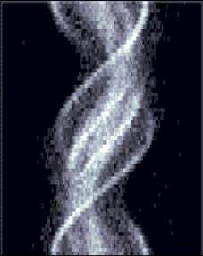
Single Photon Emission Computerized Tomography
Fundamentals of SPECT Imaging
Presented by Mark H. Crosthwaite, M.Ed., CNMT, PET, FSNMMI-TS
Associate Professor and Program Director
Virginia Commonwealth University

Slide 2
Before We Get Started - Consider
What is/are the advantages of SPECT vs planar imaging?
Planar imaging takes a 3D object and blends it into a two dimensional plain
Consider a tumor residing deep within the right lobe of the liver. Healthy tissue surrounds the liver hiding the disease when images are taken in 2D.
SPECT will allow for tomographic analysis displaying slices of data deep within the liver tissue, which would reveal photopenic tumor.
Generally speaking, planar imaging will usually have greater counts when compared to SPECT image.
Counts from a SPECT scan and its related resolution is only as good as any one acquired slice of data within the array images taken to generate the tomographic data.
What makes SPECT so powerful image contrast, via filtering, resulting in the SPECT data becoming superior to planar data. This fact is of greater significant when disease is buried deep within health tissue.
Example = Hacot and collogues compared SPECT to planar in detecting coronary artery disease and concluded that SPECT had enhanced reliability in localizing coronary artery disease¹.

Slide 3
First Let’s Think Planar
While the matrix size of a SPECT image varies between 64 x 64 or 128 x 128. Let us examine a 5 x 5 matrix and collect activity from a single point source.
The number 3 represents the acquired counts that generated from the single red hot spot.
Notice that all other pixels have a value of zero since no activity was collected in any of the other pixels.

Slide 4
SPECT Acquisition
Assume that you collect data from two different directions from that same single point source.
Anterior back protection collects a vertical set of counts.
Lateral back projection collects a horizontal set of counts.
When summing the “arrays” from both projections the center pixel receives the highest number of counts per pixel.

Slide 5
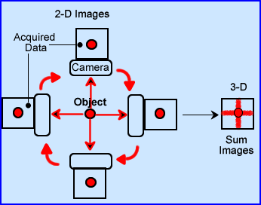
SPECT Acquisition
From a slightly different perspective this image shows a gamma camera collecting data from the same centered hot spot.
While there are two sets of arrays, vertical and horizontal, the greatest concentration of activity is in the center, where these two arrays meet.
Any activity outside the center would be considered background and must be ”removed.”
More on the “background arrays” when we talk about filters.

Slide 6
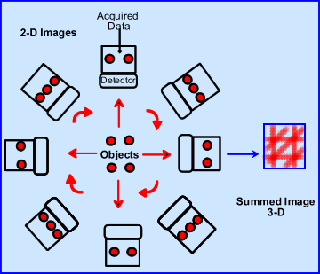
SPECT Acquisition
Now let us examine what happens when you wish to collect four-point sources with an acquisition occurring every 45 degrees.
This image shows us what can be seen at the different angles of acquisition.
Furthermore, the 3D summation image identifies the location of these four-point sources.
Note
Where the arrays cross each other are the location of the four-point sources having the highest degree of counts per pixle.
Outside these margins is data, or arrays, that must be filtered out.

Slide 7
SPECT Acquisition - Backprojection
Consider the orientation of the patient containing a radioactive tracer emitting gamma radiation as seen in this image.
The information is being picked, back projected, to the detector that rotates around the patient.
In definition SPECT is a composite of all the array sums, multi-angled in a series of 2-D projections
An analogy to this could be a patient at the center of the room sending out data on a movie projector at different angles against the wall. Except it is our gamma camera that is picking up these back projections not a movie screen.

Slide 8
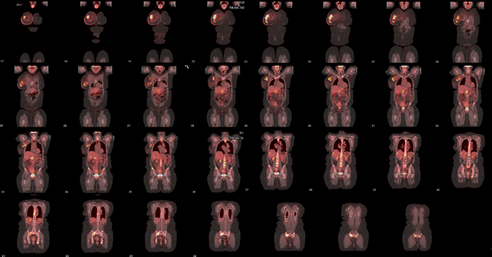
Displaying the Acquired Results
The raw data can then be played back as a cine.
Observing the raw data helps to assess image quality.
Did you acquire the correct area of interest? If not, re-acquire.
Did the patient move – If so, then apply motion correction software. If that does not work, re-acquire your data.
Are there any attenuation defects. This may also cause a re-acquisition.
If the acquisition, raw data is acceptable, it can now be processed and filtered, which will generate our tomographic slices.
This image is actually a PET image, however,
The same principles of tomography apply.

Slide 9
End Results – Tomographic Data
The beauty of SPECT is the ability to ”slice and dice” the physiological data into three different plains. Transverse – Sagittal – Coronal
The image displayed is color coded to better identify the correct tomographic plain.
But first we need to discuss

Slide 10
Imaging Parameters

Slide 11
Collimation
When imaging with pertechnetate Low Energy High Resolution (LEHR) collimator is recommended.
Rationale
Consider the length of the septa and the diameter of the hole.
The longer the septa and the smaller the hole, less scatter is acquired. Likewise fewer counts are collected. LEHR
Negative/positive effect of LEHR - Fewer counts reduces image quality making the image grainer, however, the counts collected are true counts defining the location of the gamma event.
GAP – Have Shorter septa and larger diameter holes that bring in more counts, but those additional counts are scatter counts.
Scatter has a negative impact on image quality, by reducing image contrast since they define the wrong location of the gamma event.
Therefore, ALWAYS use a high resolution collimator.
Furthermore, literature indicates 2 mm improvement when implementing a ultra-high resolution collimator.²

Slide 12
What is the best type of Orbit?
First compare elliptical to a circular orbit.
Do you recall that the further away the detector is from the patient the greater amount of scatter is added to the acquisition. Net result is a lost in imaging contrast.
Therefore an elliptical orbit is usually preferred over circular.
However, if your imaging system has body contour then this would be the method of choice.

Slide 13
Matrix Size – 64 or128?
A 128 matrix does improve image resolution however, it will introduce more noise. Less counts relates to more image noise.
In this example V = amount of pixels, N = counts.
If 64 and 128 matrixes are acquired at the same amount of time, then both would have the same amount of counts.
Assume you are acquiring a SPECT bone for 25 minutes with a 64 matrix.
To have the same amount of noise in the 128 matrix you’d have to acquire a 70 minute scan. (25 minutes x 2.8)
Can the patient lay still for that long?

Slide 14
Counts – Planar vs SPECT
Planar imaging ALWAYS has more counts. More counts should improve image resolution.
SPECT imaging has significantly fewer counts because resolution is based on each individual projection.
Misconception – Total counts form a 360 degree collection of data would probably contain more counts then a single planar image, however, resolution is based on each single projection.
Key Point
A slight variation in a single PMT may have little to no effect in a planar image.
However, if a SPECT image contains the same slight variation and 64 projections are collected, then that slight variation is magnified 64 times.
QC and image flood field uniformity is extremely important when acquire SPECT data. Likewise, if you have a two-heading imaging system both heads must be “well tuned.” <3% variation between pixels in an uniformity flood is suggested as it related to integral and differential system uniformity.

Slide 15
Amount of Stops – Angular Sampling
Radon Transform identifies that a infinite number of projections around an object yields a “perfect replication.”
In a similar assessment, the greater the amount of stops (angles) around an objection the better its image quality.
The fewer the stops the greater the noise and the loss of data.
It should also be noted that the greater the amount of stops in an acquisition will image background.
As a rule of thumb the amount of stops should be equal to the the size of the matrix.
Applications of SPECT filters allows us to reduce background and/or noise in an image.
For these reasons it becomes essential to filter out unwanted data in the frequency domain.
http://www.people.vcu.edu/~mhcrosthwait/clrs322/SPECTimagingparameters.html

Slide 16
Spatial Data Conversion
Data acquired and evaluated on a CRT screen assess data in the spatial domain.
A digital image has a designated matrix size comprised of pixels that contain counts. Variation of counts within these pixels determines image contrast/resolution allowing to visualize differentiate objects within their the spatial domain.
Key - Image filtering becomes less complicated if spatial data is processed in the frequency domain; hence, spatial data is converted into a frequency domain where, BKG and noise can be removed.
Conversion
Counts are mathematically converted to frequencies domain with the application of a Fourier Transform.
Imaging filter(s) are then applied to remove unwanted frequencies with the goal of enhancing “true counts.”
After completing this process, data is converted back to the spatial domain.

Slide 17
Filtered Back Projection (FBP)

Slide 18
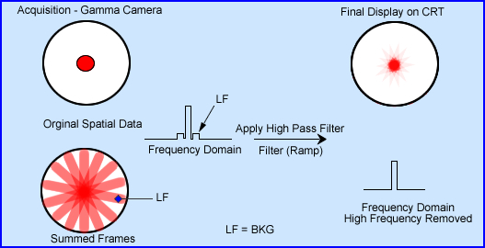
Processing the Raw Data
Before we look at the next image there are several key points that require discussion.
Data from SPECT is collected in a spatial domain (360 degrees around the patient)
Through Fourier Reconstruction spatial data is converted into a frequency domain.
This allows for better image manipulation, filtering, by adjusting its frequencies.
Later we will discuss these filters, but for now let us look at a simpler picture that well better explain this process.

Slide 19
Another Look at that Hot Spot
A 360 degree SPECT acquisition around a point source resultes in an unfiltered backprojection (UBP) image. This blurring data is a result of the sum of arrays, much of which is considered unwanted data in the low frequency domain.
However, additional processing, via the application of a high pass filtered removes the low frequency. This image is defined as filtered backprojection, FBP.
A transverse count profile further demonstrates the difference between the UBP and the FBP data.

Slide 20
Object Activity vs Image Contrast
In the spatial domain, the ability to see an object depends on the amount of activity being emitted by that object.
It should be said that variation in activity being emitted defining image contrast.
Realistically, in a black/white image contrast is displayed in 2⁸(256) shades of gray. The human eye can distinguish around 30 variation within a gray scale.
In order to define different objects in an image, there has to be enough variation in counts, between surrounding pixels/voxels.
These variation in counts translate to the contrast of an image.

Slide 21
Modular Transfer Function (MTF)
Conversion from the spatial domain to the frequency domain is displayed.
MTF identifies the ability to visualize an object where 1.0 shows no loss and 0.0 shows complete loss of image data.
Relate this to the lines on the graph with the patterns of each sinusoid.
The larger objects within an image are graphed at an MTF of 1.0 which show to slower oscillations.
As objects get smaller the frequency is higher and the oscillations (cycles/time) become more abundant. Note the negative slope on the MTF graph.
Technically where the MTF crosses zero the image is completely lost.
It is in the frequency domain that various filters can be applied to enhance the acquired data
After filtering has been applied in the frequency domain data is then converted back to the spatial domain for visual and/or quantitative analysis.

Slide 22
What’s in the different Frequencies
Breaking down the spatial domain into the frequency domain allows for the manipulation of the different frequencies.
Slower frequencies are to the left which include background and larger object with an image.
The center amplitudes contain the true counts or the object/information.
Noise is inherent throughout the graph.
Modular Transfer Function (MTF) demonstrates the resolution of the imaging system.
Adjusting the MTF can improve image contrast by removing noise and/or background counts.
Note – Spatial resolution is lost where the smallest object(s) reaches the point where MTF curve and noise meet.

Slide 23
Compare Spatial to Frequency Domain
What might the different spatial objects look like in the frequency domain?
A four quadrant bar phantom shows four different quadrants of resolution.
Next to the bar phantom are examples of what the frequency domain might look like.
As the spatial dimension become smaller the oscillations increase, as seen in this image.
It should be noted that at some point the the object becomes too small to be seen. One could say that it gets lost to the inherent noise of the acquired data.

Slide 24
Parameters of Frequency
1- An object or objects have difference sizes and amounts of activity which are displayed in the above
frequency domain.
2- MTF defines the resolution of the imagine system 1.0 to 0.0.
3 – Noise is inherent throughout any image and is a reflection of the amount of counts in an image. The lesser the amount of counts the greater the noise. Note – SPECT ALWAYS has fewer counts when compared to planar. Therefore, there is more noise in a SPECT scan.
4 – Frequencies from 1 – 3 are reflected into graph 4, then blended into graph 5.
5 – Power Spectrum is the summation of all frequencies acquired from the spatial domain.

Slide 25
Another Example
A – Bar phantom used in radiology
As the bars get smaller they become more difficult to visualize.
In the far right they disappear.
B – Shows the frequency domain.
C – Is what the MTF would look like.
Another comparison to MTF and frequency. The red line indicates that you can see the all the frequencies, including the smallest.
Even in real life there is a limit to what we can see at a given distance. Therefore an MTF will reflect a descending pattern.

Slide 26
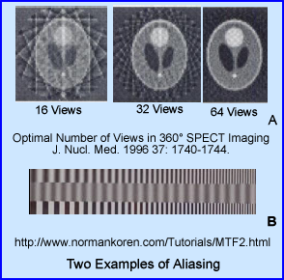
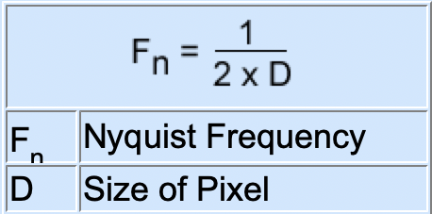
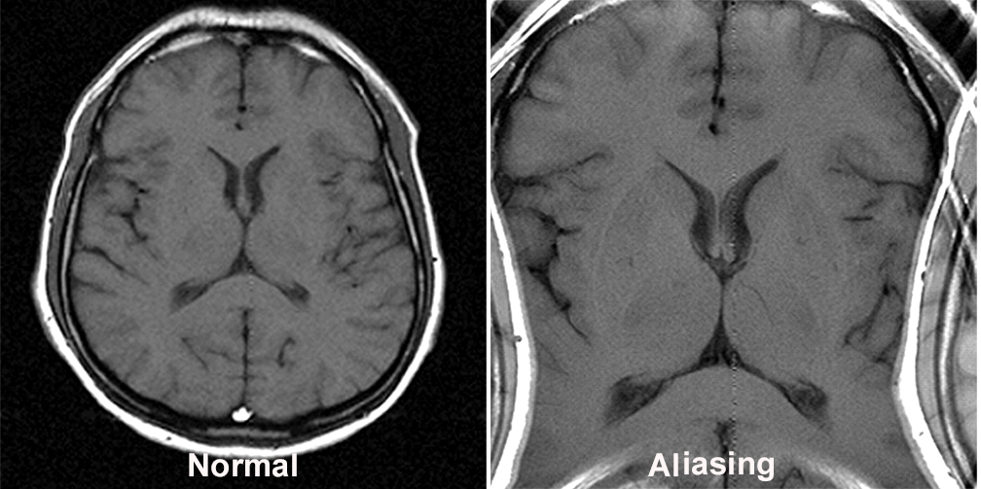
Nyquist Frequency (NF)
NF is the relationship between a pixel and sinusoid.
No more than ½ a cycle should fit in a pixel. Anything beyond that causes aliasing.
Maximizing your NF is a key component in resolving smaller objects.
Brain phantom shows aliasing as it relates to the amount of stops in a SPECT scan.
Digital camera shows how aliasing can affect the digital image.
Example of aliasing in an MRI scan.

Slide 27
NF Calculation
The following is an example of calculating NF on a gamma camera that has an FOV of 38.1 cm by 38.1 cm with a matrix size of 64 x 64.
When you calculate NF its maximum acceptable frequencyis 0.084 cycles/mm⁻¹.
Reducing the mm/pixel below 5.95 will cause aliasing.
It should be noted that different gamma camera manufacturers have slight variations on how to calculate NF. The critical factor is to know that NF is be NO greater than ½ of an oscillation per pixel.

Slide 28
Imaging Filtering

Slide 29
Pre-Filtering
Since SPECT raw data images have low count’s, it is recommended to smooth that data before other filters are applied, such as a 9-point smooth.
This image profile shows significant variation in counts in the raw data flood source which is graphically displayed.
Applying a 9-point smooth image reduces the amount of variation at the pixel level reduce the amount of image noise.

Slide 30
Types of Filters
Goal in processing FBP data
1) Remove BKG.
2) Remove noise.
Application of Low Pass Filters remove noise (high frequencies).
Application of High Pass Filters remove BKG (low frequencies).
Band Pass filters remove low and high frequencies keeping the mid-range frequencies where the true data is located.

Slide 31
Windowing the Frequencies
The closest filter to a Band Pass would be the application of windowing the frequencies.
Applying a low frequency filter, Hanning, remove image noise.
Applying a high frequency filter, Ramp, removes the low frequencies
The net results of reconstructing the frequencies is to keep the middle frequencies where the true counts are located.

Slide 32
Butterworth Filter – Critical Frequency
Critical Frequency – in the example shown.
Adjusting the critical frequency has two effects.
Increasing the frequency brings in smaller objects.
Increasing the critical frequency to beyond 0.5 cycles/pixel with cause aliasing.
Never going beyond the NF frequency.

Slide 33
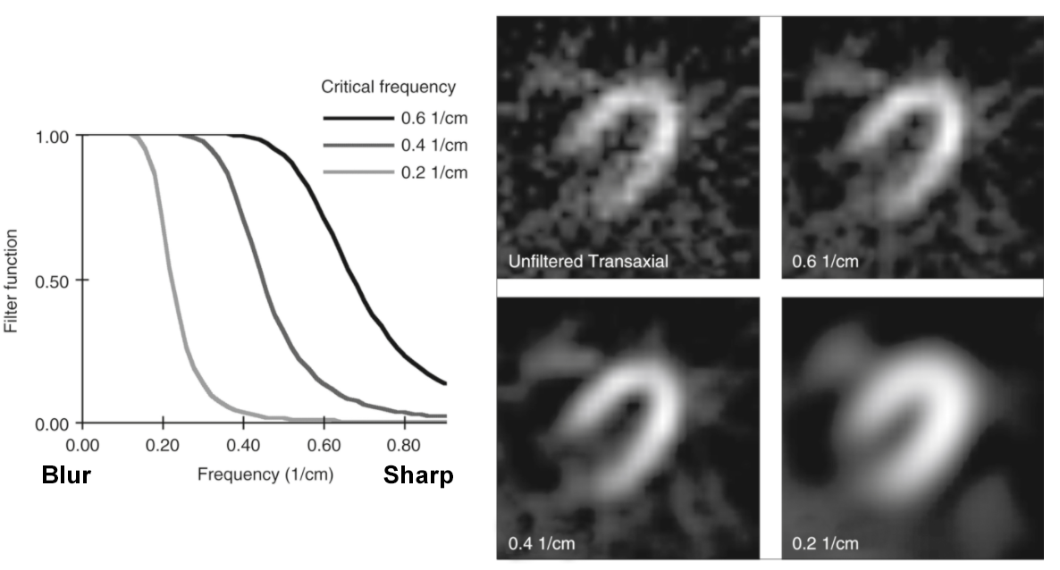
Example Critical Frequency

Slide 34
Butterworth – Order
Changing the order will adjust the slop of the MTF
8 gives you more low frequency and cuts off the noise and smaller objects.
4 reduces BKG and increases noise and smaller objects data.
2 brings in the greatest amount of noise and small object data while further reducing BKG.

Slide 35
Butterworth – Cut-Off
Role of cut-off frequency can help improve image quality
The MTF of best fit is the order of 2 (blue) with a NF cutoff of 0.5 cycles/pixel/.
Consider
In the upper portion of the MTF there is an indentation of the curve reducing the background frequency. At the lower portion of the curve there is a significant increase in high frequencies.
If you place an imaginary cutoff of 0.5 you maximize the higher frequencies, but prevent aliasing
Depending on where you place the cut-off you can:
Reduce the amount of noise
Reduce the amount of background
Prevent aliasing
Net result - Improve image contrast

Slide 36
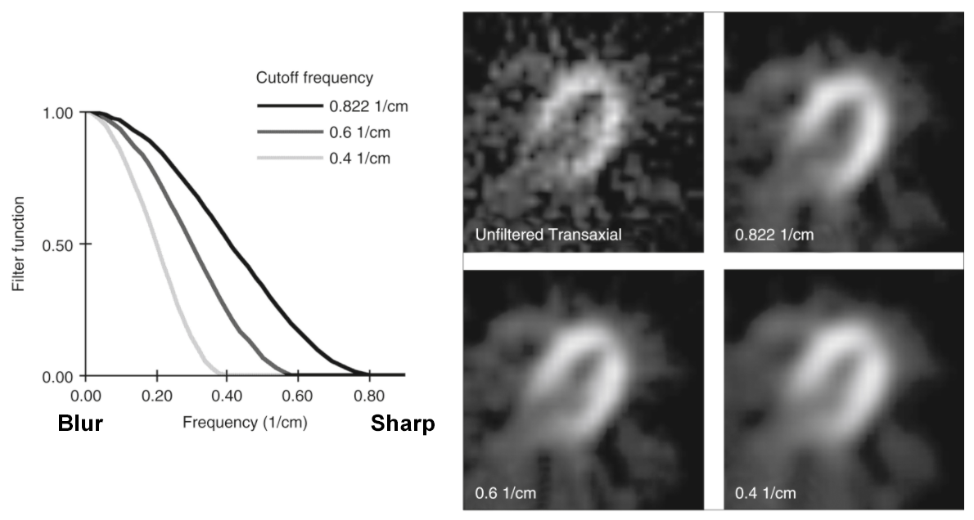
Example – Cut-Off Frequency

Slide 37
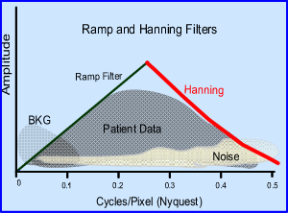
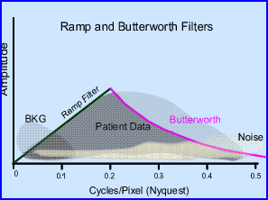
Applying windowing
If you were going to apply windowing to process this data which two filters would you choose?
Ramp removes the BKG
All others are low frequency filters.
Applying Butterworth causes a loss in patient data
However, Hanning keeps all the patient data and removes excessive noise.

Slide 38
Other Filters

Slide 39
Filters – High and Low Frequencies
High pass filter
Ramp
Low Pass filter
Butterworth
Hanning
Hamming
Parzen
Shepp-Logan (Is it?)
https://www.researchgate.net/figure/Shepp-Logan-Butterworth-Hann-Parzen-filter-functions-from-Van-Laere-et-al-2001_fig6_51494115

Slide 40
Restoration Filters
Concept – improve resolution of low count images by restoring counts.
Metz filter inverts the MTF as noted in the example.
Wiener applies a different principle. Its goal is to filter out noise by assuming that noise and true data are linear.
In an attempt to eliminate noise it applies a statical concept referred to as minimum mean squared error.

Slide 41
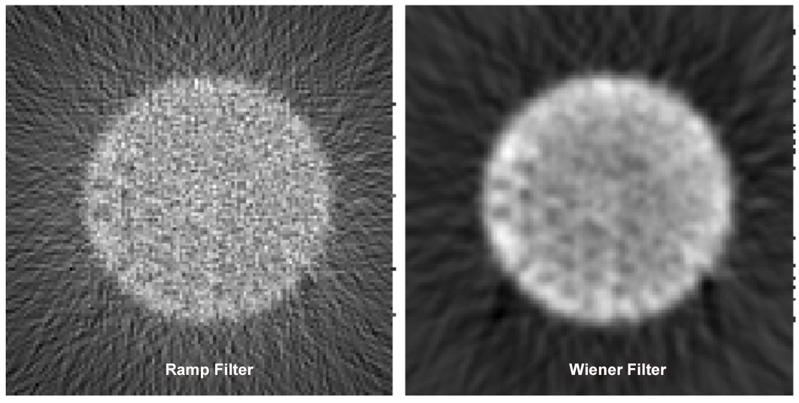
Ramp vs Wiener Filter
Jaszczak phantom.
Can you explain the difference between Ramp and Wiener?
Ramp filters out low frequencies therefore producing a extensive sum of arrays.
Wiener filter removes statistical noise improving the image quality
https://www.owlnet.rice.edu/~elec539/Projects97/cult/node4.html

Slide 42
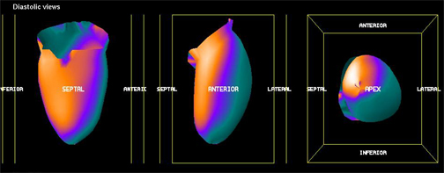
Creating a Three-Dimensional Image
Cross-sectional profiles assess activity in the left ventricle of the myocardium.
The first purple arrows represent a threshold that define the edge of the myocardial wall.
The second purple arrow defines the other end of the myocardial wall.
Four graphs are displayed showing the count distribution within each specific profile slice.
The result shows an example of what is referred to as volume rendering data.

Slide 43
Example of Volume Rending
Here is another example.
All exterior areas of the brain can be assessed from this PET brain scan.
Any abnormality found on the surface would present itself in this assessment.
However, if disease is ”deep” within the brain and does not extend to the surface, then disease could be missed.

Slide 44
Chang Filter for Brain Imaging
Chang filter attempts to add counts lost form the attenuated photon that occurs within the depth of an object.
If an object is homogenous in density then Chang can be applied.
This can be done in a brain scan with the net result of adding more counts in the center of the brain.
Process
A – Draw a region around the brain to B – Setup the correction map.
C – Shows the original transverse slice while D – Shows the corrected.
There does appear to be a subtle improvement in structures located closer to the center of the brain.

Slide 45
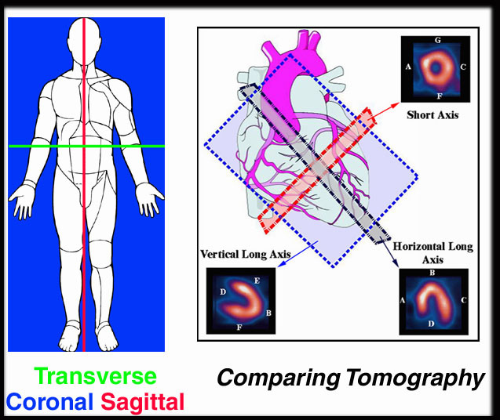
Tomographic Slices
Based on the anatomical position of the body most SPECT images can be ”sliced’ into transverse, coronal, and sagittal.
These slices have been color coded for your review.
However, the heart is positioned at an angle hence the tomographic slices are renamed: horizontal long, vertical long and short axis.
In addition these tomographic slices exposed different walls of the heart and are define as:
A – Septal
B – Apex
C – Lateral
D – Base
E – Anterior
F – Inferior
G - Anterior

Slide 46
Iterative Reconstruction (IR)

Slide 47
IR - Techniques
Goal – To estimate the true counts in each pixel/voxel.
Advantages over FBP
Attenuation map can be employed.
Estimation of radiopharmaceutical distribution is applied.
Backprojection can be used in the process.
Improved data allows for better quantitative analysis.
No star defect.
Disadvantage
Longer processing time.
Need greater computer power.

Slide 48
IR Explained
Data acquired in a set of 2D matrices (64 or 128)
Smoothing filter maybe applied prior to processing.
1 – Initial Guess data obtained by assuming uniform distribution of activity .
2 - Forward projection generates an estimated 3D matrix that is influenced by patient attenuation map and extra data that is specific to imaging physics.
Then 2D Estimated Projections are compared with the 2D Measured Projections.

Slide 49
IR Explained (cont.)
3 – These 2D Comparison generates a value that is the difference between Estimated and Measured.
Backprojection can also be applied to further assess in developing the 3D Error Matrix.
4 – A 3D Error Matrix is then applied to step 2 Estimated 3D Matrix. Generating a new 3D Matrix.
This starts another iteration repeating steps 2 to 4.
There can be multiple iterations with the goal of estimating the true counts per voxel.

Slide 50
Expectation Maximization (EM)
EM is the overall terminology used for this type of processing.
Maximum-Likelihood (MLEM) is one method within EM that is used to generate “true” counts.
It assess all projected, one at a time, as it goes through the iteration process. It may take between 50 to 100 iterations to complete the desired result.
Ordered-Subset (OSEM) reduces processing time by grouping projections into subsets.
Ex. If there were 128 projections these would be broken down into 8 subsets each containing 16 projections. The amount of iterations is usually less than 15.
End result – it saves time and is the preferred method.

Slide 51
Application of OSEM
From the images displayed the number below them represents the amount of iterations applied in IR.
At some point the increase in the amount of iterations does not improve image quality.
Note
Each iteration generates more noise and is referred to as noise breakup phenomenon.
Too much noise can reduce image contrast.
A post smoothing filter may also be applied to reduce noise in the final product.

Slide 52
Assessing Filtered Images

Slide 53
Metz and its Frequencies
The Cut-Off of one and an order of 30 generates a very graining image displaying a lot of high frequency data. Look at the location of the MTF curve.
Why is it so graining?
Cut-Off of 0.55 and an order of 1 removes most of the high frequency data generating low frequency, blurry image.
Why is it so blurry?

Slide 54
Hanning and its Frequencies
Note the location of the MTF curve
Cut-Off of 0.5 and an Alpha of 0.5 shows a very blurry image. Note how the MTF curve has a significant negative slope.
Cut-Off of 0.5 and an Alpha of 0.75 significantly raises the area of the MFT but the cut it off is set at 0.5. Since it exposes a significantly greater amount of high frequencies.
The net result is a sharper image/grainer.

Slide 55
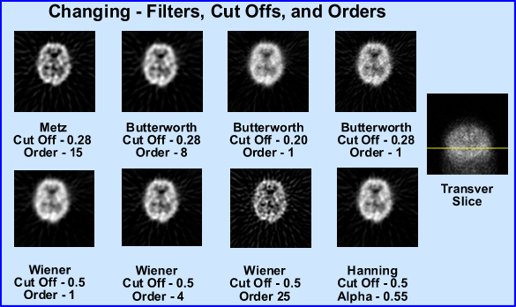
Brain Scan With Different Settings
I’m really not sure which image I’d prefer. Do you have a favorite?

Slide 56
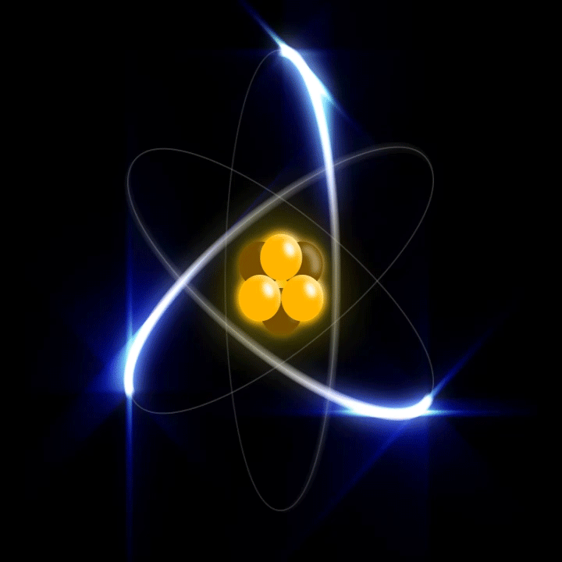
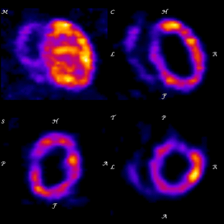
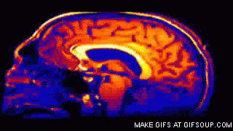
The End
https://gifer.com/

Slide 57
References
1 – Hacot JP, Bojovic M, Delonca J, et al. Comparison of planar imaging and single-photon emission computed tomography for the detection and localization of coronary artery disease. Int J Card Imaging. 1993 Jun;9(2):113-9.
2 - Prekeges J. Nulcear Medicine Instrumentation,2nd Ed. Sudbury, MA. Jones and Barlett Publishers. 2012
3 - SPECT Single-Photon Emission Computed Tomography: A Primer. Reston, VA. SNMMI.. 1986
4 - Waterstram-Rich, Gilmore, D. Nuclear Medicine and PET/CT: Technology and Techniques, 8th edition2017.
5 – Many images applied in this presentation were created by MH Crosthwaite and can be found in https://people.vcu.edu/~mhcrosthwait/clrs322/index.htm

