Slide 1
Ventilation And Perfusion Lung Imaging
In Nuclear Medicine Technology

Slide 2
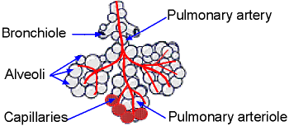
Lung Anatomy
The lung consists of 5 lobes.
From the main stem bronchi bifurcation occurs to the level of bronchioles and terminate in alveoli.
Pulmonary artery divides to terminal pulmonary arteriole which then branch to capillaries that cover the alveoli,
This is where O₂ and CO₂ are exchanged.

Slide 3
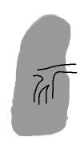
Diseases of the Lung
Our primary concern is the diagnosis of pulmonary emboli (PE)
Assessment of ventilation and perfusion - PE
Ventilation would not be affected
Blood flow (perfusion) would lack blood flow to the area being occluded
Assessment of ventilation and perfusion - COPD
Chronic obstruction will affect ventilation and may also alter circulation
Ventilation. Perfusion

Slide 4
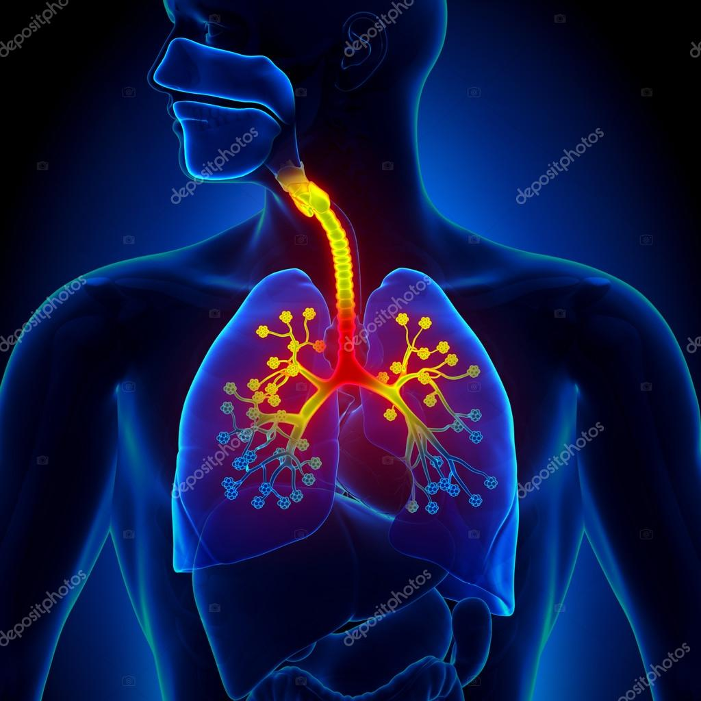
Ventilation Lung
 | Acquired Position | Gamma Energy | Washout | Negative Pressure
¹³³Xe | One - View | 80 keV | Yes | Yes
^{99m}TcDTPA | Many – Many Views | 140 keV | No | No
^{99m}Tc-Technegas | Many – Many Views | 140 keV | No | No
Xenon is a radioactive gas and must be administered in a negative pressure room
^{99m}TcDTPA and Technegas are different forms of particulates and do not need a negative pressured room

Slide 5
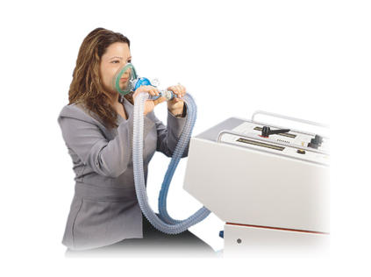
¹³³Xe Procedure
Patient the patient in supine position with the FOV to include the entire POST lung field
Matrix size 128 x 128
Collimator – LEHR
Dose – 5 to 20 mCi (200 TO 750 MBq) of ¹³³Xe
Suggest ventilation to be done before perfusion
Setup of the three-part procedure
Initial breath Acquire one image for ~ 20 to 30 seconds
Equilibration Acquire 1 to 2 images at 60 seconds per image
Washout – Acquire 1-minute images until there is no more Xenon in the lungs. Usually, this takes ~4 to 5 minutes. If the patient has COPD, activity will remain in the lungs for a longer period of time.

Slide 6
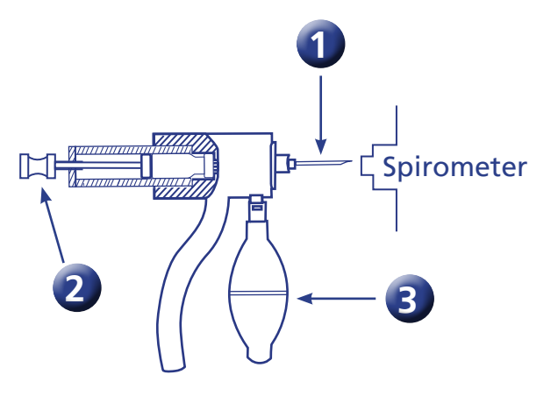
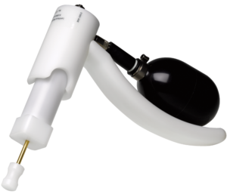
Application of ¹³³Xe
A Xenon-type gun (Calidose Dispenser) is used to administer the dose.
A vial of 133Xe gas is placed into the dispenser
1 - A needle is placed at the opposite end of the and inserted into the spirometer
2 – The plunger is pushed, which pierces the rubber stopper on the xenon vial
3 – The bulb is then squeezed, forcing the gas into the xenon delivery system
https://www.lantheus.com/assets/Operating-Instructions-for-Calidose-Dispenser.pdf

Slide 7
Application of ¹³³Xe
Initial Breath (closed system)
The patient sits upright with the detector, imaging the posterior portion of the lung field.
Gas is injected, and the patient holds their breath for 20- 30 seconds.
Equilibration (closed system)
Exhaled air then passes a biofilter
Anhydrous crystals remove moisture.
Sodium lime absorbs CO₂ and prevents acidosis.
Xenon enters the large chamber where additional O₂ is added.
The filtered air and ¹³³Xe then return to the patient.
Acquire 1 to 2 images at 60 second each

Slide 8
Application of ¹³³Xe
Washout – Open system
The system now follows the path of anhydrous to sodium lime to charcoal filter and then exits out the exhaust
On each inhalation, NO xenon case is given. It only washes out of the lungs
Gas that does not get trapped by the charcoal filter should be vented out of the department.’
One-minute images are taken until xenon is no longer seen in the lungs

Slide 9
Examples of Ventilation Systems
https://capintec.com/product/pulmonex-ii-xenon-system/
http://people.vcu.edu/~mhcrosthwait/clrs317web/LungVentilationrev.html

Slide 10
Other Technical Factors – ¹³³Xe
Xenon must be administered in a negatively pressured room
100% air turnover should be computed in case of gas escapes during its administration.
Close door(s) and allow this to occur before letting the patient leave the room
The room should be tested quarterly to ensure that the negative pressure is still present. Variations in pressure will require a recalculation of air turnover.
Anhydrous crystals are initially blue. As they absorb moisture, they turn pink. Once all the material has turned pink, it should be discarded, and the tube should be refilled.
During the washout phase, the patient should stay connected until all the xenon leaves the lungs. If activity is still noted and the patient is discharged, xenon gas will be exhaled into the room and surrounding environment.

Slide 11
Normal Xenon Ventilation Scan

Slide 12
Ventilation - Aerosol
Matrix – 128 x 128 or 256 x 256
Collimator - LEHR
25 - 35 mCi (900 – 1300 MBq) ^{99m}TcDTPA is placed into the injection port and is contained with the nebulizer.
O2 is connected to the O2 port.
The patient should sit upright with the camera’s FOV covering the thoracic cavity.
When the patient is connected to the system, clamp their nose and turn the O2 on to 10L/min.
If the gamma camera has a per-second readout in a non-acquisition mode, stop aerosol administration @ 3.0k/sec.
If a per-second readout is unavailable, administer the dose for 5 minutes. Do not go beyond 5 minutes.
At a minimum, acquire ANT, POST, LPO, and RPO. LAO, RAO, R-LAT, and L-LAT are optional.
Collect 150k counts or more per image.
Once completed, you may continue to the perfusion portion of the procedure.
Notes:
More about the tail later

Slide 13
Another example of an Aerosol System
Principles are the same
A – This is where you connect the O₂
B – Nebulizer
C – Injection port
D – Single tubing that goes to the Pt
E – Filter to trap the exhaled droplets
F – Filtered exhalation

Slide 14
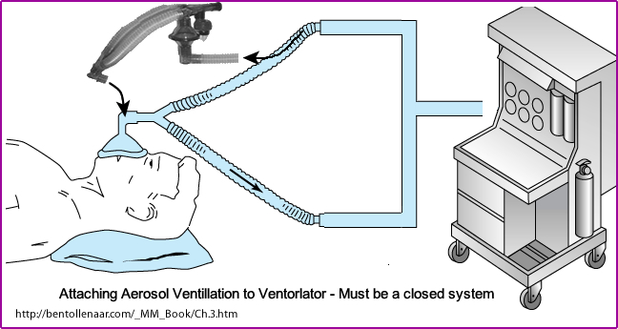
Ventilator Patient

Slide 15
Getting the Right Droplet
Ideally, your droplet size should be around 0.22 µ
10 – 15 µ gets trapped by the tubing
<0.1 µ will escape from the filter
The volume of DTPA in the nebulizer should be between 3 – 5 mL
The higher the O2 per minute, the better – suggest 10 L/min.
Limit the administration to no more than 5 minutes. The number of counts between perfusion and ventilation should be at least 3 to 1.
It is suggested that a 10% ethanol solution be added to DTPA solution.
Reduce the surface tension of the droplet

Slide 16
Comparing ^{99m}TcDTPA to ¹³³Xe

Slide 17
Examples of ^{99m}TcDTPA Aerosol
Example of two different ventilation scans
Both are “normal,” showing the following features
Oral activity
Aerosol deposition in the bronchi
Stomach uptake that occurs from swallowing the aerosol

Slide 18
Start with ¹³³Xe or ^{99m}TcMAA
Ideally, ^{99m}TcMAA could be administered first. Why?
If MAA is normal, there is no need to administer ¹³³Xe
If this logic is applied, then Compton Scatter from ^{99m}Tc will spill into the Xenon window.
The energy of ¹³³Xe is 81 keV, whereas the energy of 99mTc is 140 keV.

Slide 19
Apply 3 to 1 Ratio - MAA/DTPA
MAA and DTPA both have the same radionuclide
Therefore, in order to prevent DTPA from shining through the MAA image (think PE)
There must be at least a 3 to 1 ratio
An example of that calculation is noted

Slide 20
Physiology Behind MAA
Acceptable particle size
10 – 90µ at 90%
<150µ at 10%
Capillary diameter = 7 to 8µ
When injected, it blocks the lower end arterioles
The ratio of blocked arterioles ~1 in 1,000
Total particles injected should be between 200k to 700k
How does decay affect the amount of particles injected?

Slide 21
PIOPED⁴
Prospective Investigation of Pulmonary Embolism Diagnosis
High Probability (>/= 80%)
Two large mismatched segmental perfusion defects or
Similar combination
Intermediate Probability (20-79%)
One moderate to two large mismatched segmental perfusion defects or
Similar combination
Single matched defect with negative chest x-ray
Low Probability (</= 19%)
Non segmental perfusion defects
Any perfusion defect with large chest x-ray abnormality
Matched defect (perfusion/ventilation) - with clear chest x-ray and some areas of normal perfusion in the lung scan
Any number of small perfusion defects with normal chest x-ray
Normal
No perfusion defects
Chest x-ray and V/Q lung scan are normal
https://en.wikipedia.org/wiki/Pulmonary_embolism

Slide 22
Lung Perfusion Procedure with ^{99m}TcMAA
Collimation – LEHR /20% window
Administer 4 - 5 mCi of ^{99m}TcMAA IV while the patient is in the supine position
Tell the patient to take several deep breaths after the injection is given
Do not flush the syringe with the patient’s blood!
Set Matrix size – 256 by 256
Acquire 500k images or preset time ton 5 minutes
Take ANT, POST, LPO, and RPO images. You may also take LAO, RAO, L-LAT, and R-LAT
All perfusion images must match the same angles taken from the ventilation image
A chest x-ray must also accompany the procedure and should be taken within 24 hours pre-V/Q exam. Otherwise, a new chest x-ray must be taken and submitted with the V/Q procedure

Slide 23
Normal Perfusion Lung Scan

Slide 24
Patients that Should Review Reduced Particles
Pediatrics = 520k to 75k
Pulmonary Hypertension = 100k to 150k
Patient with one lung = 150k to 200k
Normal lung scan = 200k to 700k
Should there be a patient that would receive reduced particles
Worksheet Explained
Blank worksheet

Slide 25
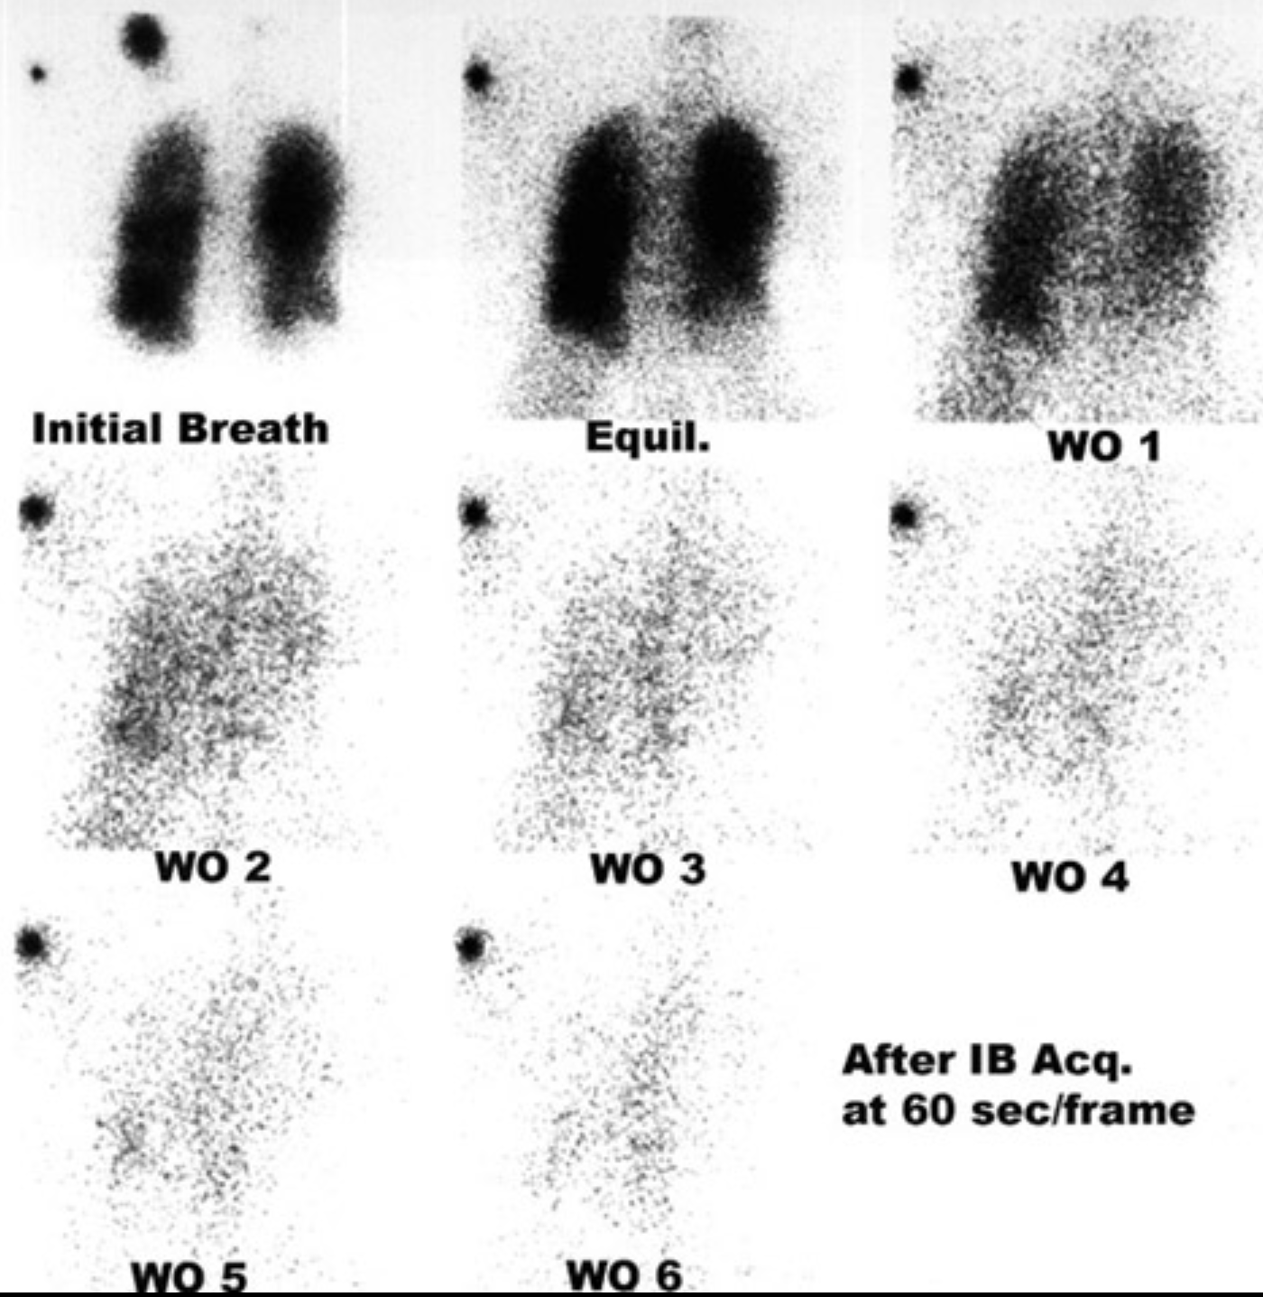
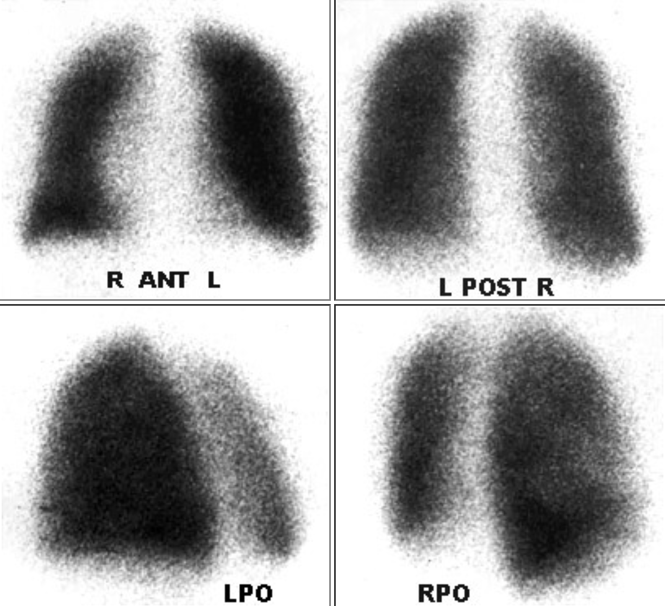
Normal VQ Lung Scan

Slide 26
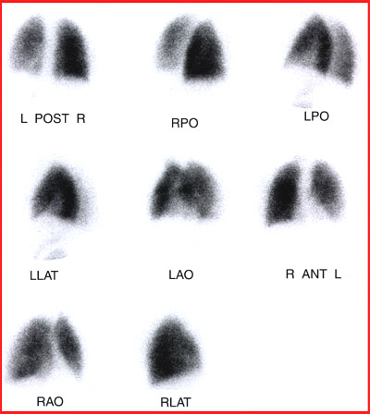
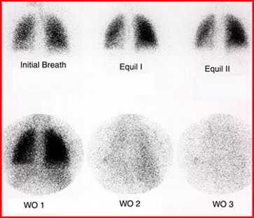
VQ Scan – Pre and Post Therapy

Slide 27
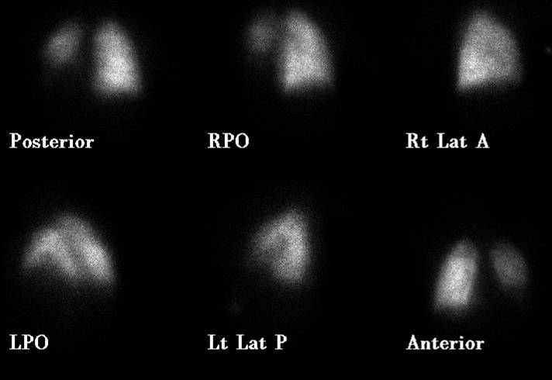
Abnormal VQ Scan
Xenon Ventilation MAA Perfusion

Slide 28
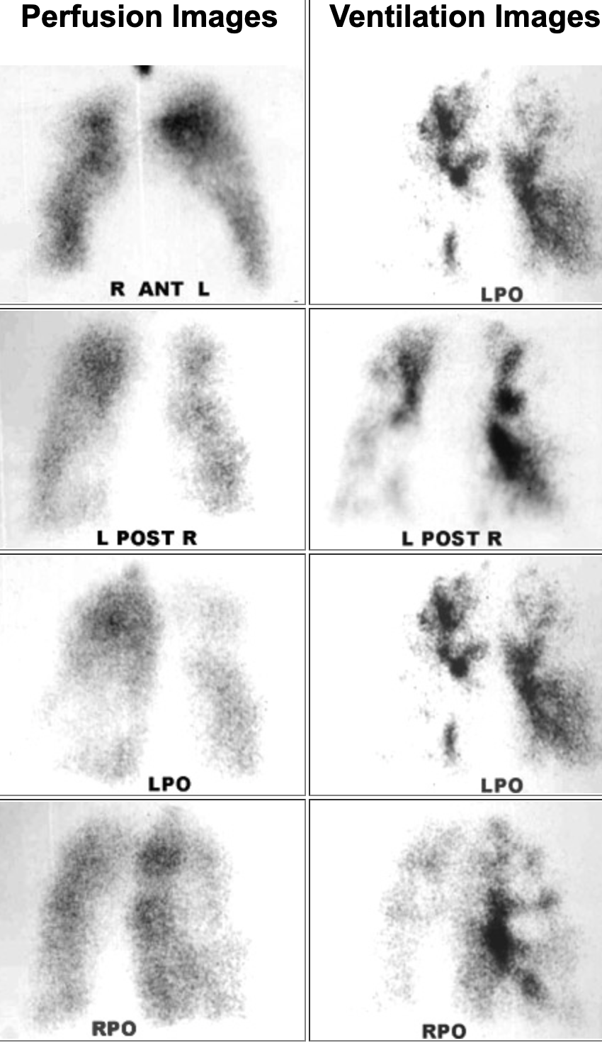
Abnormal VQ Scan – Aerosol
Pulmonary Emboli (PE) Chronic Obstruction Pulmonary Disease (COPD)

Slide 29
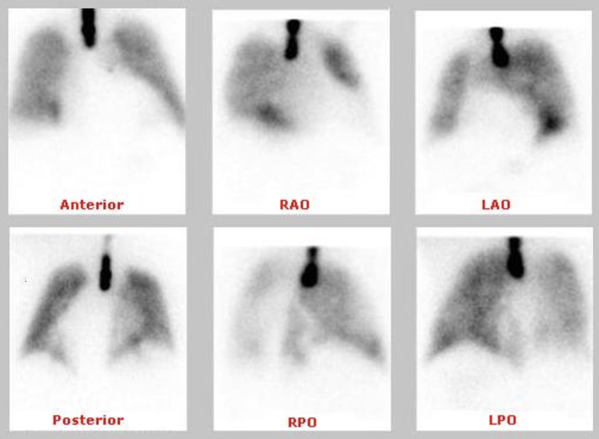
Abnormal VQ Scan
Aerosol Ventilation Scan. Perfusion Scan
http://www.nucmed.com/nucmed/cases/edited/VQ_34789039026.htm

Slide 30
Abnormal VQ Aerosol

Slide 31
Fissure Sign
This is a result of fluid buildup in the thoracic cavity – pleural effusion.
The additional fluid presses into the lobes of the lungs and with increased attenuation, this defect can be seen.
This patient does not have PE.
https://pubs.rsna.org/doi/full/10.1148/radiology.213.1.r99oc1359

Slide 32
Right to Left Shunt
A – ^{99m}TcDTPA ventilation scan
B – Chest view reveals spleen and kidney uptake. Lung activity is missing.
C – Anterior Whole-body image shows excessive soft tissue uptake and the brain. Possible thyroid uptake is noted.
D – Posterior Whole-body reveals similar results
This is a classic indication of a left-to-right shut.
https://journals.lww.com/nuclearmed/Fulltext/2021/03000/Complete_Right_to_Left_Shunt_in_Lung_Perfusion.33.aspx

Slide 33
Other Facts About PE
90% of PE is multiple
85% is bilateral
More tend to appear at the base of the lungs (consider circulation)
PE can affect an entire lung, but usually, this is due to a large mass pressing on a pulmonary artery.
A chest x-ray may show an underlining disease that correlates to a matched defect.
Symptoms of PE may include reduced PO2 level, DVT, dyspnea, coughing, pleuritic chest pain, tachycardia, and postpartum.

Slide 34
References
Overall data from this PPT comes from “SNM Practice Guideline for Lung Scintigraphy 4.0” by Parker, JA, et. al.
Effect of ethanol on droplet size, efficiency of delivery, and clearance characteristics of technetium-99m DTPA aerosol” by Sir, SA, et al.
Additional detailed information can be found at https://people.vcu.edu/~mhcrosthwait/clrs317web/index.htm
“Evaluation of revised criteria for ventilation-perfusion scintigraphy in patients with suspected pulmonary embolism.” by Sostman, HD, et al.

