Slide 1
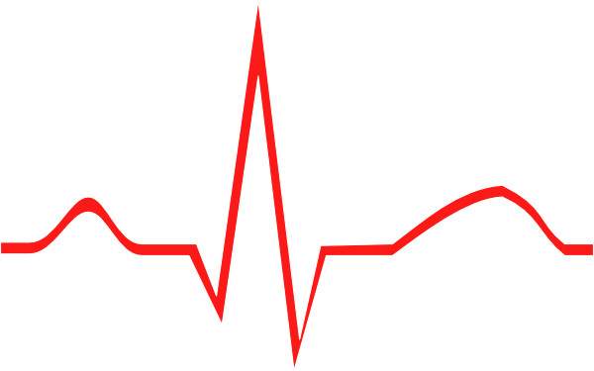
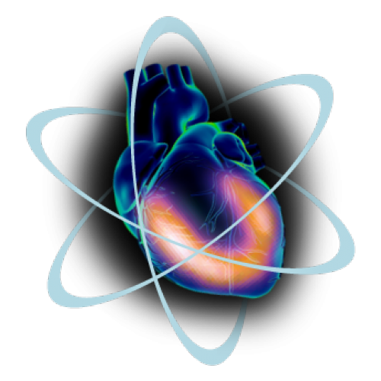
Dynamic Imaging Current Applications
Mark Crosthwaite, M.Ed., CNMT, PET, CNMT(RS), FSNMMI-TS
Associate Professor and Program Director

Slide 2
Frost Bite and Electrical Burns
Frost Bite
^{99m}TcO₄⁻ used to evaluate viable from non-viable tissue in the finger and toes. Lack of activity indicated loss of blood flow
Electrical Burns
Using ^{99m}TcPYP extent of muscle damage can be determined
Lacking uptake and flow was an indication of necrotic tissue
Delayed images also showed a donut shapes (cold center) and focal hotspots indicating damaged viable to the tissue

Slide 3
Monitoring Therapeutic Embolization
Polyvinyl alcohol spongelike (Ivalon) particles are used to occlude AV malformation and vascular tumors
Particles are tagged with ^{99m}Tcsulfur colloid so that the procedure can be monitored for its effectiveness
Catheter inserted and placed at the site of interest where embolization occurs
If too Ivalon particles appear in the lung “PE” type issues occur, requiring catheter adjustment

Slide 4
Repair of an Aneurysm
^{99m}TcRBCs are injected IV to identify an aneurysm.
Green arrows indicate aneurysm
Purple indicate repair
Note the difference in radiopharmaceutical distribution

Slide 5
Arterial Injection of Tc99mMAA
Prior to the application of SIR-Spheres an arterial injection of MAA is administered
Shunting must be less than 20% to the lungs
Greater than 20% may cause radiation pneumonitis
Related lecture
https://www.researchgate.net/figure/Planar-nuclear-medicine-shunt-study-Technetium-99-macroaggregated-albumin-was-injected_fig3_8399677

Slide 6
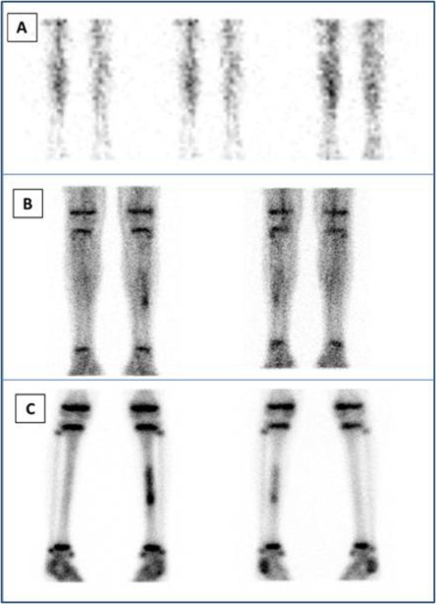
Don’t forget our Three-Phase
Don’t forget about our 3-phase bone scan!
This is a scan of a 9-year old boy
What do you think is going on?
https://www.researchgate.net/figure/a-Three-phase-bone-scan-from-the-legs-Upper-row-A-anterior-images-of-the-perfusion_fig3_259472486

Slide 7
Shunt
A different type of flow study
Assessment of a shunt
This shunt is surgically implanted with patients’ that have what?
There appears to be no blockage
https://www.slideshare.net/ganeshkumar7982/new-seminar-41895221

Slide 8
Assessment of Brain Death
Remember this one?
Which one is positive/negative for brain death?
What do we look for?
https://www.slideshare.net/ganeshkumar7982/new-seminar-41895221

Slide 9
Hot Glove
Flowing an injection of 99mTcMDP the three hour delayed imaging was acquired
What caused the left hand and arm to be hot?

Slide 10
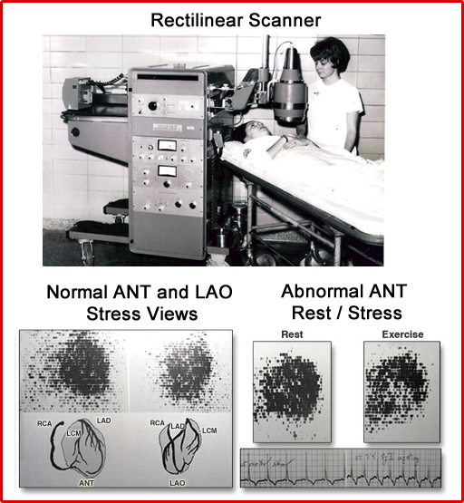
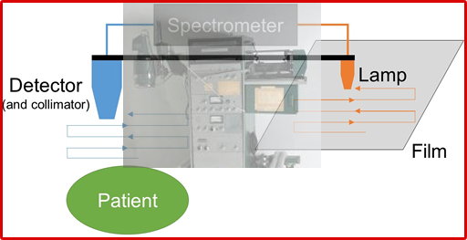
Good Old Days?¹
Rectilinear scanner had a single probe with a duplicating arm that moved across film
The light source would flash on the film
Light intensity depended on the amount of activity present within the body
In this case the heart

Slide 11
Why MPI?
Diagnosing CAD Via
Myocardial wall perfusion
Assessing myocardial viability
Looking at contractility and EF Determining future cardiac events
Less invasive
Reduces health care costs
Does PET brings in a new era of myocardial assessment?
https://www.independentimaging.com/expect-cardiac-stress-test/

Slide 12
Nuclear Cardiology and Our Goals¹
Our current model with perfusion SPECT
Treatment of CAD
Find and identify the lesion
Treatment with revascularization
A new Paradigm
Myocardial Blood Flow (MBF) – measured in the rate of flow mL/minute/g
Myocardial Fraction Reserve (MFR)* – Difference of blood in arteries stress vs rest
MBF and MFR will go up with increase stress if its normal
MBF and MFR will drop in the presence of disease
From detection to prediction of resulting in the prevention of cardiac disease
Knowing blood flow to the myocardial tissue
Evaluate current therapy – Pre and post cardiac med
Assessing from baseline, following the patient, gives a more personalized approach
Disease prevention
* MFR and Coronary Flow Reserve (CFR) has the same definition.

Slide 13
Ingredients Required to Assess MFR and MBF
Extraction Fraction – the higher the better
The less roll-off the better
Ability to image the dynamic uptake of the radiotracer
The amount of scintillating crystal around the heart
Type of crystal
Application of technology: Attenuation Correction, Motion Correction, Counting Statistics
Pharmacological Stressing
Resolution

Slide 14
Effects of Myocardial Flow Reserve
MFR is the reserve in coronary circulation
Exercises causes ATP ADP AMP Adenosine (vasodilation)
Normal flow reserve can increase by 3 to 4 fold
Ischemic (~80 occlusion) ~1.6 fold increase
Exercise X2
Dipyridamole x 4.3
Adenosine x 4.4
Lexiscan x2 – 2.4
Increase flow = increase counts

Slide 15
Pharm-it with Lexiscan
Unit dose is 0.4 mg
Inject slowly
Flush it with saline
Inject 30 mCi ^{99m}Tc - tracer
Scan 30 to 60 minutes later
Aminophylline reverses the effect (same with adenosine)
Look out for the BKG

Slide 16
Lexiscan vs. Adenosine³
Most of the world uses Lexiscan, but is that a good idea?
Brink HL, et al (2016) compared the agents
489 patients – 235 with adenosine and 254 with Lexiscan
80% had reaction to Lexiscan and 31.5% had a reaction to adenosine
Reactions –arrhythmias, dyspnea, headache
Aminophylline – 19.2% Lexiscan and 0.8% adenosine
Results
Adenosine better tolerated
Adenosine cost $25k less
Why was adenosine better tolerated? It has to do with biological T_{1/2} ~ 10 seconds

Slide 17
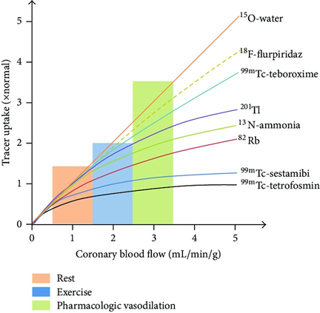
Radiotracer Extraction Fraction⁴
Consider the linear progression – As blood flow increases
Roll-off – as you continue to increase stress uptake “flattens out”
Increase stress has less effect
Reduced count
High-extraction fraction – is most ideal
Compare rest to exercise to pharmacological
Improved extraction will help in calculating absolute quantification of myocardial blood flow

Slide 18
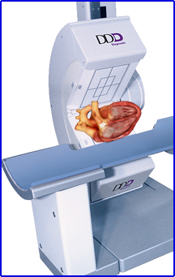
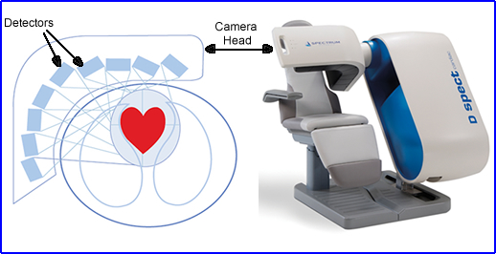
Let’s First Look at Using Gamma Camera Technology

Slide 19
Gamma Camera Application
²⁰¹Tl
Has redistribution properties
High extraction fraction at normal flow rates ~87%
Long T_{1/2} = increased dosimetry
Low energy = greater attenuation when compared to ^{99m}Tc
^{99m}Tc-sestamibi was the first to come out
Uptake, and retention, with little redistribution
Extraction fraction 68%
Less attenuation when compared with ²⁰¹Tl
Should we talk about hepatic clearance?
2 injections – 1 day protocol
Tetrofosmin as similar prosperities, however:
Extraction fraction is 54% therefore reduced count density
Improved hepatic clearance

Slide 20
Can ^{99m}Tc Assess MFR/MBF?
Radiotracer – has a poor extraction fraction however, more work needs to be done with animal models
Instrumentation requires fast rotation of a dual imaging system to acquire the appropriate temporal resolution
Klein has had some success with animal models⁹
Success in determining MBF correlates with low vs high probability of disease
In general SPECT has less counts with limited temporal resolution resulting in poor count sensitivity
Solid State – SPECT improves the quantitative process
Increase in counts and resolution
Improved software
Higher sensitive
Focusing collimators

Slide 21
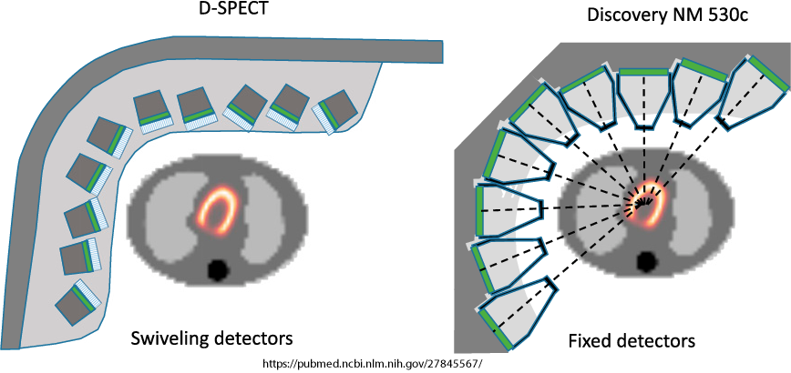
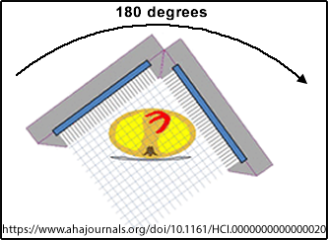
Traditional Gamma Camera vs CZT Technology
In general, these system crystals, Cadmium–zinc–telluride (CZT) have better energy resolution in traditional SPECT systems. Each CZT crystals are 2.46 mm in size, improving spatial and energy resolution when compared to Na(I). D-SPECT 10 detectors rotate to increase the amount of angles of acquisition, while the NM 530c remain stationary.

Slide 22
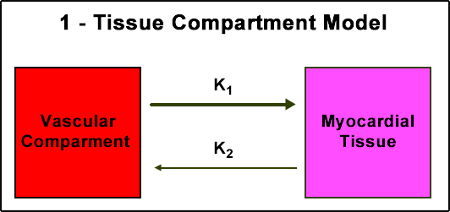
PET to Solid State Gamma Camera⁵
Wells and colleagues compared ⁸²Rb and ¹³N-ammonia to ^{99m}Tc-tetrofosmin
A 1-tissue compartment model was used
^{99m}Tc-tetrofosmin was most successful when patient motion correction and evaluation of tracer binding to RBCs was applied
Global MFR and MFB can be compared to PET tracers
Variation of MBF was 2% ± 32%
Variation to MBR was 2% ± 28%

Slide 23
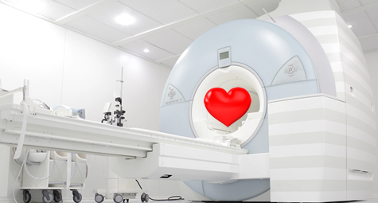
PET – Cardiac Quantification
¹⁸Flupiridaz
⁸²Rb
¹³NH₃
¹⁵O-Water

Slide 24
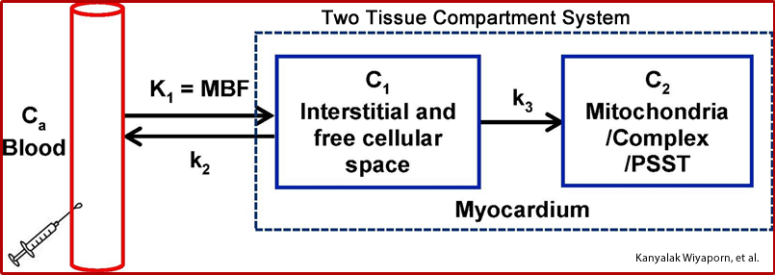
Assessing MBF⁶
Requires high counts in a dynamic acquisition

Slide 25
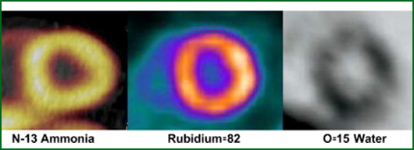
Gold Standard?
¹⁵O – 2 minute T_{1/2} and having a cyclotron inhouse
Flow and uptake is great, but what about its retention/trapping?
Requires repeated dynamic imaging to acquire data – think MUGA
Extraction fraction = 100%⁸
Redistribution – multiple injection - T_{1/2}

Slide 26
PET Radiopharmaceuticals
¹⁵O – 2 minute T_{1/2} and having a cyclotron inhouse
Flow and uptake is great, but what about its retention/trapping?
Requires repeated dynamic imaging to acquire data – think MUGA
Extraction fraction = 100%⁸
Redistribution – multiple injection - T_{1/2} ?
¹³N – ammonia has a T_{1/2} of 10 minutes and an inhouse cyclotron
Meets our kinetic model
~80 Extraction Fraction⁸
Rolls off at high flow rates
Newer software can determine absolute flow measurements – why is that important?

Slide 27
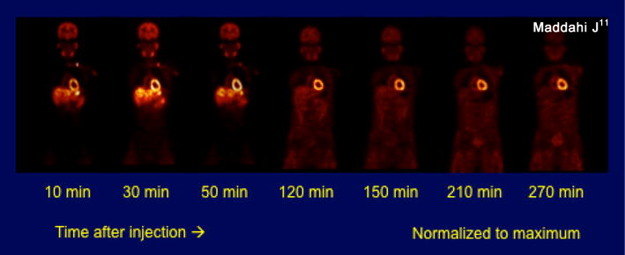
PET Radiopharmaceuticals
⁸²Rb – 75 second T_{1/2} generator produced
K⁺ analog with no washout
Extraction Fraction ~65%⁸
Roll off at high flow rates
¹⁸Flurpiridaz – 108 minute T_{1/2} cyclotron produced
Inhibits mitochondrial complex-1 by completing for ubiquinone
Rat model shows rapid uptake with slow washout – 50% in 120 minutes
Extraction Fraction~90% (94%¹¹)
Little to no roll-off effect

Slide 28
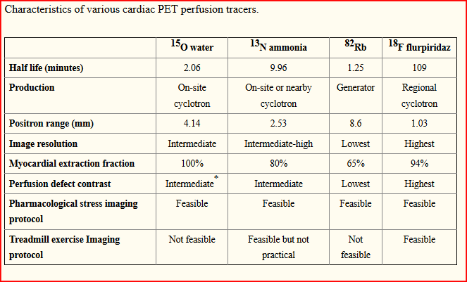

Slide 29
Flurpiridaz and Its Flow⁶
MBF @ K₁ is 1.1951 mL/min/g – >90% extraction fraction
The infusion rate with highest MBF accuracy the least amount of error 30 seconds (suggested range 15 to 60 seconds)
Normal MBF: Rest 0.73 mL/min/g and 2.53 mL/min/g with an MFR of 3.70
<50% stenosis MBF: Rest 0.73 mL/min/g and stress 2.02 mL/min/g and MFR 2.97
>50% stenosis MBF: Rest 0.86 mL/min/g and stress 1.43 mL/min/g with an MFR of 1.86
Effective at high flow rates
High retention
Convergence – MBF/MFR/software/PET effect

Slide 30
Compare the Flow⁷
 | Average MBF Rest | Avg MBF Stress
¹³N | 0~0.45mL/min/g | ~2.01 mL/min/g
⁸²Rb* | ~0.90 mL/min/g | ~2.23 mL/min/g
¹⁸Flurpiridaz | ~0.73 mL/min/g | ~2.53 mL/min/g
¹³N data is an average attained from all 3 coronary arteries

Slide 31
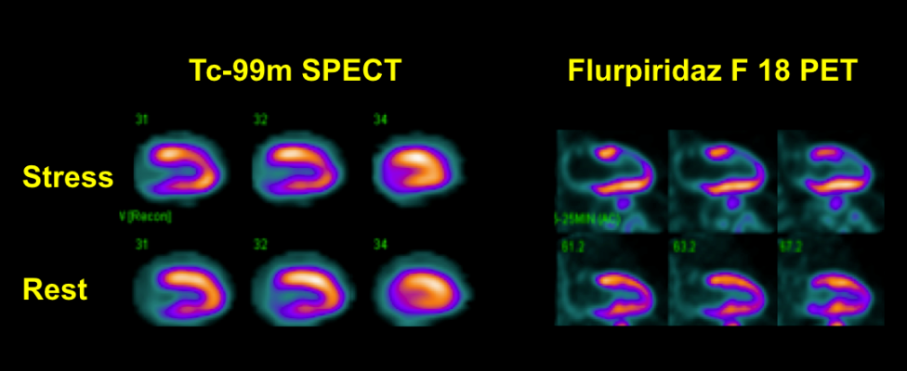
^{99m}Tc vs ¹⁸F PET⁸
SPECT defines defect in stress that appears normal in rest.
This false positive is due to an attenuation defect
PET identifies normal uptake in stress and rest images
Attenuation correction and the higher energy photon are accredited
The second image is false negative with SPECT

Slide 32
MBF and MFR – Flurpiridaz²

Slide 33
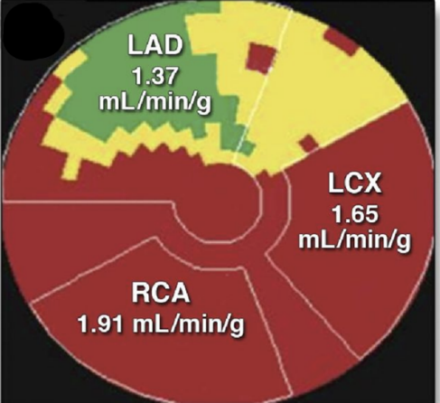
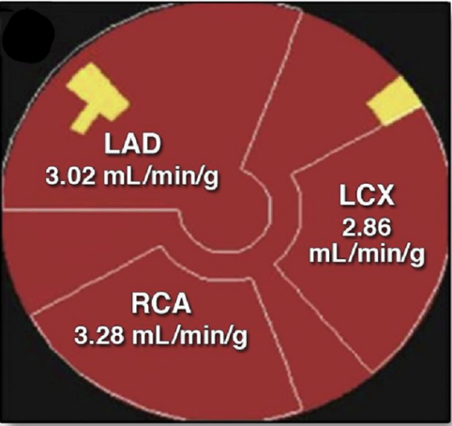
Polar Map and Absolute Quantification¹
If this was a ^{99m}Tc cardiac where would you identify the suspected lesion?
This is a PET with quantification of MBF - Fluripiridaz
Based on the prior slide we can assess stenosis
Consider a patient with 3 vessel disease where uptake appears normal, but the MBF is Abby normal
Following surgical intervention another PET cardiac scan was completed with the following polar map results
Stenosis <50% = 2.02mL/min/g
Stenosis >50% = 1.43mL/min/g

Slide 34
How Does a β Particle Travel?
All beta particles receive a certain amount of know energy when ejected from the nucleus
The Average Energy is defined as 1/3 Beta Max
What energy remains is then give to the ν
The graph shows the distribution of energy given to ⁸²Rb β⁺ particle and the distance it travels in water

Slide 35
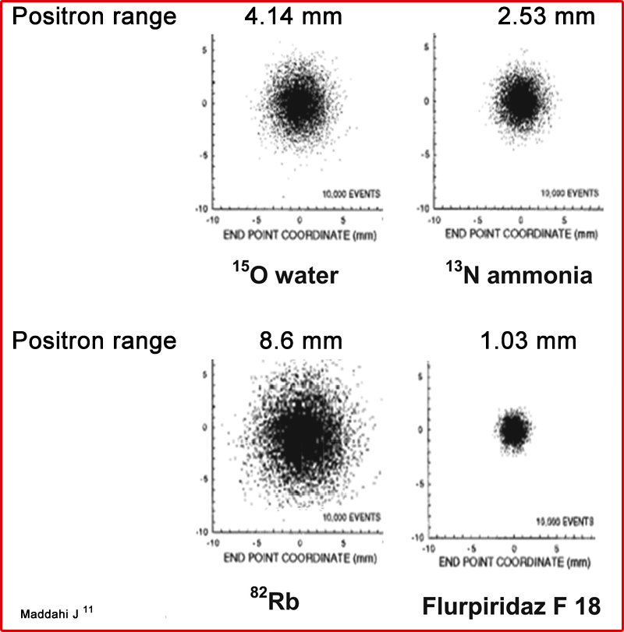
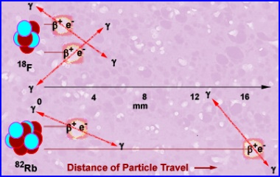
What About the Photons?⁵
^{Effects of β+} energy with spatial resolution
⁸²Rb
Photon travel
Average – 2.6mm
Max – 17.0 mm
¹⁸F
Photon travel
Average – 0.23mm
Max 2.72mm

Slide 36
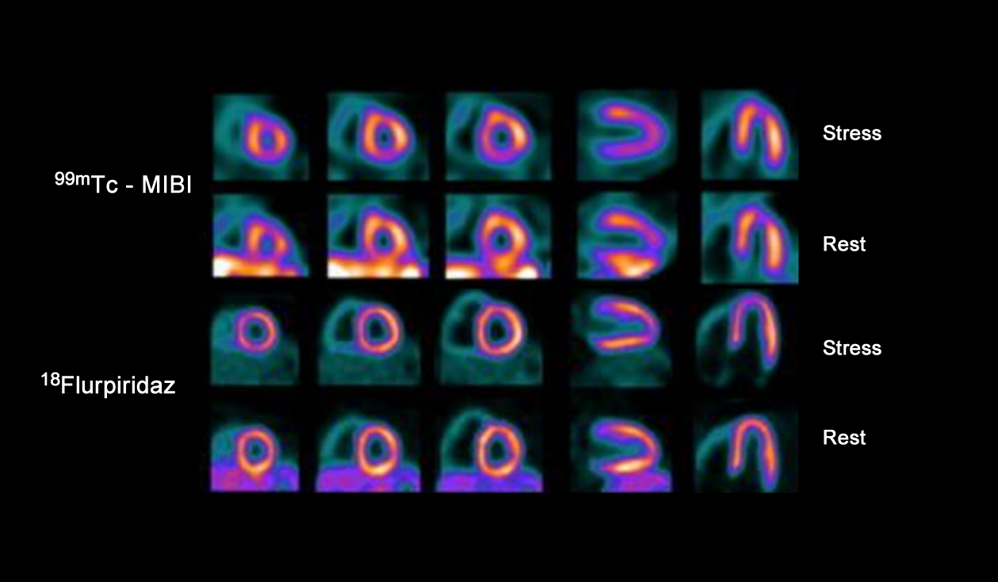
Normal Distribution ^{99m}Tc vs ¹⁸F⁹

Slide 37
Perfusion Defect – ^{99m}Tc vs ¹⁸F⁹

Slide 38
Refocus
Our current model with perfusion SPECT
Treatment of CAD
Find and identify the lesion
Treatment with revascularization
Revising our approach - evolving technology defines Myocardial Blood Flow (MBF), its Reserve (MBR) given the appropriate radiotracer
From detection to prediction of resulting in the prevention of cardiac disease
Knowing blood flow to the myocardial tissue
Evaluate current therapy – Pre and post cardiac med
Assessing from baseline, following the patient, gives a more personalized approach
Disease prevention

Slide 40
References
1. Will There Be Another Quantum Leap With the F-18–Labeled Myocardial Perfusion Tracers?
Vasken Dilsizian and Raymond Taillefer JACC
2. Absolute Quantitation of Myocardial Blood Flow in Human Subjects with or without Myocardial Ischemia using Dynamic Flurpiridaz F 18 Positron Emission Tomography. Parckrad, RS, et al PMC
3. Adenosine vs. Reagdenson in Cardiac Stress Testing. Brink HL, et al. AM. JACC
4. Properties of an ideal PET perfusion tracer: New PET tracer cases and data
Maddahi J Journ of Nucl Card
5. Optimization of SPECT Measurement of Myocardial Blood Flow with Correction for Attenuation, Motion,
and Blood Binding Compared to PET. Wells RG, et al. J Nucl Med
6. Optimization of imaging protocols for myocardial blood flow (MBF) quantification with ¹⁸F-flurpiridaz
PET. Wiyanpron K, et al PMID
7. Optimally Repeatable Kinetic Model Variant for Myocardial Blood Flow Measurements with ⁸²Rb PET Ocneanu AF, et al Comput Math Methods Med
8. Cardiac PET Perfusion Tracers: Current Status and Future Directions
Maddahi J, et al. PMC
9. Improvement in PET myocardial perfusion image quality and quantification with flurpiridaz F 18. Bermen D, et al Journ of Nucl Card

