Slide 1
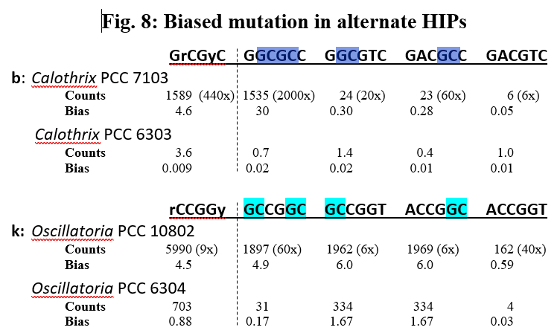
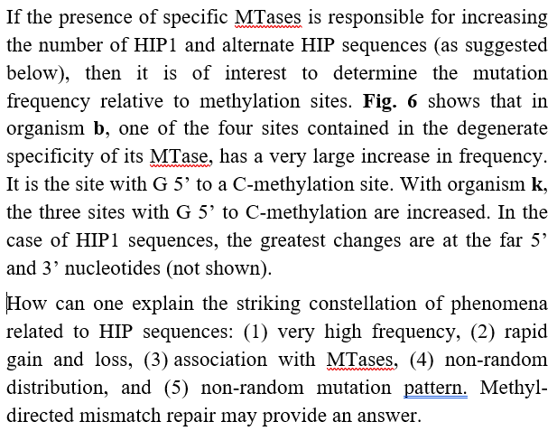
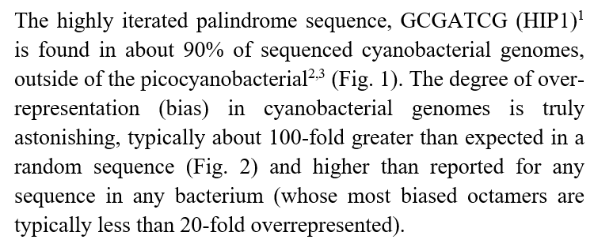
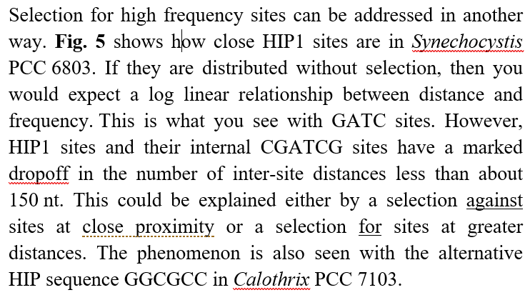
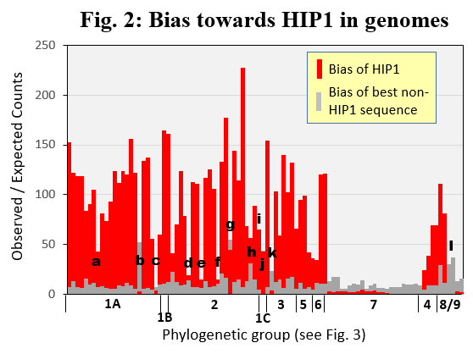
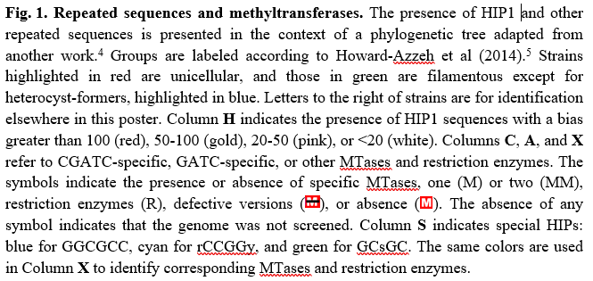
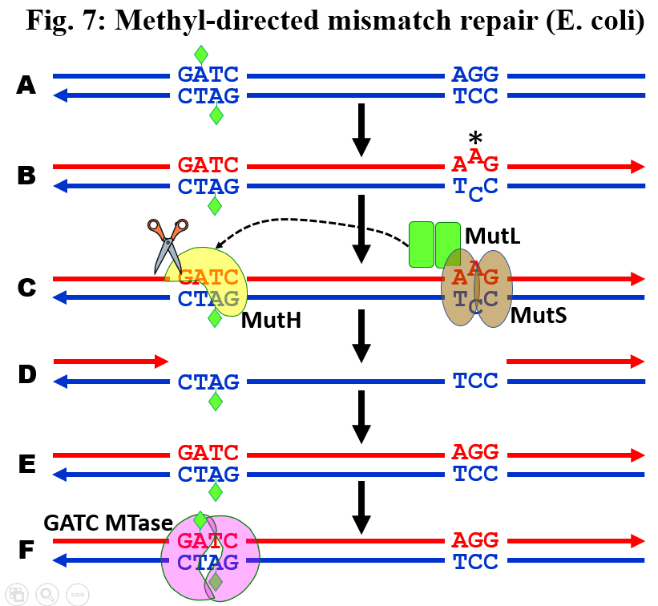
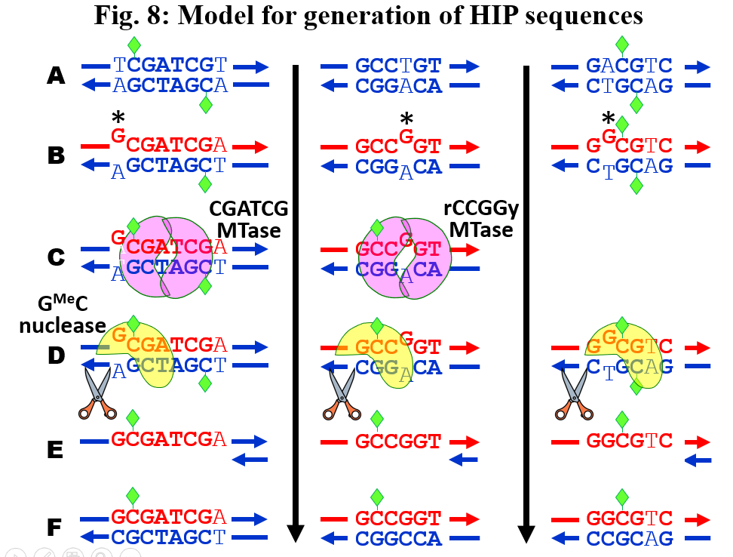
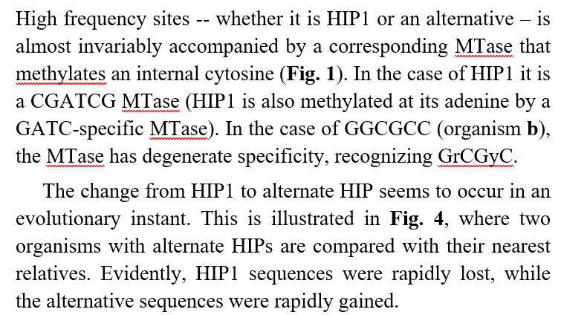
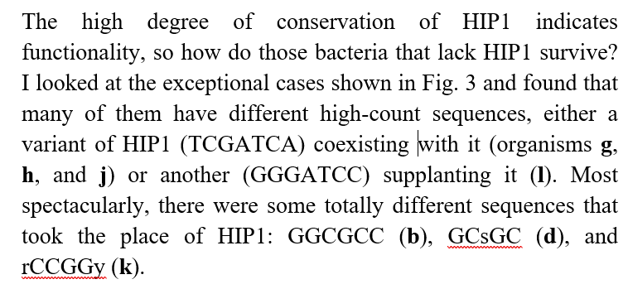
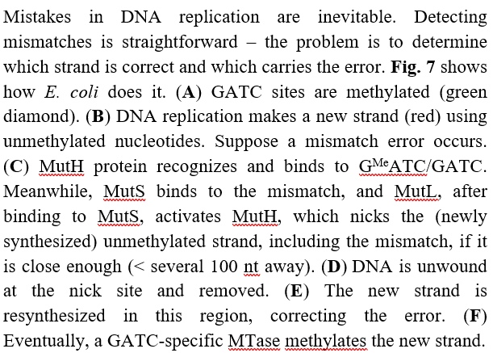
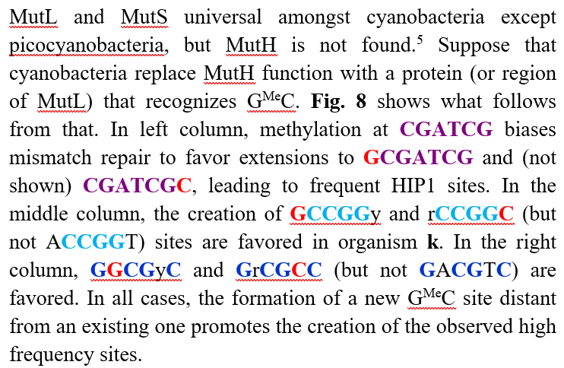
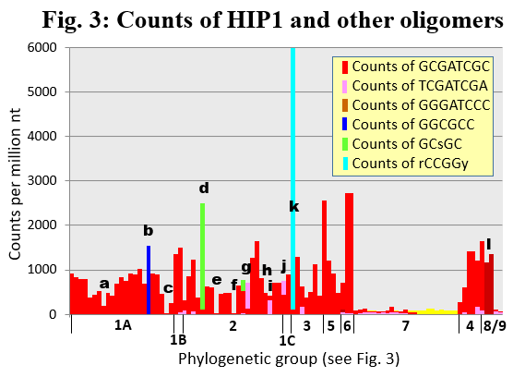
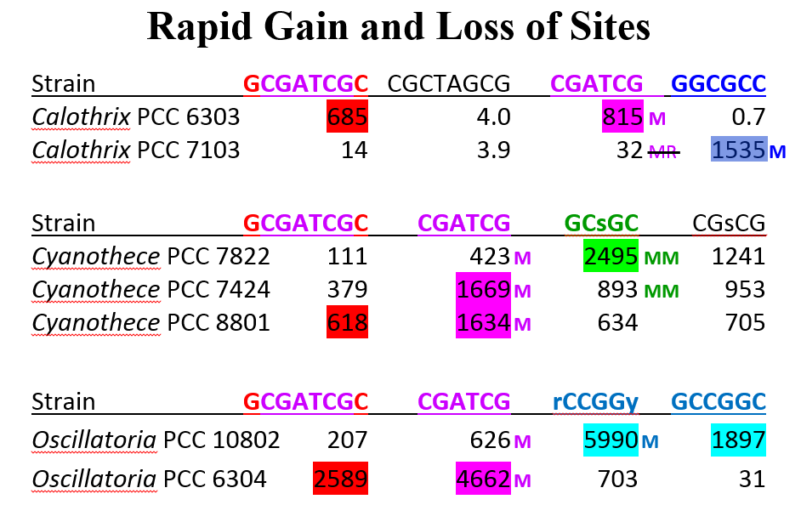
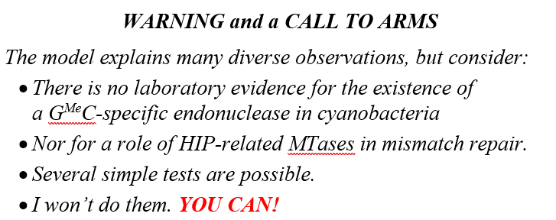
Superabundant HIP1 and other oligomers in cyanobacterial genomes: A mechanism for their gain and loss
Jeff Elhai Center for the Study of Biological Complexity, Virginia Commonwealth University, USA
Abstract
Superabundant HIP1 sites
Most cyanobacteria have lots of GCGATCGC (HIP1)
Also GATC- and CGATCG-specific methyltransferases
The function of HIP1 and the MTases remains a mystery.
Some cyanobacteria lack superabundant HIP1 sites
Most have gained superabundant other sites
E.g.: Calothrix PCC 7103 low HIP1, high GGCGCC But Calothrix PCC 6303 high HIP1, low GGCGCC
Rapid change in high abundance oligomers
Why loss of HIP1, gain GGCGCC?
Calothrix PCC 7103 gained restriction specific for GATC- and CGATCG
Also gained Mtase specific for GGCGCC
Propose rapid gain of sites through hypothetical GMeC-directed mismatch repair
Exceptional strains: Neither HIP1 nor replacement
Four symbiotic strains (loss of O₂ production?)
Picocyanobacteria (monoploid, so no benefit?)
Fig. 1: Repeated sequences and methyltransferases
Nickname H C A S X
Fig. 4: Distribution of distances between sites
Nostoc piscinale cena21 Nos21
Nostoc PCC 7107 Nos7107
Nostoc PCC 7524 Nos7524
Nostoc NIES 3756 Nos3756
Anabaena variabilis ATCC 29413 Ana29413
Anabaena PCC 7120 Ana7120
Anabaena circinalis AWQC310F Ana310F
Anabaena WA102 Ana102
Anabaena 90 Ana90
Anabaena PCC 7108 Ana7108
Anabaena cylindrica PCC 7122 Ana7122
Anabaena azollae 0708 (fern) a: AnaAzo
M M
M M M
M M M
Synechocystis PCC 6803
Synechocystis PCC 6803
M M
MM
M M
A
All 4-mers
B
All 6-mers
M
M
M M
M
M
M
M
M
M
M
M
M
M M
MR
M RM
M M M M M M M
M M
M
M
M M
a
b
c
d
e
f
g
h
I
j
k
l
l
M
Log₁₀ counts per bin
Cylindrospermopsis raciborski CS 505 CylR505
Raphidiopsis brookii D9 RapD9
Cylindrospermum stagnale PCC 7417 CylS7417
Nostoc punctiforme ATCC 29133 Nos29133
Nodularia spumigena CCY 9414 Nod9414
Tolypothrix PCC 7601 Tol7601
Calothrix PCC 7507 Cal7507
Microchaete PCC 7126 Mch7126
Hassallia byssoidea VB512170 Has512170
Tolypothrix PCC 9009 Tol9009
Calothrix 336-3 Cal336-3
Calothrix PCC 6303 Cal6303
Calothrix PCC 7103 b: Cal7103
Chlorogloeopsis fritschii PCC 6912 Chl6912
Chlorogloeopsis fritschii PCC 9212 Chl9212
Fischerella NIES 3754 Fis3754
Fischerella thermalis PCC 7521 Fis7521
Fischerella PCC 9339 Fis9339
Hapalosiphon MRB220 Hap220
Scytonema hofmanni PCC 7110 Scy7110
Tolypothrix bouteillei VB521301 Tol521301
Scytonema tolypothrichoides VB61278 Scy61278
Mastigocladopsis repens PCC 10914 Mas10914
Tolypothrix campylonemoides VB511288 Tol511288
Richelia intracellularis HH01 c: RicHH01
Rivularia PCC 7116 Riv7116
Mastigocoleus testarum BC008 Mas008
M M
GATC
M RM
CGATCG
M
M
M M
Synechocystis PCC 6803
Calothrix PCC 7103
MR
MR
M R M
MR
M M M
1A
M
M
M
MM
M
M
M
M
M
M
C
All 8-mers
D
All 6-mers
M
Log₁₀ counts per bin
GCGATCGC
GGCGCC
M M
Gloeocapsa PCC 7428 GloC7428 Chroococcidiopsis thermalis PCC 7203 Chro7203
1B
M M
Microcystis aeruginosa NIES 843 MicA843
Synechocystis PCC 6803 Syn6803
Pleurocapsa PCC 7327 Ple7327
Cyanothece PCC 7424 Cyan7424
Cyanothece PCC 7822 d: Cyan7822
Cyanothece PCC 8802 Cyan8802
Cyanothece PCC 8801 Cyan8801
Epithemia turgida ETSB (diatom) e: EpiTur
M
M
M
M
M
M
M
M
M
M
M
M
M
M M M
M
M M
Distance between adjacent sites (nt)
Distance between adjacent sites (nt)
MR
M M
MR
M
Crocosphaera watsonii WH8501 CroC8501
Cyanothece CCY 0110 Cyan0110
Cyanothece ATCC 51142 Cyan51142
Atelocyanobacterium thalassa f: UCYN-A
Cyanobacterium stanieri PCC 7202 CyaS7202
Cyanobacterium aponinum PCC 10605 CyaA10605
Geminocystis herdmanii PCC 6308 g: Syn6308
Leptolyngbya PCC 7376 Lep7376
Synechococcus PCC 7002 Syn7002
MR
M R
MR
M
MR
M R
M
M M MMR
M MMR M
M R M
2
M M
M
MM M MMR
Stanieria cyanosphaera PCC 7437 Sta7437
Prochloron didemni P4 (tunicate) h: ProcP4
Spirulina subsalsa PCC 9445 Spi9445
Dactylococcopsis salina PCC 8305 i: Dac8305
Halothece PCC 7418 Halo7418
Microcoleus PCC 7113 Mic7113
Chamaesiphon minutus PCC 6605 j: Cha6605
Crinalium epipsammum PCC 9333 Cri9333
Oscillatoria PCC 10802 k: Osc10802
Oscillatoria acuminata PCC 6304 Osc6304
Geitlerinema PCC 7105 Gei7105
Phormidium OSCR PhoOSCR
Microcoleus vaginatus FGP2 MicFGP2
Oscillatoria nigro-viridis PCC 7112 Osc7112
Trichodesmium erythraeum IMS101 Tri101
Planktothrix agardhii NIVA cya 126-8 Pla126-8
Planktothrix prolifica NIVA cya 406 Pla406
Planktothrix rubescens NIVA cya 15 Pla15
Planktothrix rubescens NIVA cya 407 Pla407
Arthrospira platensis NIES 39 Arth39
Arthrospira maxima CS 328 Arth328
Arthrospira PCC 8005 Arth8005
Lyngbya PCC 8106 Lyn8106
Lyngbya aestuarii BL-J LynBLJ
M
M
MR
M
M
MR M
M
M
M RM
1C
M MR M
MM
M
M
MMR
M M
3
M M
MRM
MM
M M
MR
M
MR MR
MR M
M
MR
MM
RMM
M
M
M
M
M
M
M
M
MR
M M
M
M
MM
M
M
M
M R
5
Geitlerinema PCC 7407 Gei7407
Oscillatoriales cyanobacterium JSC-12 Osc12
Leptolyngbya boryana PCC 6306 Lep6306
Leptolyngbya NIES 2104 Lep2104
Leptolyngbya NIES 3755 Lep3755
Leptolyngbya PCC 6406 Lep6406
Synechococcus PCC 7335 Syn7335
Leptolyngbya heron island J LepHIJ
Prochlorothrix hollandica PCC 9006 ProH9006
Synechococcus elongatus PCC 6301 Syn6301
Synechococcus elongatus PCC 7942 Syn7942
PICOCYANOBACTERIA
Acaryochloris marina MBIC 11017 Amar11017
Cyanothece PCC 7425 Cyan7425
Thermosynechococcus elongatus BP1 TherBP1
Thermosynechococcus NK55a Ther55a
Pseudanabaena biceps PCC 7429 PseA7429
Pseudanabaena roaring creek PseARC
Pseudanabaena PCC 6802 PseA6802
Pseudanabaena PCC 7367 PseA7367
Synechococcus OS type A prime l: SynOSA
Synechococcus OS type B prime l: SynOSB
//
6
//
4
7
MM
M M
M
MM M MM
M
M
M
M
M
M
9
8
//
M
Gloeobacter kilaueensis JS1 GloBJS1
Gloeobacter violaceus PCC 7421 GloB7421

