Slide 1
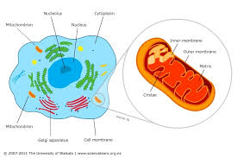
Mitochondria
https://static.sciencelearn.org.nz/images/images/000/002/273/embed/Cell-featuring-mitochondria20161028-31199-144bq9m.jpg?1522307353
Subcommittee on Genetic Modification
Representative Nathaniel Smith

Slide 2
Mitochondria → ATP (energy molecule)
https://previews.123rf.com/images/tverdohlib/tverdohlib1801/tverdohlib180100434/93012910-happy-man-flex-muscles-biceps-triceps-on-grey-background-macho-with-strong-arms-in-white-singlet-spo.jpg

Slide 3
Mitochondrial DNA Maternal Inheritance
https://i.pinimg.com/originals/4a/e0/7d/4ae07dac8a962e25c7198afeb4202ecb.jpg

Slide 4
Pedigree of Maternal Inheritance
Schaefer, Andrew M., et al (2007)

Slide 5
Mutations occur - 1 in 10,000
Chinnery et al., 2012
Heteroplasmy –Mutated & normal
(penetrance & expressivity)
Homoplasmy –
all mutated or all normal
1) University of Miami Miller School of Medicine

Slide 6
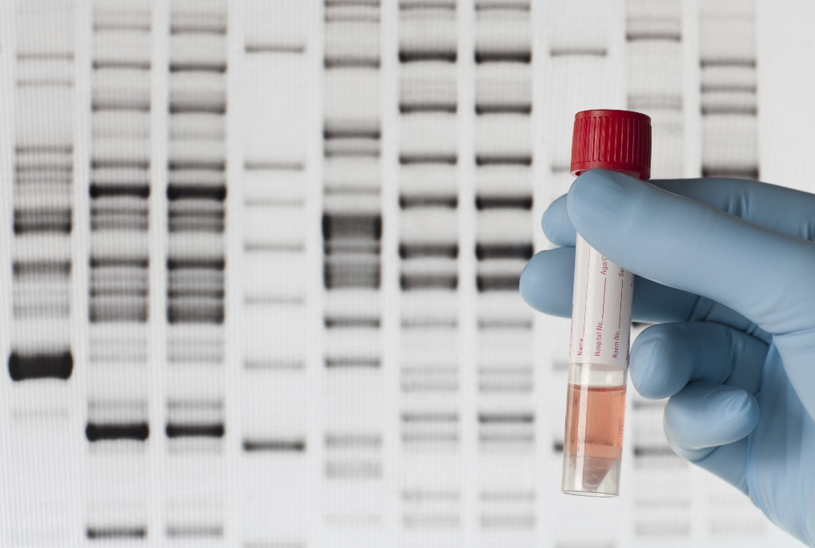
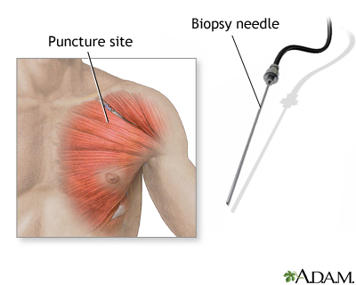
Diagnosis?
mtDNA genome sequencing in blood or other organs/tissues
Testing blood, urine, and spinal fluid (enzymes, amino acids)
DNA testing
Tissue biopsy
Neuroimaging
https://medlineplus.gov/ency/images/ency/fullsize/8868.jpg
https://fortunedotcom.files.wordpress.com/2015/06/gettyimages-186815051.jpg
Parikh, Sumit, et al. (2015)

Slide 7
What does this do?
Khan et al (2015)

Slide 8
2006-2015, n = 221 Studied patients with mitochondrial diseases
14% mortality rate, avg. age of death ~6yrs
Eom et al (2017)
https://encrypted-tbn0.gstatic.com/images?q=tbn:ANd9GcRExzv26q2NnUv3a3NmNHPbxrz66thebkTF4t8QuF3vaskco_MtUw

Slide 9
Cures? MITOCHONDRIAL REPLACEMENT THERAPY
https://eideard.com/2016/06/14/know-nothing-congress-roadblocks-us-policy-on-mitochondrial-therapy/

Slide 10
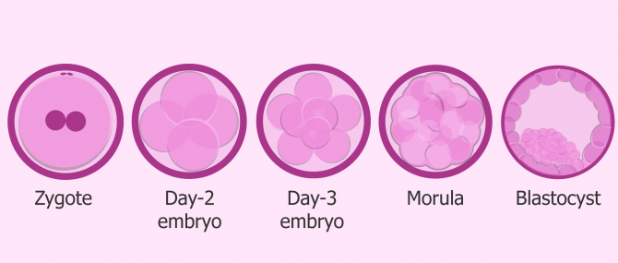
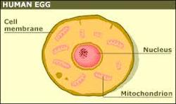
MST vs PNT Transfer of maternal DNA into donor cell
Pronuclear Transfer
Uses Zygotes
Enucleated donor zygote + maternal DNA
Maternal Spindle Transfer
Uses Oocyte
Enucleated donor cell + maternal DNA
https://www.invitra.com/differences-between-a-zygote-an-embryo-and-a-fetus/
https://theracetomakeababy.weebly.com/the-cells-in-more-detail.html

Slide 11
MST > PNT
Uses Oocytes not Zygotes
Less of an ethical issue
Wang, Tian, et al (2014)

Slide 12
UK Human Fertilisation and Embryology Authority (HFEA) Sequenced mitochondrial genome in 1981 Began developing MRT techniques in 1985 Legalized MRT (both MST and PNT) in 2015
https://upload.wikimedia.org/wikipedia/en/thumb/a/ae/Flag_of_the_United_Kingdom.svg/125px-Flag_of_the_United_Kingdom.svg.png
Castro, and Rosa J. (2016)

Slide 13
More cautious than UK Report suggesting MRT only in serious cases or male embryos Research not approved, safety concerns
https://www.dhgate.com/product/stripes-flag-red-line-american-usa-flag-decoration/403919674.html

Slide 14
General Consensus
Castro, and Rosa J. (2016)
HFEA (UK) – MRT was ‘not unsafe’ and should be used
FDA (USA) – not enough data in animals to justify trials in humans
MRT
https://d2gg9evh47fn9z.cloudfront.net/800px_COLOURBOX29002573.jpg

Slide 15
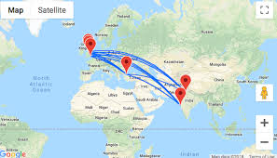
Possible Consequences/Pushback
Unwanted changes in genome (unlikely)
Possible retention of mutated mtDNA
Medical Tourism – limits research and clinical follow up
Rights and Increased demand of egg donors
Safety & efficacy (heavily debated)

Slide 16
Overall: Pros of MRT > Cons of not using MRT
Proposed Regulation:
1.) Use MST vs PNT - prevents destroying zygotes
2.) Legalize MRT in males, study for ~6yrs – prevents heritability of genetically modified mitochondria,
6 years is avg time of clinical diagnosis for mitochondrial diseases, so if no issues,
3.) continue with females

Slide 17
Citations
1) Review article
University of Miami Miller School of Medicine (below)
http://hihg.med.miami.edu/code/http/modules/education/Design/Print.asp?CourseNum=2&LessonNum=4
2) Review article
Mitochondrial disorders: Challenges in diagnosis & treatment
Khan et al (2015)
CSIR-Centre for Cellular & Molecular Biology
http://www.ijmr.org.in/article.asp?issn=0971-5916;year=2015;volume=141;issue=1;spage=13;epage=26;aulast=Khan

Slide 18
3) Research article
Cause of Death in Children With Mitochondrial Diseases
Eom et al (2017)
Pediatric Neurology, 66 , pp. 82-88.
https://www.ncbi.nlm.nih.gov/m/pubmed/27843091/
4) Research article
“Prevalence of Mitochondrial DNA Disease in Adults.”
Schaefer, Andrew M., et al (2007)
Annals of Neurology, John Wiley & Sons, Ltd,
https://onlinelibrary.wiley.com/doi/full/10.1002/ana.21217

Slide 19
5)
“Polar Body Genome Transfer for Preventing the Transmission of Inherited Mitochondrial Diseases.”
Wang, Tian, et al (2014)
Cell, U.S. National Library of Medicine, 19 June 2014, www.ncbi.nlm.nih.gov/pubmed/24949971?dopt=Abstract
6)
“Diagnosis and Management of Mitochondrial Disease: a Consensus Statement from the Mitochondrial Medicine Society.”
Parikh, Sumit, et al. (2015)
Genetics in Medicine : Official Journal of the American College of Medical Genetics, U.S. National Library of Medicine, Sept. 2015,
www.ncbi.nlm.nih.gov/pmc/articles/PMC5000852/

Slide 20
7)
“Mitochondrial Replacement Therapy: the UK and US Regulatory Landscapes.”
Castro, and Rosa J. (2016)
OUP Academic, Oxford University Press, 22 Nov. 2016, https://academic.oup.com/jlb/article/3/3/726/2566730

