Slide 2
Therepeutic Genetic Modification
Gene Therapy Restores Immunity in Infants With Rare Immunodeficiency Disease
Gene Therapy Offers Hope for Reversing Congenital Deafness
Next-generation Gene Therapy Cassettes for Muscular Dystrophy

Slide 3
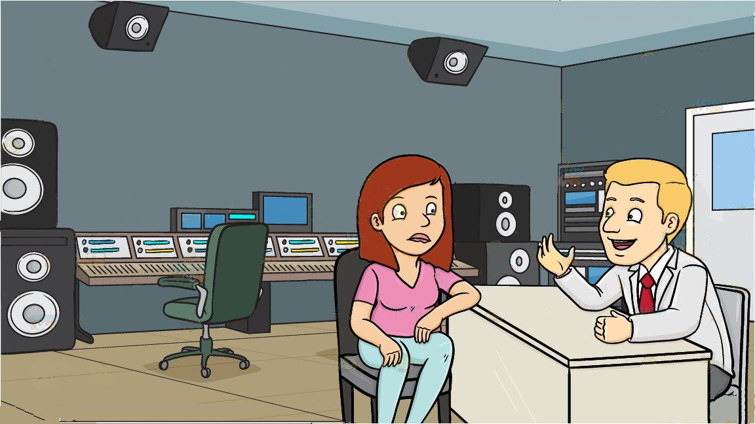


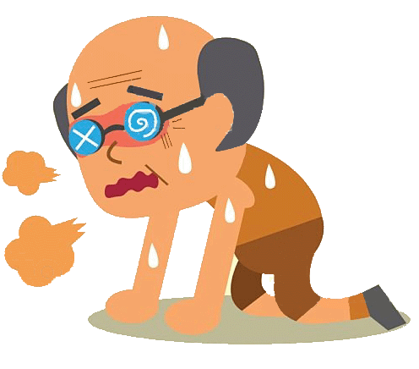

Genetic Enhancement

Slide 4
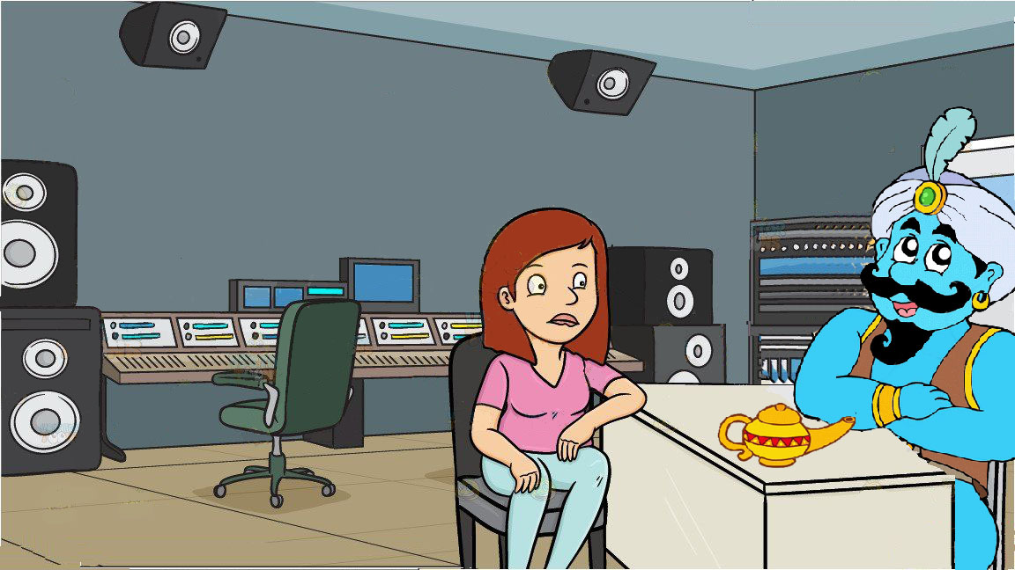

Genetic Enhancement

Slide 5
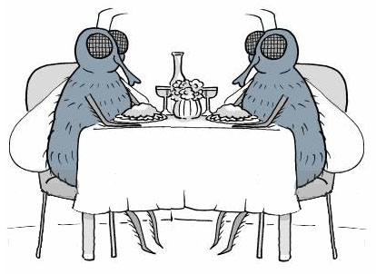
Longevity Through Nutritional Deprivation
Well fed

Slide 6
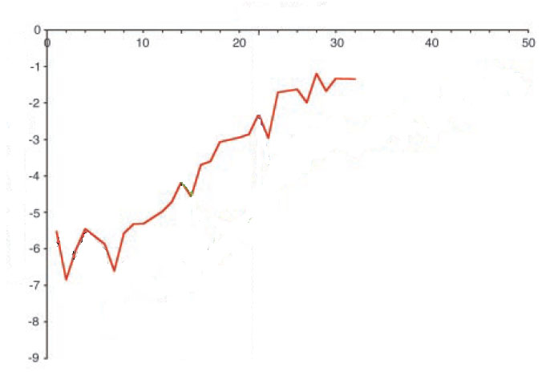
Longevity Through Nutritional Deprivation
Age (days)
Well fed
Death Rate (Log)
Mair et al. (2003)

Slide 7
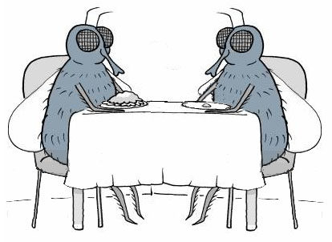
Longevity Through Nutritional Deprivation
Well fed
Limited
diet

Slide 8
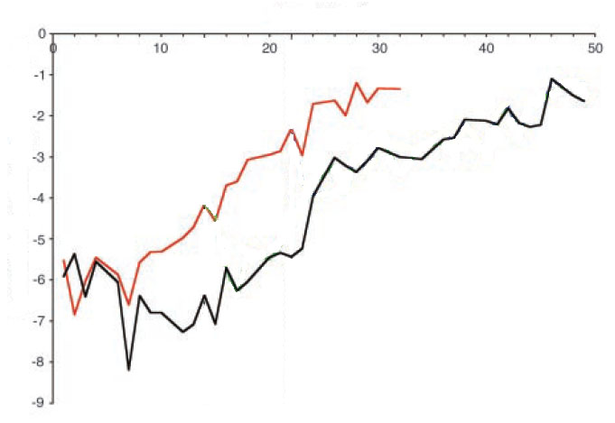
Longevity Through Nutritional Deprivation
Not happy
Age (days)
Well
fed
Limited
diet
Death Rate (Log)
~7 times
Mair et al. (2003}

Slide 9

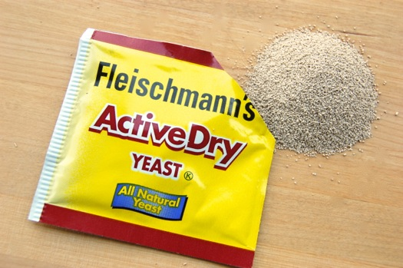
How to find genes related to longevity?
>> billions
What is long life in yeast years?

Slide 10
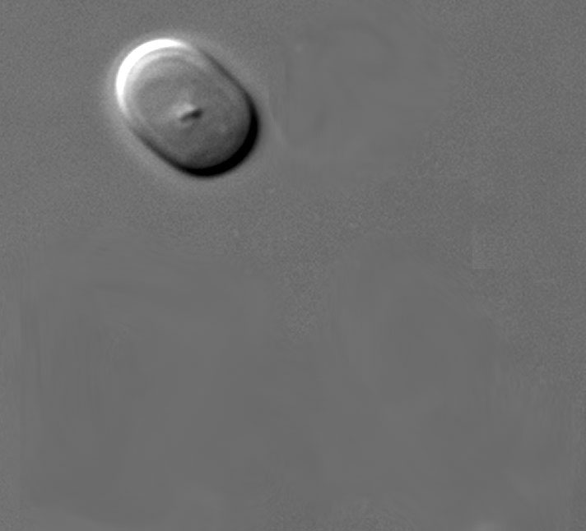
How to find genes related to longevity?
Masur, Wikipedia

Slide 11
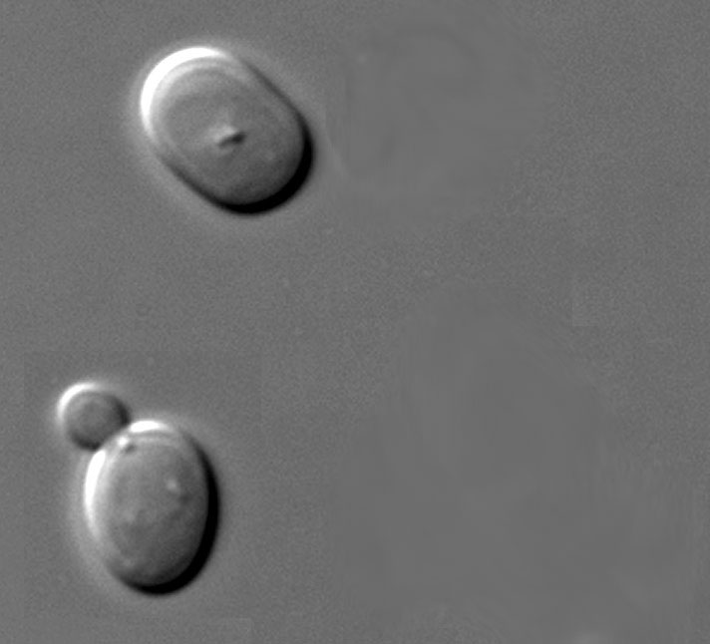
How to find genes related to longevity?
Masur, Wikipedia

Slide 12
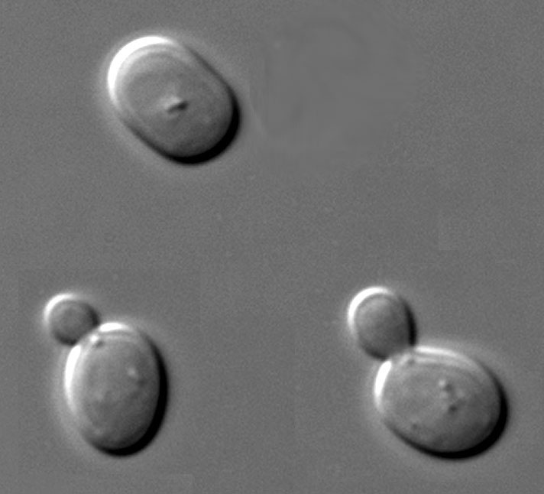
How to find genes related to longevity?
Masur, Wikipedia

Slide 13
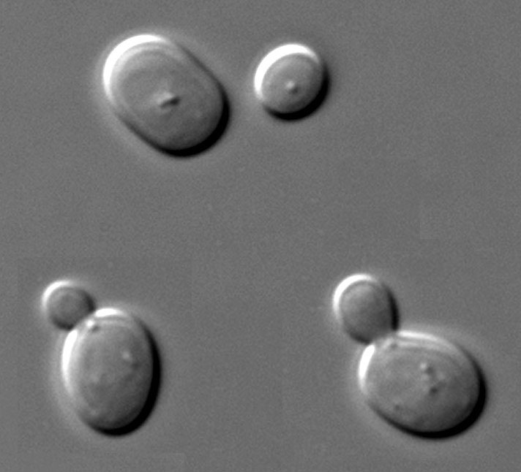
How to find genes related to longevity?
Well fed
~21 cycles*
Limited
~26 cycles*
*Lin et al (2000)
Masur, Wikipedia

Slide 14
How to find genes related to longevity?
SIR2
Life span (mean cycles)*
WT SIR2⁺
23
SIR2⁻
11
SIR2⁺⁺
29
*Kaeberlein et al (1999)

Slide 15
What is SIR2?
SIR2
Protein
Acetylase
acetyl−
protein
protein
Protein
Deacetylase
SIR2

Slide 16
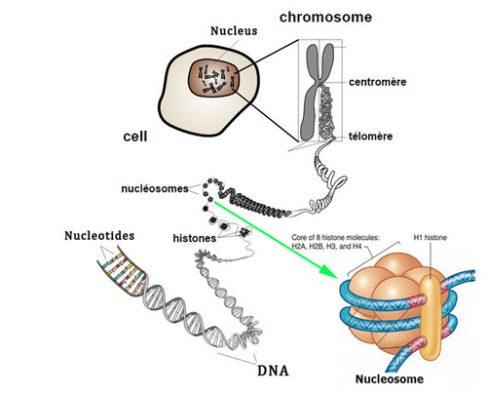
What is SIR2?
www.easybiologyclass.com

Slide 17
What is SIR2?
Zoom in 50x
www.easybiologyclass.com

Slide 18
What is SIR2?
Zoom in 50x
www.easybiologyclass.com

Slide 19
What is SIR2?
Zoom in 15x
www.easybiologyclass.com

Slide 20
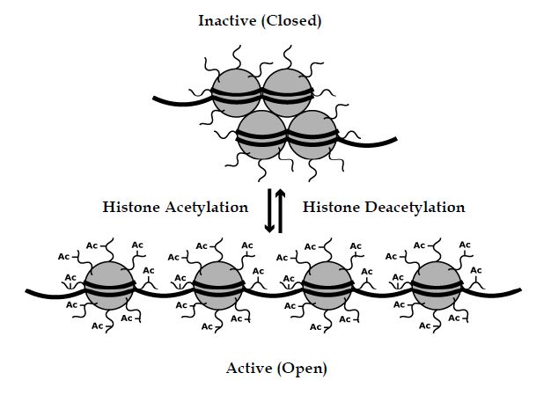
What is SIR2?
Silenced gene expression
NAD
Silenced Information Regulation
➔ SIR
SIR2
Histone
Acetylase
Histone
Deacetylase
Increased gene expression
http://missinglink.ucsf.edu/lm/genes_and_genomes/acetylation.html

Slide 21
What is SIR2?
Glucose
NAD
Histone
Acetylase
Histone
Deacetylase
SIR2
Citric
Acid
Cycle
NADH
NAD
http://missinglink.ucsf.edu/lm/genes_and_genomes/acetylation.html

Slide 22
What is SIR2?
Glucose
NAD
Histone
Acetylase
Histone
Deacetylase
SIR2
Citric
Acid
Cycle
NADH
NAD
http://missinglink.ucsf.edu/lm/genes_and_genomes/acetylation.html

Slide 23
What is SIR2?
Glucose
NAD
Histone
Acetylase
Histone
Deacetylase
SIR2
Citric
Acid
Cycle
NADH
NAD
http://missinglink.ucsf.edu/lm/genes_and_genomes/acetylation.html

Slide 24
What is SIR2?
SIR2
Life span (mean cycles)*
WT SIR2⁺
SIR2⁻
SIR2⁺⁺
23
11
29
*Kaeberlein et al (1999)

Slide 25
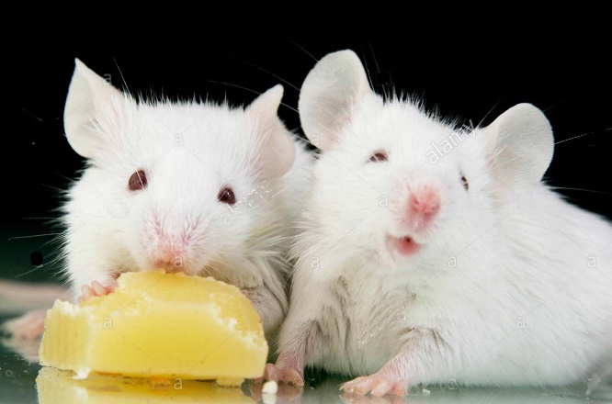
What is SIR2?
SIR2 in mice?
(called SIRT1)
SIR Two-like protein
SIR2
SIRT1
Life span (mean cycles)*
WT SIRT1⁺
WT SIRT1⁺
~100 weeks
>100 weeks
Well fed
Limited
diet
?
SIRT1⁻
SIRT1⁻
~50 weeks
~50 weeks
SIRT1
SIRT1
*Li et al (2008)

Slide 26
Overexpressed SIRT1 in mice?
Ca
SIRT1
SIRT1
DNA damage
Cancer
How confine expression
to the brain?
No Δ Lifespan
???
Herranz et al (2010)

Slide 27

Overexpression of SIRT1 in brain
Mad Cow Disease
Prion protein (PrP)
P_{prp}
PrP gene
intron
Satoh et al (2013)

Slide 28
Overexpression of SIRT1 in brain
Ca
P_{prp}
SIRT1
SIRT1 gene
intron
SIRT1 mRNA
P_{prp}
SIRT1
Satoh et al (2013)

Slide 29
PrP/SIRT1 overexpression and longevity
PrP/SIRT1 (SIRT1⁺⁺)
WT (SIRT1⁺)
Survival (%)
12%
Age (days)
Why longevity from SIRT1 in brain?
(Off target effects?)
Satoh et al (2013)

Slide 30
Genetic Enhancement
+10 years

Slide 31
Genetic Enhancement – Why Not?
Complications of SIRT1 in mice
Giblen et al (2014)

Slide 32
Genetic Enhancement – Why Not?
Complications of SIRT1 in mice
Boutant & Cantó (2014)

Slide 33

Genetic Enhancement – Why Not?
Testing
~1 month
~4 years
~80 years
Solution: Accumulate anecdotal experiences?
Solution: Conditional modifications?
Stock (2002)

Slide 34
Guideline considerations

Slide 35
References
Boutant M, Cantó C (2014). SIRT1 metabolic actions: Integrating recent advances from mouse models. Molec Metab 3:5-18.
Giblen W, Skinner ME, Lombard DB (2014). Sirtuins: guardians of mammalian healthspan . Trends Genet 30:271-286.
Herranz D, Muñoz-Martin M, Cañamero M, Mulero F, Martinez-Pastor B, Fernandez-Capetillo O, Serrano M (2010). Sirt1 improves healthy ageing and protects from metabolic syndrome-associated cancer. Nature Commun 1:3
Kaeberlein M, McVey M, Guarente L (1999). The SIR2/3/4 complex and SIR2 alone promote longevity in Saccharomyces cerevisiae by two different mechanisms. Genes Devel 13:2578-2580.
Li Y, Xu W, McBurney MW, Longo VD (2008). SirT1 Inhibition Reduces IGF-I/IRS-2/Ras/ERK1/2 Signaling and Protects Neurons. Cell Metab 8:38-48.
Mair W, Goymer P, Pletcher SD, Partridge L (2003). Demography of Dietary Restriction and Death in Drosophila. Science 301:1731-1733.
Satoh A, Brace CS, Rensing N, Cliften P, Wozniak DF, Herzog ED, Yamada KA (2013). Sirt1 Extends Life Span and Delays Aging in Mice through the Regulation of Nk2 Homeobox 1 in the DMH and LH. Cell Metab 18:416-430.
Stock G (2002). Redesigning Humans: Our Inevitable Genetic Future. Houghton Mifflin Harcourt.
Wang J, Xu G, Slunt HH, Gonzales V, Coonfield M, Fromholt D, Copeland NG, Jenkins NA, Borchelt DR (2005). Coincident thresholds of mutant protein for paralytic disease and protein aggregation caused by restrictively expressed superoxide dismutase cDNA. Neurobiol Disease 20:943-952.

Slide 36
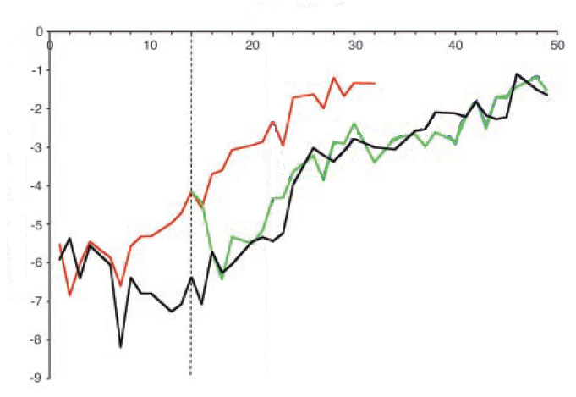
Longevity Through Nutritional Deprivation
Age (days)
Starve at 14 days
Well
fed
Limited
diet
Death Rate (Log)
Mair et al. (2003}

Slide 37
Where does PrP express?
Protein levels driven by P_{PrP}
Wang et al (2005)

