Slide 1
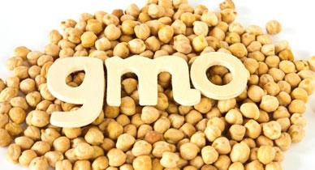
Resistance to Glyphosate
By: Jada Wilson

Slide 2
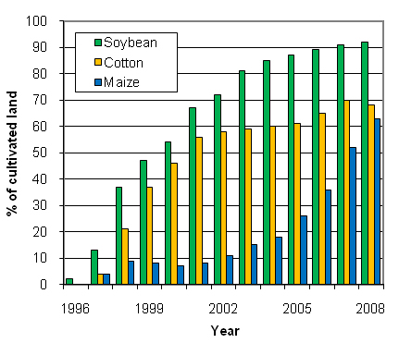
Why Modify Soybeans?

Slide 3
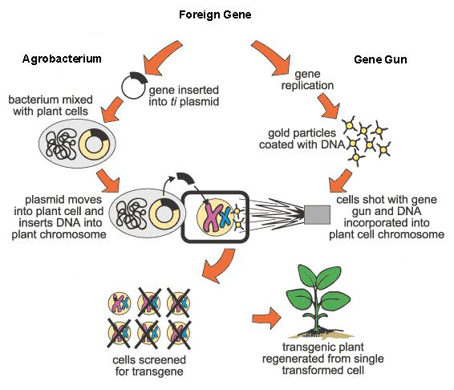
Creating Resistance
CP4 EPSP synthase (enzyme) 5-enolpyruvylshikimate-3-phosphate
Mutation at active site
Microparticles

Slide 4
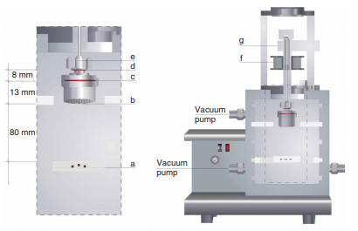
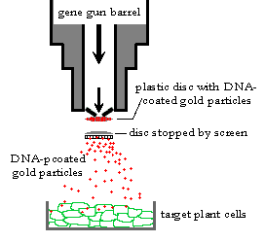
Gene Gun

Slide 5
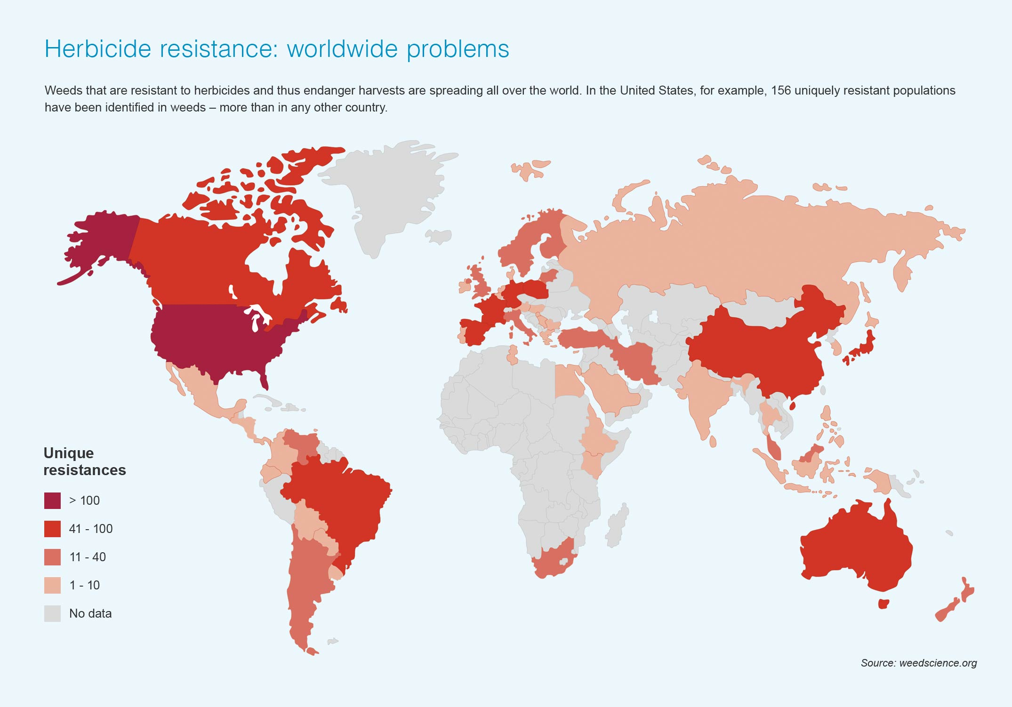
Arising Issues

Slide 6
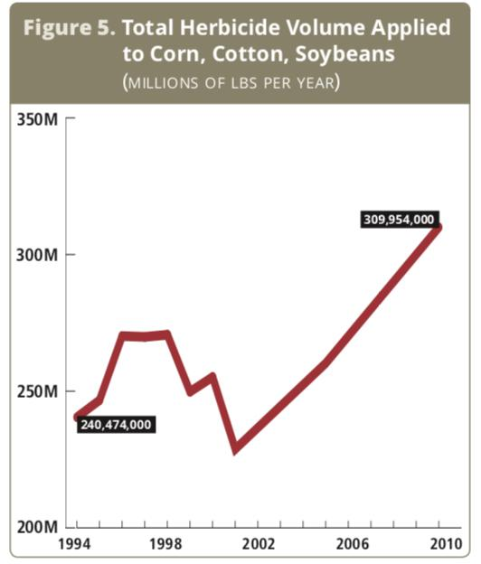
Downside

Slide 7
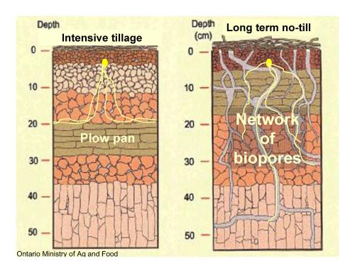

Slide 8
Solution
Introduce plant to multiple herbicide resistance genes
Employ preventive measures
Crop rotation
Till plots

Slide 9
Concerns
What are the risks?
Multiple herbicides
Stronger Herbicides

