Slide 1
The mechanisms of weed resistance to glyphosate
By: Cameron Green

Slide 2
Why are weeds becoming resistant?
What is the problem?
Glyphosate resistance
Who has this problem?
Farmers
Why should this problem be solved?
Has a potential to create superweeds
How will I know this problem has been solved?
Once the weed population has been destroyed

Slide 3
How weeds Become resistant
Transgenic crops are modified to be resistant to glyphosate and the herbicide is distributed
Most weeds are then killed by glyphosate but some survive and become resistant
Resistance is the result of two separate mechanisms:
Weak
Strong

Slide 4
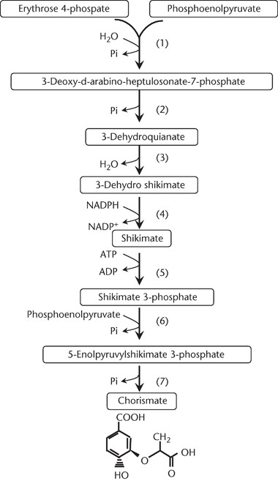
Resistance Mechanisms
Weak
Strong
Results in a mutation in the EPSPS gene
At nucleotide 301 cytosine changes to thymine
The plant simply distributes the herbicide throughout itself
Glyphosate is still able to effect the plant
This means it does not sit in it’s root and kill it
The amino acid serine is created instead of proline

Slide 5
Why is this not an issue?
Because what doesn’t kill the plants actually makes them weaker
A side effect of these resistance mechanism is that the weeds lose fitness compared to the wild-type
This is why when we find cases of glyphosate resistance it is only a small percentage

Slide 6
This is not true for all weeds and herbicides
Some weeds can form a resistance so strong that over 75% of their population becomes resistant
Herbicide resistance isn’t tested until applied commercially
If a weed becomes resistant to one herbicide we can’t guarantee the other will work

Slide 7
Always assume herbicides create super weeds
Herbicide resistance must be tested in laboratories before they are introduced commercially
If the herbicides produce a weed population with over 50% becoming resistant then it must not be used
The U.S has a list of noxious weeds that must be destroyed and we don’t want to add to it

Slide 8
References
Gene replacements and insertions in rice by intron targeting using CRISPR-Cas9.
Jun Li, Xiangbing Meng, Yuan Zong, Kunling Chen, Huawei Zhang, Jinxing Liu, Jiayang Li, Caixia Gao Nat Plants. 2016; 2: 16139. Published online 2016 Sep 12. doi: 10.1038/nplants.2016.139
Castle LA, Siehl DL, Gorton R, Patten PA, Chen YH, Bertain S, Cho HJ, Duck N, Wong J, Liu D, Lassner MW. Discovery and directed evolution of a glyphosate tolerance gene. Science. 2004;304:1151–1154.
Broster, JC and Pratley, JE, A decade of monitoring herbicide resistance in Lolium rigidum in Australia. Aust J Exp Agric 46: 1151– 1160 ( 2006).
Powles, SB, Lorraine‐Colwill, DF, Dellow, JJ and Preston, C, Evolved resistance to glyphosate in rigid ryegrass (Lolium rigidum) in Australia. Weed Sci 46: 604– 607 ( 1998).
Simarmata, M., & Penner, D. (2008). The Basis for Glyphosate Resistance in Rigid Ryegrass (Lolium rigidum) from California. Weed Science, 56(2), 181-188. Retrieved from http://www.jstor.org/stable/25148501
Fernández-Moreno, P. T., Alcántara-de la Cruz, R., Smeda, R. J., & De Prado, R. (2017). Differential Resistance Mechanisms to Glyphosate Result in Fitness Cost for Lolium perenne and L. multiflorum. Frontiers in plant science, 8, 1796. doi:10.3389/fpls.2017.01796
Ishii, T., & Araki, M. (2016). A future scenario of the global regulatory landscape regarding genome-edited crops. GM crops & food, 8(1), 44–56. doi:10.1080/21645698.2016.1261787

