Slide 1
Plants Genome modification
SoGem 2019

Slide 2
How’s the world looks right now ?
Famine
WAR
Malnutrition

Slide 3
How’s the world looks right now ?
Famine
WAR
Malnutrition

Slide 4
How’s the world looks right now ?
Famine
WAR
Malnutrition

Slide 5
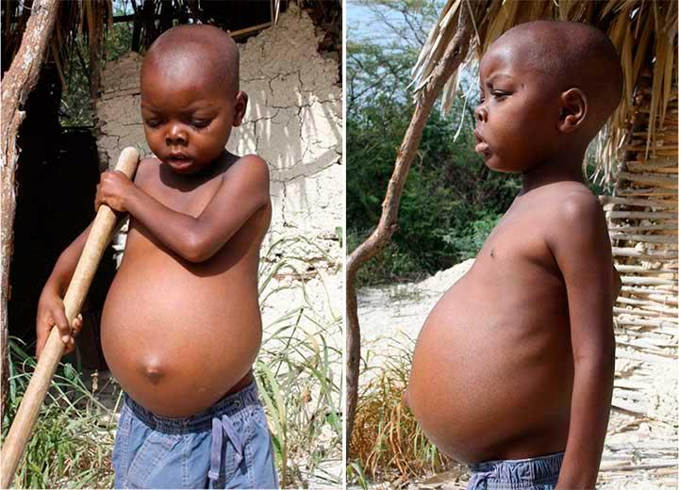
How’s the world looks right now ?
Famine
WAR
Malnutrition

Slide 6
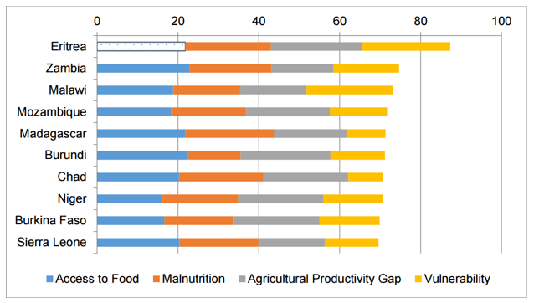
An estimate of the problem

Slide 7
Possible Solution?
Higher crops yield?
better Crops?
Induced more nutritions

Slide 8
It’s all about the plants!!

Slide 9
It’s all about the plants!!
Problems?

Slide 10
Stress!
Climate Change

Slide 11
Drought
Climate Change

Slide 12
Drought
Climate Change
Intens
sunlight

Slide 13
Drought
Temperature
Climate Change
Intens
sunlight

Slide 14
Drought
Temperature
Climate Change
Intens
sunlight
Wind

Slide 15
Biotic factors

Slide 16
Microorganisms
Biotic factors

Slide 17
Microorganisms
Biotic factors
Competitors

Slide 18
Microorganisms
Biotic factors
Competitors
Low crops yield

Slide 19
Genetically Modified Plants

Slide 20
Genetically Modified Plants
Biotic factors
Climate Change

Slide 21
Techniques to Transfect Plants?
Genetically Modified Plants

Slide 22
Techniques to Transfect Plants?
Agrobacterium-mediated genetic transformation
Genetically Modified Plants

Slide 23
Techniques to Transfect Plants?
CRISPR Cas9 system
Agrobacterium-mediated genetic transformation (AMT).
Genetically Modified Plants

Slide 24
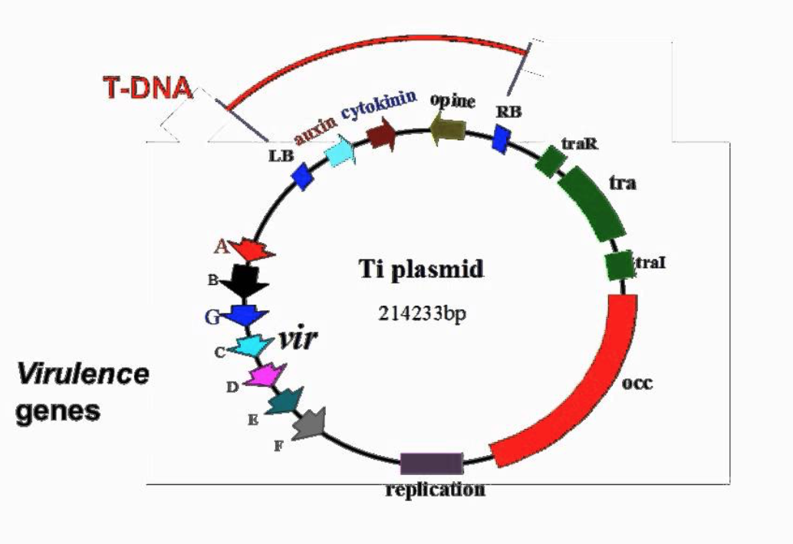
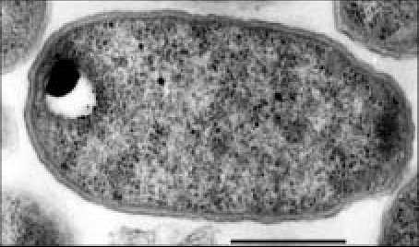
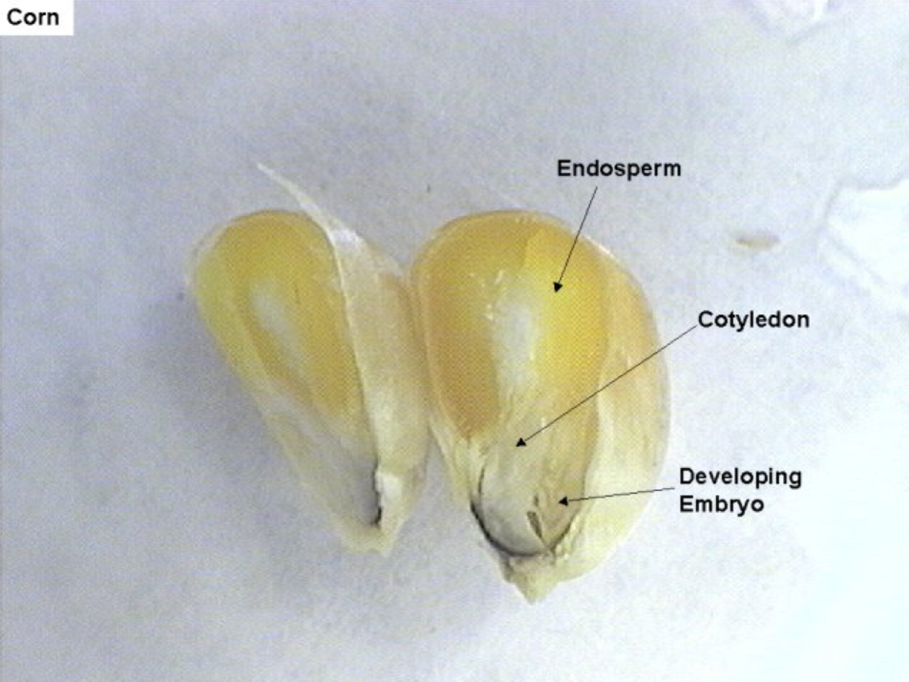
Essentials?
Agrobacterium-mediated genetic transformation
Genetically Modified Plants

Slide 25
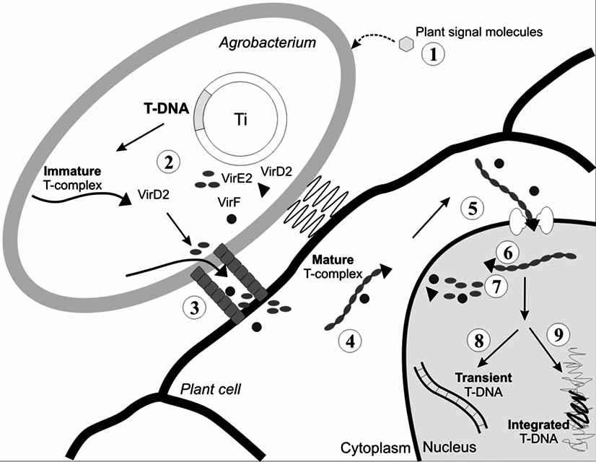
Illustration
Agrobacterium-mediated genetic transformation
Genetically Modified Plants

Slide 26
Essentials?
CRISPR Cas9 system
sgRNA
KO
PAM+Target sequence
Cas9
Insertion
HDR
Genetically Modified Plants

Slide 27
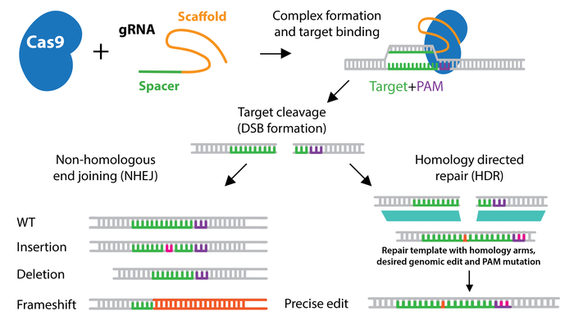
Illustration
CRISPR Cas9 system
Genetically Modified Plants

Slide 28
Stresses!
Drought
Temperature
Climate Change
Intens
sunlight
Wind

Slide 29
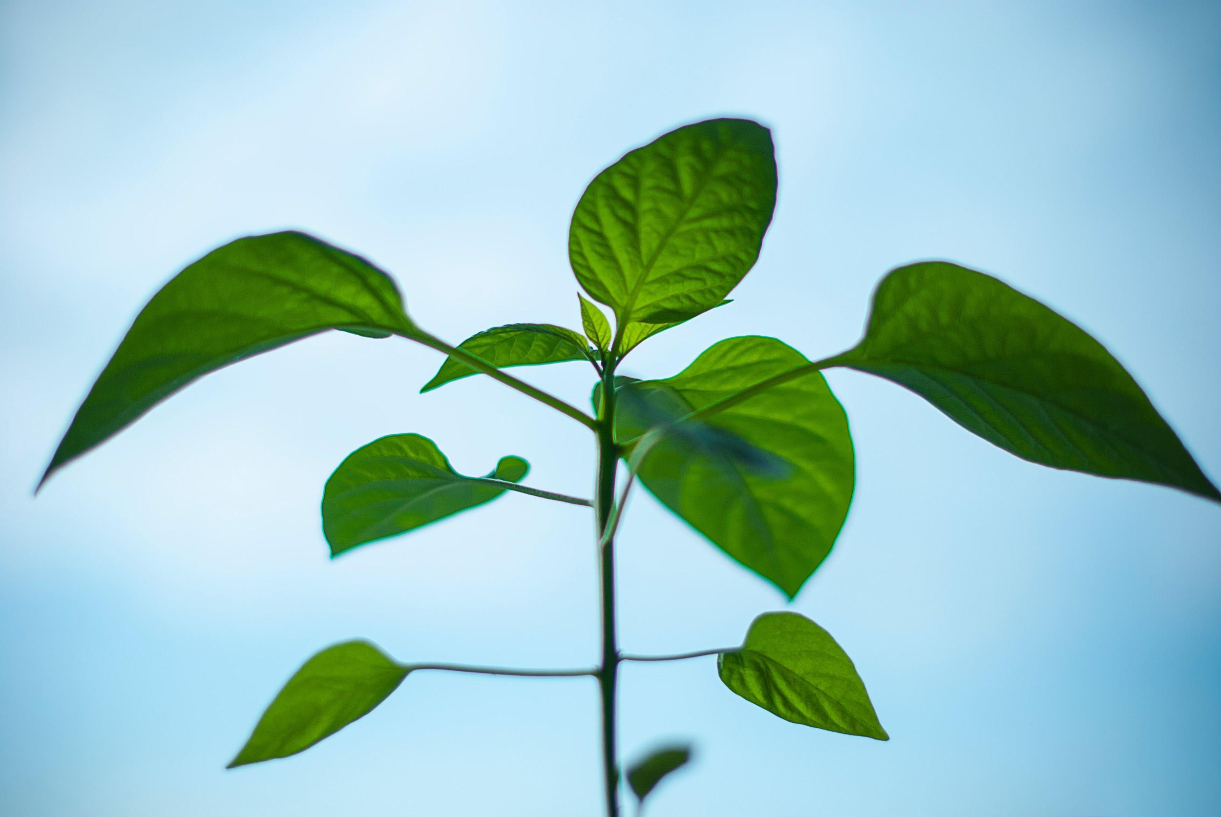
Agrobacterium-mediated genetic transformation
How Do plants react to stresses?
Biotic Abiotic
Genetically Modified Plants
(Colombatti, 2019)
Climate Change

Slide 30
Agrobacterium-mediated genetic transformation
How Do plants react to stresses?
Biotic Abiotic
Reactive oxygen species(ROS).
Genetically Modified Plants
(Colombatti, 2019)
Climate Change

Slide 31
Agrobacterium-mediated genetic transformation
How Do plants react to stresses?
DNA
Reactive oxygen species(ROS).
Lipids
Protein
Genetically Modified Plants
(Colombatti, 2019)
Climate Change

Slide 32
Agrobacterium-mediated genetic transformation
How Do plants react to stresses?
DNA
Reactive oxygen species(ROS).
Lipids
Proteins
Genetically Modified Plants
(Colombatti, 2019)
Climate Change

Slide 33
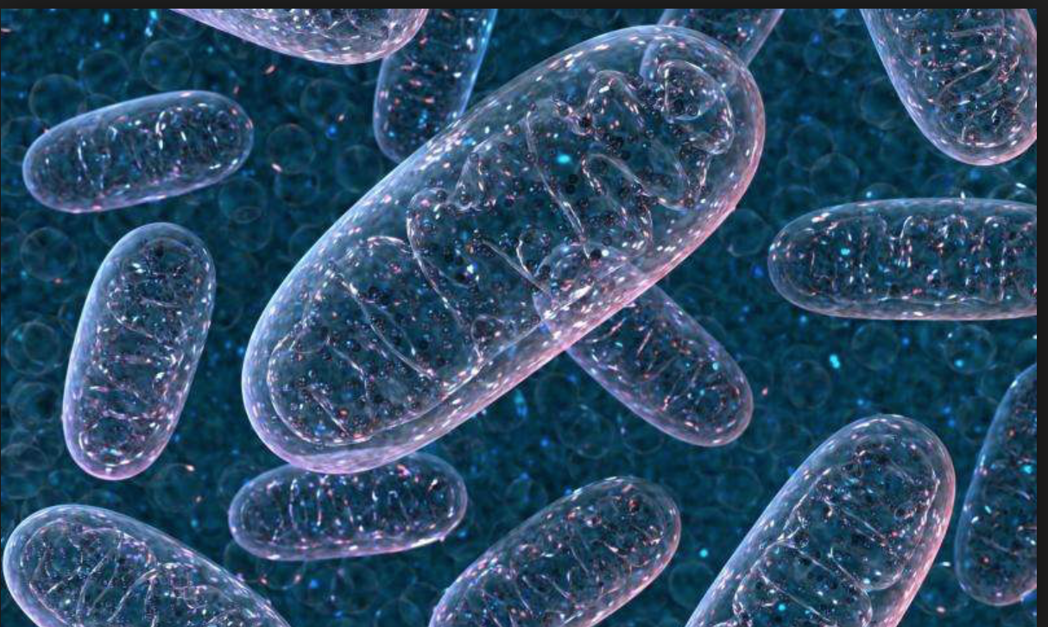
Agrobacterium-mediated genetic transformation
Reduce ROS levels?
AtOXR2
Genetically Modified Plants
(Colombatti, 2019)
Climate Change

Slide 34
Agrobacterium-mediated genetic transformation
Reduce ROS levels?
AtOXR2
Genetically Modified Plants
(Colombatti, 2019)
Climate Change

