Slide 1
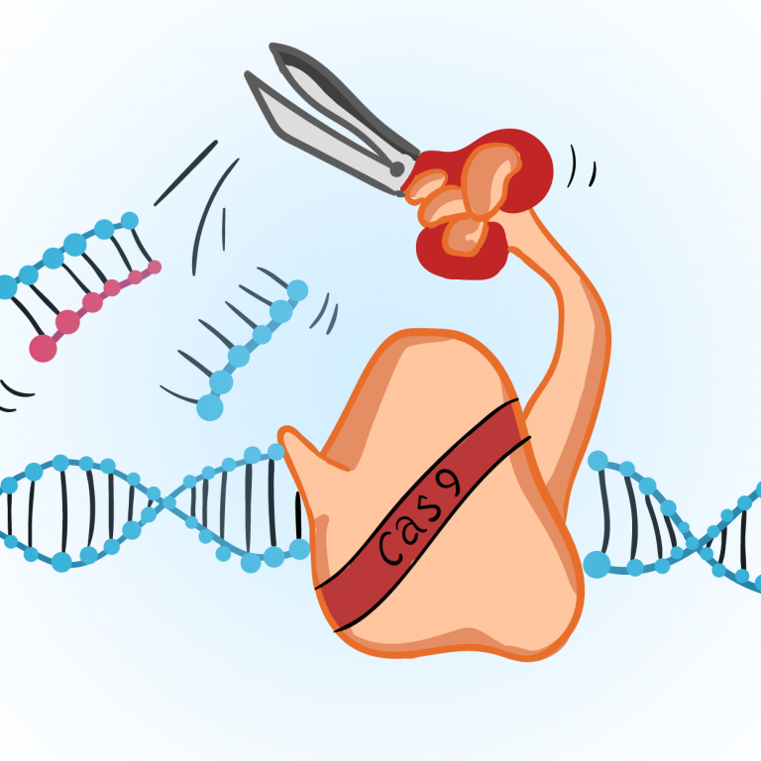
Germline Modification
By: Jada Wilson

Slide 2
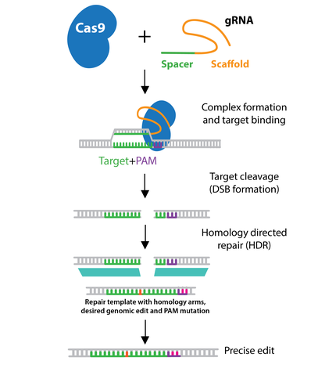
CRISPR Cas9

Slide 3
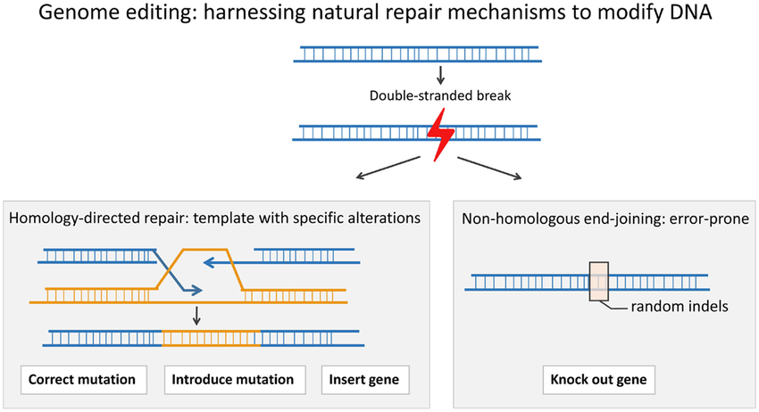
Limitations

Slide 4
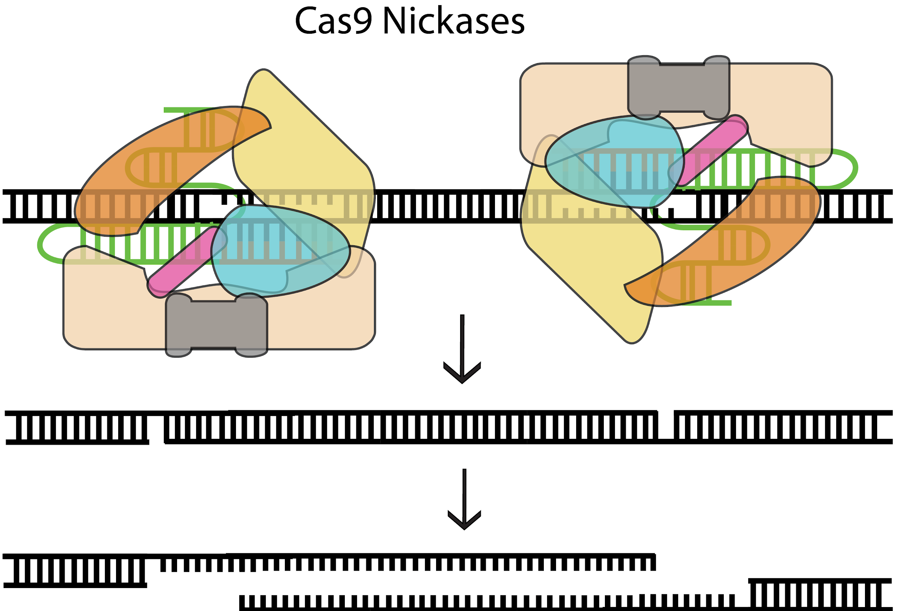
Solution

Slide 5
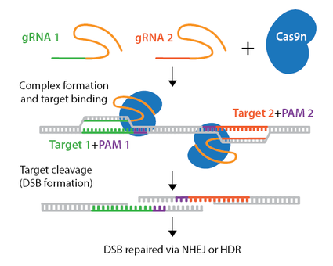

Slide 6
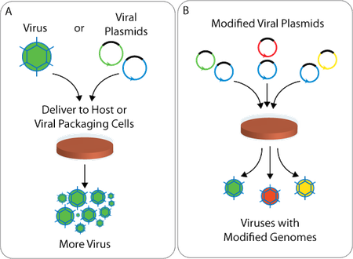
The Process

Slide 7
Suggestion

Slide 8
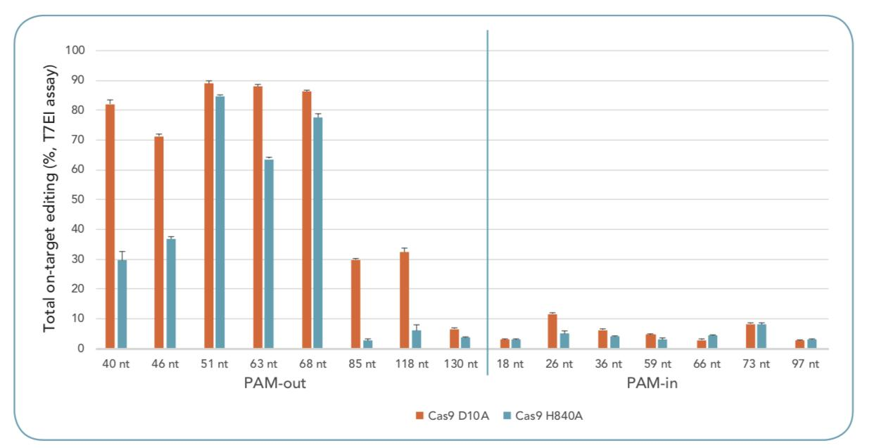

Slide 9
Solution
Use PAM-Out orientation
Use donor DNA to employ HDR

Slide 10
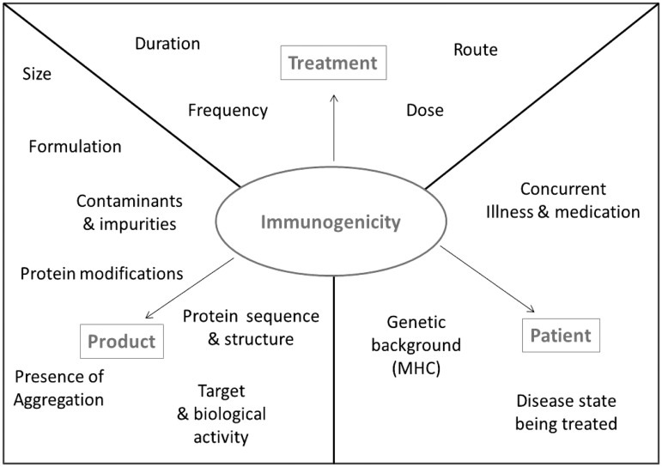
Issues
Immune response

