Slide 1
Human germline modification

Slide 2
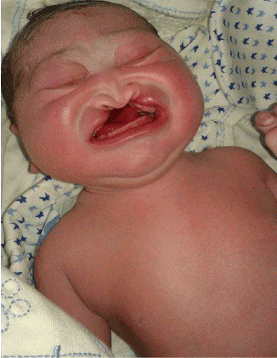
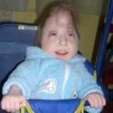
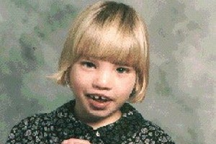
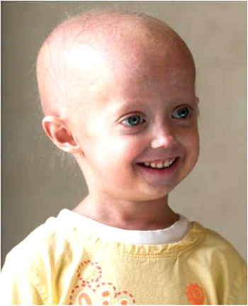
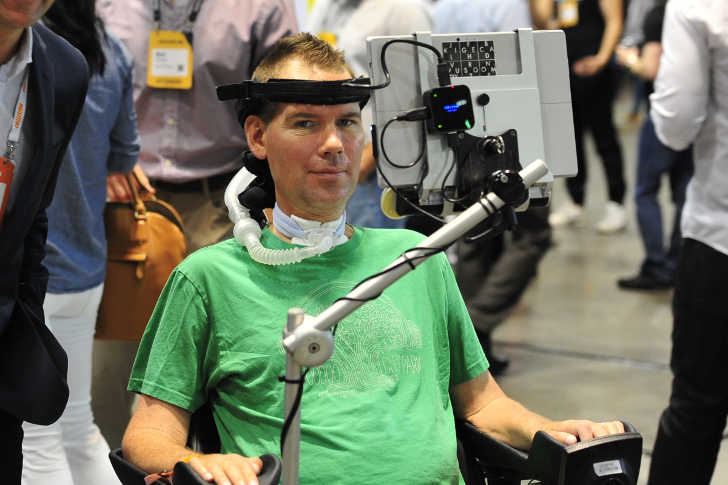
Fatal genetic disorders No cure
Notes:
Bottom left, progeria, bottom middle, ALS, bottom right, down syndrome (trisomy 21), top right – cri du chat, top right – Edward syndrome (trisomy 18), top middle – patau syndrome (trisomy 13), top left – huntington’s disease

Slide 3
1 in 3 infant deaths are from genetic disorders
180/523 infant deaths
University of Utah
(1998-1998)
Stevenson, David A, and John C Carey (2004).

Slide 4
Maternal Age Carrier for unwanted gene? Down Syndrome
Allen, Emily Graves et al ( 2008).

Slide 5
What can we do about this?

Slide 6
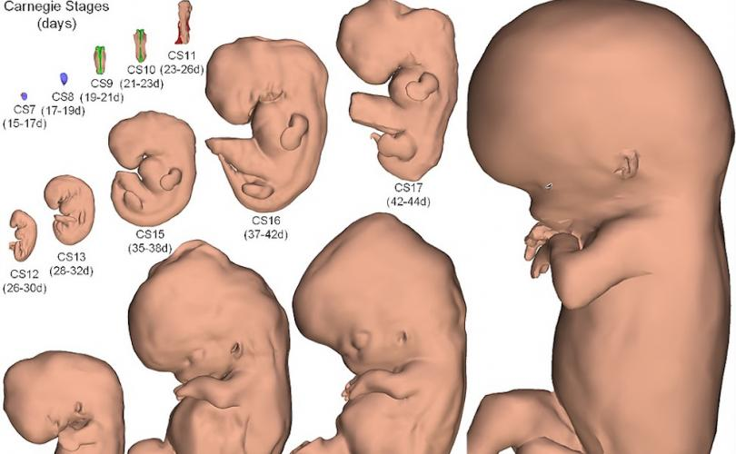
Genetic Modification at Embryonic Stage

Slide 7
Preimplantation Genetic Diagnosis (PGD)

Slide 8
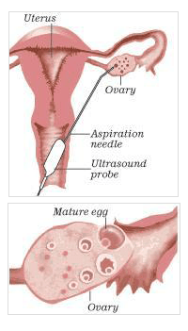
Ovarian stimulation & oocyte retrieval (GnRH agonist)

Slide 9
Co-incubation of sperm + egg in petri dish ~70% success rate
Brezina, Paul R et al (2013).

Slide 10
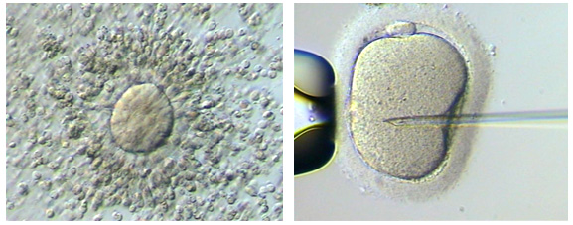
2) Embryo Biopsy

Slide 11
3 – 5 days post fertilization, biopsy occurs

Slide 12
3) FISH Screen for genetic abnormalities
Notes:
Picture 1 https://pf.millennialsd.com/wp-content/uploads/sites/9/2017/07/20150822_ldp001.jpg
Picture 2 https://lejeunefoundation.org/wp-content/uploads/2018/04/Pennsylvania-Down-syndrome-protection-law.jpg
Picture 3 https://encrypted-tbn0.gstatic.com/images?q=tbn:ANd9GcRLVlGQZOlkK9Wjc7ZUqVPNYEgfeqZB27_OAUEmNjd461QUxgey
Picture 4 https://ccr.cancer.gov/sites/default/files/progeria.jpg
Picture 5 https://d1zqayhc1yz6oo.cloudfront.net/thumbs/thumb-6b0faa2c828838cad8cf41eeb2bd71dd.jpg
Picture 6 https://www.oatext.com/img/JPR-1-120-g001.gif
Picture 7 https://health9.org/edwards-syndrome/
Picture 8 https://pathways.org/wp-content/uploads/2017/11/3babies.jpg
Picture 9 https://www.internationalfertilitycentre.com/testing/wp-content/uploads/2018/10/PGD.jpg

Slide 13
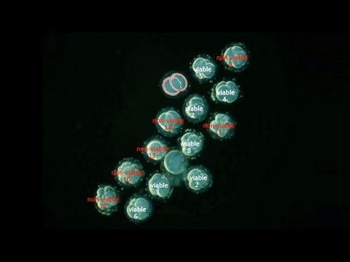
Select Normal Embryo & Discard Abnormal

Slide 14
Embryonic transfer & pregnancy

Slide 15
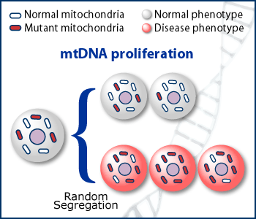
Mitochondrial Replacement Therapy (MRT) Legal in UK Since 2015

Slide 19
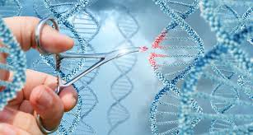
CRISPR/Cas9 Clustered Regularly Interspaced Palindromic Repeats 2 components

Slide 20
1) Guide RNA 2) Cas9
Redman, Melody et al (2016).

Slide 21
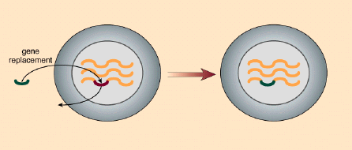
HDR vs. NHEJ

Slide 22
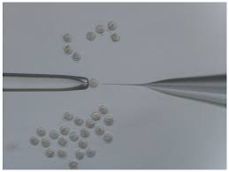
Microinjection into Cytoplasm/Nucleus
Liu, Chengyu et al (2013).

Slide 23
Microinjection
Near 100% accuracy
Most efficient at yielding normal embryos
Low rate of off-target effects
Lino, Christopher A et al (2018).

Slide 24
Electroporation of zygote “Nucleofection”
Lino, Christopher A et al (2018).

Slide 25
Limitations to Germline Modification

Slide 26
CRISPR/Cas9:
not 100% accurate
Heritable changes
off target effects - BAD
Lino, Christopher A et al (2018).

Slide 27
PGD/IVF/MRT
Moral status of early embryo
destruction of fertilized embryos
IVF procedure:
stressful on woman
limited chance of success

Slide 28
Proposed Regulation of Human Germline Modification
Refine gene-editing techniques on Tripronuclear zygotes
Reduce off-target mutations - guide RNA
Improve IVF techniques to increase rate of normal embryos
Legalize MRT – UK already has!
Liang, Puping et al (2015).

Slide 29
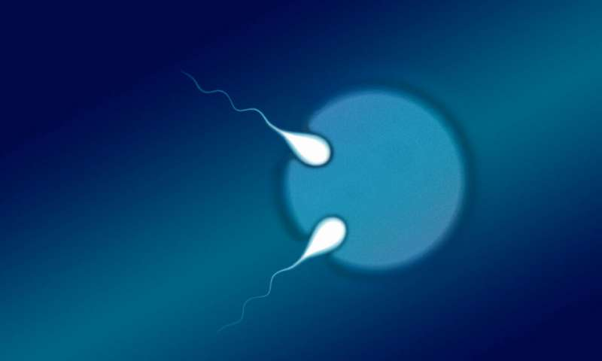
Tripronuclear (3n) Zygotes
Product of IVF, usually discarded
HDR editing ~ 25% success
NHEJ ~ 20-60% success
Practice template for CRISPR/Cas9
Lino, Christopher A et al (2018).
Liang, Puping et al (2015).

