Slide 1
Phytoremediation
By:Jada Wilson

Slide 2
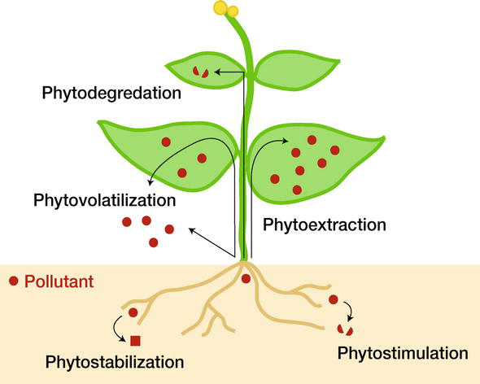
What is Phytoremediation?

Slide 3
Phytostabilization

Slide 4
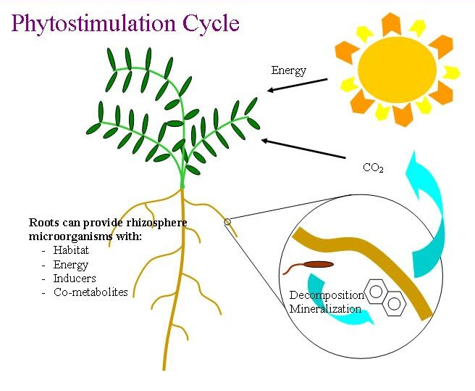
Phytostimulation

Slide 5
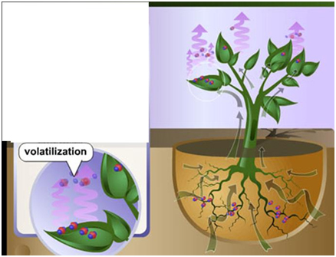
Phytovolatilization

Slide 6
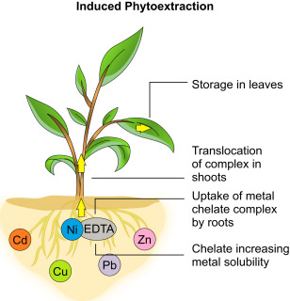
Phytoextraction

Slide 7
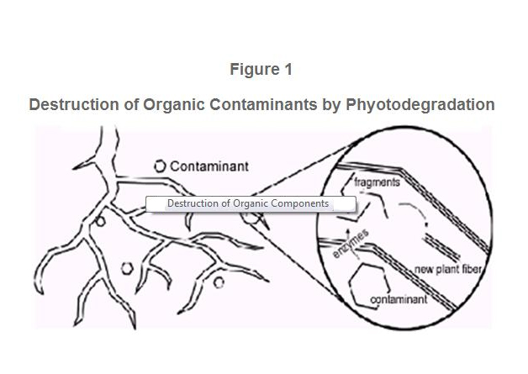
Photodegradation

Slide 8
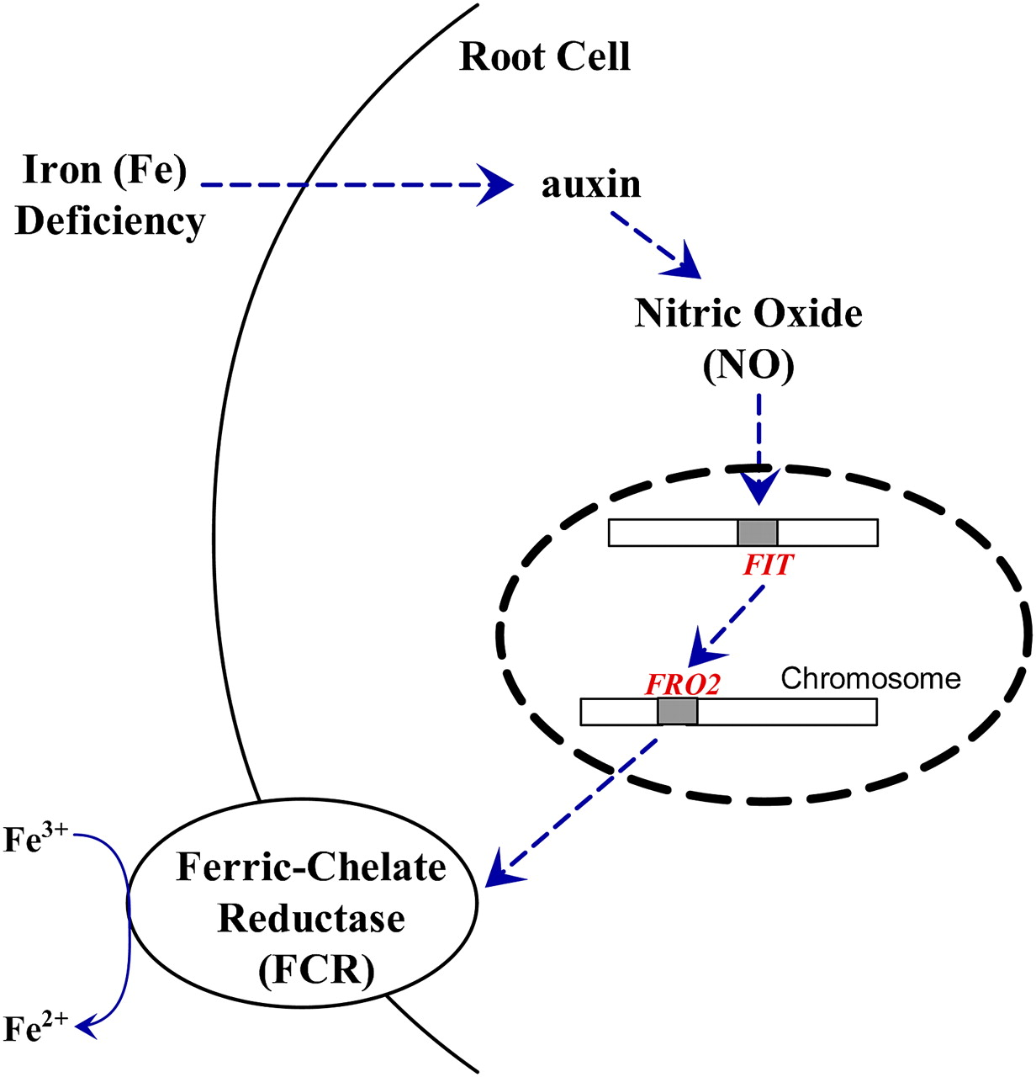
Why Phytoremediation?
Allows stabilization and accumulation

Slide 9
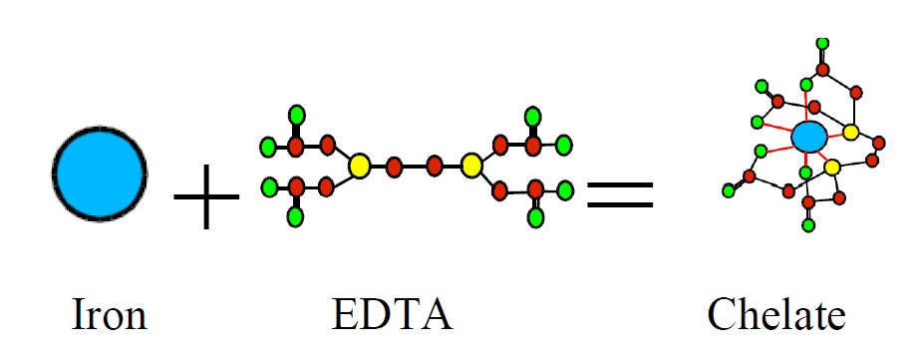
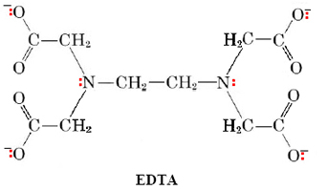
How to increase accumulation?
Introduce plant to the FRE1 and FRE2 genes
Genes from yeast
Codes for ferric-chelate reductase (ligand)

Slide 10
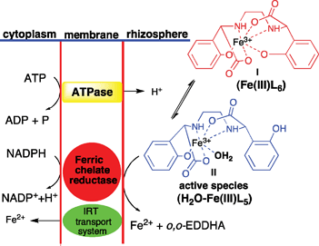
Reduction Mechanism

Slide 11
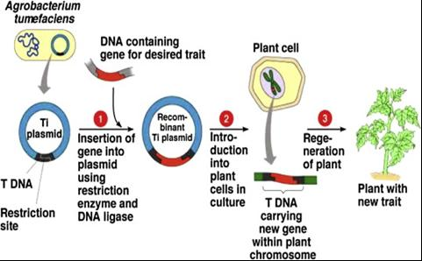
Creation Of Modified Plant
Agrobacterium tumefaciens-mediated transformation

Slide 12
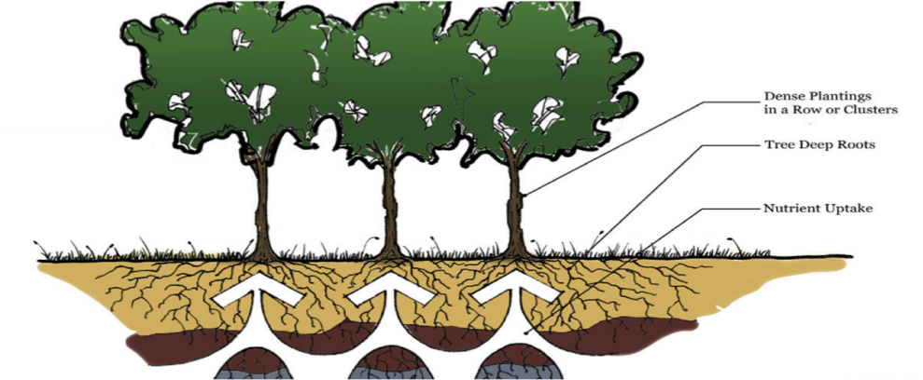
Solution
Use Trees for the remediation
Deeper roots
More leaves

Slide 13
Limitations/Concerns
Metals cannot be degraded
Disposal
Edible?
Could cause a biodiversity issue
Slow process
Can’t be used if contamination levels are high
Phytovolatilization may not help

