Slide 1
Search for CRISPRs in mycobacteriophages
Rachel Siefring

Slide 2
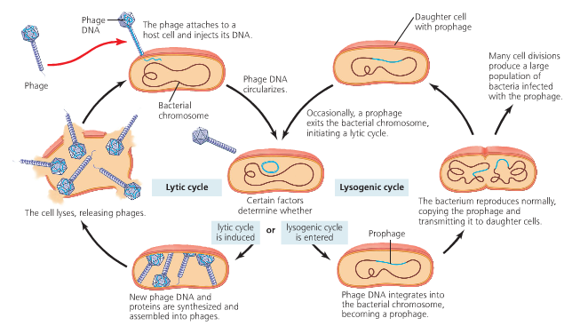
Phage life cycle

Slide 3
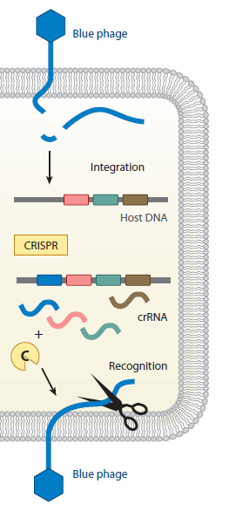
What is a CRISPR?
Figure 1: Figure 1 of Westra et al (2012). Simple representation of

Slide 4
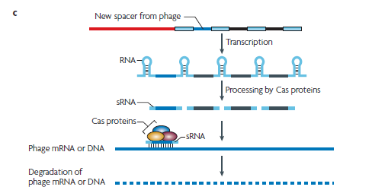
How CRISPRs work
repeat
Figure 1C from Sorek et al (2008).
Notes:
Repeat: 24 to 47 bp
Spacers: 26 to 72bp

Slide 5
Seed et al 2013
O1 antigen receptor
V. cholerae phage ICP1
V. cholerae

Slide 6
Seed et al 2013
Mutated O1 antigen receptor
V. cholerae phage ICP1
V. cholerae

Slide 7
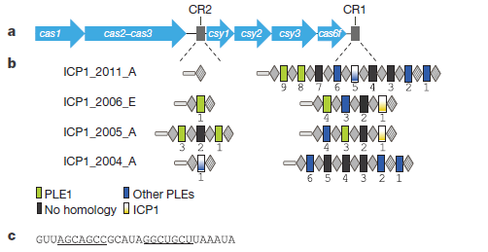
CRISPR in ICP1

Slide 8
Looking for CRISPRs in BioBIKE

Slide 9
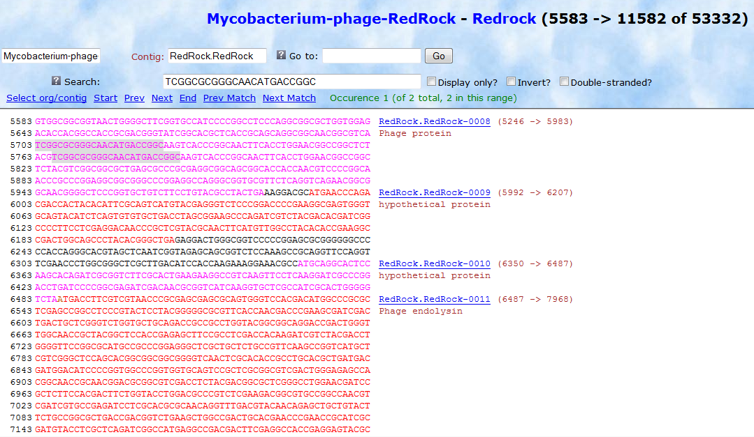
Looking for CRISPRs in BioBIKE

Slide 10
Mycobacteriophage Giles
First repeat in mycobacteriophage Giles
Second repeat in mycobacteriophage Giles
Third repeat in mycobacteriophage Giles
Notes:
First repeat: 240 nuc difference. The 40nuc after the second repeat is more likely…
Second repeat: There’s a 120 nucleotide difference from the beginning of the first repeat to the beginning of the second repeat.
Third repeat: There’s over 700 nuc difference between these two repeats. Not likely

Slide 11
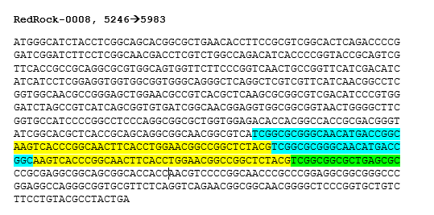
Mycobacteriophage RedRock
Notes:
62nt repeat. My algorithm divided it into 3 different 23nt repeats.

Slide 12
Other results
Searched for CRISPRs in 17 Cluster A mycobacteriophages
No 23nuc repeats

Slide 13
Future improvements
Improve my algorithm so that it only catches spacers of a specific length (35 to 40 nuc).
Use this algorithm to search for CRISPRs in all phage on BioBIKE.

Slide 14
References
Sorek, R., et al. (2008). CRISPR – a widespread system that provides acquired resistance against phages in bacteria and archaea. Nature Reviews Microbiology. 6: 181-186.
Seed, K., et al. (2013). A bacteriophage encodes its own CRISPR/Cas adaptive response to evade host innate immunity. Nature. 494: 489-491. http://www.nature.com.proxy.library.vcu.edu/nature/journal/v494/n7438/full/nature11927.html#supplementary-information
Samson, J. E., et al. (2013). Revenge of the phages: defeating bacterial defenses. Nature Reviews Microbiology. 11: 675-687. http://www.nature.com.proxy.library.vcu.edu/nrmicro/journal/v11/n10/full/nrmicro3096.html
Westra, et al. (2012). The CRISPRs, They are a-changin': How Prokaryotes Generate Adaptive Immunity. Annu. Rev. Genet. 46: 311-319.

