Slide 1
Consensus SDR Sequence in E. coli near Important Genes
Nav Saini
BNFO 301
4/29/15

Slide 2
Short Dispersed Repeats
Repeating Nucleotide Sequences with gaps in between.
Not seen as often as tandem repeats.
FIG 1: Sequence Assembly – Wikipedia

Slide 3
What is so important about them?
From Odahara and Kolvhanov, repeats may have functions that deal with transcription and recombination.
Specific Cellular Process? Specific gene locations?
Most say “Function is Unknown”.

Slide 4
Finding Function
Initial intent was to find recombination function.
Mazin and Odahara explain about recombination between dispersed repeats.
Genomic Stability?
Rad1-Rad10 nuclease promotes chromosome translocations between dispersed repeats
Specific gene (RECG) suppresses recombination between repeats in mitochondrial DNA

Slide 5
Finding Consensus
“We found SDR sequences.” “Great, what is the sequence?” “What sequence?”
Bachellier et al gave a 28 bp alignment with CCCTCTCCC as a main core.
Many mismatches for both downstream and upstream of the core.
Used K-12 and two other e. coli strains

Slide 6
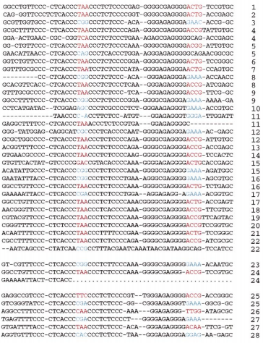
FIG 2: 28 SDR sequences found in E. coli with mismatches (Bachellier, Sophie et al)

Slide 7
Biobike
Looked at 4 E. coli strains: k-12, f11, hs, and ATCC-8739
Used count of “CCCTCTCCC” in K-12, only found 18 sequences, not 28.
Double Strand gave around 40.
F11 did not give that many sites.

Slide 8
Double Strand for Recombination
K-12 and ATCC had the most matches
Multimodular transpeptidase-transglycosylase.
Belkum et al found around “disappointing” results of 5 set repeats with K-12.
Some sets of 4. Many sets of 2. Around 100 bp gap between repeats.

Slide 9
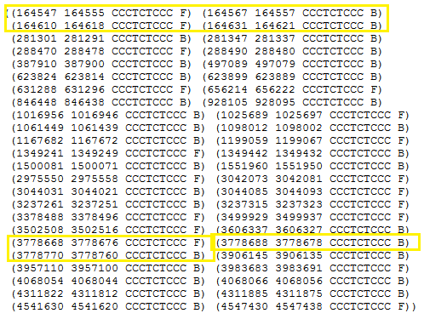
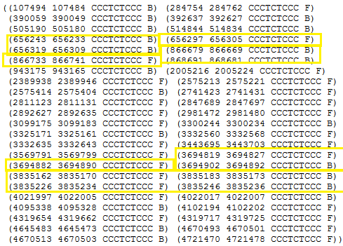
K-12
ATCC

Slide 10
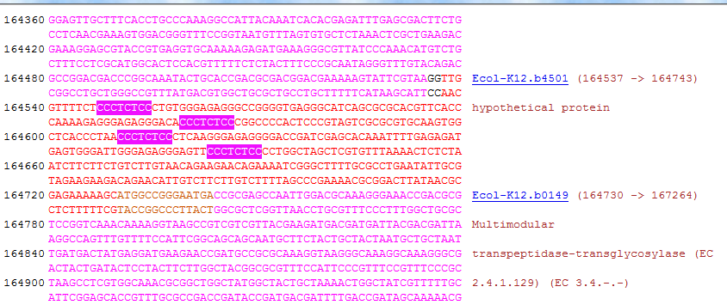

Slide 11
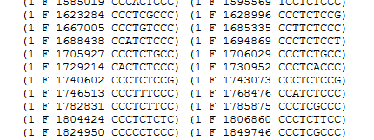
Single Strand
Gave many sets of 3 SDR sites with around 100 bp gap.
K-12 ATCC

Slide 12
Chi sites
Ying Xu gave consensus sequence GCTGGTGG for E. coli (chi site).
Found around 600 locations in K-12.
May look at this next for recombination occurrences around important/same genes for various E. coli strains.
Recombination in REC system.

Slide 13
References
Bachellier, Sophie et al. (1999). “Short palindromic repetitive DNA elements in enterobacteria: a survey.” Res. Microbiol.
http://ac.els-cdn.com/S092325089900128X/1-s2.0-S092325089900128X-main.pdf?_tid=40cd8204-ed74-11e4-a71b-00000aab0f6b&acdnat=1430204608_34ab1825a3102cb9c30f957f13913bf6
Alex van Belkum et al. (1998). “Short-Sequence DNA Repeats in Prokaryotic Genomes.”
http://www.ncbi.nlm.nih.gov/pmc/articles/PMC98915/
Kolvhanov et al. “Computer Analysis of Genetic Macromolecules: Structure, Function, and Evolution.
https://books.google.com/books?id=crip5tRcF0YC&pg=PA332&lpg=PA332&dq=Dispersed+Repeats+prokaryotic&source=bl&ots=03DCQ7xPt4&sig=1gNGaJ3mY45Jng_SDtCt4KZm9Eo&hl=en&sa=X&ei=d08dVeudDYOMNpSggLAE&ved=0CDQQ6AEwAw#v=onepage&q=Dispersed%20Repeats%20prokaryotic&f=false
Mazon, Gerard et al. (2012). “The Rad1-Rad10 nuclease promotes chromosome translocations between dispersed repeats.”
http://www.ncbi.nlm.nih.gov/pmc/articles/PMC3443319/
Odahara, Masaki et al. (2015). “RECG Maintains Plastid and Mitochondrial Genome Stability by Suppressing Extensive Recombination between Short Dispersed Repeats.”
http://journals.plos.org/plosgenetics/article?id=10.1371/journal.pgen.1005080
“The Origin and Possible Functional Role of Short Dispersed Repeats.”
http://www.vcu.edu/csbc/bbsi/people/students/0506/m_kato/BBSI%20final%20report.pdf
Ying Xu et al. “Computational Methods for Understanding Bacterial and Archaeal Genomes.”
https://books.google.com/books?id=GH99OB14Q3UC&pg=PA29&lpg=PA29&dq=short+dispersed+repeats+bacteria&source=bl&ots=WxmIT9DTpT&sig=BFiOwgBKj3-6IZiphzK2LNjUJTw&hl=en&sa=X&ei=m6QaVZGXH4uYNvOzgJgC&ved=0CDwQ6AEwBA#v=onepage&q=short%20dispersed%20repeats%20bacteria&f=false

