Slide 1
Clustered Repeats and Regulatory Sequences and more fun…
Amanda Rutledge

Slide 2
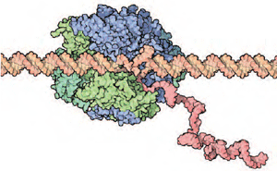
What are clustered repeats and regulatory sequences ?
Sequence of a genome that regulates the expression of genes
Transcription factors bind to these sites

Slide 3
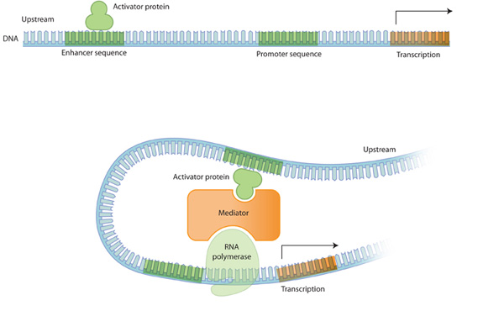
In order for them to bind…
They need to be able to recognize the proper binding site so the sequence needs to be unique and purposely placed

Slide 4
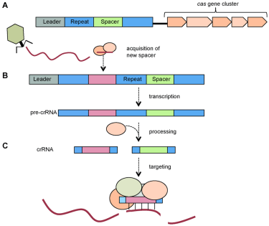
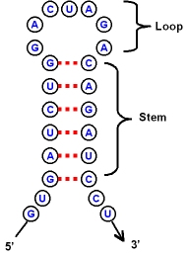
What to look for…
Stem Loop Structures
Repeated sequences or patterns

Slide 5
How can we look for these?
BIOBIKE!

