Slide 1
Tryptophan Regulation by the Formation of Structures in Bacteria

Slide 2
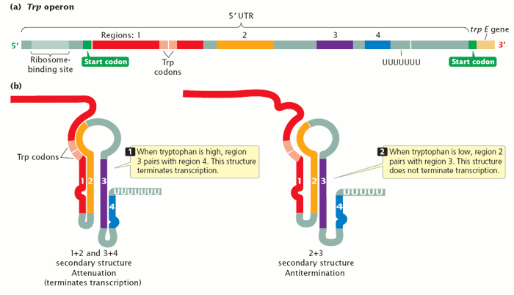

Slide 3
AAGTTCACGTAAAAAGGGTATCGACAATGAAAGCAATTTTCGTACTGAAAGGTTGGTGGCGCACTTCCTGAAACGGGCAGTGTATTCACCATGCGTAAAGCAATCAGATACCCAGCCCGCCTAATGAGCGGGCTTTTTTTTGAACAAAATTAGAGAATAACA

Slide 6
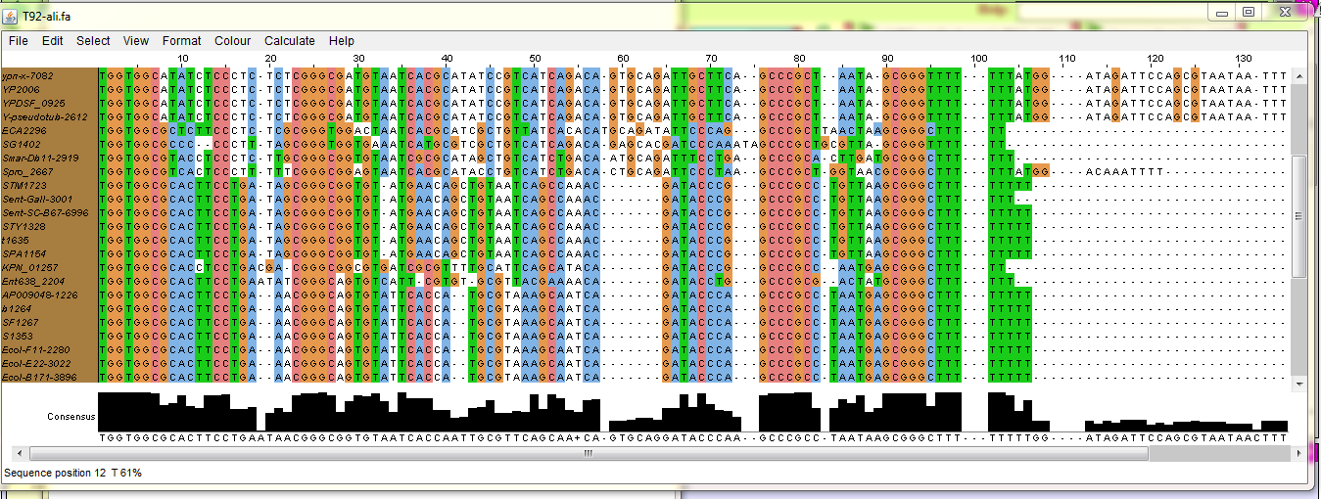

Slide 7
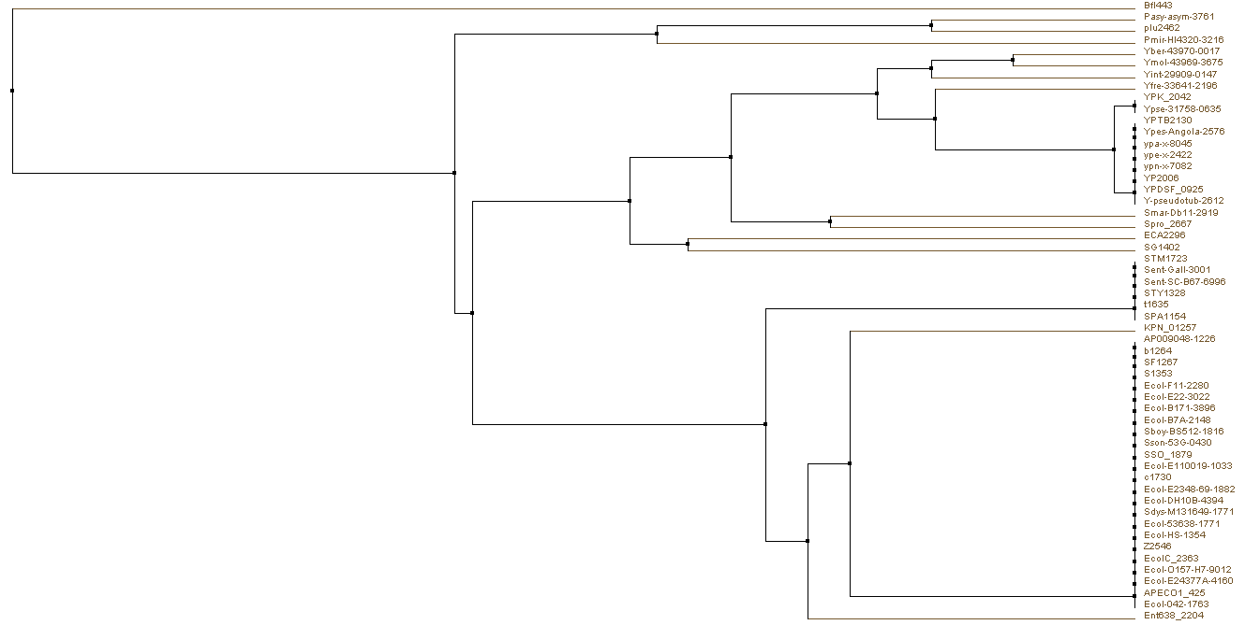

Slide 8
