Slide 1
Identifying recombination events in phage Giles through presence of repeat sequences
Megan Mair

Slide 2
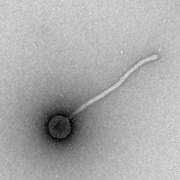
Mycobacteriophage Giles
Genes Conserved in Other Phages
Genes Unique to Giles
28%
22 genes
72%
57 genes
clusters
A B
C D
F G
H I
J K
M N
P R
T Singleton
Phamerator-generated data
Hatfull et al., 2010

Slide 3
Where do nonessential genes originate?
Tandem repeats are well-documented in mycobacteria – presence might imply origin? Sun et al.,2004

Slide 4
Autocorrelation Function
✓
✓
✓
✓
✓
✓
✓
✓
x
✓
✓
✓
CGTCTGACGGCTGA
x
✓
Total Score: 6
Total Possible Score: 7
+3
+1
+2
(nothing added)
+2

Slide 5
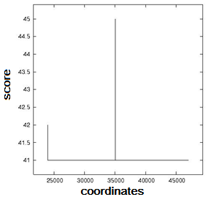
Scores > 40 (0.03% chance of occurring randomly)
gp27
120 nucleotide repeat
gp46
120 nucleotide repeat

Slide 6
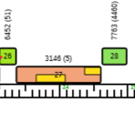
gp27
Minor Tail Protein
No documented protein-protein interactions
Phamerator Map
Mehla et al., 2015

Slide 7
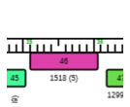
gp46
Phamerator Map
No known function
One protein-protein interaction with minor tail protein gp17
Mehla et al., 2015

Slide 8
Possible traces of satellite DNA (Deumling, 1981)

Slide 9
Further Research
Sequence alignment documentation to further investigate sequence similarities between gp27, gp46 and identified sequences within mycobacterium
Host range studies to correlate data

Slide 10
References
Cresawn SG, Bogel M, Day N, Jacobs-sera D, Hendrix RW, Hatfull GF. Phamerator: a bioinformatic tool for comparative bacteriophage genomics. BMC Bioinformatics. 2011;12:395.
Dedrick RM, Marinelli LJ, Newton GL, Pogliano K, Pogliano J, Hatfull GF. Functional requirements for bacteriophage growth: gene essentiality and expression in mycobacteriophage Giles. Mol Microbiol. 2013;88(3):577-89.
Deumling B. Sequence arrangement of a highly methylated satellite DNA of a plant, Scilla: A tandemly repeated inverted repeat. Proc Natl Acad Sci USA. 1981;78(1):338-42.
Elhai J, Taton A, Massar JP, et al. BioBIKE: a Web-based, programmable, integrated biological knowledge base. Nucleic Acids Res. 2009;37(Web Server issue):W28-32.
Haft DH, Selengut J, Mongodin EF, Nelson KE. A guild of 45 CRISPR-associated (Cas) protein families and multiple CRISPR/Cas subtypes exist in prokaryotic genomes. PLoS Comput Biol. 2005;1(6):e60.
Hatfull GF, Jacobs-sera D, Lawrence JG, et al. Comparative genomic analysis of 60 Mycobacteriophage genomes: genome clustering, gene acquisition, and gene size. J Mol Biol. 2010;397(1):119-43.
Morris P, Marinelli LJ, Jacobs-sera D, Hendrix RW, Hatfull GF. Genomic characterization of mycobacteriophage Giles: evidence for phage acquisition of host DNA by illegitimate recombination. J Bacteriol. 2008;190(6):2172-82.
Sun YJ, Bellamy R, Lee AS, et al. Use of mycobacterial interspersed repetitive unit-variable-number tandem repeat typing to examine genetic diversity of Mycobacterium tuberculosis in Singapore. J Clin Microbiol. 2004;42(5):1986-93.

