Slide 1
Position of HIP-1 (Highly Iterated Palindrome -1) in Cyanobacteria around Deoxyadenosine Methylase loci.
By: Liam lewis

Slide 2
Background
Highly Iterated Palindrome-1 (HIP-21)
5’-GCGATCGC-3’
Short, eight nucleotide, palindromic sequence
Extremely abundant among Cyanobacteria
Except in some species of Synechococcus and Prochlorococcus (Elhai 2015)
There is no function of HIP-1 that is currently known
No idea if it’s an advantageous sequence or just a point-mutation that becomes conserved

Slide 3
Palindromes
Palindromes exhibit reverse complement symmetry (Rizvi and Bhattacharya 2014)
Shown to aid in:
Genome replication
Gene regulation
Catalysis of Double Strand Breaks of DNA

Slide 4
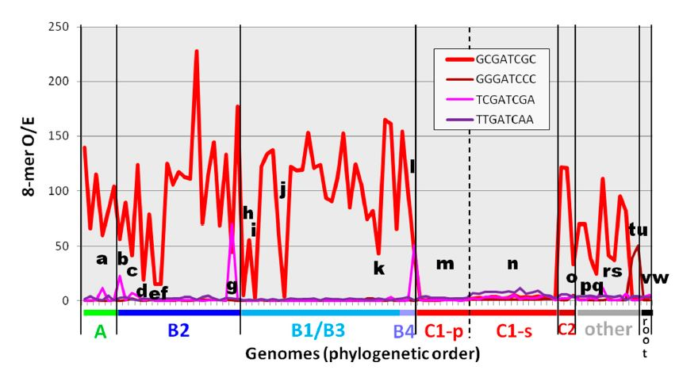
Previous work
In previous studies (Delaye and Moya 2011), it was found that HIP-1 was found to be highly abundant within Cyanobacteria
Later studies (Elhai 2015) showed that HIP-1 was almost absent in certain species of Syncechococcus and Prochlorococcus.
Elhai, J. 2015 Highly Iterated Palindromic Sequences (HIPs) and Their Relationship to DNA Methyltransferases.

Slide 5
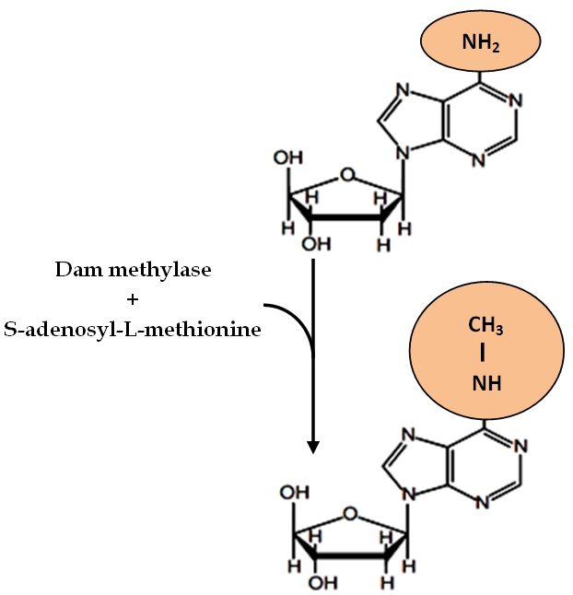
Question
Due to the abundance of Highly Iterated Palindrome-1 in the genomes of Cyanobacteria,
I want to examine the position of HIP-1 in relation to the Deoxyadenosine Methylase gene in the genomes of Thermosynechococcus elongatus BP-1, Cyanothece SP ATCC 51142, Anabaena Variabilis ATCC 29413, Nostoc Punctiforme PCC 7310, Synechococcus elongatus PCC 6301 and Synechococcus elongatus PCC 7942.
Where does this sequence occur in relation to the Deoxyadenosine Methylase gene? Does it occur before the start of the gene, after the end of the gene or during the coding region of the gene itself?

Slide 6
Experimental Design
1. Find the number of HIP-1 sequences in EACH organism.
2. Determine where the Deoxyadenosine Methylase gene is.
3. Find the relation of HIP-1 to the gene
Whether it occurs, directly before, during or after and accounts of all.
4. Compare results

Slide 7
Count-of and presence of HIP-1

Slide 8
Presence of HIP-1 around Methylase gene

Slide 9
Data
Table 1.
Organism | Methylase Coord. | HIP-1 Before? | HIP-1 After? | HIP-1 During?
Thermosynechococcus | 1546230 ← 1546892 | 1, 075 nt | 4,845 nt | -
Cyanothece | 10104 → 11072 | 5,091 nt | 1,540 nt | -
Anabaena | 3294260 ← 3295093 | 904 nt | 1,088 nt | 223 nt after start
Nostoc Punc. | 833361 ← 834218 | 2,110 nt | 954 nt | -
Synech. - 6301 | 2455241 ← 2455879 | 270 nt | 283 nt | -
Synech. - 7942 | 1861019 → 1861810 | 117 nt | 283 nt | 12 nt after start
Table 1. Shows the location of HIP-1 relative to Deoxyadenosine methylase gene.

Slide 10
Results
Before
In Cyanothece, the location of HIP-1 before the start of the gene is drastically different (5,091 nucleotides)
HIP-1 shown to occur within 2,000 nucleotides before the start of the gene.
After
HIP-1 in Thermosynechococcus was shown to occur 4,845 nucleotides after the end of the gene.
HIP-1 occurred generally within 1500 nucleotides after the end of the gene.
During
HIP-1 found to be relatively absent within the gene of Deoxyadenosine methylase.
Found in Anabaena varabilis 29413 and Synechococcus elongatus 7942

Slide 11
Future Work
For future work, research could address:
Why does the sequence occur less within the DAM Methylase gene and how did it arise?
Does the occurrence of HIP-1 in Cyanothece have a correlation to the relation of the other bacterium?
Does the occurrence of HIP-1 after the gene in Thermosynechococcus have a correlation to the relation of the other bacterium?

Slide 12
Works Cited
Elhai, J. 2015 Highly Iterated Palindromic Sequences (HIPs) and their Relationship to DNA Methyltransferase. Life 5: 921-948.
Delaye, L., A. Moya. 2011 Abundance and Distribution of the Highly Iterated palindrome 1 (HIP1) among prokaryotes. Mobile genetic elements 1(3): 159-168.
Aloui, A., A. May, S. Sahbani and A. Landoulsi 2013 Roles of methylation and sequestration in the mechanisms of DNA Replication in some members of the Enterobacteriaceae Family. Intech. 315-332.
Rizvi, A., and C. Bhattacharya 2014 Detection of Replication origin sites in Herpesvirus Genomes by Clustering and Scoring of Palindromes with Quadratic Entropy Measures. IEEE/ACM 11(6): 1108-1118.

