Slide 1
Analysis of specific tandem repeats across an array of cyanobacteria
Kireet Kundavaram

Slide 2
Tandem repeats? What's that?
Short oligomeric units repeated one after another
Formed in DNA when a pattern of one or more nucleotides is repeated and binds to itself.

Slide 3
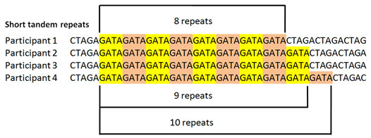

Slide 4
What did I do?
I searched through over 50 cyanobacteria to find 15 that had the “TTGGTCATTGGTCA” tandem repeat.
Next I searched those15 cyanobacteria for the “ATTCGATTCG” tandem repeat.

Slide 6
Then what did you do?
Next I counted how many time the “TTGGTCATTGGTCA” repeat occurred in each of the 15 cyanobacteria
Then I counted how many times the “ATTCGATTCG” repeat occurred in the 11 cyanobacteria

Slide 8
Cyanobacteria | "TTGGTCATTGGTCA" hits | “ATTCGATTCG” hits
anabaena_cylindrica_pcc_7122 | 34 | 11
anabaena_pcc7120 | 28 | 0
anabaena_sp-pcc_7108 | 22 | 5
anabaena_variabilis_atcc29413 | 30 | 0
calothrix_sp-pcc_7103 | 12 | 16
calothrix_sp-pcc_7507 | 36 | 6
chlorogloeopsis_fritschii_pcc_6912 | 33 | 15
chroococcidiopsis_thermalis_pcc_7203 | 62 | 0
crinalium_epipsammum_pcc_9333 | 39 | 12
cyanothece_atcc51142 | 6 | 9
stanieria_cyanosphaera_pcc_7437 | 7 | 0
cyanothece_sp-pcc_7424 | 15 | 11
cyanothece_sp-pcc_7425 | 4 | 9
cyanothece_sp-pcc_7822 | 18 | 15
cylindrospermum_stagnale_pcc_7417 | 96 | 10

Slide 9
What’s the significance?
These sequences have been previously confirmed in other bacterial genomes. Thus, one of the primary goals was to analyze the degree of conservation of tandemly repeated sequences in bacteria of varying sizes to the ones analyzed in the article. Using the same sequences as the a reference point is important to maintain consistency and provide substantiation to any conclusions derived about the role of these tandemly repeated sequences

Slide 10
Questions?

