Slide 1
Proposed Regulatory Sequence that influences Transcription of Carboxylase Gene(s)
EJ Kochis

Slide 2
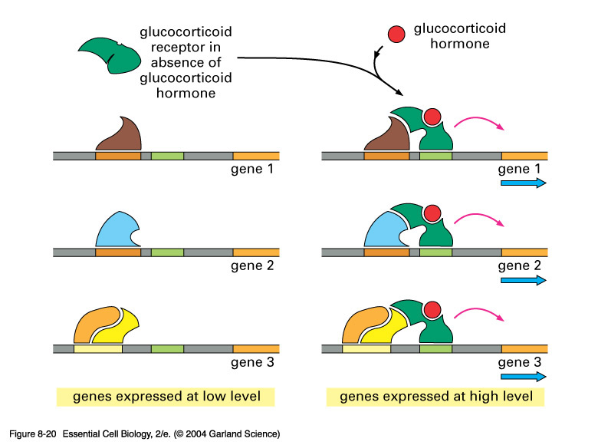
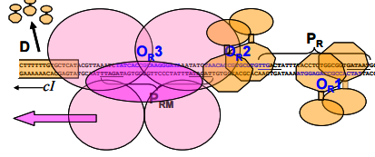
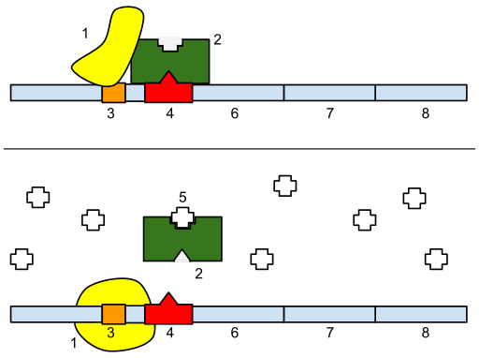
Area of Interest
Regulatory sequences found in intergenic regions of DNA
There are different types!
Repressor
Promoter
DNAa Sites

Slide 3
Object of my Research
Article by Vogel et Al published in 2003 about PrMED4
Intergenic DNA
☑
☑
Near Transcription Site
Effects on Transcription
???
Attempt to find this sequence in other organisms and try to discern it’s significance

Slide 4
Methods
I examined 25 organisms all Prochlrococcus and Synechococus
I used the code below to find the sequence
Nucleotide sequence
Organism
Results of function, highlighted nucleotides are matches of Vogels conserved sequence

Slide 5
Results!
Total 12 promoters found out of 25 organisms queried
Prochlororcocus Marinius as9601
312 259 303 GCTTGACTTATAAGTACTTAATGAAGCATTCTTCGGATTGAACAT
MED4
296 258 302 GCTTGACTTATCAGTACGTTATGGACCATTCTTCGGATTGAACAT
MIT 9301
299 262 306 GCTTGACTTATAAGTACTTAATGAAGCATTCTTCGAATTGAACAT
MIT 9303
467 99 143 GCTTGACGGAAGGATGGGCTGCAGAGCATTGTCCATTGCGAACAT
MIT 9313
823 69 23 GCTTGACGGAAGTTGCCTGCGCAGAGCATTCTCCTTCCCGAACAT
MIT 9515
335 259 303 GCTTGACTTATAAGTACGTTATGGACCATTCTTCCAATTGAACAT
Synechococcus Carboxylase promoters:
Bl107
1068431 1068475 GCTTGACGGCGAGGGTCTTGGCAGAGCAATGTCCCGAGCGAACAT
CC9311
1173 69 23 GCTTGACGAGTTGGCCTCCGGCAGACCAATGTCATCGGCGAACAT
CC9605
399 262 306 GCTTGACGGGAAGGGTTCTGGCGAAGCAATGTCCCCAGCGAACAT
CC9902
900 68 22 GCTTGACGGCGAGGGTCTTGGCAGAGCAATGTCCCGAGCGAACAT
WH 7803
348 223 267 GCTTGACGGCCAGGCCTCTGGCAGAGCAGTCTCGGCGGCGAACAT
WH 8102
880 68 22 GCTTGACGGGAAGGGATCTGGCGGACCAATGTCCCGAGCGAACAT

Slide 6
Context of Sequences
I found them…so what?
They are ALL upstream of a gene coding for Carboxylase
My Sequence
Carboxylase Gene

Slide 7
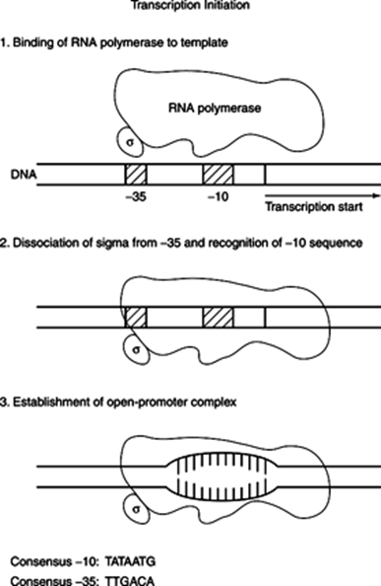
Possible Promoters?
My sequences have the characteristics of a promoter sequence
GCTTGACGGATATGGGA [T/C] [T/G] TGGC [A/G] GAGCATT [G/C] TCCCGAGCGAACAT
-35 -10 TSS
Using an alignment I formed a consensus sequence from my 12 matches

Slide 8
Similarities to Other Promoters
Consensus 35 region-
Experimental 35 region - GCTTGAC
Consensus -10 region- TATAATG
Experimental 10 region- GAGCAGT
TTGACA

Slide 9
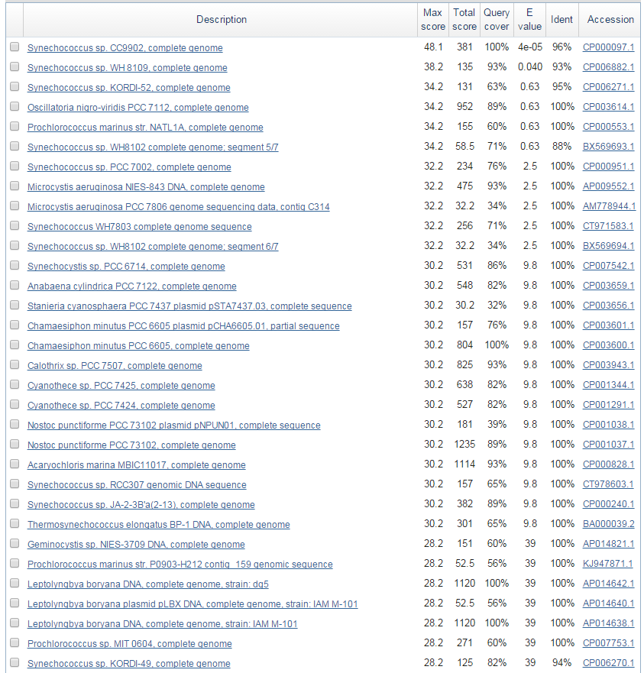
Possible Further Research
Carboxylase is in every cyanobacteria found thus far. Why isn’t this possible promoter?
List of organisms that the consensus sequence was found in
100+

Slide 10
References
Hawley, D. K. & McClure, W. R. (1983) Nucleic Acids Res. 11, 2237-2255
Gary M. STUDNICKA. "Escherichia Coli Promoter -10 and -35 Region Homologies Correlate with Binding and Isomerization Kinetics."Biochem. (1988) 252, 825-831 (n.d.): n. pag. Web. 14 Apr. 2015.
Kinney, James N., et al. "Elucidating essential role of conserved carboxysomal protein CcmN reveals common feature of bacterial microcompartment assembly." Journal of Biological Chemistry 287.21 (2012): 17729-17736.
"Transcription in Prokaryotes." Transcription in Prokaryotes. CliffsNotes, n.d. Web. 27 Apr. 2015.
Vogel, Jörg, et al. "Experimental and computational analysis of transcriptional start sites in the cyanobacterium Prochlorococcus MED4." Nucleic acids research 31.11 (2003): 2890-2899.

