Slide 1
Positioning of DNA Uptake Sequences in the Pasteurellaceae family
Farrah Hermes

Slide 2
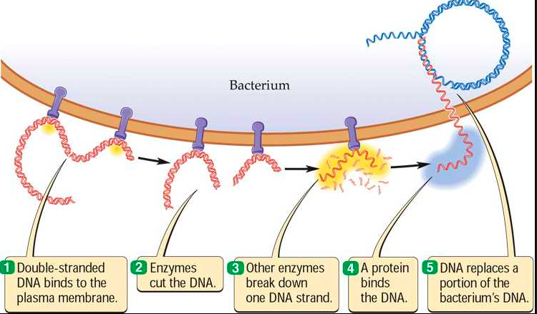
DNA uptake

Slide 3
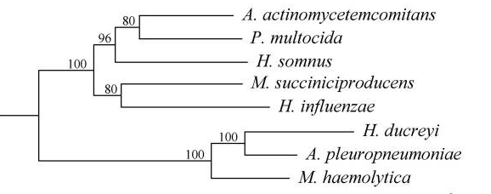
The Pasteurellaceae family, hin subclade

Slide 4
Sequence of Interest
(5’-AAGTGCGGT-3’)
DNA Uptake sequence found in hin subclade
Studied mostly in H. influenza

Slide 5
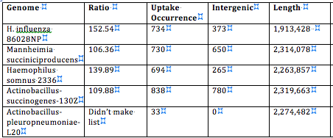

Slide 6
From the Apl subclade

Slide 7
Closer look into Actinobacillus pleuropneumoniae
Uptake sequence occurs in genes that suggest competence
Found the “AAGTGCGGT” in genes that coded for
Chromosome segregation ATPases

Slide 8
Closer look into Actinobacillus pleuropneumoniae
Uptake sequence occurs in genes that suggest competence
Found the “AAGTGCGGT” in genes that coded for
Chromosome segregation ATPases
Site-specific recombinase

Slide 9
Closer look into Actinobacillus pleuropneumoniae
Uptake sequence occurs in genes that suggest competence
Found the “AAGTGCGGT” in genes that coded for
Chromosome segregation ATPases
Site-specific recombinase
Putative periplasmic phosphate binding

Slide 10
Closer look into Actinobacillus pleuropneumoniae
Uptake sequence occurs in genes that suggest competence
Found the “AAGTGCGGT” in genes that coded for
Chromosome segregation ATPases
Site-specific recombinase
Putative periplasmic phosphate binding
Phage portal protein

Slide 11
The next step…
The frequency of occurences of the DNA Uptake sequence within genes and in genes will be compared to the expected frequency of occurrence.
This will be done by examining the composition of the genome in terms of the sequences (e.g. what proportion is coding vs. non coding) and then calculating the expected occurrences of the DUS.
This will help us observe some of the patterns of occurrence of the sequence across the genome, and any anomalies can then be further examined.

Slide 12
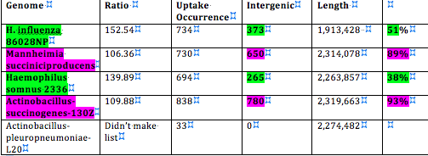
Where to start

Slide 13
Works Cited
Maughan, H., Sinha, S., et al. “Competence, DNA Uptake and Transformationi n Pasteurellaceae” pg 82-100
Smith, H., et al. “ DNA uptake signal sequences in naturally transformable bacteria” Research in Microbiology v. 150, 1999. Pg 603-616.
Chen, I. and Dubnau, D. “DNA uptake during bacterial transformation.” Microbiology. March 2004 pg 241-249.
Redfield, Rosemary J et al. “Evolution of Competence and DNA Uptake Specificity in the Pasteurellaceae.” BMC Evolutionary Biology 6 (2006): 82. PMC. Web. 30 Apr. 2015.

