Slide 1
Mysterious Sequence Repeats in Phage Genomes
Akhil Garg
BNFO 301
April 30, 2015

Slide 2
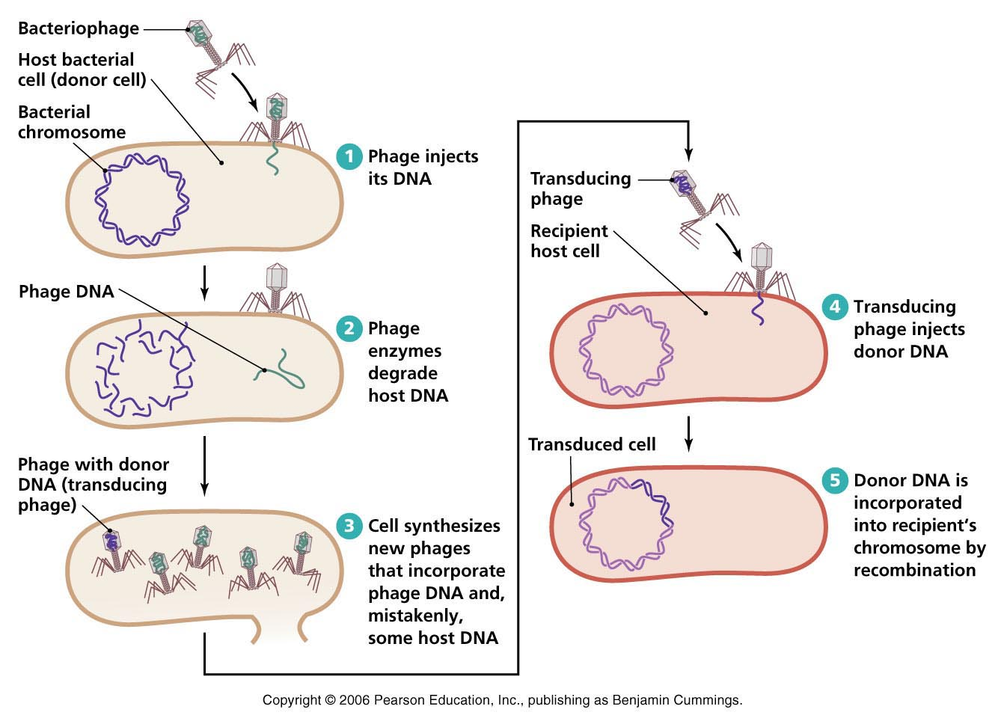
Phages are useful!
Therapy for antibiotic-resistant bacteria
Way of delivering genes to other organisms
We need to understand how phage genes are regulated in order to use them

Slide 3
Phages – near the edge of life
Can’t replicate on their own
Yet have genomes
endotoxin-test.com

Slide 4
Phage genomes
Short: usually less than 100 000 nucleotides (~1/10 or ~1/100 size of bacteria)
Jam-packed with genes
Color: genes
Black: intergenic regions
BioBIKE

Slide 5
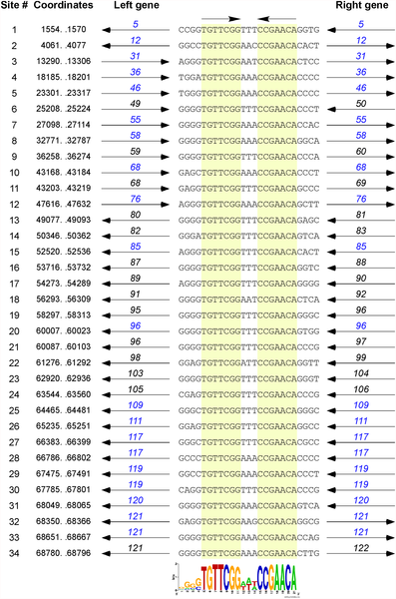
And yet…
There are patterns in the intergenic regions!
On the left: a previously found 17-nucleotide intergenic palindromic repeat in the genomes of cluster O mycobacteriophages
Could not have arisen by chance
What is its function?
Cresawn et al. (2015)

Slide 6
Other phages
Do repeats occur in other phages?
Cluster (group of closely related phages) A3 has a repeat:
[TC]GT[GT][GC][GT][AC]TGTCAAGT
(Also occurs in cluster A4 and A10)

Slide 7
Phage | # forward | # backward
Bxz2 | 11
Jhc117 | 11
Microwolf | 12
Rockstar | 10 | 2
Vix | 11
Heldan | 9 | 2
Methuselah | 12
Jobu08 | 12
Phantastic | 9 | 1
Anubis | 12
Marquardt | 11
Phoxy | 12
Spike509* | 12
Farber | 11
QuinnKiro | 8 | 2
Tiffany | 11
Cluster A3:
matches of [TC]GT[GT][GC][GT][AC]TGTCAAGT
Very unlikely to arise by chance: p=1/10¹¹!
Repeat does not exist in bacteria

Slide 8
These repeats
Importance?
Function?

Slide 9
Clues to function
Where in the genome?
Within closely-related phages, similar genes tend to be close to each other
Take start coordinate of each repeat
Divide coordinate by the length of the genome
Plot results in a bar graph

Slide 10
Genome location - method
Take start coordinate of
each repeat
Divide coordinate by the length of the genome

Slide 11
Location within genome
Plot results in a bar graph
Like the cluster O repeats, these repeats are concentrated in the right end of the genome
Why?
Are certain genes nearby?

Slide 12
Limitations of genome location %
Human created – genome location % has no biological meaning
only a way of searching for anomalies
Need to look at specific genes at the right of genomes
How is the genome organized near its right?
Are the genes structural? Lysis-related? Replicative?

Slide 13
Conclusions
Function? Not yet known.
Need to research this repeat more
find more context (which genes are around the repeats)
characterize how it occurs in other clusters
Could lead to insight on phage gene regulation
does the sequence regulate a specific subset of genes?
does the sequence control the amount of transcription or translation?

