Slide 1
Identification of Tandem Repeats in Geobacillus and Heamophilious Phages
Ramey Elsarrag

Slide 2
Introduction
Tandem repeats are adjacently repeated patterns of DNA sequences
They are associated with genetic instability and are used for forensic identification
Not much work had been done in characterizing them in bacteriophages phages

Slide 3
Objective
To characterize Tandem repeats in 4 phages: Geobacillus E2, Geobacillus GBSV1, Heamophilious HP1 and Heamophilious HP2
Asses general characteristics of the tandem repeats
Score
Identity
Location
Associated Proteins

Slide 4
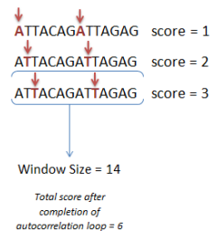
Methods
Autocorrelation Function:
Go over sequence of interest in sets of 100 nucleotides
Use a window of 7
Attempt to match every 7th nucleotide
For every match increment score
Find score for 100 nucleotide set
Repeat

Slide 5
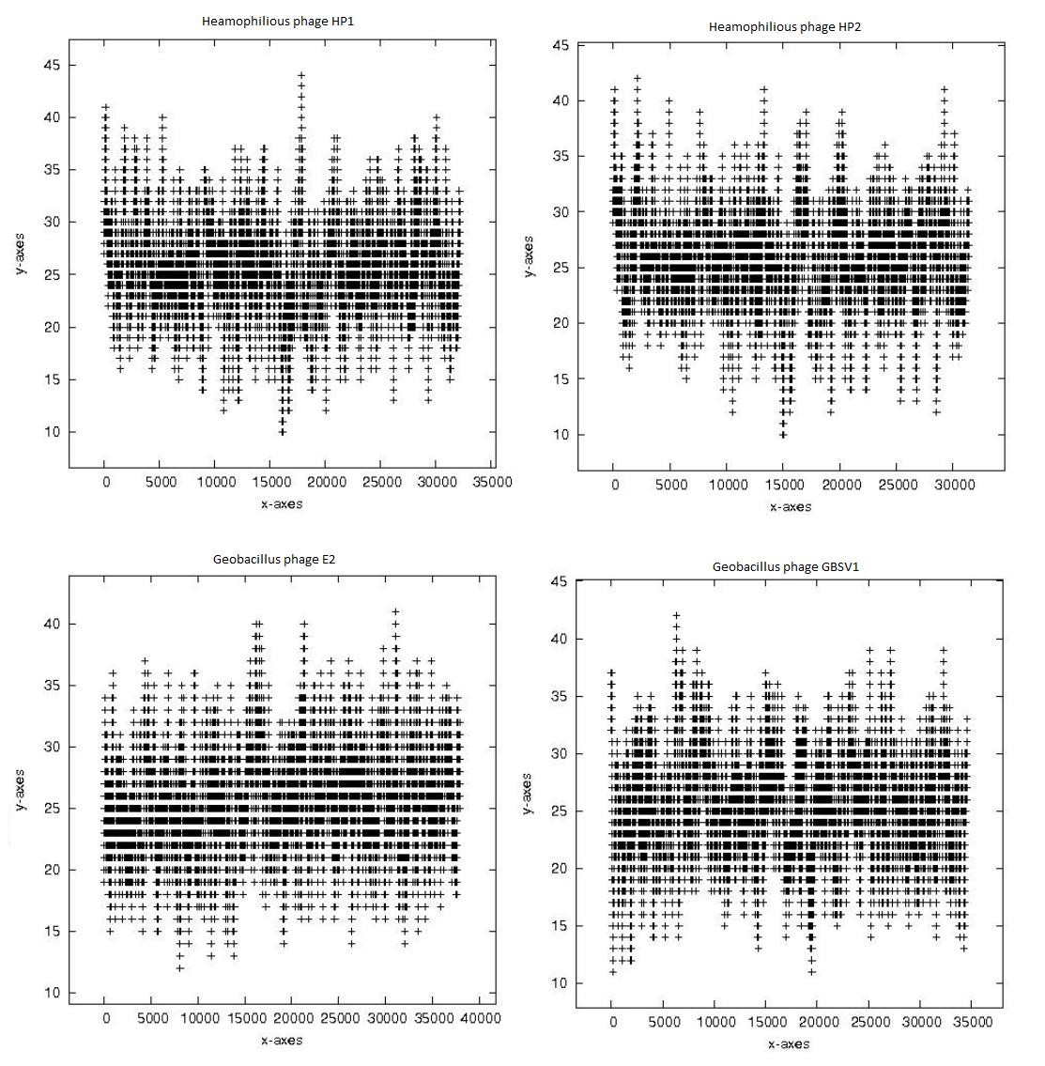
Autocorrelation results

Slide 6
General Results
Organism | Start Coordinate (s) | Score(s) | Context
Heamophilious HP1 | 116 | 41 | Intergenic, HP1p42-HP1p01
Heamophilious HP1 | 17864-17865, 17868-17906 | 41-44 | HP1p27
Heamophilious HP2 | 118 | 41 | Intergenic, HP2p37-HP2p01
Heamophilious HP2 | 2165-2168, 2170-2171 | 41-42 | HP2p02
Heamophilious HP2 | 13309 | 41 | HP2p17
Heamophilious HP2 | 29241 | 41 | HP2p36
Geobacillus E2 | 31132-31133 | 41 | GBVE2_gp040
Geobacillus GBSV1 | 6317-6318 | 41-42 | GPGV1_gp11
Geobacillus GBSV1 | 6319-6325 | 41-42 | Intergenic, GPGV1_gp11- GPGV1_gp12

Slide 7
Associated Proteins
Protein | Function
HP1p42 | Phage protein #ACLAME 180
HP1p01 | Phage Integrase, site-specific tyrosine recombinase
HP1p27 | Phage tail completion protein
HP2p37 | Phage protein #ACLAME 180
HP2p01 | Phage Integrase, site-specific tyrosine recombinase
HP2p02 | Phage protein
HP2p17 | Phage Capsid scaffolding protein
HP2p36 | Phage Protein
GBVE2_gp040 | DNA helicase, phage associated
GPGV1_gp11 | Transcriptional regulator ArpU or LmaC associated with virulence in Listeria
GPGV1_gp12 | Phage Protein

Slide 8
Conclusions
No scores above 45: Oddly low
How many tandem repeats are actually in phages
Tandem repeats within genes?
Large portion of results in genes
Phages have ‘efficient’ genomes

Slide 9
Questions?

Slide 10
References
Siwach, Pratibha. "Tandem Repeats in Human Disorders: Mechanisms and Evolution." Frontiers in Bioscience: 4467. Print.
Benson, G. "Tandem Repeats Finder: A Program to Analyze DNA Sequences." Nucleic Acids Research: 573-80. Print.
Van Belkum A, Scherer S, van Alphen L, Verbrugh H. Short-sequence DNA repeats in prokaryotic genomes. Microbiol Mol Biol Review. 1998, 6(2):275-293.
. Lupski J, Weinstock G. Short, interspersed repetitive DNA sequences in prokaryotic genomes. Journal of Bacteriology. July, 174(14):4525-4529
Mazel D, Houmard J, Castets AM, and Tandeu N. Highly repetitive DNA sequences in cyanobacterial genomes. Journal of Bacteriology. 1990, 172(5):2755-2761.
Lindstedt B, Heir E, Gjernes E, Vardund T, Kapperud G. DNA Fingerprinting of Shiga-toxin producing Escherichia coli O157 based on multiple-locus variable-number tandem-repeats analysis (MLVA). Annals of Clinical Microbiology and Antimicrobials. 2003, 2:12.
Lindstedt, Bjørn-Arne. "Multiple-locus Variable Number Tandem Repeats Analysis for Genetic Fingerprinting of Pathogenic Bacteria." Electrophoresis: 2567-582. Print.
Elhai, J., A. Taton, J. Massar, J. K. Myers, M. Travers, J. Casey, M. Slupesky, and J. Shrager. "BioBIKE: A Web-based, Programmable, Integrated Biological Knowledge Base." Nucleic Acids Research (2009): W28-32. Print.
Korcovelos E (2014). Determination of tandem repeats in Bacillus bacteriophages.

