Slide 1
Yersinia Palindromic Sequences
Introduction to Bioinformatics 301
April 30th, 2015
Jordan Davis

Slide 2
Yersinia Palindromic Sequences (YPALs)
Mini DNA insertions scattered along the genome of known Yersinia bacteria
Significance: YPALs encode mRNA stabilizers by forming RNA hairpins
RNA hairpins counteract the progression of
Exonucleases
Degradosome
De GDelihas, Nicholas. "Small mobile sequences in bacteria display diverse structure/function motifs." Molecular microbiology 67.3 (2008): 475-481.
regorio, Eliana, et al. "Structural organization and functional properties of miniature DNA insertion sequences in Yersiniae." Journal of bacteriology 188.22 (2006): 7876-7884.

Slide 3
Background: Yersinia bacteria
Yersinia bacteria are extremely pathogenic to humans
Yersinia plasmids have yet to be analyzed for YPALs
Yersinia bacteriophages may have instances of YPALs due to parallel virulent evolution with Yersinia strains
De GDelihas, Nicholas. "Small mobile sequences in bacteria display diverse structure/function motifs." Molecular microbiology 67.3 (2008): 475-481.
regorio, Eliana, et al. "Structural organization and functional properties of miniature DNA insertion sequences in Yersiniae." Journal of bacteriology 188.22 (2006): 7876-7884.

Slide 4
Questions at Hand
Do YPALs exists outside of Yersinia chromosomal DNA? Can any instance of YPAL be found in Yersinia plasmids?
Do Yersinia bacteriophages include any instance of YPALs?

Slide 5
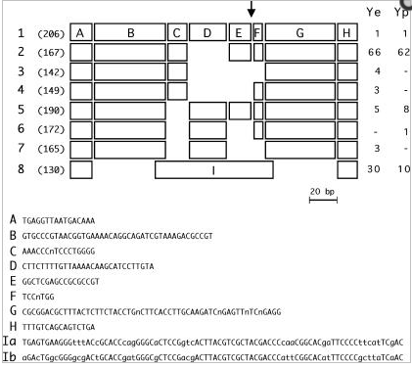
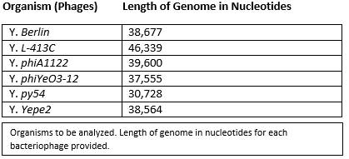
YPAL Sequences in Yersinia Bacteriophage?
Sequence was searched
in Phantome to find
any instances of YPALs in all
Yersinia phage included in BioBike
De GDelihas, Nicholas. "Small mobile sequences in bacteria display diverse structure/function motifs." Molecular microbiology 67.3 (2008): 475-481.
regorio, Eliana, et al. "Structural organization and functional properties of miniature DNA insertion sequences in Yersiniae." Journal of bacteriology 188.22 (2006): 7876-7884.

Slide 6
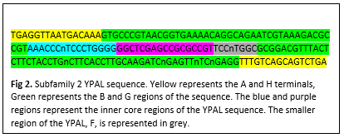
YPAL Sequences in Yersinia Plasmids?
Plasmids for all
Yersinia Bacteria
were checked in
Sequence viewer
using the same YPAL
sequence

Slide 7
Result & Further Study
No matches of any instance of YPAL found in Yersinia bacteriophage and Yersinia plasmids in BioBike
No Sequences similar to YPAL in all Yersinia bacteriophage and Yersinia plasmids in BioBike

Slide 8
Result & Further Study (cont)
For further study…
Find amount of hits of YPALs in each Yersinia strain that has not been documented to date
Highly conserved regions of YPALs across genus of Yersinia

Slide 9
Works Cited
1. De Gregorio, Eliana, et al. "Enterobacterial repetitive intergenic consensus sequence repeats in yersiniae: genomic organization and functional properties."Journal of bacteriology 187.23 (2005): 7945-7954.
2. Delihas, Nicholas. "Enterobacterial small mobile sequences carry open reading frames and are found intragenically—evolutionary implications for formation of new peptides." Gene regulation and systems biology 1 (2007): 191.
3. Delihas, Nicholas. "Small mobile sequences in bacteria display diverse structure/function motifs." Molecular microbiology 67.3 (2008): 475-481.
4. De Gregorio, Eliana, et al. "Structural organization and functional properties of miniature DNA insertion sequences in Yersiniae." Journal of bacteriology 188.22 (2006): 7876-7884.

