Slide 1
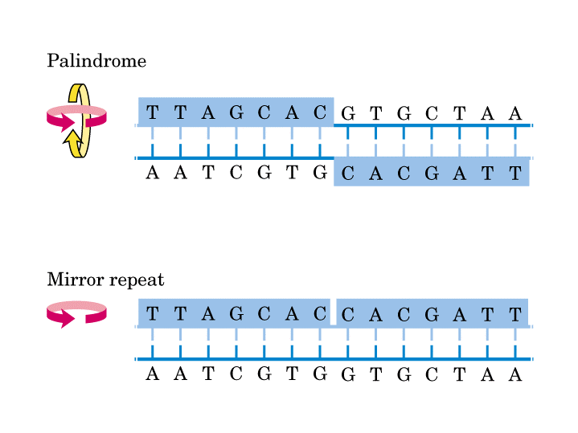
The case of the missing palindromes
Tayab Waseem

Slide 2
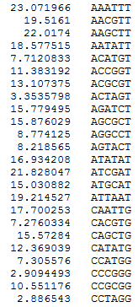
Expected Values of 64 palindromes

Slide 3
Observed Values of 64 palindromes

Slide 4
Use chi-squared test

Slide 5
