Slide 1
Identification and comparison of indirect readout sequences in mycobacteriophage
By: Kristen Wade

Slide 2
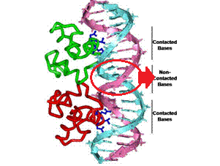
What are indirect readout sites (IDRS)?
Short (~4 bps), non-contacted DNA sequences that do not directly interact with the binding protein
Image adapted from: http://www.acsu.buffalo.edu/~koudelka/

Slide 3
Location:
In the center of direct protein binding sites
Usually occur on the minor groove of DNA
Function:
Are essential for formation of B’ DNA
Stretches DNA
This allows for protein to access direct readout sites
Mechanism of regulation
Notes:
Image: http://www.acsu.buffalo.edu/~koudelka/

Slide 4
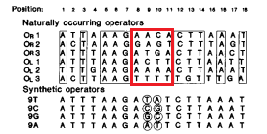
Identification
- In Wu, et al 1992, the operator sites of phage P22’s repressor binding site were evaluated by their IDR sites.
- Red box surrounds the IDR sites. The authors noted that a characteristic trait of these sequences is that of a greater base pair diversity, as compared to the surrounding direct readout sequences.

Slide 5
Can these sites be identified bioinformatically within mycobacteriophage?

Slide 6
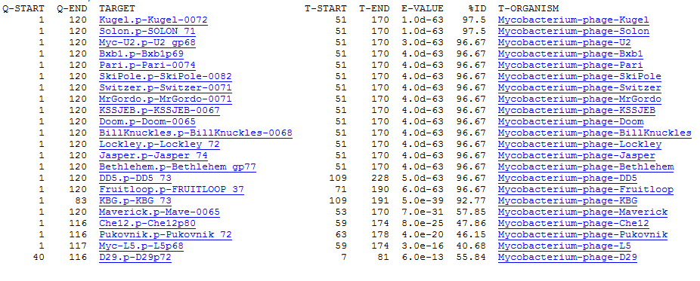
My work:
Top hits for proteins similar to Little E-0183 (repressor), Pham 54
Mostly in cluster A

Slide 7
Little E did not have any good motif matches in its upstream sequence (where the operator sequences should be).
However, several of the other phages with similar proteins did…

Slide 8
Phage U2 (3rd match) had a motif with a consensus sequence at the 3 central bases that displayed more sequence diversity than the surrounding positions: g[CG][AGT][CT]t

Slide 9
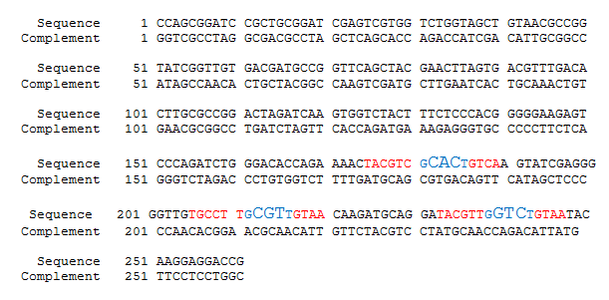
Location of putative operator motifs (red) in the upstream sequence of U2 repressor. Central consensus sequence is identified in blue.

Slide 10
In addition to U2, these other phages had the exact same IDR consensus sequence of g[CG][AGT][CT]t:
Skipole
Bxb1
Switzer
Doom
Lockley

Slide 11
Final thoughts…
g[CG][AGT][CT]t is 100% conserved in 6 out of 17 phages with very closely related proteins
Likely represents a highly essential mechanism of indirect readout shared between these phages
However, that is assuming that these motifs do represent the correct operator sequences of each phage repressor
Only found on forward strand
Only three motifs, not 6

Slide 12
References
Indirect readout of DNA sequence by p22 repressor: roles of DNA and protein functional groups in modulating DNA conformation. Lydia-Ann Harris, Derrick Watkins, Loren Dean Williams, Gerald B Koudelka (2013) Journal of molecular biology 425 (1) p. 133-43
Non-contacted bases affect the affinity of synthetic P22 operators for P22 repressor. L Wu, A Vertino, G B Koudelka (1992)The Journal of biological chemistry 267 (13) p. 9134-9
Image: http://www.acsu.buffalo.edu/~koudelka

